Slide 1
Class & Objects
Constructor and Method Overloading

Slide 2
Class Fundamentals
A class can be defined as a template that describes the functionalities and attributes that the instance of this class could support. Classes tell the compiler how to build a certain object during runtime.
The object which is an instance of a class have both functionalities and attributes.
Example: A car has attributes like colour, number of wheel, model, price and functionalities like forward, reverse, switch on indicators, cleaning windshield etc.,

Slide 3
Classes and Objects (Examples)
Class: Dog
Attributes: Colour Name Breed
Functionalities Barking Eating Wagging the tail
Class: Mobile
Attributes: Number Service Provider Operating System
Functionalities Make_Call Hear_Music Check_Mail
Class: Car
Attributes: No_of_Seat Car_Make Fuel_type
Functionalities Forward Reverse Windshield Clean

Slide 4


Object and Object Reference
Object is an instance of a class and class is a template; here Car and Dog are classes shown below
German
Bull Dog
Labrador
Maruthi
Ford
Hyundai

Slide 5
Class & Object - Reference
Here , German is a memory reference to a Dog class
object stored in memory
Memory Allocation
Dog German = New Dog();
Dog Bulldog = New Dog();
Dog Labrador = New Dog();
Dog German = new Dog();
Heap
123
Constructor
Instance name
German @123
Colour
Name
Breed
Class name

Slide 6
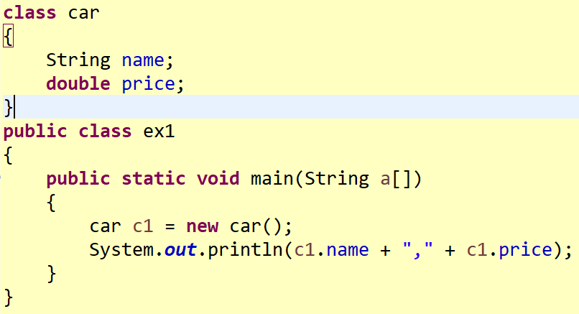
Class & Object
null,0.0

Slide 7
Constructors
A constructor initializes an object when it is created
It has the same name as its class and is syntactically similar to a method, but constructors have no explicit return type
Constructors are used to give initial values to the instance variables as defined by the class/any other startup procedures
All classes have default constructors, whether you define one or not
Java automatically provides a default constructor that initializes all members with their default values depending on the type of variables
The default constructor is no longer used, once we define our own constructor

Slide 8
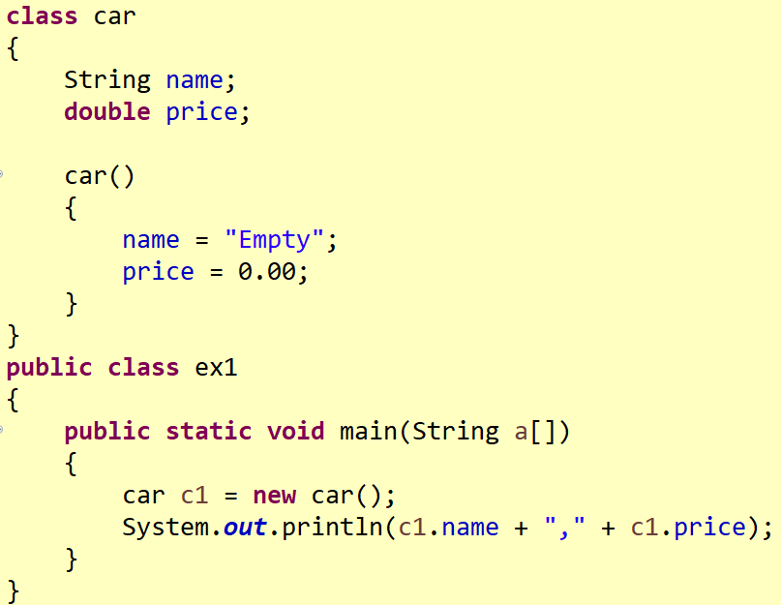
Constructor
Empty,0.0

Slide 9
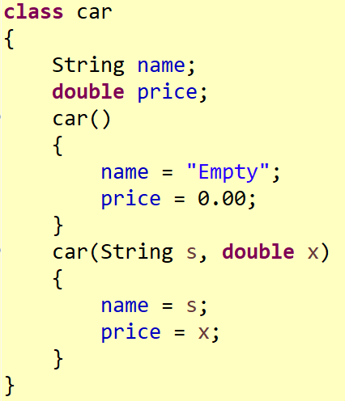
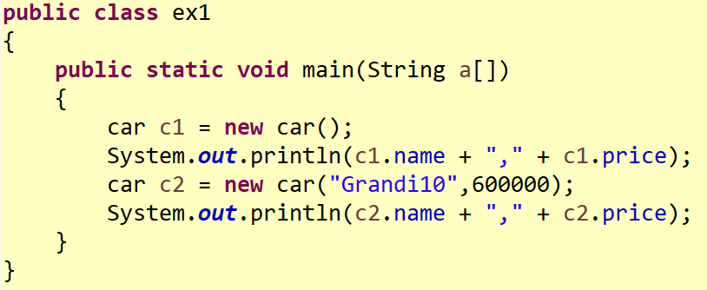

Slide 10
Output
Empty,0.0
Grandi10,600000.0

Slide 11
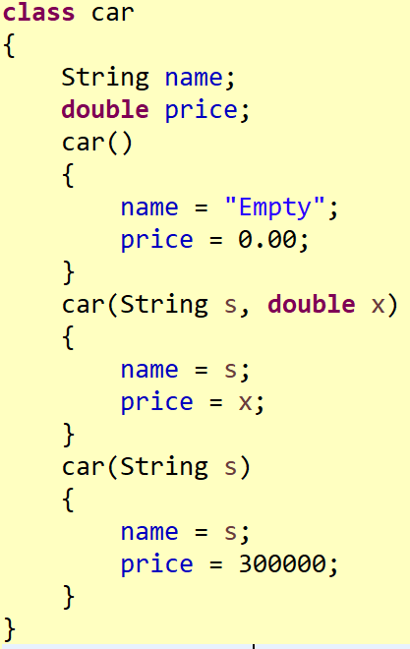
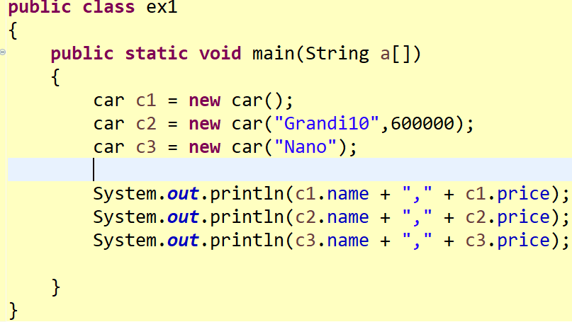
Empty,0.0
Grandi10,600000.0
Nano,300000.0

Slide 12
What is the name of that Concept?
Constructor Overloading
Same method name
Do different tasks as per the Signature of the method
Different Signatures – in Parameter List – Number of Parameters are vary

Slide 13
Method Overloading in Java
Method Overloading is a polymorphic feature that allows a class to have more than one method sharing the same name, provided the signature of the method differ.
Even a static method and non- static method can share the same name in method overloading

Slide 14
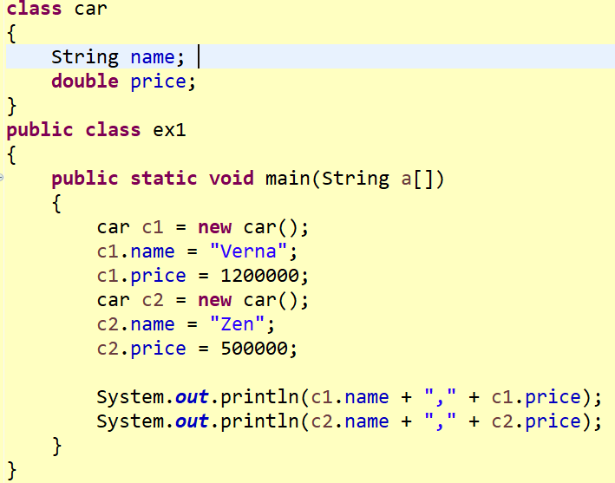
Access Specifiers
Verna,1200000.0
Zen,500000.0

Slide 15
Access Specifiers
Student class
Properties: Mobile Number, Subject Code
Students can change their Mobile Number
After their course registration, they can not change their Subject Code
Access Specifiers ? ? ? (Default/Public/Private/Protected)– Member variables
Mobile Number ?
Subject Code ?
How to define a Student class?

Slide 16
Methods in Java
Methods are functionalities defined to operate on class data members
A method can be static or non static

Slide 17
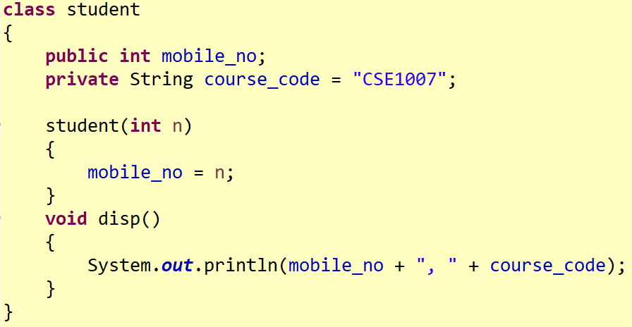

Slide 18
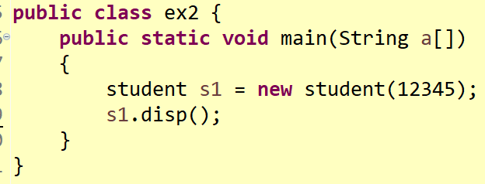
12345, CSE1007

Slide 19
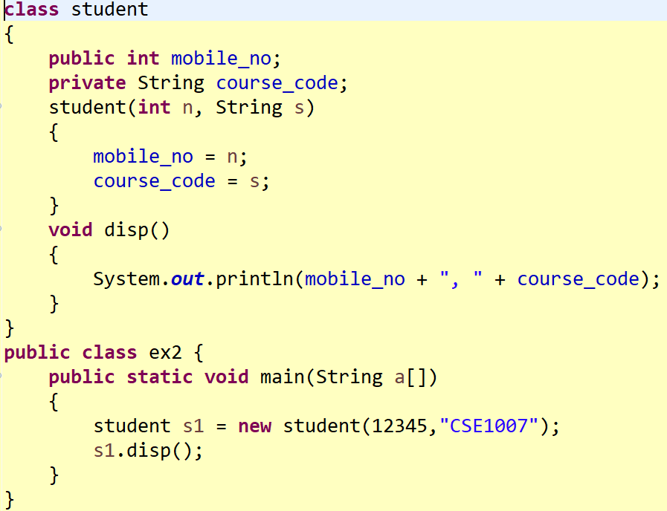
Access Specifier

Slide 20
Output
12345, CSE1007

Slide 21
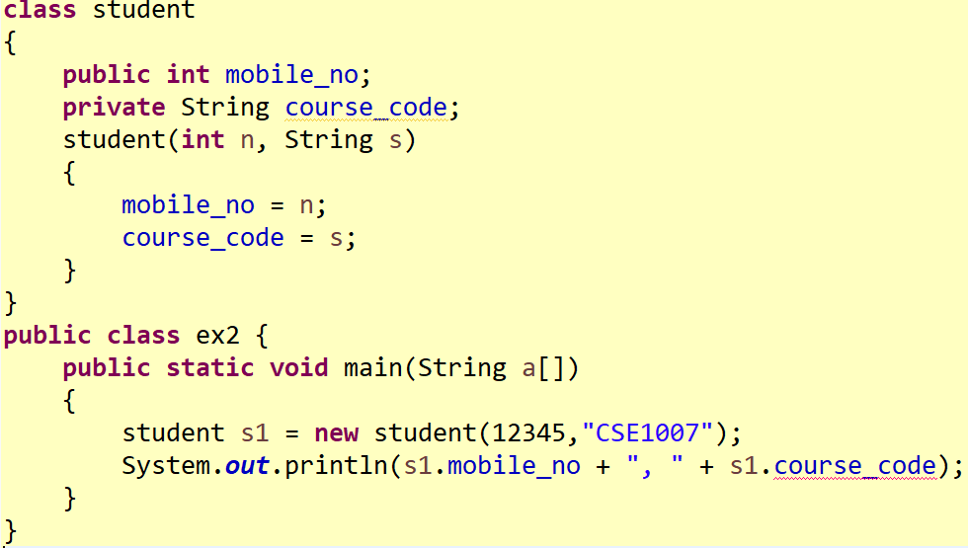
Access Specifier

Slide 22
Exception in thread "main" java.lang.Error: Unresolved compilation problem:
The field student.course_code is not visible
at ex2.main(ex2.java:15)

Slide 23
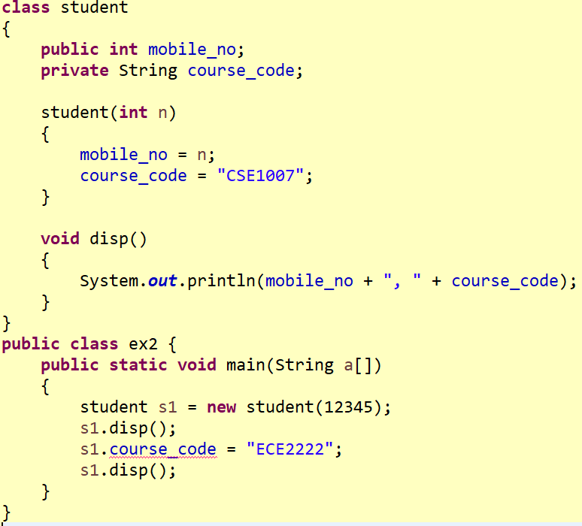
Access Specifier

Slide 24
Exception in thread "main" java.lang.Error: Unresolved compilation problem:
The field student.course_code is not visible

Slide 25
Arrays of Objects
An array is a collection of homogeneous typed variables that are referred to by a common name
As the name defined, array of objects stores an array of objects
To create multiple objects, array of objects are created
Arrays can hold only memory reference to the objects; not the actual object

Slide 26
Syntax for Array of Object Creation
Classname identifier[] = new Classname [size];
where size is the number of array objects required

Slide 27
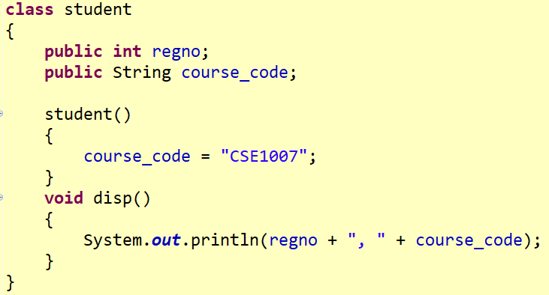
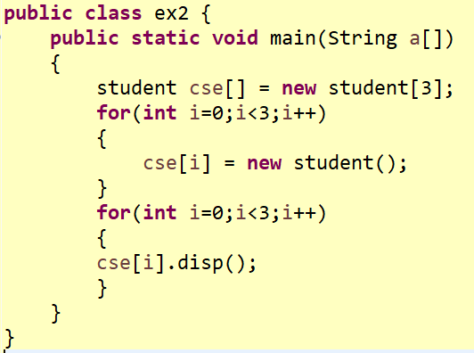
0, CSE1007
0, CSE1007
0, CSE1007

Slide 28
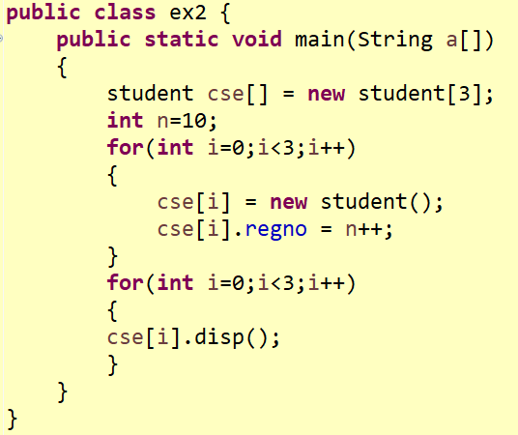
10, CSE1007
11, CSE1007
12, CSE1007

Slide 29
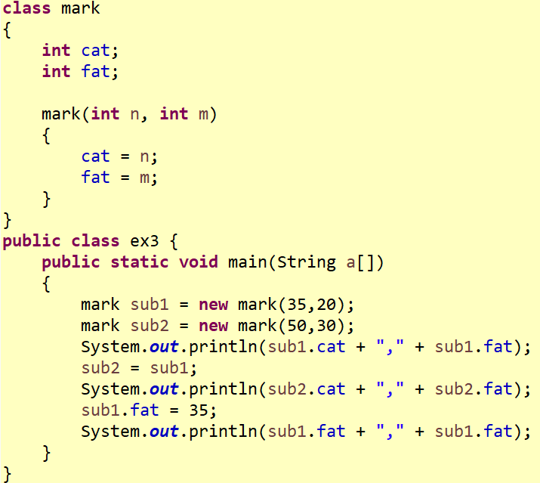
35,20
35,20
35,35

Slide 30
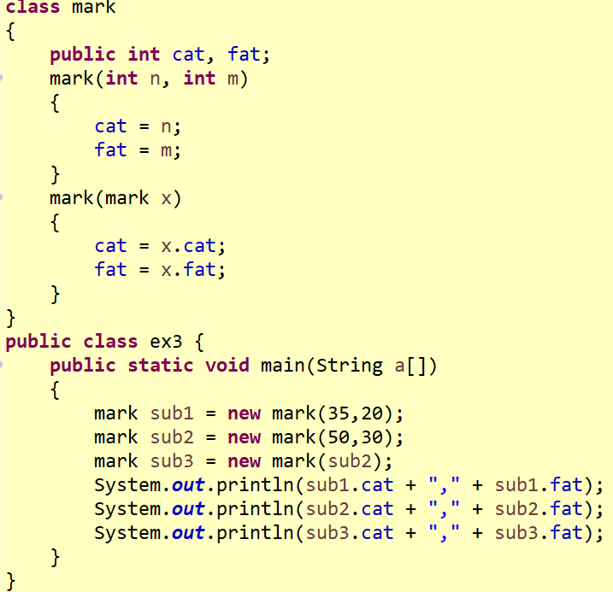
35,20
50,30
50,30

Slide 31
TASK
Write a Java program to create a ‘Human’ class with member variables Name, Age and Aadhaar number. Father object should be created by an empty parameterized constructor. Mother object should be created by parameterized constructor. Sister object should be created by an implicit default constructor. From main, initialize the members for Sister object. Print all 3 object details.

Slide 32
Task
Create a class ‘Subject’ with member variables. name, code, faculty members and mark. Create the objects as per the number of courses you have registered for this semester. Print the total marks of the subject.

Slide 33
TASK
Write a Java program to create the ‘Calculator’ class that implement an arithmetic calculator with 4 operations over integer values: add, sub, mul and div.
Write a Java program to create a ‘Calculator’ class for integer and double values using Method Overloading concept.

