Slide 1
Java Constructors & Destructor

Slide 2
A constructor is a block of codes similar to the method.
It is called when an instance of the class is created.
At the time of calling constructor, memory for the object is allocated in the memory.
It is a special type of method which is used to initialize the object.
Every time an object is created using the new() keyword, at least one constructor is called.
It calls a default constructor if there is no constructor available in the class. In such case, Java compiler provides a default constructor by default.
There are two types of constructors in Java: no-arg constructor, and parameterized constructor.

Slide 3
Rules for creating Java constructor
There are two rules defined for the constructor.
Constructor name must be the same as its class name
A Constructor must have no explicit return type
A Java constructor cannot be abstract, static, final, and synchronized

Slide 4
Default Constructor
//Java Program to create and call a default constructor
class Bike1{
//creating a default constructor
Bike1()
{
System.out.println("Bike is created");
}
//main method
public static void main(String args[]){
//calling a default constructor
Bike1 b=new Bike1();
}
}

Slide 5
/*The default constructor is used to provide the default values to the object like 0, null, etc., depending on the type.*/
class Student3{
int id;
String name;
void display(){
System.out.println(id+" "+name);}
public static void main(String args[])
{
Student3 s1=new Student3();
Student3 s2=new Student3();
s1.display();
s2.display();
} }
0 null
0 null

Slide 6
Parameterized Constructor
class Student4{
int id;
String name;
//creating a parameterized constructor
Student4(int i,String n){
id = i;
name = n;
}
void display(){System.out.println(id+" "+name);}
public static void main(String args[]){
//creating objects and passing values
Student4 s1 = new Student4(111,"Karan");
Student4 s2 = new Student4(222,"Aryan");
//calling method to display the values of object
s1.display();
s2.display();
} }

Slide 7
Constructor Overloading
class Student5{
int id;
String name;
int age;
//creating two arg constructor
Student5(int i,String n){
id = i;
name = n;
}
//creating three arg constructor
Student5(int i,String n,int a){
id = i;
name = n;
age=a;
}
void display()
{
System.out.println(id+" "+name+" "+age);
}
public static void main(String args[]){
Student5 s1 = new Student5(111,“Anu");
Student5 s2 = new Student5(222,"Abi",25);
s1.display();
s2.display();
}
}

Slide 8
class Main {
String language;
// constructor with no parameter
Main() {
this.language = "Java";
}
// constructor with a single parameter
Main(String language) {
this.language = language;
}
public void getName() {
System.out.println("Programming Langauage: " + this.language);
}
public static void main(String[] args) {
// call constructor with no parameter
Main obj1 = new Main();
// call constructor with a single parameter
Main obj2 = new Main("Python");
obj1.getName();
obj2.getName();
}
}

Slide 9
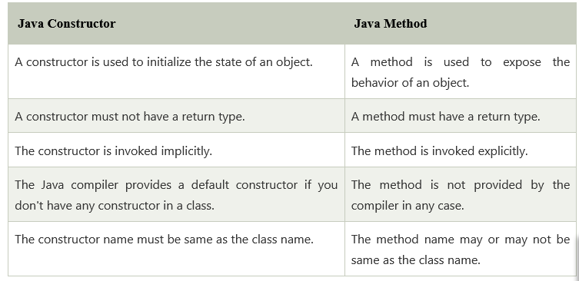

Slide 10
class Main {
int a;
boolean b;
// a private constructor
private Main() {
a = 0;
b = false;
}
public static void main(String[] args) {
// call the constructor
Main obj = new Main();
System.out.println("Default Value:");
System.out.println("a = " + obj.a);
System.out.println("b = " + obj.b);
}
}
?

Slide 11
class MainConstructor {
int a;
boolean b;
// a private constructor
private MainConstructor() {
a = 0;
b = false;
}
}
class Main
{
public static void main(String[] args) {
// call the constructor
MainConstructor obj = new MainConstructor();
System.out.println("Default Value:");
System.out.println("a = " + obj.a);
System.out.println("b = " + obj.b);
}
}
?

Slide 12
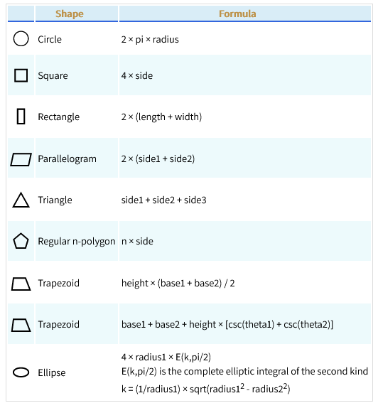
Generate a Java program to calculate area of various shapes using constructor.

Slide 13
Java Destructor
In Java, when we create an object of the class it occupies some space in the memory (heap).
If we do not delete these objects, it remains in the memory and occupies unnecessary space.
There is no concept of destructor in Java. In place of the destructor, Java provides the garbage collector that works the same as the destructor.
The garbage collector is a program (thread) that runs on the JVM. It automatically deletes the unused objects (objects that are no longer used) and free-up the memory. The programmer has no need to manage memory, manually.

Slide 14
What is the destructor in Java?
It is a special method that automatically gets called when an object is no longer used. When an object completes its life-cycle the garbage collector deletes that object and deallocates or releases the memory occupied by the object.
It is also known as finalizers that are non- deterministic. In Java, the allocation and deallocation of objects handled by the garbage collector. The invocation of finalizers is not guaranteed because it invokes implicitly.
Advantages of Destructor
It releases the resources occupied by the object.
No explicit call is required, it is automatically invoked at the end of the program execution.
It does not accept any parameter and cannot be overloaded.

Slide 15
How does destructor work?
When the object is created it occupies the space in the heap. These objects are used by the threads.
If the objects are no longer is used by the thread it becomes eligible for the garbage collection.
The memory occupied by that object is now available for new objects that are being created.
It is noted that when the garbage collector destroys the object, the JRE calls the finalize() method to close the connections such as database and network connection.

Slide 16
Java finalize() Method
It is difficult for the programmer to forcefully execute the garbage collector to destroy the object. But Java provides an alternative way to do the same. The Java Object class provides the finalize() method that works the same as the destructor.
protected void finalize throws Throwable()
{
//resources to be close
}

Slide 17
import java.lang.*;
public class demo {
protected void finalize() throws Throwable
{
try {
System.out.println("inside demo's finalize()");
}
catch (Throwable e) {
throw e;
}
finally {
System.out.println("Calling finalize method"+ " of the Object class");
// Calling finalize() of Object class
super.finalize();
} }
public static void main(String[] args) throws Throwable
{
demo d = new demo();
d.finalize();
}
}

