Slide 1

JAVA Program
Dr.A.Menaka Pushpa, SCOPE, VIT, Chennai, India

Slide 2
Java Specifications
Java API (Application Programming Interface)
Library of predefined Java Classes and Interfaces
JDK (Java Development Toolkit)
Platform for Java program creation and execution
Command Line Execution
Ex: JDK8
IDE (Integrated Development Environment)
Platform for quick program creation and execution
Ex: NetBeans, Eclipse, and TextPad

Slide 3
Java Standard Edition
Java SE
Client-side Applications
Java EE
Server – side Applications
Java servlets, JavaServer Pages (JSP), and JavaServer Faces (JSF)
Java ME
Mobile Device Applications

Slide 4
First Java Program
File Name: first.java
public class first
{
public static void main(String argv[])
{
System.out.println (“Hello VIT Students”);
}
}

Slide 5
Compile and Run – Command Line Execution
Compiling Java Program
javac first.java
Running Java Program
java first

Slide 6
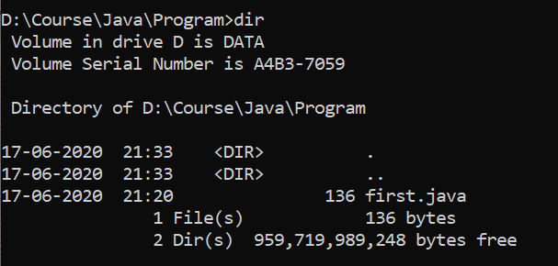
Before Compilation

Slide 7
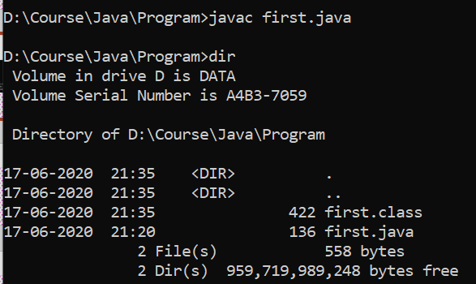
After Compilation – Class file generation

Slide 8

After Running - Output

Slide 9
First Java Program
File Name: first.java
public class first
{
}
class – Java Keyword
first – Identifier for ‘first’ class
Class Definition with members along with access specifier

Slide 10
First Java Program
public class first
{
public static void main(String argv[])
{
}
}
Access Specifier – Code from outside class can access this method
Program Entry Point – First method to be executed in the Compilation Unit
Call this method, without creating an object of ‘first’ class
Return value of this method
Array of String Object – Read values from command line @ running

Slide 11
First Java Program
public class first
{
public static void main(String argv[])
{
System.out.println (“Hello VIT Students”);
}
}
Display the String and values
Predefined Java Class to access this method
Output stream to standard output device

Slide 12
Write a Java Program
To Display your Residential and University Address
To convert money amount from Rupees into US Dollars and Vice-versa (Rs. 6000/-) & ($456)
To perform subtraction, multiplication, division and modulo of two integers (20, 10)
To convert minutes into hours and seconds into minutes
(220 minutes) & (45 seconds)

Slide 13
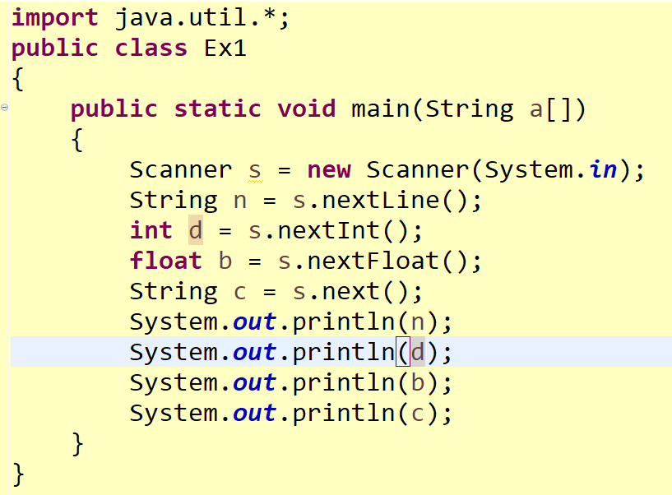
Read Value @ Run Time

Slide 14
Program 1
Write a Java Program to settle the following question:
A bank account starts out with Rs.50,000. Interest is compounded monthly at 6 percent per year (0.5 percent per month). Every month, Rs.500 is withdrawn to meet college expenses. After how many years is the account depleted?

Slide 15
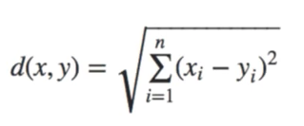
Program 2
Write a Java program to find distance between two points (x,y) and (x1,y1) using
Manhattan Formula: |x – x1| + |y – y1|
Euclidian Formula:
Find closest points: (10,20) (7,12) (19,100) (55,72) (12,34)
Don’t use Array

Slide 16
Program3
Write a Java program to find the number of Days from the year 2015 to 2021.

Slide 17
Program4
Write a Java program to implement a calculator using Switch case; 1 – addition, 2 – subtraction, 3 – multiplication, 4 – Division, 5 – modulo, 6 – Exit from Switch
Conditions:
The last statement of the output is “Thank You…Welcome Back!”
Input Values are in between 1 to 50
Otherwise; print ‘Invalid Number’
Print the number of operations performed by the user

Slide 18
fahrenheit = (9 / 5) * celsius + 32
if (year is not divisible by 4) then (it is a common year) else if (year is not divisible by 100) then (it is a leap year) else if (year is not divisible by 400) then (it is a common year) else (it is a leap year)
For example, the following is the complete list of leap years for the 21st century (from year 2001 to 2100): 2004, 2008, 2012, 2016, 2020, 2024, 2028, 2032, 2036, 2040, 2044, 2048, 2052, 2056, 2060, 2064, 2068, 2072, 2076, 2080, 2084, 2088, 2092, 2096.

