Slide 1
BASIC PROGRAMMING CONSTRUCTS
Dr.A.Menaka Pushpa, SCOPE, VIT, Chennai, India

Slide 2
Topics
Lexical Issues
Data Types
Variable
Operators
Control & Looping Constructs
Enhance For Loop

Slide 3
JAVA - Atomic Elements
Whitespace
Identifiers
Literals
Comments
Operators
Separators
Keywords

Slide 4
Lexical Issues
Whitespace
No Indentation rules
Space between keywords
Space, Tab or Newline
Identifiers
Naming concept for Class / Methods / Variables
Sequence of Alpha- Numeric
Special Symbol: $ and _ (Underscore)
Case Sensitive
Should not start with Number

Slide 5
Find Valid and Invalid Identifiers
Total
frame2
TOTAL
$rs
5test
var_1_int
Ticket-7
Course_1007
goto

Slide 6
Lexical Issues
Literals
Constant values in under data types (integer, float, Character, String)
Ex: ID = 12
Price = 1500.45
Section = ‘A’
Dept = “Computer Science and Engg”
Comments
Documentation purpose – lines are not executed
Single line (\\)
Multiple lines (\*………….*\)

Slide 7
Lexical Issues
Separators
; (Semicolon) → statement end
( ) (parenthesis) → list of parameters
{ } (Braces) → code block (class / method)
[ ] (Brackets) → Array index
, (comma) → identifier separation in variable declaration statement
. (period) → Access methods from packages/sub packages / classes objects
:: (colon) → Method access from its class

Slide 8
Lexical Issues
Keywords
61 keywords
Ex: new, int, char, private, class, public, this, void, try, if, while, for etc
Used to built sentences
Reserved words; can’t use as identifiers
‘const’ and ‘goto’ are reserved but not used
Additional Reserved Words: true, false (Boolean values) & null

Slide 9
Data Types

Slide 10
Primitive Data Types
Each variable and expression has data type
Type defines the operations performed over the value
Data Types
Integer (int, short, long, byte) – Signed whole number
Floating Point (float, double) – number with fractional portions
Character (char) – Symbols in a character set
Boolean (boolean) – true / false value
Width is defined as Bits
How many Data Types?

Slide 11
Integer
byte (8 bits)
Range: -128 to 127
File Streaming purpose
short (16 bits)
Rarely used
Range: –32,768 to 32,767
int (32 bits)
Range: –2,147,483,648 to 2,147,483,647
Commonly used data type under Integer
long (64 bits)
Range: larger than int
Used where value is more than int
Ex: Number vehicles crossed the signal per month

Slide 12
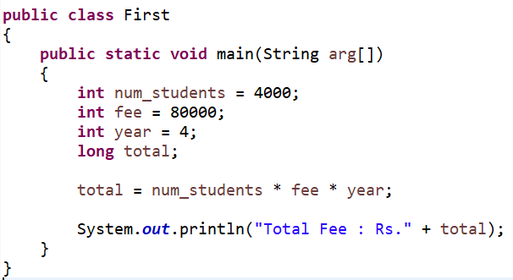

Slide 13
Output
Total Fee : Rs.1280000000

Slide 14
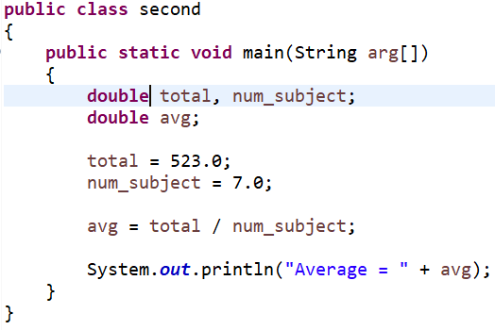

Slide 15
Average = 74.71428571428571

Slide 16
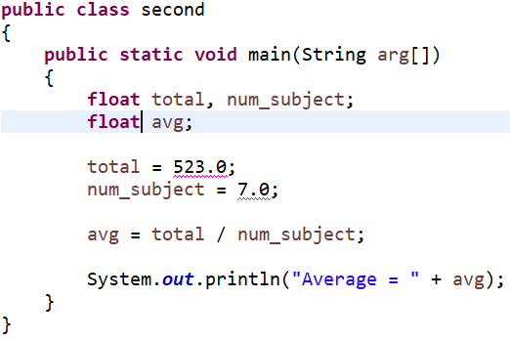

Slide 17


Slide 18
Character
Unicode to represent all the characters in natural languages
16 bits
Range: 0 to 65,536

Slide 19
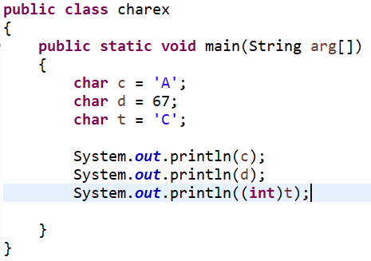
A
C
67

Slide 20
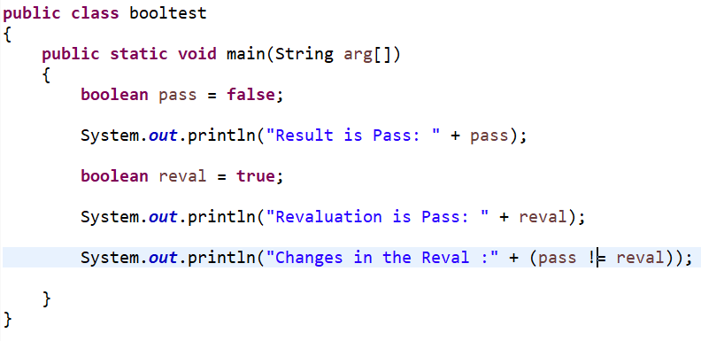

Slide 21
Result is Pass: false
Revaluation is Pass: true
Changes in the Reval :true

Slide 22
Variables

Slide 23
Variables
Storage location in the computer memory
Has value, data type and identifier
Variable Declaration
Syntax
type identifier1, identifier2,…..identifier6;
type identifier1 = value1, identifier2 = value2;
Example:
Int a, b;
Float f = 3.14;

Slide 24
Dynamic Initialization
double r = pi * r * r;
Scope : Object visibility to other parts of program
Scope determines lifetime of the object
Global & Local Scope

Slide 25
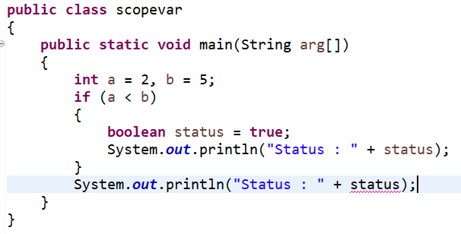
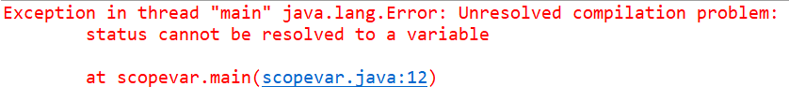

Slide 26
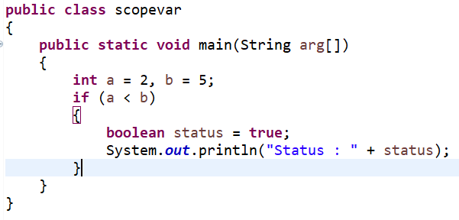
Status : true

Slide 27
Operators

Slide 28
Arithmetic Operators
Operator | Meaning | Example | Result
+ | Addition | 5 + 5 | 10
- | Subtraction | 10 - 5 | 5
* | Multiplication | 2 * 8 | 16
/ | Division | 20 / 4 | 5
% | Modulus | 22 % 4 | 2

Slide 29
Augmented (compound) Assignment Operators
Arithmetic operators (+, -, *, /, %) are combined with assignment (=) operator
Operator | Meaning | Example | Result | Expansion
+= | Addition Assignment | n = 10 n += 1 | 11 | n = n + 1
-= | Subtraction Assignment | n = 10 n -= 1 | 9 | n = n - 1
*= | Multiplication Assignment | n = 10 n *= 2 | 20 | n = n * 1
/= | Division Assignment | n = 10 n /= 5 | 2 | n = n / 1
%= | Modulus Assignment | n = 10 n %= 3 | 1 | n = n % 1

Slide 30
Increment and Decrement Operator
Operator | Meaning | Example | Result | Expansion
++var | Pre increment | n = 10 n = ++n | 11 | n = n + 1 n = n
var++ | Post increment | n = 10 n = n++ | 10 | n = n n = n + 1
--var | Pre decrement | n = 10 n = --n | 9 | n = n - 1 n = n
var-- | Post decrement | n = 10 n = n-- | 10 | n = n n = n - 1

Slide 31
Bitwise Operator
Operator | Meaning | Example | Result | Explanation
~ | Bitwise Unary NOT | A = 1 ~A | 0
& | Bitwise AND | A = 0, B = 0 A & B | 0
| | Bitwise OR | A = 1, B = 0 A | B | 1
^ | Bitwise Exclusive OR | A = 1, B = 0 A ^ B | 1
>> | Shift Right
>>> | Shift Right Zero fill
<< | Shift Left

Slide 32
Bitwise Operator
 | Meaning | Example | Result | Explanation
&= | Bitwise AND Assignment
|= | Bitwise OR Assignment
^= | Bitwise Exclusive OR Assignment
>>= | Shift Right Assignment
>>>= | Shift Right zero fill Assignment
<<= | Shift Left Assignment

Slide 33
Relational Operator
Operator | Meaning | Example | Result
A = true, B = false
== | Equal | A == B | false
!= | Not Equal | A != B | true
X = 2, Y = 4
> | Greater than | X > Y | false
< | Less than | X < Y | true
<= | Less than or equal | X <= Y | true
>= | Greater than or equal | X >= Y | false
True & False are non-numeric values; not equal to zero or one or non-zero like in C & C++

Slide 34
Boolean Logical Operator
Operator | Meaning | Example | Result
 | A = true, B = false
& | Logical AND | A & B | False
| | Logical OR | A | B | True
^ | Logical XOR | A ^ B | True
|| | Short Circuit OR | A || B | True
&& | Short circuit AND | A && B | False
! | Logical Unary NOT | !A | False
X = true; Y = true
!X&!Y | X^Y|!Y ----> ?

Slide 35
Assignment Operator
Syntax
variable = value;
variable = expression;
Example
w = 2;
w = 3 + 6 – 1;

Slide 36
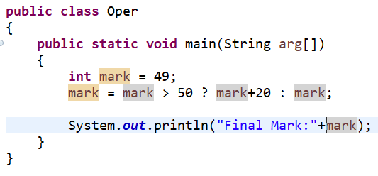
The ? Operator
Ternary (three) operator
Syntax
Expression1 ? Expression2 : Expression3;
Expression1 is true → Expression2 will be executed → Else, Expression3 will be executed
Final Mark:49

Slide 37
Operator Precedence
++ (postfix), --(postfix), ++(prefix), --(prefix),
~, !, +(unary), -(unary)
*, /, %
+, -, >>, >>>, <<
>, >=, <, <=
==, !=
&, |, ^, &&, ||, ?:,
Int a = 10, b = 2, c = 20;
Int t = a + b * c
Ans: 240 ? 50 ?
Ans: 50

Slide 38
Operator Precedence
++ (postfix), --(postfix), ++(prefix), --(prefix),
~, !, +(unary), -(unary)
*, /, %
+, -, >>, >>>, <<
>, >=, <, <=
==, !=
&, |, ^, &&, ||, ?:,
Parenthesis
Int a = 10, b = 2, c = 20;
Int t = (a + b) * c
Ans: 240 ? 50 ?
Ans: 240
HOW ???

