Slide 1
BCSE103E-Computer Programming Java
Lecture By,
Dr. Anusooya G/SCOPE

Slide 2
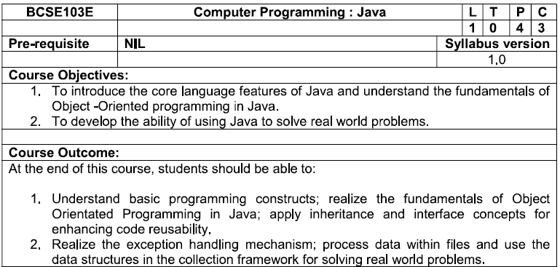
Syllabus

Slide 3
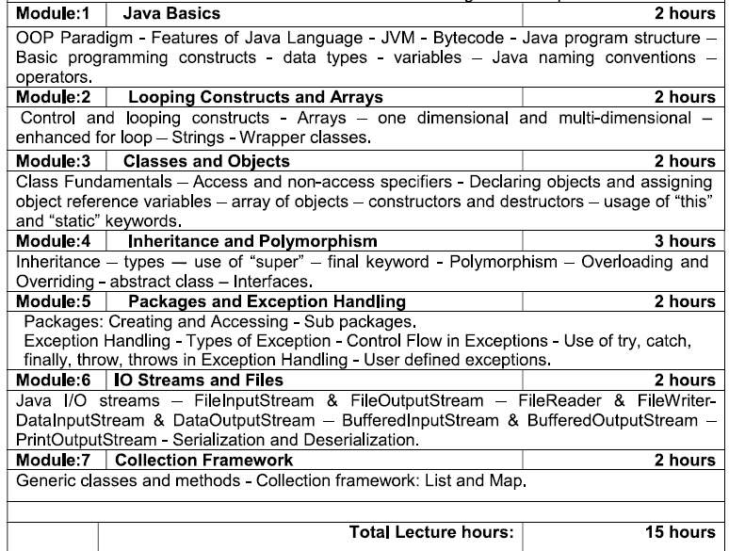

Slide 4
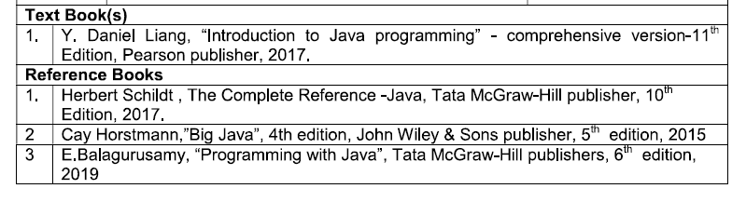
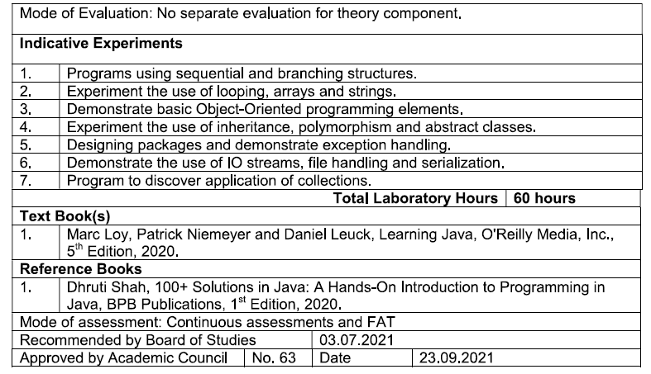

Slide 5
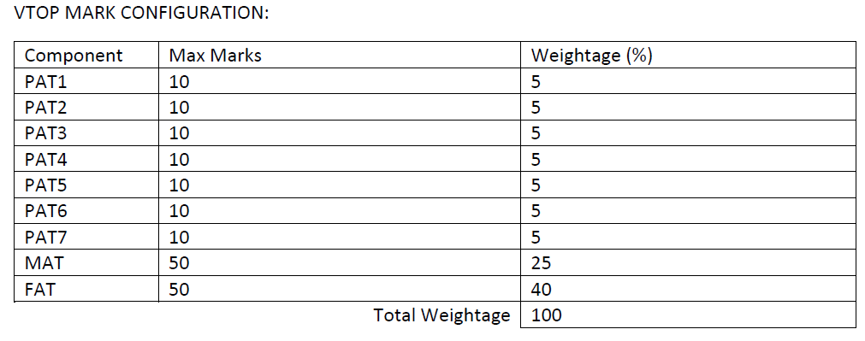
Mark Configuration

Slide 6
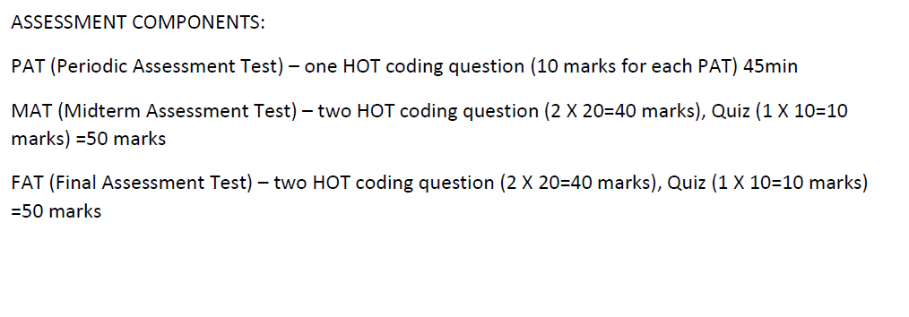
Assessment

Slide 7
JAVA
Java is a popular programming language, created in 1995.
It is owned by Oracle, and more than 3 billion devices run Java.
It is used for:
Mobile applications (specially Android apps)
Desktop applications
Web applications
Web servers and application servers
Games
Database connection
And much, much more!

Slide 8
Uses
Java works on different platforms (Windows, Mac, Linux, Raspberry Pi, etc.)
It is one of the most popular programming language in the world
It is easy to learn and simple to use
It is open-source and free
It is secure, fast and powerful
It has a huge community support (tens of millions of developers)
Java is an object oriented language which gives a clear structure to programs and allows code to be reused, lowering development costs
As Java is close to C++ and C#, it makes it easy for programmers to switch to Java or vice versa

Slide 9
Let’s Start…
public class DemoMain {
public static void main(String[] args) {
System.out.println("Hello All! Welcome to JAVA Programming.");
}
}
Output:
Hello All! Welcome to JAVA Programming.

Slide 10
Why to learn Java?
Object Oriented
In Java, everything is an Object. Java can be easily extended since it is based on the Object model.
Platform Independent
Byte code is distributed over the web and interpreted by the Virtual Machine (JVM) on whichever platform it is being run on.
Simple
Secure
With Java's secure feature it enables to develop virus-free, tamper-free systems. Authentication techniques are based on public-key encryption.

Slide 11
Architecture-neutral
Java compiler generates an architecture-neutral object file format, which makes the compiled code executable on many processors, with the presence of Java runtime system.
Portable
Being architecture-neutral and having no implementation dependent aspects of the specification makes Java portable. Compiler in Java is written in ANSI C with a clean portability boundary
Robust
Java makes an effort to eliminate error prone situations by emphasizing mainly on compile time error checking and runtime checking.

Slide 12
Applications of Java Programming
The latest release of the Java Standard Edition is Java SE 17.0. 2. With the advancement of Java and its widespread popularity, multiple configurations were built to suit various types of platforms. For example: J2EE for Enterprise Applications, J2ME for Mobile Applications.

Slide 13
Different Programming Paradigms
Functional/procedural programming:
program is a list of instructions to the computer
Object-oriented programming
program is composed of a collection objects that communicate with each other

Slide 14
Main Concepts
Object
Class
Inheritance
Encapsulation

Slide 15
Objects
identity – unique identification of an object
attributes – data/state
services – methods/operations
supported by the object
within objects responsibility to provide these services to other clients

Slide 16
Class
“type”
object is an instance of class
class groups similar objects
same (structure of) attributes
same services
object holds values of its class’s attributes

Slide 17
Inheritance
Class hierarchy
Generalization and Specialization
subclass inherits attributes and services from its superclass
subclass may add new attributes and services
subclass may reuse the code in the superclass
subclasses provide specialized behaviors (overriding and dynamic binding)
partially define and implement common behaviors (abstract)

Slide 18
Encapsulation
Encapsulation in Java is a mechanism of wrapping the data (variables) and code acting on the data (methods) together as a single unit. In encapsulation, the variables of a class will be hidden from other classes, and can be accessed only through the methods of their current class.

Slide 19
JVM
JVM(Java Virtual Machine) acts as a run-time engine to run Java applications.
JVM is the one that actually calls the main method present in a java code.
JVM is a part of JRE(Java Runtime Environment).
Java applications are called WORA (Write Once Run Anywhere).
When we compile a .java file, .class files(contains byte-code) with the same class names present in .java file are generated by the Java compiler.

Slide 20
Platform Dependent
myprog.c
gcc
myprog.exe
C source code
machine code
OS/Hardware
Platform Independent
javac
myprog.class
myprog.java
bytecode
Java source code
JVM
OS/Hardware

Slide 21
Java Install
C:\Users\Your Name>java -version
Setup for Windows
To install Java on Windows:
Go to "System Properties" (Can be found on Control Panel > System and Security > System > Advanced System Settings)
Click on the "Environment variables" button under the "Advanced" tab
Then, select the "Path" variable in System variables and click on the "Edit" button
Click on the "New" button and add the path where Java is installed, followed by \bin. By default, Java is installed in C:\Program Files\Java\jdk-11.0.1 (If nothing else was specified when you installed it). In that case, You will have to add a new path with: C:\Program Files\Java\jdk-11.0.1\bin Then, click "OK", and save the settings
At last, open Command Prompt (cmd.exe) and type java -version to see if Java is running on your machine

Slide 22
Link
https://www.oracle.com/in/java/technologies/javase-downloads.html.
https://www.javatpoint.com/how-to-download-java

