Slide 1
Looping Constructs and Arrays

Slide 2
Control Flow Statements.
Decision Making statements
if statements
switch statement
Loop statements
do while loop
while loop
for loop
for-each loop
Jump statements
break statement
continue statement

Slide 3
If Statements
Simple if statement
if-else statement
if-else-if ladder
Nested if-statement
public class Student {
public static void main(String[] args) {
int x = 10;
int y = 12;
if(x+y > 20) {
System.out.println("x + y is greater than 20");
}
}
}

Slide 4
Body Mass Index (BMI) is a measure of health on weight. It can be calculated by taking your weight in kilograms and dividing by the square of your height in meters. The interpretation of BMI for people 16 years or older is as follows: Develop a JAVA application to get the weight and height of a person and print appropriate information.

Slide 5
import java.util.Scanner;
public class Example {
public static void main(String args[]) {
Scanner sc = new Scanner(System.in);
System.out.print("Input weight in kilogram: ");
double weight = sc.nextDouble();
System.out.print("\nInput height in meters: ");
double height = sc.nextDouble();
double BMI = weight / (height * height);
System.out.print("\nThe Body Mass Index (BMI) is " + BMI + " kg/m2");
}
}

Slide 6
switch (expression){
case value1:
statement1;
break;
.
.
.
case valueN:
statementN;
break;
default:
default statement;
}

Slide 7
public class Student {
public static void main(String[] args) {
int num = 2;
switch (num){
case 0:
System.out.println("number is 0");
break;
case 1:
System.out.println("number is 1");
break;
default:
System.out.println(num);
}
}
}

Slide 8
Java User Input (Scanner)
The Scanner class is used to get user input, and it is found in the java.util package.
To use the Scanner class, create an object of the class and use any of the available methods found in the Scanner class documentation.
In our example, we will use the nextLine() method, which is used to read Strings:
import java.util.Scanner; // Import the Scanner class
class Main {
public static void main(String[] args) {
Scanner myObj = new Scanner(System.in); // Create a Scanner object
System.out.println("Enter username");
String userName = myObj.nextLine(); // Read user input
System.out.println("Username is: " + userName); // Output user input
}
}

Slide 9
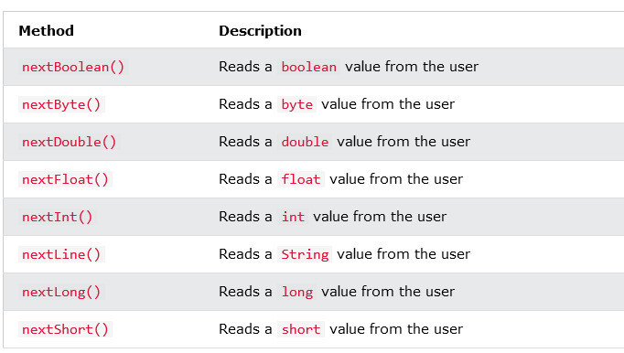
Input Types

Slide 10
import java.util.Scanner;
class Main {
public static void main(String[] args) {
Scanner myObj = new Scanner(System.in);
System.out.println("Enter name, age and salary:");
// String input
String name = myObj.nextLine();
// Numerical input
int age = myObj.nextInt();
double salary = myObj.nextDouble();
// Output input by user
System.out.println("Name: " + name);
System.out.println("Age: " + age);
System.out.println("Salary: " + salary);
}
}

Slide 11
while (condition) {
// code block to be executed
}
int i = 0;
while (i < 5) {
System.out.println(i);
i++;
}
0 1 2 3 4

Slide 12
do {
// code block to be executed
}
while (condition);
int i = 0;
do {
System.out.println(i);
i++;
}
while (i < 5);
0 1 2 3 4

Slide 13
for (statement 1; statement 2; statement 3) {
// code block to be executed
}
for (int i = 0; i < 5; i++) {
System.out.println(i);
}
for (int i = 0; i <= 10; i = i + 2) {
System.out.println(i);
}
0 1 2 3 4
0 2 4 6 8 10

Slide 14
for (int i = 0; i <= 10; i = i + 2) {
System.out.println(i);
If (i==3)
break;
}
for (int i = 0; i < 10; i++) {
if (i == 4) {
continue;
}
System.out.println(i);
}
0 1 2 3
0 1 2 3 5 6 7 8 9

Slide 15
Java For-each Loop
for(data_type variable : array | collection){
//body of for-each loop
}
The Java for-each loop traverses the array or collection until the last element. For each element, it stores the element in the variable and executes the body of the for-each loop.

Slide 16
//An example of Java for-each loop
class ForEachExample1{
public static void main(String args[]){
//declaring an array
int arr[]={12,13,14,44};
//traversing the array with for-each loop
for(int i:arr){
System.out.println(i);
}
}
}
12 13 14 44

Slide 17
class ForEachExample1{
public static void main(String args[]){
int arr[]={12,13,14,44};
int total=0;
for(int i:arr){
total=total+i;
}
System.out.println("Total: "+total);
}
}
Total: 83

