Slide 1
Arrays
Dr.A.Menaka Pushpa
SCOPE, VIT, Chennai

Slide 2
One dimensional array

Slide 3
Array
Set of same data type variables named as an identifier
Elements of memory represented by Index
Index starts from 0
Single or multidimensional array size
Each variable of the array is called elements
Elements are retrieved using array index
Exception: out-of-index element access → Run time Error

Slide 4
Specific City pincode
public class onedarray
{
public static void main(String arg[])
{
String city[] = {"Chennai","Delhi","Bangaluru","Hyderabad", "Mumbai"};
int pincode[] = {600001, 110001, 560001, 500001, 400001};
System.out.println(city[2] + " Pincode is " + pincode[2]);
}
}
Bangaluru Pincode is 560001

Slide 5
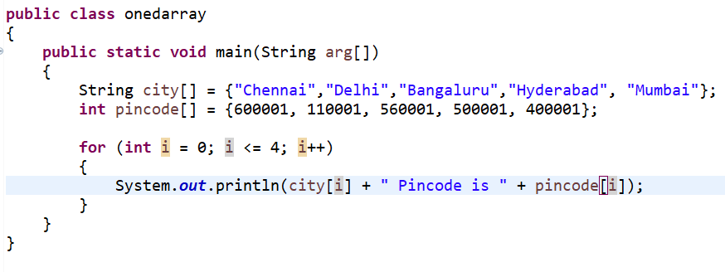
Cities pincode – using for loop

Slide 6
output
Chennai Pincode is 600001
Delhi Pincode is 110001
Bangaluru Pincode is 560001
Hyderabad Pincode is 500001
Mumbai Pincode is 400001

Slide 7
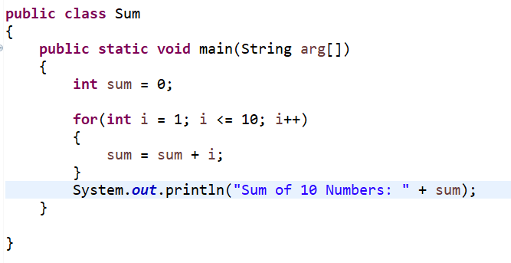
One Dimensional Array – Sum of ‘n’ numbers
Array variable Declaration

Slide 8
output
Sum of 10 Numbers: 55

Slide 9
multi dimensional array

Slide 10
Read and display the matrix
public class multidm1
{
public static void main(String arg[])
{
int matrix1[][] = {{1,2},{3,4}};
int matrix2[][] = {{1,1},{2,2}};
// Display the Matrix1
System.out.println("Matrix1");
for(int i=0; i<2; i++)
{
for(int j=0; j<2; j++)
System.out.print(matrix1[i][j] + "\t");
System.out.println("");
}

Slide 11
Read and display the matrix
// Display the Matrix2
System.out.println("\n Matrix2");
for(int i=0; i<2; i++)
{
for(int j=0; j<2; j++)
System.out.print(matrix2[i][j] + "\t");
System.out.println("");
}
}
}

Slide 12
Output
Matrix1
1 2
3 4
Matrix2
1 1
2 2

Slide 13
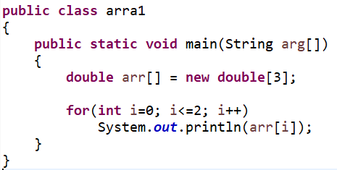
array declaration using ‘new’
0.0
0.0
0.0

Slide 14
Memory allocation using ‘new’
arr
0.0
0.0
0.0
Dynamic memory allocation
Syntax:
data_type identifier [ ] = new data_type [ array_size ];
Allocate memory using new
Array variable Declaration

Slide 15
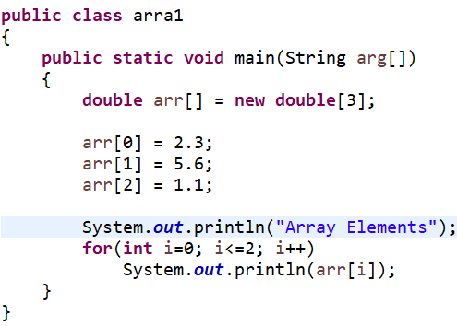
Array – ‘new’
Array Elements
2.3
5.6
1.1

Slide 16
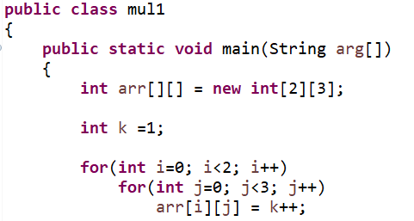
Multi dimensional array – ‘new’

Slide 17
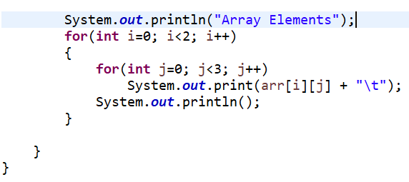
Multi dimensional array – ‘new’
Array Elements
1 2 3
4 5 6

