Slide 1

CONDITIONAL STATEMENTS
Dr.A.Menaka Pushpa
SCOPE, VIT, Chennai

Slide 2

If - Statement
If-else-if
Nested if

Slide 3
if Statement - Syntax
if (Condition)
Statement1;
else
Statement2;
If Condition is ‘true’ then Statement1 is executed else Statement2 is executed

Slide 4
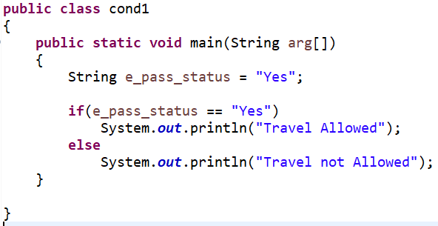
if – else - then
Travel Allowed

Slide 5
Nested if Statement - Syntax
if (Condition1)
Statement1;
else if(Condition2)
Statement2;
else if(Condition3)
Statement3;
….
…
else
Statementn;

Slide 6
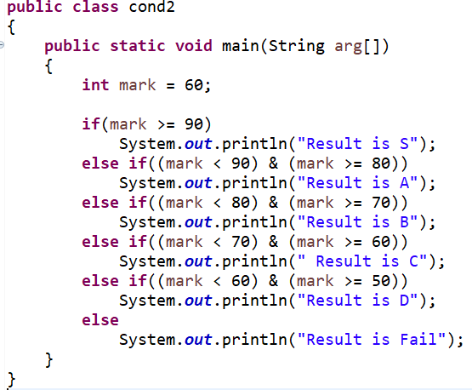
Nested if
Result is C

Slide 7
Switch
Switch
Nested Switch

Slide 8
switch - Syntax
switch (Expression)
{
case value1:
//statements;
break;
.
.
default
//statements
}

Slide 9
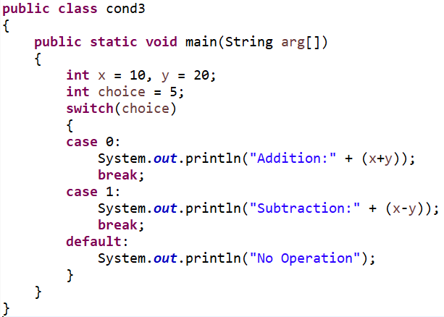
switch
No Operation

Slide 10
Nested Switch - Syntax
switch (Expression)
{
case value1:
switch (Expression2)
{
// Switch Block
}
.
.
default
//statements
}

Slide 11
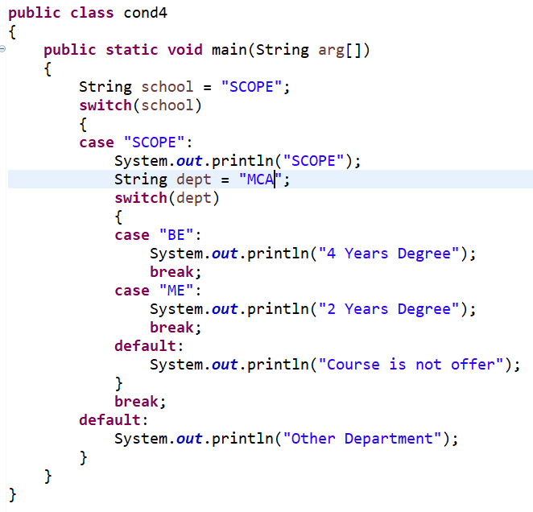
Nested switch
SCOPE
Course is not offered

Slide 12
Iteration statements

Slide 13
for loop - Syntax
for (Initialization; Condition; Iteration)
{
Statements
}

Slide 14
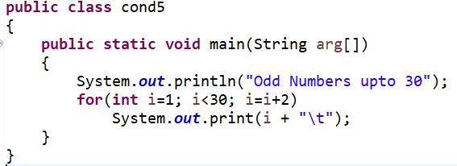
for Loop
Odd Numbers upto 30
1 3 5 7 9 11 13 15 17 19 21 23 25 27 29

Slide 15
while loop
While
Do-while

Slide 16
while - Syntax
while (Condition)
{
Statements;
}

Slide 17
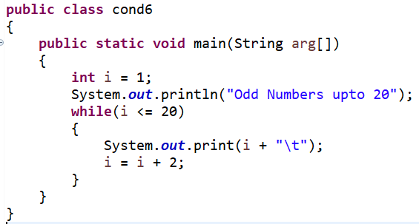
while
Odd Numbers upto 20
1 3 5 7 9 11 13 15 17 19

Slide 18
do-while Syntax
do
{
Statements;
} while (Condition);

Slide 19
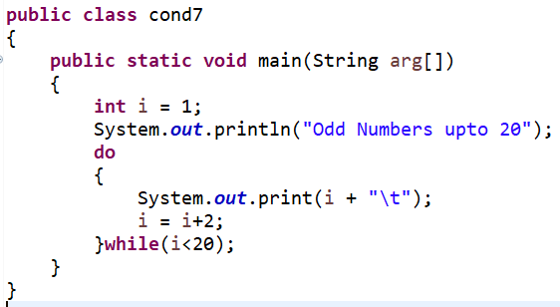
do - while
Odd Numbers upto 20
1 3 5 7 9 11 13 15 17 19

Slide 20
Enhanced for - Syntax
for (type iterative_variable : collection)
{
Statements;
}

Slide 21
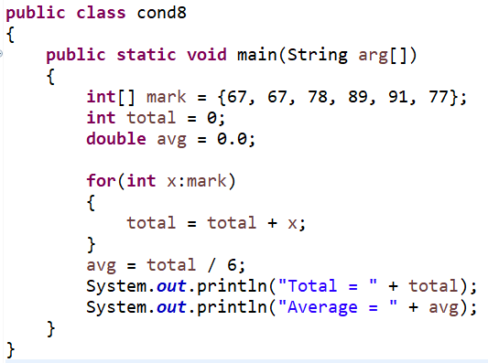
Enhanced for
Total = 469
Average = 78.0

