Slide 1

STRING
Dr.A.menaka Pushpa
Scope, vit, chennai

Slide 2
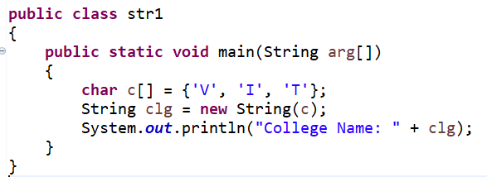
String
Java’s Predefined Object
String Buffer & String Builder – can modify the string after its creation
String, String Buffer & String Builder classes are in java.lang
String Constructor – Object creation
String str1 = new String();
College Name: VIT

Slide 3
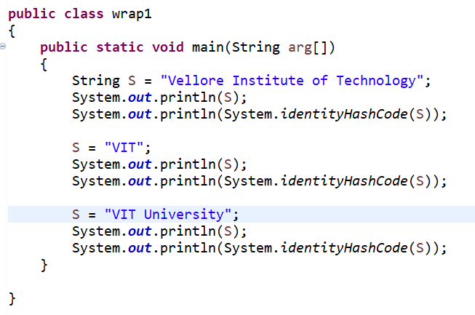
string
String is immutable; can’t be changed once it is created

Slide 4
string
Vellore Institute of Technology
366712642
VIT
1829164700
VIT University
2018699554

Slide 5
String
Str.length()
String S = “VIT” + Str + “ “ + 600001
C = “VIT”.charAt (2)
void getChars (int sourceStart, int sourceEnd, char target[ ], int targetStart)
byte[ ] getBytes( )
char[ ] toCharArray( )
boolean equals(Object str)
boolean regionMatches(int startIndex, String str2, int str2StartIndex, int numChars)

Slide 6
String
boolean startsWith(String str)
boolean endsWith(String str)
str1.equals (str2)
int compareTo(String str)
indexOf( ) Searches for the first occurrence of a character or substring
lastIndexOf( ) Searches for the last occurrence of a character or substring
String substring(int startIndex, int endIndex)
String concat(String str)

Slide 7
String
String replace(char original, char replacement)
String trim( )
static String valueOf(double num)
static String valueOf(long num)
static String valueOf(Object ob)
static String valueOf(char chars[ ])
String toUpperCase( )
String toLowerCase( )
static String join(CharSequence delim, CharSequence … strs)

Slide 8
String buffer
String is mutable
String can grow or shrink

Slide 9
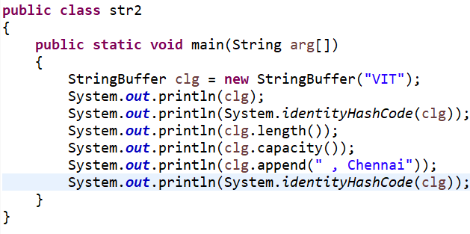
String buffer

Slide 10
String buffer
VIT
366712642
3
19
VIT , Chennai
366712642

Slide 11
String buffer/builder
StringBuffer( )
StringBuffer(int size)
StringBuffer(String str)
StringBuffer(CharSequence chars)
int length( )
int capacity( )
void ensureCapacity(int minCapacity)
void setLength(int len)
char charAt(int where)
void setCharAt(int where, char ch)

Slide 12
String buffer/builder
void getChars(int sourceStart, int sourceEnd, char target[ ], int targetStart)
StringBuffer append(String str)
StringBuffer append(int num)
StringBuffer append(Object obj)
StringBuffer insert(int index, String str)
StringBuffer insert(int index, char ch)
StringBuffer insert(int index, Object obj)
StringBuffer reverse( )

Slide 13
String buffer/builder
StringBuffer delete(int startIndex, int endIndex)
StringBuffer deleteCharAt(int loc)
StringBuffer replace(int startIndex, int endIndex, String str)
String substring(int startIndex)
String substring(int startIndex, int endIndex)

Slide 14
Wrapper class

Slide 15
Wrapper classes
Primitive Data Types (int, double, char, float, byte, short, long, Boolean) are converted into objects for processing by the wrapper class
Wrapper classes are defined in java.lang package;
Wrapper Classes: Integer, Double, Character, Float, Byte, Short, Long and Boolean
Methods to convert wrapper class objects into primitive data type (Numeric);
doubleValue ( )
intValue ( )
byteValue ( )

Slide 16
Y. Daniel Liang, ―Introduction to Java programming -comprehensive version-11th Edition, Pearson publisher,2017

Slide 17
Wrapper classes
Wrapper classes are immutable
Compare method; compareTo ( ) returns -1,0,1 correspondingly less than, equal to and greater than
parseInt ( ) → parse numeric string into int value
valueOf ( ) converts a value into wrapper class object

Slide 18
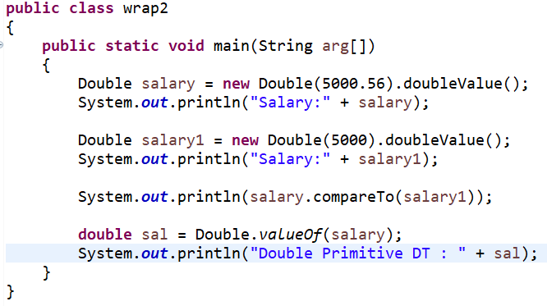

Slide 19
output
Salary:5000.56
Salary:5000.0
1
Double Primitive DT : 5000.56

