Slide 1
Java Wrapper Class

Slide 2
Wrapper Class
The wrapper class in Java provides the mechanism to convert primitive into object and object into primitive.
Java is an object-oriented programming language, so we need to deal with objects many times like in Collections, Serialization, Synchronization, etc.

Slide 3
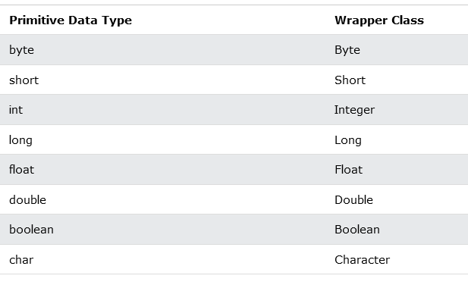

Slide 4
Collection Framework
Java collection framework works with objects only. All classes of the collection framework (ArrayList, LinkedList, Vector, HashSet, LinkedHashSet, TreeSet, PriorityQueue, ArrayDeque, etc.) deal with objects only.

Slide 5
ArrayList<int> myNumbers = new ArrayList<int>(); // Invalid
ArrayList<Integer> myNumbers = new ArrayList<Integer>(); // Valid

Slide 6
import java.util.ArrayList;
public class Main {
public static void main(String[] args) {
ArrayList<Integer> myNumbers = new ArrayList<Integer>();
myNumbers.add(10);
myNumbers.add(15);
myNumbers.add(20);
myNumbers.add(25);
for (int i : myNumbers) {
System.out.println(i);
}
}
}
10 15 20 25

Slide 7
public class Main {
public static void main(String[] args) {
Integer myInt = 5;
Double myDouble = 5.99;
Character myChar = 'A';
System.out.println(myInt);
System.out.println(myDouble);
System.out.println(myChar);
}
}
5 5.99 A

Slide 8
Methods
you can use certain methods to get information about the specific object.
For example, the following methods are used to get the value associated with the corresponding wrapper object: intValue(), byteValue(), shortValue(), longValue(), floatValue(), doubleValue(), charValue(), booleanValue().

Slide 9
public class Main {
public static void main(String[] args) {
Integer myInt = 5;
Double myDouble = 5.99;
Character myChar = 'A';
System.out.println(myInt.intValue());
System.out.println(myDouble.doubleValue());
System.out.println(myChar.charValue());
}
}

Slide 10
the toString() method, which is used to convert wrapper objects to strings
public class Main {
public static void main(String[] args) {
Integer myInt = 100;
String myString = myInt.toString();
System.out.println(myString.length());
}
}

Slide 11
Autoboxing: Primitive to Wrapper
public class WrapperExample1{
public static void main(String args[]){
//Converting int into Integer
int a=20;
Integer i=Integer.valueOf(a);//converting int into Integer explicitly
Integer j=a;//autoboxing, now compiler will write Integer.valueOf(a) internally
System.out.println(a+" "+i+" "+j);
}}
20 20 20

Slide 12
Unboxing: Wrapper to Primitive
//Java program to convert object into primitives
//Unboxing example of Integer to int
public class WrapperExample2{
public static void main(String args[]){
//Converting Integer to int
Integer a=new Integer(3);
int i=a.intValue();//converting Integer to int explicitly
int j=a;//unboxing, now compiler will write a.intValue() internally
System.out.println(a+" "+i+" "+j);
}}
3 3 3

Slide 13
toString() method
public class Main {
public static void main(String[] args) {
Integer myInt = 100;
String myString = myInt.toString();
System.out.println(myString.length());
}
}

