Slide 1
Polymorphism Abstract Class & Methods

Slide 2
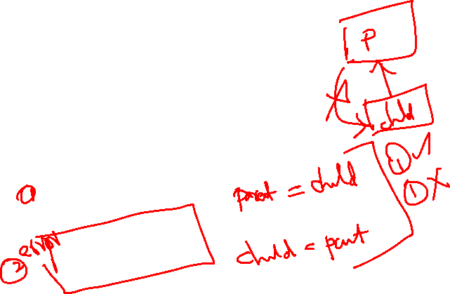
Inheritance
Member1.java
public class Member1
{
public void disp()
{
System.out.println(“Super Class");
}
}
MyTest.java
public class MyTest
{
public static void main(String[] args)
{
Member1 A = new Member1();
A.disp();
Student obj = new Student();
obj.disp();
System.out.println("After Assign");
Member1 B = obj;
B.disp();
Student obj1 = A;
obj1.disp();
}
}
Student.java
public class Student extends Member1
{
public void disp()
{
System.out.println("Sub class");
}
}

Slide 3
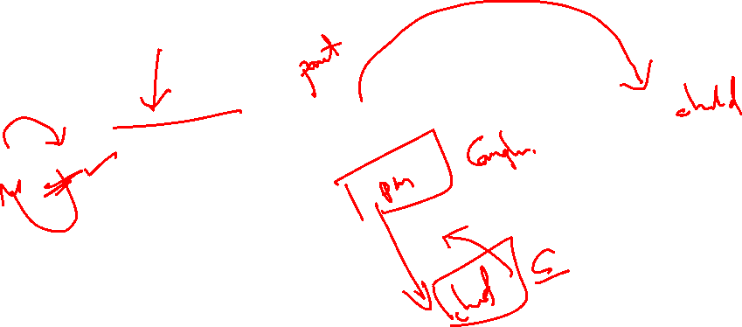
Output
MyTest.java:14: error: incompatible types: Member1 cannot be converted to Student
Student obj1 = A;
^
1 error

Slide 4
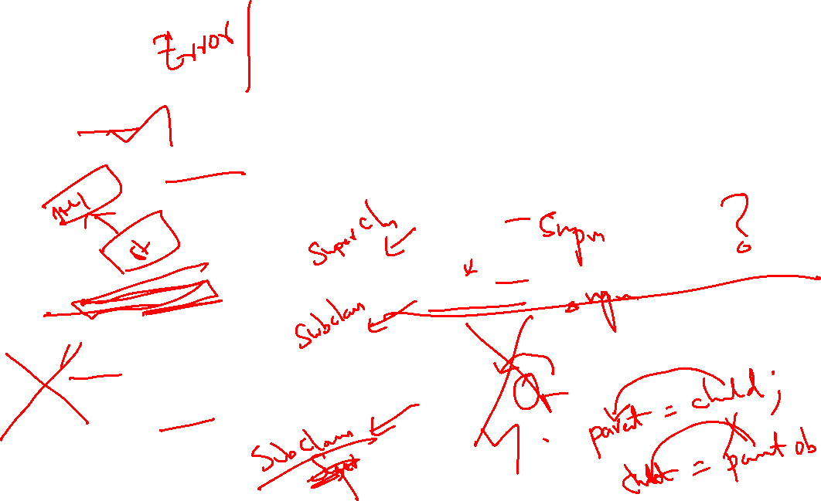
Inheritance
class Member1
{
public void disp()
{
System.out.println(“Super Class");
}
}
public class MyTest
{
public static void main(String[] args)
{
Member1 A = new Member1();
A.disp();
Student obj = new Student();
obj.disp();
System.out.println("After Assign");
Member1 B = obj;
B.disp();
}
}
class Student extends Member1
{
public void disp()
{
System.out.println("Sub class");
}
}

Slide 5
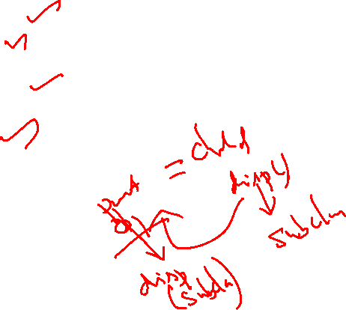
Output
E:\MyJava>java MyTest
Super Class
Sub class
After Assign
Sub class

Slide 6
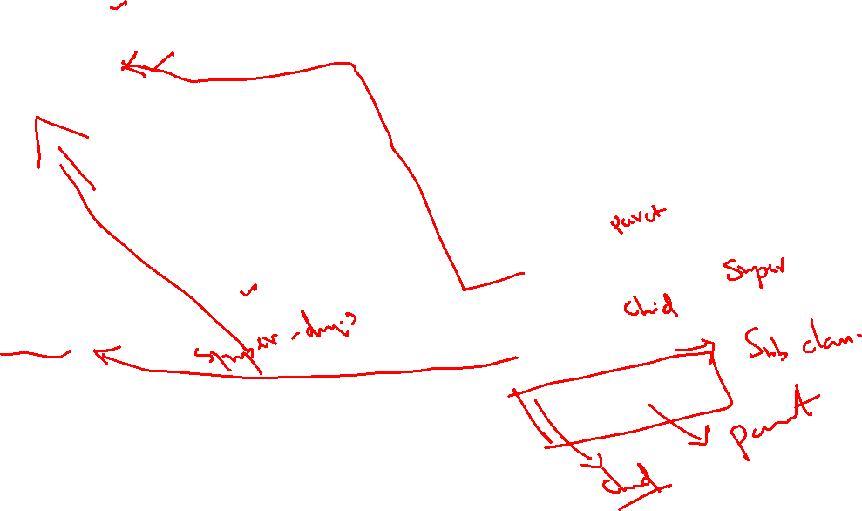
Member1.java
public class Member1
{
public void super_disp()
{
System.out.println("Super Class");
}
}
Inheritance
MyTest.java
public class MyTest
{
public static void main(String[] args)
{
Member1 A = new Member1();
A.super_disp();
Student obj = new Student();
obj.sub_disp();
obj.super_disp();
}
}
Student.java
public class Student extends Member1
{
public void sub_disp()
{
System.out.println("Sub class");
}
}

Slide 7

Output
Super Class
Sub class
Super Class

Slide 8
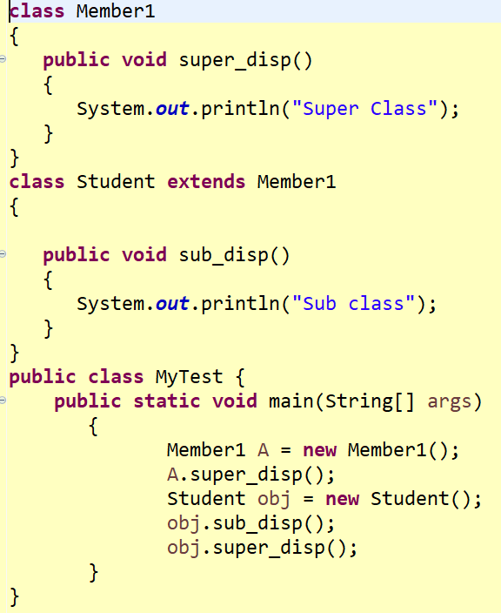

Inheritance
Super Class
Sub class
Super Class

Slide 9
Abstract Class
Employee.java
public abstract class Employee
{
private String Name;
Employee(String n)
{
Name = n;
}
public abstract void sal_cal(int empno);
}
MyTest.java
public class MyTest
{
public static void main(String[] args)
{
Employee e = new Employee();
}
}

Slide 10
Output
E:\Java>javac MyTest.java
MyTest.java:5: error: Employee is abstract; cannot be instantiated
Employee e = new Employee();
^
1 error

Slide 11
Abstract Class & Abstract Method
Employee.java //Abstract Class
public abstract class Employee
{
private String Name;
Employee(String n)
{
Name = n;
}
public abstract void sal_cal(int empno);
@Override
public String toString()
{
return String.format("%s", Name);
}
}

Slide 12
Manager.java
public class Manager extends Employee
{
private int Emp_No;
private double basic_pay;
Manager(String name, int no, double sal)
{
super(name); //call super class constructor
Emp_No = no;
basic_pay = sal;
}
public void sal_cal(int empno)
{
if(Emp_No == empno)
System.out.println(basic_pay * 12);
else
System.out.println("Invalid Emp No");
}
public String toString()
{
return String.format("%s %d %f", super.toString(), Emp_No, basic_pay);
}
}
Abstract Class & Abstract Method

Slide 13
Manager.java
public class Manager extends Employee
{
private int Emp_No;
private double basic_pay;
Manager(String name, int no, double sal)
{
Emp_No = no;
basic_pay = sal;
super(name); //call super class constructor
}
public void sal_cal(int empno)
{
if(Emp_No == empno)
System.out.println(basic_pay * 12);
else
System.out.println("Invalid Emp No");
}
public String toString()
{
return String.format("%s %d %f", super.toString(), Emp_No, basic_pay);
}
}
Abstract Class & Abstract Method

Slide 14
Error
E:\Java>javac Manager.java
Manager.java:7: error: constructor Employee in class Employee cannot be applied
to given types;
{
^
required: String
found: no arguments
reason: actual and formal argument lists differ in length
Manager.java:10: error: call to super must be first statement in constructor
super(name); //call super class constructor
^
2 errors

Slide 15
Abstract Class & Abstract Method
MyTest.java
public class MyTest
{
public static void main(String[] args)
{
Manager m1 = new Manager("Alice", 1002, 60000);
m1.sal_cal(1002);
m1.sal_cal(500);
System.out.println(m1);
}
}
E:\Java>java MyTest
720000.0
Invalid Emp No
Alice 1002 60000.000000

Slide 16
Abstract Class
Manager.java
public class Manager extends Employee1
{
private int Emp_No; private double basic_pay;
Manager()
{
Emp_No = 1002;
basic_pay = 5000;
}
public void sal_cal(int empno)
{
if(Emp_No == empno)
System.out.println(basic_pay * 12);
else
System.out.println("Invalid Emp No");
}
public String toString()
{
return String.format("%s %d %f", super.toString(), Emp_No, basic_pay);
}
}
Employee1.java
public abstract class Employee1
{
private String Name="EMP";
public abstract void sal_cal(int no);
public String toString()
{
return String.format("%s", Name);
}
}

Slide 17
MyTest.java
public class MyTest
{
public static void main(String[] args)
{
Manager m1 = new Manager();
m1.sal_cal(1002);
m1.sal_cal(500);
System.out.println(m1);
Employee1 A = m1;
Employee1 B = m1;
Manager m2 = (Manager) B;
m2.sal_cal(1002);
}
Abstract Class

Slide 18
Output
E:\Java>java MyTest
60000.0
Invalid Emp No
EMP 1002 5000.000000
60000.0

Slide 19
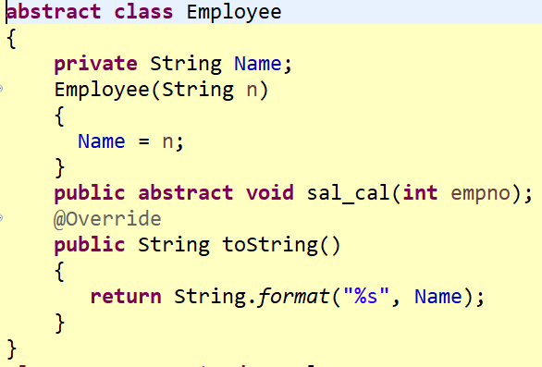
Abstract Class – in a Single File

Slide 20
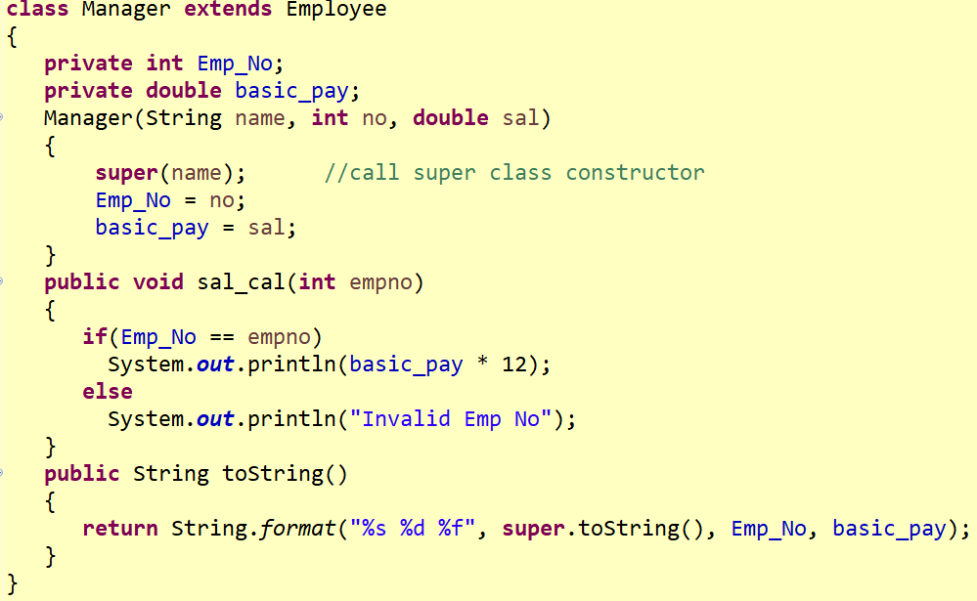
Abstract Class – in a Single File

Slide 21
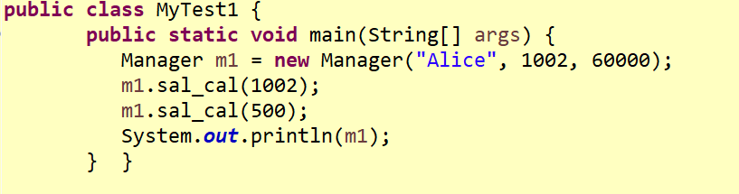
Abstract Class – in a Single File
720000.0
Invalid Emp No
Alice 1002 60000.000000

Slide 22
Final Class
Final methods in the super class can’t be override in the sub class
Private – implicit final method
Static – implicit final method
Defined in the super class
Call is resolved at compile time – static binding
Final class – cant be a super class
All methods in the final class are implicit final methods

