Slide 1
Java Inheritance

Slide 2
Inheritance
Inheritance in Java is a mechanism in which one object acquires all the properties and behaviors of parent class.
The idea behind inheritance in Java is that you can create new classes that are built upon existing classes.
When you inherit from an existing class, you can reuse methods and fields of the parent class.
Moreover, you can add new methods and fields in your current class also.
Inheritance represents the IS-A relationship which is also known as a parent-child relationship.

Slide 3
Uses
For Method Overriding (so runtime polymorphism can be achieved).
For Code Reusability.

Slide 4
Class: A class is a group of objects which have common properties. It is a template or blueprint from which objects are created.
Sub Class/Child Class: Subclass is a class which inherits the other class. It is also called a derived class, extended class, or child class.
Super Class/Parent Class: Superclass is the class from where a subclass inherits the features. It is also called a base class or a parent class.
Reusability: As the name specifies, reusability is a mechanism which facilitates you to reuse the fields and methods of the existing class when you create a new class. You can use the same fields and methods already defined in the previous class.

Slide 5
Syntax
class Subclass-name extends Superclass-name
{
//methods and fields
}
The extends keyword indicates that you are making a new class that derives from an existing class. The meaning of "extends" is to increase the functionality.

Slide 6
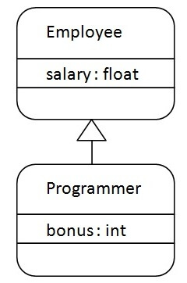
Example
Programmer IS-A Employee

Slide 7
is-a relationship
In Java, inheritance is an is-a relationship. That is, we use inheritance only if there exists an is-a relationship between two classes. For example,
Car is a Vehicle
Orange is a Fruit
Surgeon is a Doctor
Dog is an Animal
Here, Car can inherit from Vehicle, Orange can inherit from Fruit, and so on.

Slide 8
class Employee{
float salary=40000;
}
class Programmer extends Employee{
int bonus=10000;
public static void main(String args[]){
Programmer p=new Programmer();
System.out.println("Programmer salary is:"+p.salary);
System.out.println("Bonus of Programmer is:"+p.bonus);
}
}
Programmer salary is:40000.0
Bonus of programmer is:10000

Slide 9
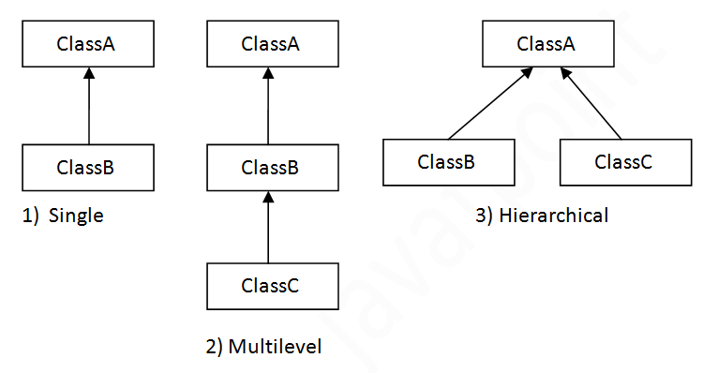
Types of inheritance in java

Slide 10
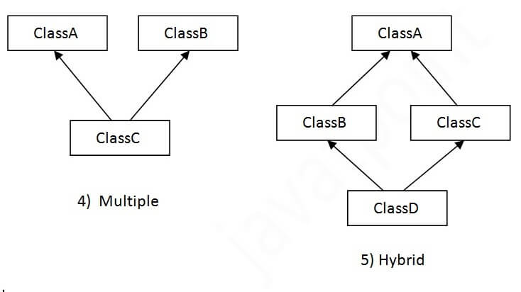
When one class inherits multiple classes, it is known as multiple inheritance. Multiple inheritance is not supported in Java through class.
In java programming, multiple and hybrid inheritance is supported through interface only.

Slide 11
Single Inheritance
class Animal{
void eat(){System.out.println("eating...");}
}
class Dog extends Animal{
void bark(){System.out.println("barking...");}
}
class TestInheritance{
public static void main(String args[]){
Dog d=new Dog();
d.bark();
d.eat(); }}
barking...
eating...

Slide 12
Multilevel Inheritance
class Animal{
void eat(){System.out.println("eating...");}
}
class Dog extends Animal{
void bark(){System.out.println("barking...");}
}
class BabyDog extends Dog{
void weep(){System.out.println("weeping...");}
}
class TestInheritance2{
public static void main(String args[]){
BabyDog d=new BabyDog();
d.weep();
d.bark();
d.eat();
}}
weeping...
barking...
eating...

Slide 13
Hierarchical Inheritance
class Animal{
void eat(){System.out.println("eating...");}
}
class Dog extends Animal{
void bark(){System.out.println("barking...");}
}
class Cat extends Animal{
void meow(){System.out.println("meowing...");}
}
class TestInheritance3{
public static void main(String args[]){
Cat c=new Cat();
c.meow();
c.eat();
//c.bark();//C.T.Error
}}
meowing...
eating...

Slide 14
Why multiple inheritance is not supported in java?
To reduce the complexity and simplify the language, multiple inheritance is not supported in java.
Consider a scenario where A, B, and C are three classes. The C class inherits A and B classes. If A and B classes have the same method and you call it from child class object, there will be ambiguity to call the method of A or B class.
Since compile-time errors are better than runtime errors, Java renders compile-time error if you inherit 2 classes.
So whether you have same method or different, there will be compile time error.

Slide 15
class A{
void msg(){System.out.println("Hello");}
}
class B{
void msg(){System.out.println("Welcome");}
}
class C extends A,B{//suppose if it were
public static void main(String args[]){
C obj=new C();
obj.msg();//Now which msg() method would be invoked?
}
}
Compile Time Error

Slide 16
class Calculation {
int z;
public void addition(int x, int y) {
z = x + y;
System.out.println("The sum of the given numbers:"+z);
}
public void Subtraction(int x, int y) {
z = x - y;
System.out.println("The difference between the given numbers:"+z);
} }
public class My_Calculation extends Calculation {
public void multiplication(int x, int y) {
z = x * y;
System.out.println("The product of the given numbers:"+z);
}
public static void main(String args[]) {
int a = 20, b = 10;
My_Calculation demo = new My_Calculation();
demo.addition(a, b);
demo.Subtraction(a, b);
demo.multiplication(a, b);
} }

Slide 17
final keyword
If you don't want other classes to inherit from a class, use the final keyword:
final class Vehicle {
...
}
class Car extends Vehicle {
...
}
Main.java:9: error: cannot inherit from final Vehicle class Main extends Vehicle { ^ 1 error)

Slide 18
Method Overriding
if the same method is present in both the superclass and subclass, what will happen?
In this case, the method in the subclass overrides the method in the superclass. This concept is known as method overriding in Java.

Slide 19
class Animal {
public void eat() {
System.out.println("I can eat");
} }
class Dog extends Animal {
// overriding the eat() method
@Override
public void eat() {
System.out.println("I eat dog food");
}
public void bark() {
System.out.println("I can bark");
} }
class Main {
public static void main(String[] args) {
Dog labrador = new Dog();
labrador.eat();
labrador.bark(); } }
I eat dog food
I can bark
Note: We have used the @Override annotation to tell the compiler that we are overriding a method. However, the annotation is not mandatory.

Slide 20
super Keyword in Java Inheritance
Previously we saw that the same method in the subclass overrides the method in superclass.
In such a situation, the super keyword is used to call the method of the parent class from the method of the child class.

Slide 21
class Animal {
public void eat() {
System.out.println("I can eat");
} }
class Dog extends Animal {
// overriding the eat() method
@Override
public void eat() {
// call method of superclass
super.eat();
System.out.println("I eat dog food");
}
public void bark() {
System.out.println("I can bark");
}
}
class Main {
public static void main(String[] args) {
Dog labrador = new Dog();
// call the eat() method
labrador.eat();
labrador.bark();
}
}
We can also use the super keyword to call the constructor of the superclass from the constructor of the subclass.
I can eat
I eat dog food
I can bark

Slide 22
class Superclass {
int age;
Superclass(int age) {
this.age = age;
}
public void getAge() {
System.out.println("The value of the variable named age in super class is: " +age);
}
}
public class Subclass extends Superclass {
Subclass(int age) {
super(age);
}
public static void main(String args[]) {
Subclass s = new Subclass(24);
s.getAge();
}
}

Slide 23
protected Members in Inheritance
class Animal {
protected String name;
protected void display() {
System.out.println("I am an animal.");
} }
class Dog extends Animal {
public void getInfo() {
System.out.println("My name is " + name);
} }
class Main {
public static void main(String[] args) {
Dog labrador = new Dog();
labrador.name = "Rocky";
labrador.display();
labrador.getInfo();
} }
I am an animal.
My name is Rocky

Slide 24
class Vehicle {
protected String brand = "Ford";
public void honk() {
System.out.println(“honk, honk!");
}
}
class Car extends Vehicle {
private String modelName = "Mustang";
public static void main(String[] args) {
Car myFastCar = new Car();
myFastCar.honk();
System.out.println(myFastCar.brand + " " + myFastCar.modelName);
}
}
honk, honk! Ford Mustang

