Slide 1
Java IOStreams

Slide 2
Java I/O Streams
In Java, streams are the sequence of data that are read from the source and written
An input stream is used to read data from the source. And, an output stream is used to write data to the destination. to the destination.
Types
Byte Stream
Byte stream is used to read and write a single byte (8 bits) of data.
All byte stream classes are derived from base abstract classes called InputStream and OutputStream.
Character Stream
Character stream is used to read and write a single character of data.
All the character stream classes are derived from base abstract classes Reader and Writer.

Slide 3
Java InputStream Class
The InputStream class of the java.io package is an abstract superclass that represents an input stream of bytes.
Since InputStream is an abstract class, it is not useful by itself. However, its subclasses can be used to read data.
FileInputStream
ByteArrayInputStream
ObjectInputStream

Slide 4
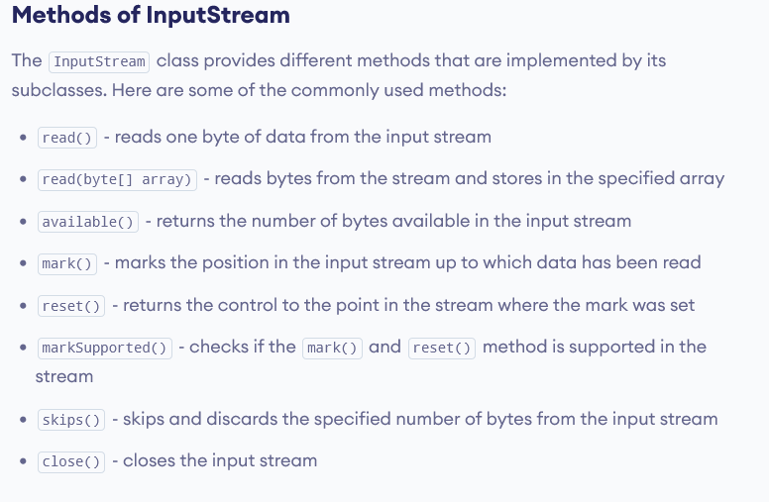

Slide 5
import java.io.FileInputStream;
import java.io.InputStream;
class Main {
public static void main(String args[]) {
byte[] array = new byte[100];
try {
InputStream input = new FileInputStream("input.txt");
System.out.println("Available bytes in the file: " + input.available());
// Read byte from the input stream
input.read(array);
System.out.println("Data read from the file: ");
// Convert byte array into string
String data = new String(array);
System.out.println(data);
// Close the input stream
input.close();
} catch (Exception e) {
e.getStackTrace();
} } }
Available bytes in the file: 39
Data read from the file:
This is a line of text inside the file

Slide 6
Java OutputStream Class
The OutputStream class of the java.io package is an abstract superclass that represents an output stream of bytes.
Since OutputStream is an abstract class, it is not useful by itself. However, its subclasses can be used to write data.
FileOutputStream
ByteArrayOutputStream
ObjectOutputStream

Slide 7
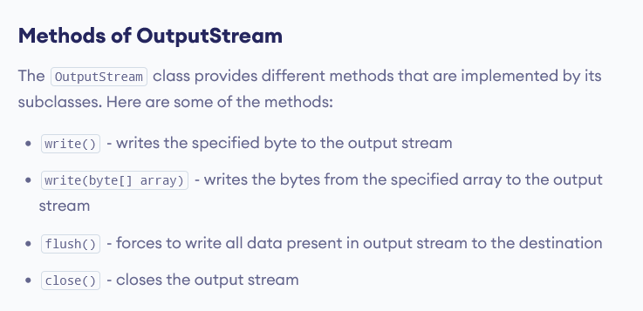

Slide 8
import java.io.FileOutputStream;
import java.io.OutputStream;
public class Main {
public static void main(String args[]) {
String data = "This is a line of text inside the file.";
try {
OutputStream out = new FileOutputStream("output.txt");
// Converts the string into bytes
byte[] dataBytes = data.getBytes();
// Writes data to the output stream
out.write(dataBytes);
System.out.println("Data is written to the file.");
// Closes the output stream
out.close();
}
catch (Exception e) {
e.getStackTrace();
} } }

Slide 9
import java.io.*;
public class BufferedInputStreamExample{
public static void main(String args[]){
try{
FileInputStream fin=new FileInputStream(“abc.txt");
BufferedInputStream bin=new BufferedInputStream(fin);
int i;
while((i=bin.read())!=-1){
System.out.print((char)i);
}
bin.close();
fin.close();
}catch(Exception e){System.out.println(e);}
}
}

Slide 10
import java.io.*;
public class BufferedOutputStreamExample{
public static void main(String args[])throws Exception{
FileOutputStream fout=new FileOutputStream("testout.txt");
BufferedOutputStream bout=new BufferedOutputStream(fout);
String s="Welcome to java file streams.";
byte b[]=s.getBytes();
bout.write(b);
bout.flush();
bout.close();
fout.close();
System.out.println("success");
}
}

