Slide 1
Java File Streams

Slide 2
Java File Handling
The File class from the java.io package, allows us to work with files.
To use the File class, create an object of the class, and specify the filename or directory name:
import java.io.File; // Import the File class
File myObj = new File("filename.txt"); // Specify the filename

Slide 3
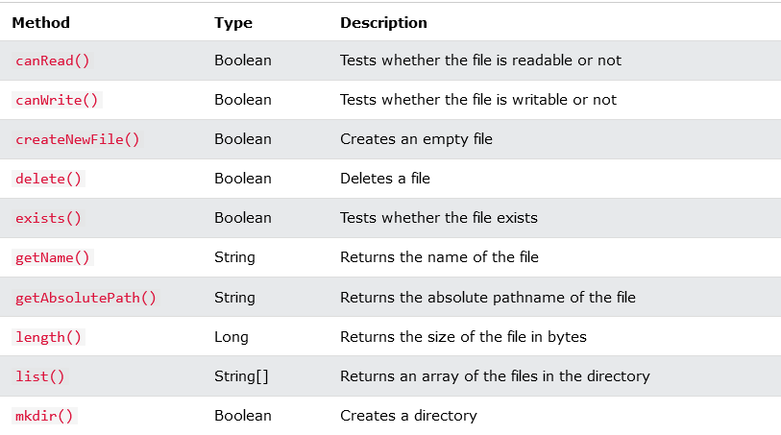

Slide 4
Create a File
import java.io.File; // Import the File class
import java.io.IOException; // Import the IOException class to handle errors
public class CreateFile {
public static void main(String[] args) {
try {
File myObj = new File("filename.txt");
if (myObj.createNewFile()) {
System.out.println("File created: " + myObj.getName());
} else {
System.out.println("File already exists.");
}
} catch (IOException e) {
System.out.println("An error occurred.");
e.printStackTrace();
}
}
}

Slide 5
Write To a File
import java.io.File; // Import the File class
import java.io.IOException; // Import the IOException class to handle errors
public class CreateFile {
public static void main(String[] args) {
try {
File myObj = new File("filename.txt");
if (myObj.createNewFile()) {
System.out.println("File created: " + myObj.getName());
} else {
System.out.println("File already exists.");
}
} catch (IOException e) {
System.out.println("An error occurred.");
e.printStackTrace();
}
}
}

Slide 6
Read a File
import java.io.File; // Import the File class
import java.io.FileNotFoundException; // Import this class to handle errors
import java.util.Scanner; // Import the Scanner class to read text files
public class ReadFile {
public static void main(String[] args) {
try {
File myObj = new File("A.java");
Scanner myReader = new Scanner(myObj);
while (myReader.hasNextLine()) {
String data = myReader.nextLine();
System.out.println(data);
}
myReader.close();
} catch (FileNotFoundException e) {
System.out.println("An error occurred.");
e.printStackTrace();
}
}
}

Slide 7
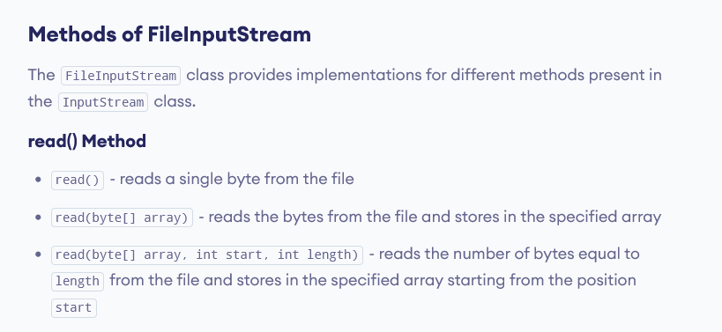
Methods of FileInputStream

Slide 8
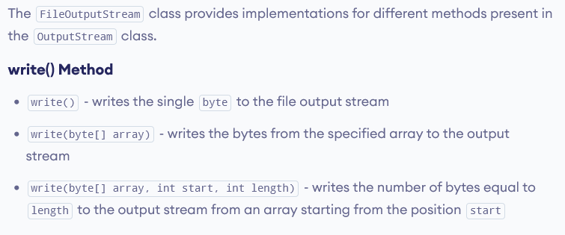
Methods of FileOutputStream

Slide 9
Byte Stream
import java.io.*;
public class CopyFile {
public static void main(String args[]) throws IOException {
FileInputStream in = null;
FileOutputStream out = null;
try {
in = new FileInputStream("input.txt");
out = new FileOutputStream("output.txt");
int c;
while ((c = in.read()) != -1) {
out.write(c);
}
}finally {
if (in != null) {
in.close();
}
if (out != null) {
out.close();
} } } }

Slide 10
Character Streams
import java.io.*;
public class CopyFile {
public static void main(String args[]) throws IOException {
FileReader in = null;
FileWriter out = null;
try {
in = new FileReader("input.txt");
out = new FileWriter("output.txt");
int c;
while ((c = in.read()) != -1) {
out.write(c);
}
}finally {
if (in != null) {
in.close();
}
if (out != null) {
out.close();
} } } }

Slide 11
import java.io.PrintStream;
class MainPrintStream {
public static void main(String[] args) {
try {
PrintStream output = new PrintStream("output.txt");
int age = 25;
output.printf("I am %d years old.", age);
output.close();
}
catch(Exception e) {
e.getStackTrace();
}
}
}

Slide 12
import java.io.PrintStream;
class MainPS {
public static void main(String[] args) {
String data = "This is a text inside the file.";
try {
PrintStream output = new PrintStream("output.txt");
output.print(data);
output.close();
}
catch(Exception e) {
e.getStackTrace();
}
}
}

Slide 13
