Slide 1
Module 2 Data Representation in Computers Part A
Dr. Bhuvaneswari A
Assistant Professor Sr.,
SCOPE, VIT Chennai

Slide 2
Topics Covered (Module 2)
Data Representation
Fixed point representation of numbers
Signed and Unsigned
1s & 2s Complement Addition , Subtraction

Slide 3
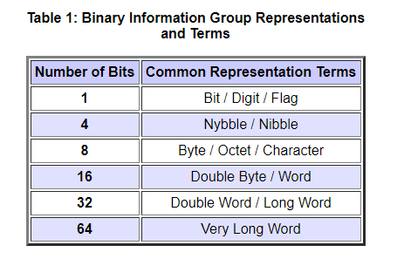
Data Representation
Bit: The most basic unit of information in a digital computer is called a bit, which is a contraction of binary digit.
Byte: The collection of 8 bits a byte.
In 1964, the designers of the IBM System/360 main frame computer established a convention of using groups of 8 bits as the basic unit of addressable computer storage.
Word: Computer words consist of two or more adjacent bytes that are sometimes addressed and almost always are manipulated collectively. The word size represents the data size that is handled most efficiently by a particular architecture. Words can be 16 bits, 32 bits, 64 bits.
Nibbles: Eight-bit bytes can be divided into two 4-bit halves called nibbles.

Slide 4
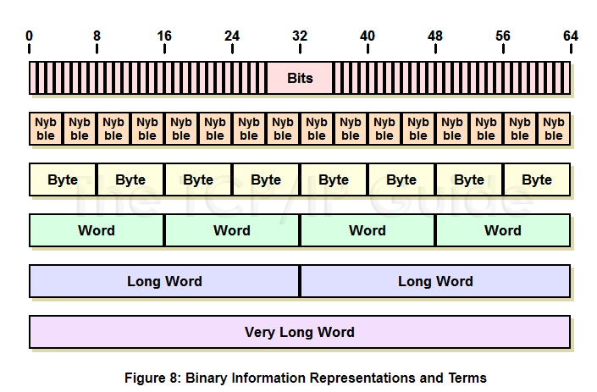

Slide 5
Numeric Data Representation
Numbers System
Positional Number system
Non positional Numbers System
Binary
decimal
octal
Hexadecimal

Slide 6
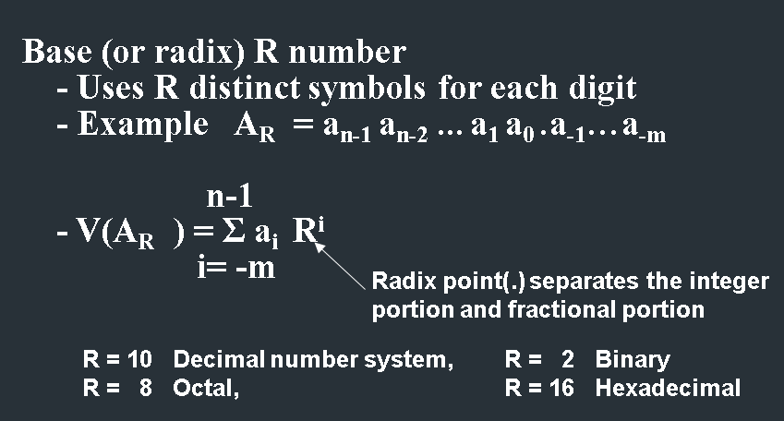
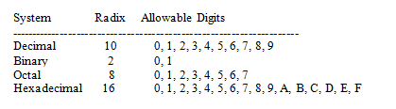
Positional Numbering Systems
Radix (or Base): The general idea behind positional numbering systems is that a numeric value is represented through increasing powers of a radix (or base).

Slide 7
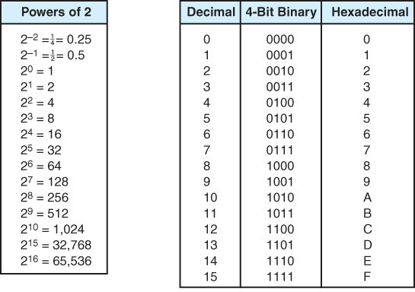

Slide 8
Types of Data Representation
Data Representation
Fixed Point Representation
Floating point representation

Slide 9
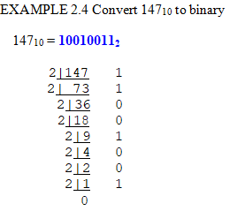
Converting Between Bases
There are two important groups of number base conversions:
Conversion of decimal numbers to base-r numbers
Conversion of base-r numbers to decimal numbers

Slide 10
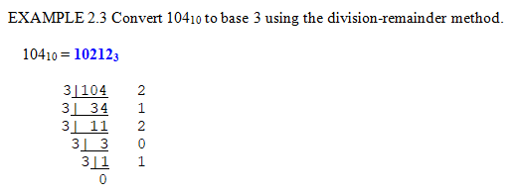
Converting Between Bases
A binary number with N bits can represent unsigned integer from 0 to 2^{n} – 1.
Overflow: the result of an arithmetic operation is outside the range of allowable precision for the give number of bits.

Slide 11
EXAMPLE 2.1 Three numbers represented as powers of a radix.
243.51₁₀ = 2 * 10² + 4 * 10¹ + 3 * 10⁰ + 5 * 10⁻¹ + 1 * 10⁻²
212₃ = 2 * 3² + 1 * 3¹ + 2 * 3⁰ = 23₁₀
10110₂ = 1 * 2⁴ + 0 * 2³ + 1 * 2² + 1 * 2¹ + 0 * 2⁰ = 22₁₀

Slide 12
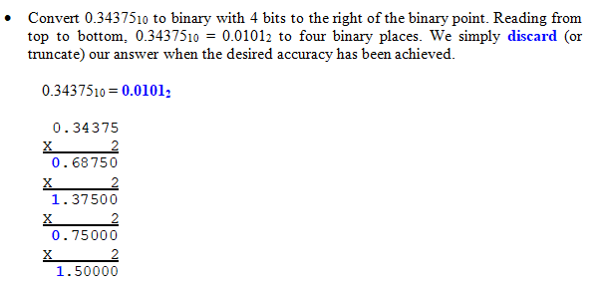
Converting Fractions

Slide 13
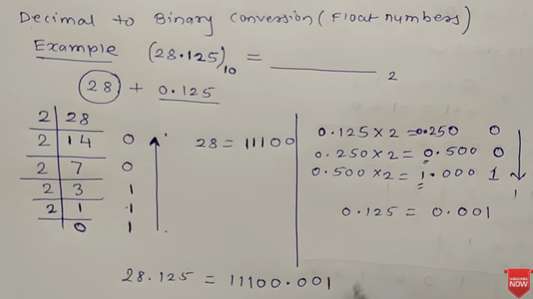

Slide 14
Number representation
Only for positive numbers For both positive and negative numbers
The sign bit
positive = 0
negative = 1
Unsigned representation
Signed representation
Signed magnitude Form
1’s complement form
2’s complement form

Slide 15
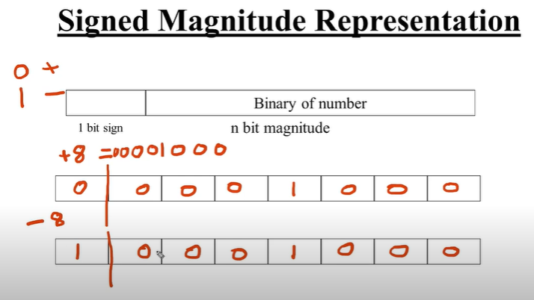

Slide 17
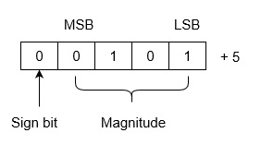
The representation of +5 using 5 bits register.

Slide 18
What is 5 bits representation of 11.
Type your answer in Chatbox

Slide 19
What is 8 bits representation of 12.
Type your answer in Chatbox

Slide 20
Addition / subtraction with signed magnitude data RULES
Signs of A and B
identical
Magnitudes Added
different
magnitudes Compared
if A > B, perform B - A, place sign of A for the result
If A < B, Perform A - B , place complement of sign of A for result.

Slide 21
Addition and Subtraction with Signed-Magnitude Data Hardware Design
B_{s}
B register
Mode Control
AVF
Complementer
M
E
Parallel Adder
Input Carry
Output Carry
S
A_{s}
A register
Load Sum

Slide 22
Flow chart for add / subtract operations
Subtract operation
Add operation
Minuend in A
Subtrahend in B
Augend in A
Addend in B
= 0
A_{S} + B_{S}
= 1
= 1
A_{S} + B_{S}
= 0
A_{S} ≠ B_{S}
A_{S} = B_{S}
A_{S} ≠ B_{S}
A_{S} = B_{S}
EA ← A + B + 1
AVF ← 0
EA ← A + B
= 0
E
= 1
A < B
A ≥ B
AVF ← E
≠ 0
= 0
A ← A
A
A ← A + 1
A_{S} ← A_{S}
A_{S} ← 0
END
(Result in A and A_{S})

Slide 23
Flow chart for add / subtract operations
Subtract operation
Add operation
Minuend in A
Subtrahend in B
Augend in A
Addend in B
= 0
A_{S} + B_{S}
= 1
= 1
A_{S} + B_{S}
= 0
A_{S} ≠ B_{S}
A_{S} = B_{S}
A_{S} ≠ B_{S}
A_{S} = B_{S}
EA ← A + B + 1
AVF ← 0
EA ← A + B
= 0
E
= 1
A < B
A ≥ B
AVF ← E
≠ 0
= 0
A ← A
A
A ← A + 1
A_{S} ← A_{S}
A_{S} ← 0
END
(Result in A and A_{S})

Slide 24
Flow chart for add / subtract operations
Subtract operation
Add operation
Minuend in A
Subtrahend in B
Augend in A
Addend in B
= 0
A_{S} + B_{S}
= 1
= 1
A_{S} + B_{S}
= 0
A_{S} ≠ B_{S}
A_{S} = B_{S}
A_{S} ≠ B_{S}
A_{S} = B_{S}
EA ← A + B + 1
AVF ← 0
EA ← A + B
= 0
E
= 1
A < B
A ≥ B
AVF ← E
≠ 0
= 0
A ← A
A
A ← A + 1
A_{S} ← A_{S}
A_{S} ← 0
END
(Result in A and A_{S})

Slide 25
Flow chart for add / subtract operations
Subtract operation
Add operation
Minuend in A
Subtrahend in B
Augend in A
Addend in B
= 0
A_{S} + B_{S}
= 1
= 1
A_{S} + B_{S}
= 0
A_{S} ≠ B_{S}
A_{S} = B_{S}
A_{S} ≠ B_{S}
A_{S} = B_{S}
EA ← A + B + 1
AVF ← 0
EA ← A + B
= 0
E
= 1
A < B
A ≥ B
AVF ← E
≠ 0
= 0
A ← A
A
A ← A + 1
A_{S} ← A_{S}
A_{S} ← 0
END
(Result in A and A_{S})

Slide 26
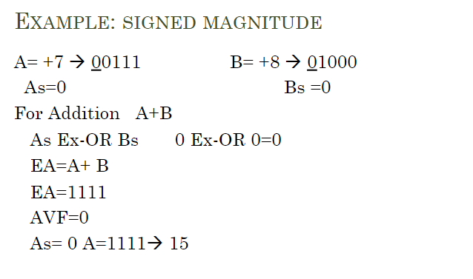

Slide 27
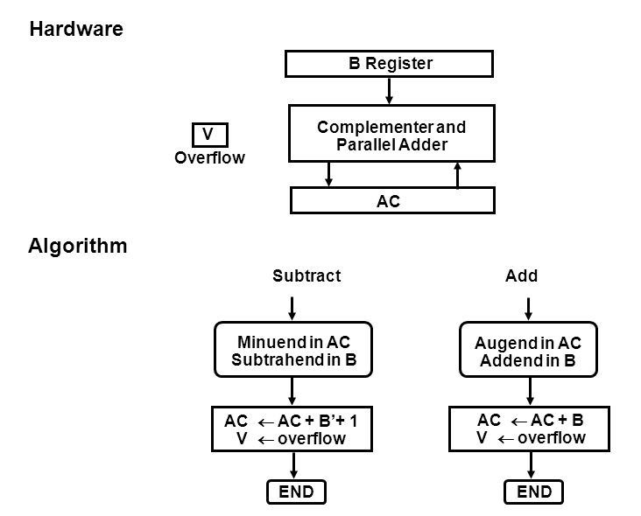
Hardware Implementation of Signed 2’s complement Addition and Subtraction

Slide 28
Signed magnitude numbers
Operation | ADD Magnitudes | SUBTRACT Magnitudes
 |  | A > B | A < B | A = B
(+A) + (+B) | + (A + B)
(+A) + (-B) |  | + (A – B ) | - (B – A ) | + (A – B )
(-A) + (+B) |  | - (A – B ) | + (B – A ) | + (A – B )
(-A) + (-B) | - ( A + B)
(+A) - (+B) |  | + (A – B ) | - (B – A ) | + (A – B )
(+A) - (-B) | + (A + B)
(-A) - (+B) | - ( A + B)
(-A) - (-B) |  | - (A – B ) | + (B – A ) | + (A – B )

Slide 29
Subtraction of two signed 2’s complement numbers RULES:
Subtraction of two signed 2’s complement numbers is as follows
Take the 2’s complement form of the subtrahend (including sign bit)
Add it to the minuend (including the sign bit)
A carry out of the sign bit position is discarded

Slide 30
Complement Systems - Bits-flipping
One’s Complement
Two’s Complement
1’s complement range: -(2^(n-1) - 1) to (2^(n-1) - 1) : (for 8 bits: -127 to 127)
2’s complement range: -(2^(n-1)) to (2^(n-1) - 1) : (for 8 bits: -128 to 127)

Slide 31

One’s Complement
This sort of bit-flipping is very simple to implement in computer hardware.

Slide 32
Binary Arithmetic of Signed Numbers using 1's Complement
Case I: When the positive number has greater magnitude.
In this case addition of numbers is performed after taking 1’s complement of the negative number and the end-around carry of the sum is added to the least significant bit.
Case II: When the negative number has greater magnitude.
In this case the addition is carried in the same way as in case 1 but there will be non end-around carry. The sum is obtained by taking 1’s complement of the magnitude bits of the result and it will be negative.

Slide 33
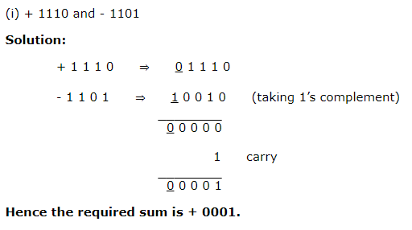
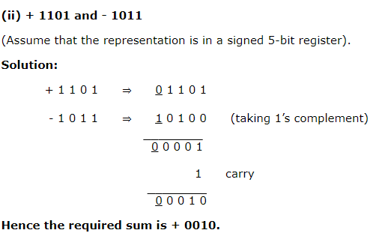
Case I: When the positive number has greater magnitude. One’s Complement
(Assume that the representation is in a signed 5-bit register).
14 + (-13) = (+ 1)
13 + (-11) = (+ 2)

Slide 34
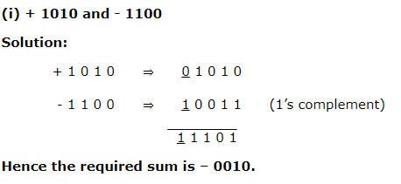
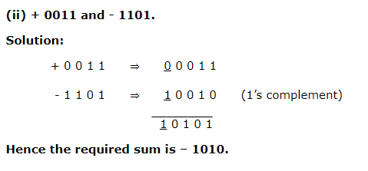
Case II: When the negative number has greater magnitude.
10 + (-12)
3 + (-13)

Slide 35
When the two numbers are negative
For the addition of two negative numbers 1’s complements of both the numbers are to be taken and then added.
In this case an end-around carry will always appear. This along with a carry from the MSB (i.e. the 4th bit in the case of sign-plus-magnitude 5-bit register) will generate a 1 in the sign bit. 1’s complement of the magnitude bits of the result of addition will give the final sum.

Slide 36
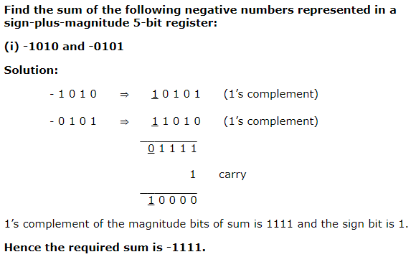
One’s Complement
(-10) + (-5) = (-15)

Slide 37
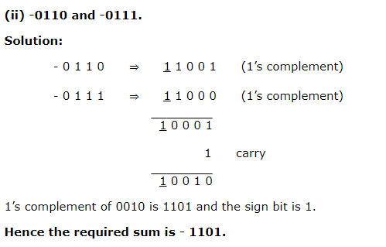
(-6) + (-7) = (- 13)
One’s Complement

Slide 38
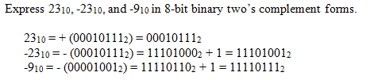
Two’s Complement
Compute the one’s complement of given number
Add 1 to get result.

Slide 39
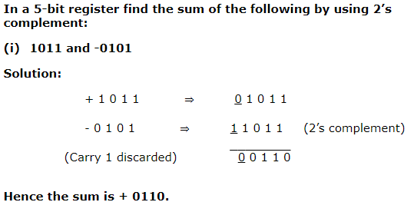
Case I: When the positive number has a greater magnitude
In this case the carry which will be generated is discarded and the final result is the result of addition. When the positive number has a greater magnitude
11+ (-5) = 6
Two’s Complement

Slide 40
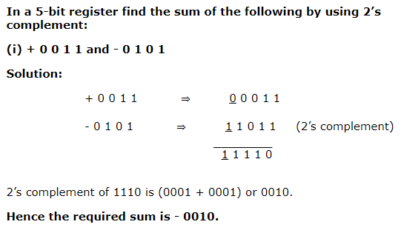
Case II: When the negative number is greater.
When the negative numbers is greater no carry will be generated in the sign bit. The result of addition will be negative and the final result is obtained by taking 2’s complement of the magnitude bits of the result.
3+ (-5) = (-2)
Two’s Complement

Slide 41
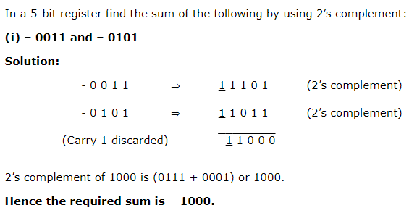
B. When the numbers are negative.
When two negative numbers are added a carry will be generated from the sign bit which will be discarded. 2’s complement of the magnitude bits of the operation will be the final sum.
(-3)+ (-5) = (-8)
Two’s Complement

Slide 42
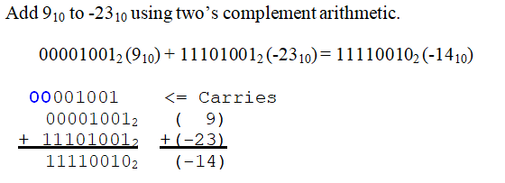
Binary Arithmetic of Signed Numbers using 2's Complement

Slide 43
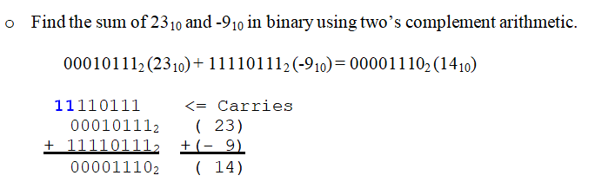
Binary Arithmetic of Signed Numbers using 2's Complement

Slide 44
Overflow
An overflow occurs when two numbers of n digits each are added and the sum occupies n + 1 digits
• Overflows are problems since the width of a register is finite
• Therefore, a flag (V) is set if this occurs and can be checked by the user
• Detection of an overflow depends on if the numbers are signed or unsigned

Slide 45
Overflow
For unsigned numbers, an overflow is detected from the end carry out of the msb
For addition of signed numbers, an overflow cannot occur if one is positive and one is negative – both have to have the same sign
An overflow can be detected if the carry into the sign bit position and the carry out of the sign bit position are not equal

Slide 46

A Simple Rule for Detecting an Overflow Condition:
If the carry in the sign bit equals the carry out of the bit, no overflow has occurred.
If the carry into the sign bit is different from the carry out of the sign bit, overflow (and thus an error) has occurred.

Slide 47
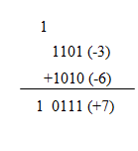
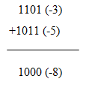
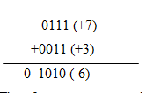
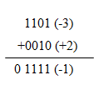
Signed Overflow
carry generated, no overflow
carry and overflow
no carry and no overflow
no carry and overflow

Slide 48


Text Book(s)
David A. Patterson and . John L. Hennessy ―Computer Organization and Design-The Hardware/Software Interface‖ 5th edition, Morgan Kaufmann, 2011.
Carl Hamacher, Zvonko Vranesic, Safwat Zaky, Computer organization, Mc Graw Hill, Fifth edition ,Reprint 2011.

Slide 49

Reference Books
W. Stallings, Computer organization and architecture, Prentice-Hall, 8th edition, 2009

Slide 50
Time for Discussion Any Queries??

Slide 51
THANK YOU

