Slide 1
Module 2 Computer Arithmetic –DIVISION

Slide 2
Lecture Topic
Division
Longhand division
Circuit arrangement for binary division
Restoring Division

Slide 3
Integer Division Operation
Division is more complex than multiplication
It involves repetitive shifting and addition or subtraction
In integer division operation, a divisor M and a dividend D are given.
We need to find quotient Q and remainder R.
The relationship between the components is given by,
D=Q*M+R

Slide 4
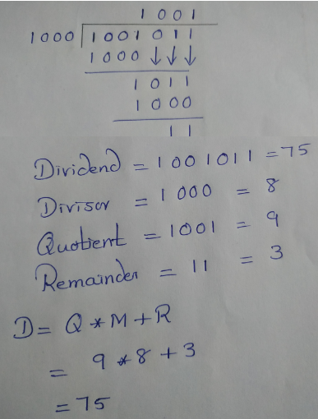
Simple Integer Division: Pencil-Paper Method
Let,
Dividend, D=1001011
Divisor, M=1000
Longhand division examples.

Slide 5
Manual Division
13
21
1101
10101
274
100010010
26
1101
14
10000
13
1101
1
1110
1101
Divisor = 13
Dividend = 21
1
Longhand division examples.

Slide 6
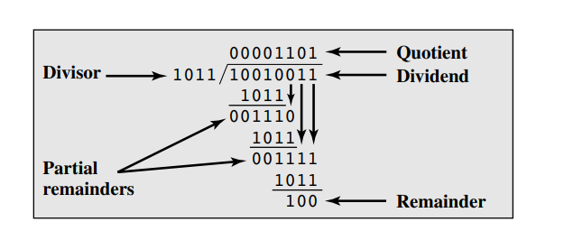
Division of Unsigned Binary Integers

Slide 7
Hardware Circuit Arrangement
Shift left
a_{n}
a_{n-1}
a₀
q_{n-1}
q₀
Dividend Q
A
Quotient
Setting
N+1 bit
adder
Add/Subtract
Control
Sequencer
0
m_{n-1}
m₀
Divisor M
Figure : Circuit arrangement for binary division.

Slide 8
Types of Fixed Point Division
Restoring Division
Non-Restoring Division

Slide 9
Restoring Division

Slide 10
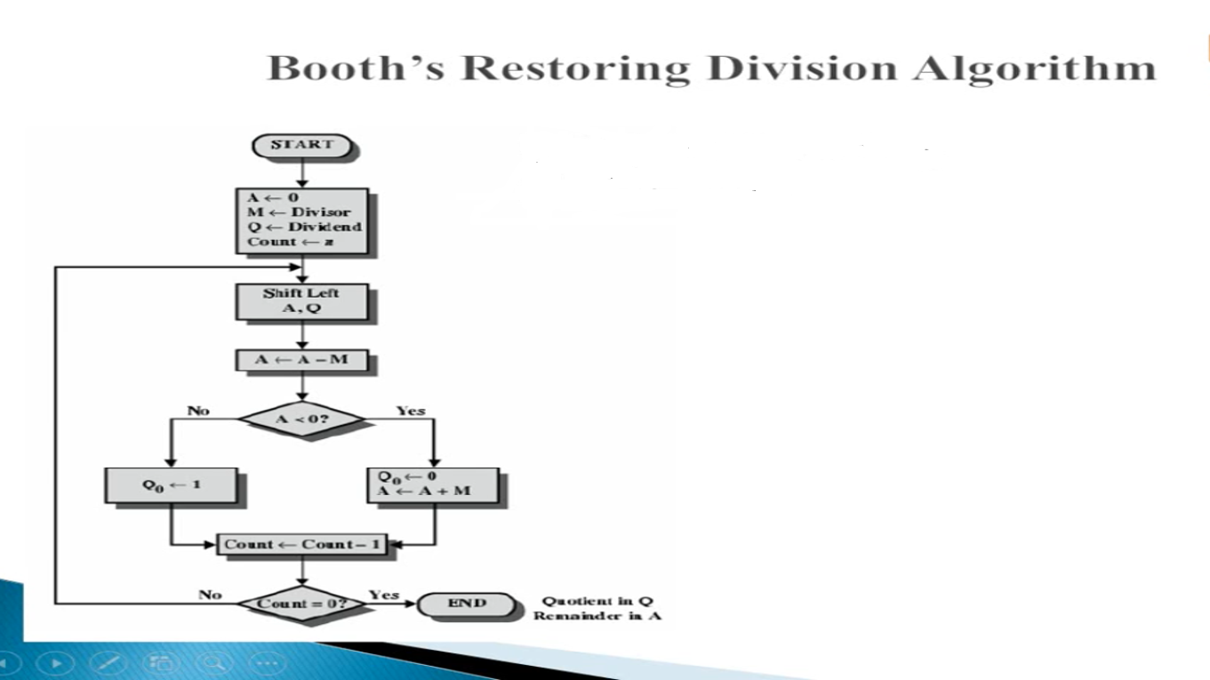
n = # of bits in Q(dividend)
# of bits in A = n+1
# of bits in M(divisor) = n+1
+ve
-ve

Slide 11
Restoring Division
Shift A and Q left one binary position
Subtract M from A, and place the answer back in A
If the sign of A is 1, set q₀ to 0 and add M back to A (restore A); otherwise, set q₀ to 1
Repeat these steps n times

Slide 12
A | Q | n | Action
+ve
-ve

Slide 13
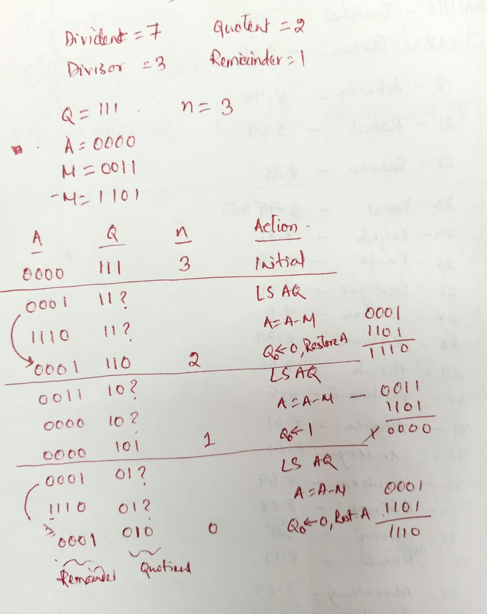
+ve
-ve

Slide 14
Examples
Initially
0
0
0
0
0
1
0
0
0
0
0
0
1
1
Shift
0
0
0
0
1
0
0
0
Subtract
1
1
1
0
1
First cycle
Set
q
0
1
1
1
1
0
Restore
1
1
1
0
0
0
0
0
1
0
0
0
0
Shift
0
0
0
1
0
0
0
0
1
1
1
0
0
0
Subtract
1
1
1
0
1
1
1
Set
q
0
1
1
1
1
1
Second cycle
Restore
1
1
1
1
0
0
0
0
1
0
0
0
0
0
Shift
0
0
1
0
0
0
0
0
Subtract
1
1
1
0
1
Set
q
0
0
0
0
0
1
Third cycle
Shift
0
0
0
1
0
0
0
0
1
Subtract
1
1
1
0
1
0
0
1
Set
q
0
1
1
1
1
1
Fourth cycle
Restore
1
1
0
0
0
1
0
0
0
1
0
Remainder
Quotient
Figure 6.22. A restoring-division example.

Slide 15
NON-RESTORING DIVISION METHOD

Slide 16
Examples
Initially
0
0
0
0
0
1
0
0
0
0
0
0
1
1
Shift
0
0
0
0
1
0
0
0
First cycle
Subtract
1
1
1
0
1
Set
q
0
1
1
1
1
0
0
0
0
0
Shift
1
1
1
0
0
0
0
0
Add
0
0
0
1
1
Second cycle
Set
q
0
1
1
1
1
1
0
0
0
0
Shift
1
1
1
1
0
0
0
0
1
1
1
1
1
Restore
remainder
Add
0
0
0
1
1
Third cycle
0
0
0
1
1
Set
q
0
0
0
0
0
1
0
0
0
1
Add
0
0
0
1
0
Remainder
Shift
0
0
0
1
0
0
0
1
Subtract
1
1
1
0
1
Fourth cycle
Set
q
0
1
1
1
1
1
0
0
1
0
A nonrestoring-division example.
Quotient

Slide 17
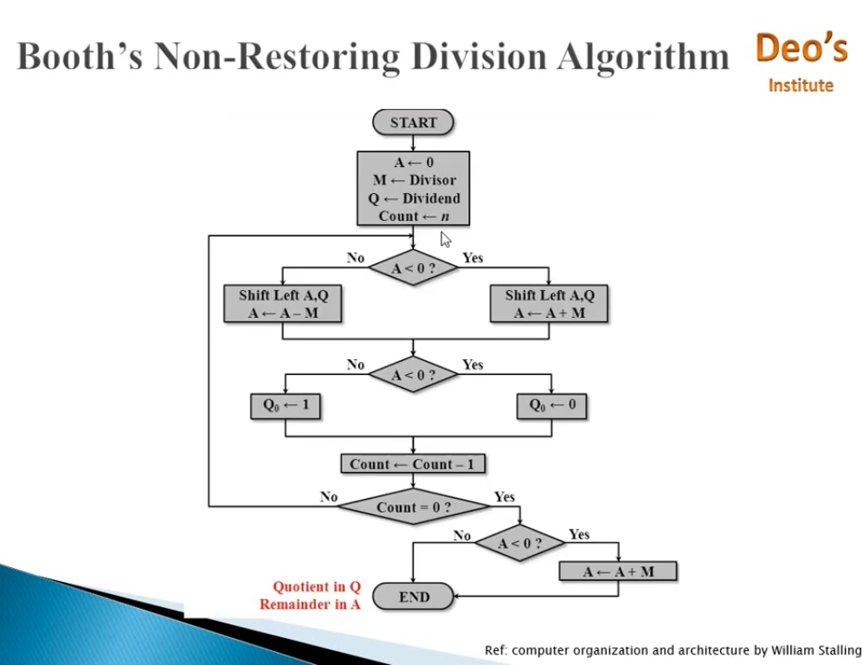
n = # of bits in Q(dividend)
# of bits in A = n+1
# of bits in M(divisor) = n+1
+ve
-ve
+ve
-ve
+ve
-ve

Slide 18
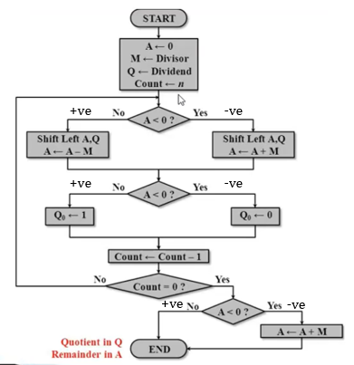
A | Q | n | Action

Slide 19
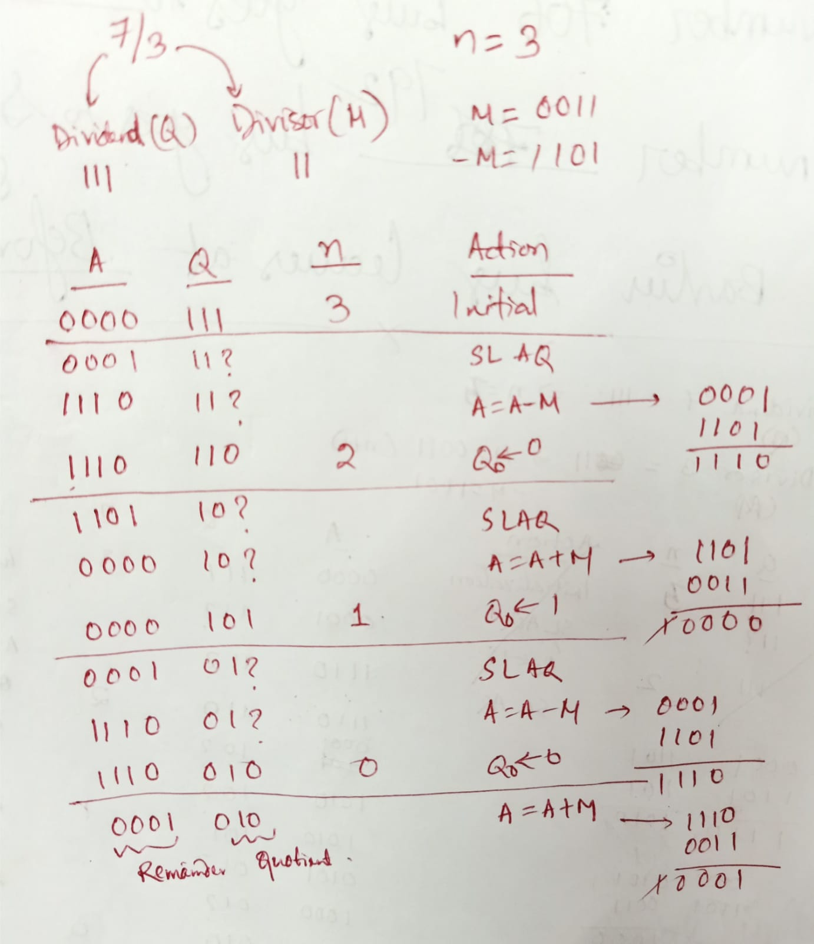
7/3

Slide 20
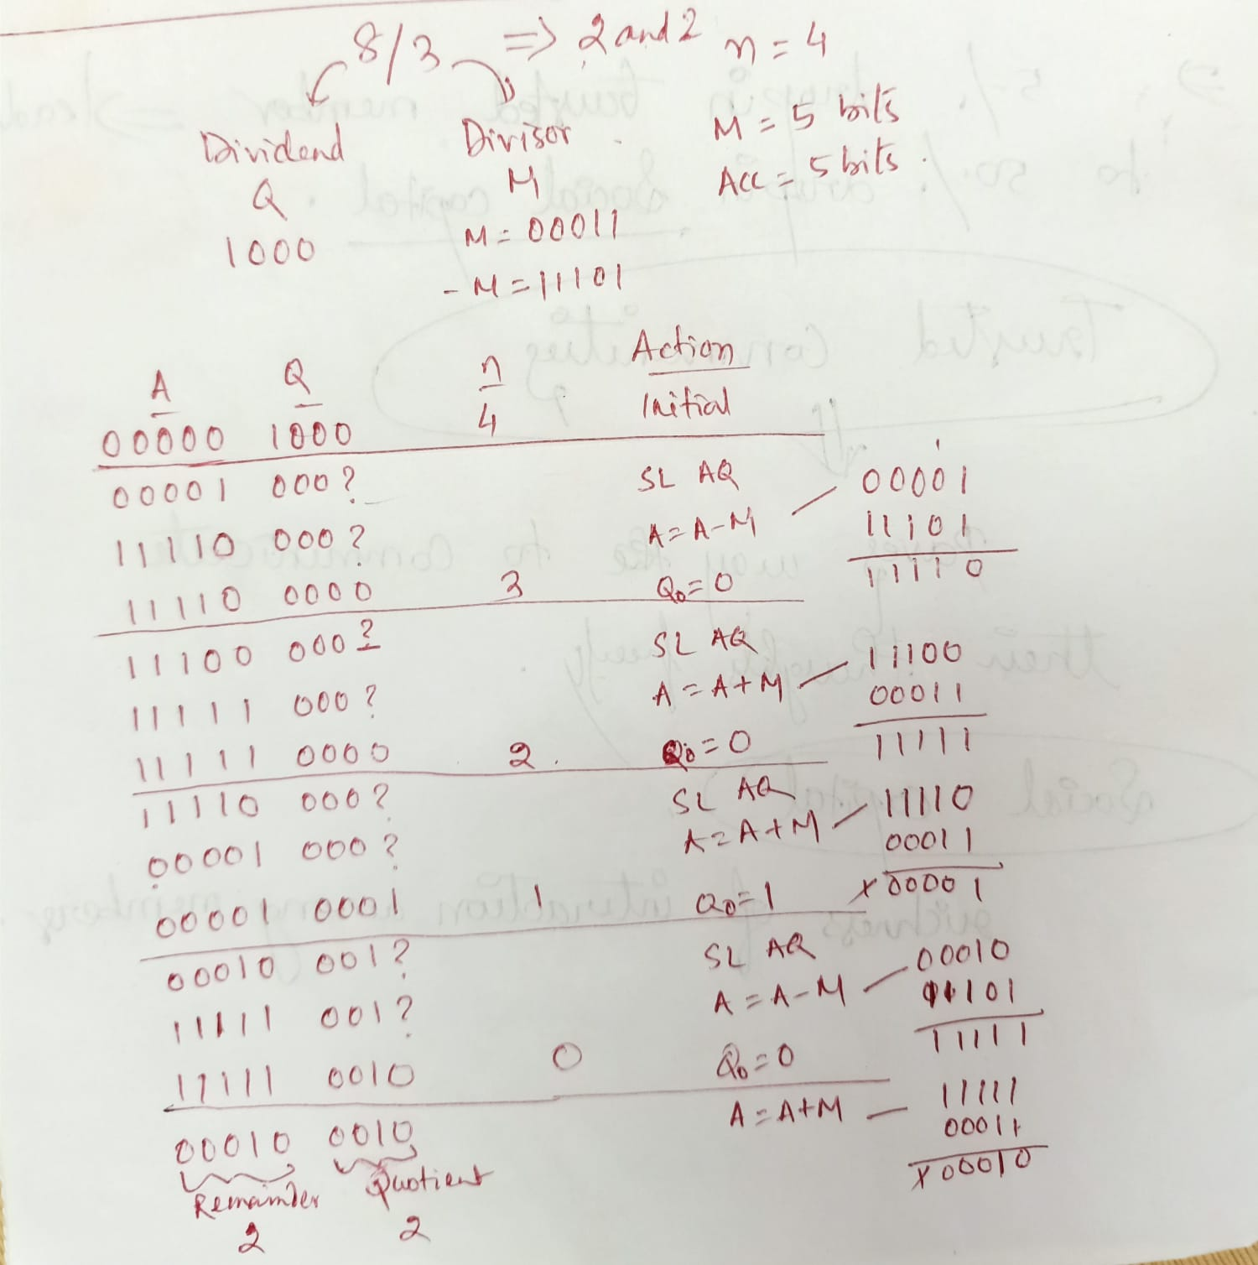
8/3

