Slide 1
Module 2
Data Representation And Computer Arithmetic
Dr. A. Bhuvaneswari
Assistant Professor, SCOPE, VIT Chennai

Slide 2
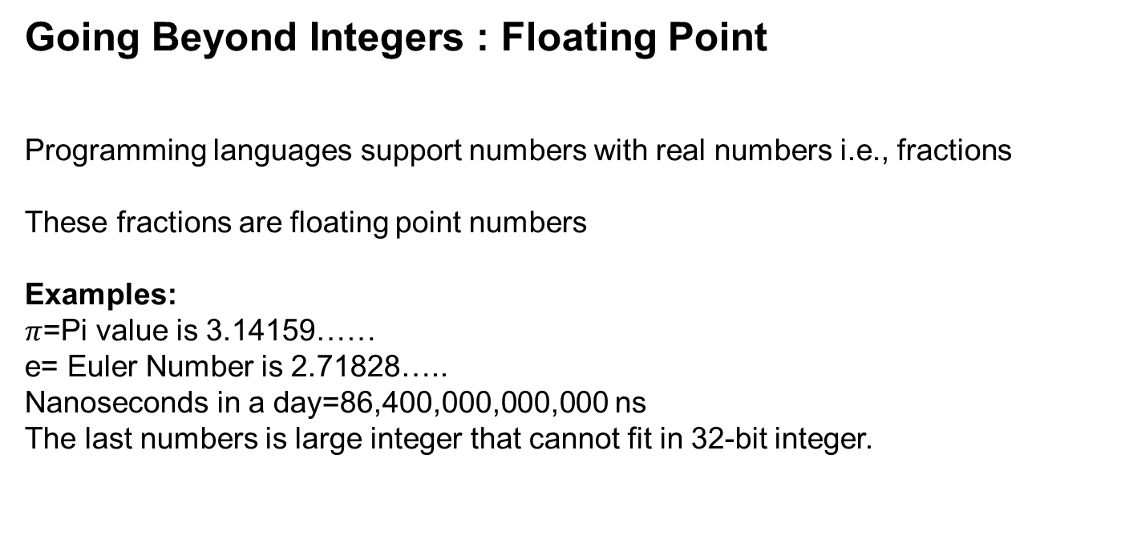
Going Beyond Integers : Floating Point
Programming languages support numbers with real numbers i.e., fractions
These fractions are floating point numbers
Examples:
$π$=Pi value is 3.14159……
e= Euler Number is 2.71828…..
Nanoseconds in a day=86,400,000,000,000 ns
The last numbers is large integer that cannot fit in 32-bit integer.

Slide 3
Distribution of Floating Point Numbers
3 bit mantissa
exponent {-1,0,1}
0
1
2
3
Notes:
September 4, 1997
3

Slide 4
Distribution of Floating Point Numbers
3 bit mantissa
exponent {-1,0,1}
0
1
2
3
Notes:
September 4, 1997
4

Slide 5
Floating Point
An IEEE floating point representation consists of
A Sign Bit (no surprise)
An Exponent (“times 2 to the what?”)
Mantissa (“Significand”), which is assumed to be 1.xxxxx (thus, one bit of the mantissa is implied as 1)
This is called a normalized representation
So a mantissa = 0 really is interpreted to be 1.0, and a mantissa of all 1111 is interpreted to be 1.1111
Special cases are used to represent denormalized mantissas (true mantissa = 0), NaN, etc., as will be discussed.
Notes:
September 4, 1997
5

Slide 6
Floating Point Standard
Defined by IEEE Std 754-1985
Developed in response to divergence of representations
Portability issues for scientific code
Now almost universally adopted
Two representations
Single precision (32-bit)
Double precision (64-bit)

Slide 7
IEEE Floating-Point Format
single: 8 bits double: 11 bits
single: 23 bits double: 52 bits
S
Exponent
Fraction
S: sign bit (0 ⇒ non-negative, 1 ⇒ negative)
Normalize significand: 1.0 ≤ |significand| < 2.0
Always has a leading pre-binary-point 1 bit, so no need to represent it explicitly (hidden bit)
Significand is Fraction with the “1.” restored
Exponent: excess representation: actual exponent + Bias
Ensures exponent is unsigned
Single: Bias = 127; Double: Bias = 1203

Slide 8
Single-Precision Range
Exponents 00000000 and 11111111 reserved
Smallest value
Exponent: 00000001 ⇒ actual exponent = 1 – 127 = –126
Fraction: 000…00 ⇒ significand = 1.0
±1.0 × 2^{–126} ≈ ±1.2 × 10^{–38}
Largest value
exponent: 11111110 ⇒ actual exponent = 254 – 127 = +127
Fraction: 111…11 ⇒ significand ≈ 2.0
±2.0 × 2⁺¹²⁷ ≈ ±3.4 × 10⁺³⁸

Slide 9
Double-Precision Range
Exponents 0000…00 and 1111…11 reserved
Smallest value
Exponent: 00000000001 ⇒ actual exponent = 1 – 1023 = –1022
Fraction: 000…00 ⇒ significand = 1.0
±1.0 × 2^{–1022} ≈ ±2.2 × 10^{–308}
Largest value
Exponent: 11111111110 ⇒ actual exponent = 2046 – 1023 = +1023
Fraction: 111…11 ⇒ significand ≈ 2.0
±2.0 × 2⁺¹⁰²³ ≈ ±1.8 × 10⁺³⁰⁸

Slide 10
Representation of Floating Point Numbers
IEEE 754 single precision
31
30
23
22
0
Sign
Biased exponent
Normalized Mantissa (implicit 24th bit = 1)
(-1)^{s} × F × 2^{E-127}
Notes:
September 4, 1997
10

Slide 11
Why biased exponent?
For faster comparisons (for sorting, etc.), allow integer comparisons of floating point numbers:
Unbiased exponent:
Biased exponent:
1/2
0
1111 1111
000 0000 0000 0000 0000 0000
2
0
0000 0001
000 0000 0000 0000 0000 0000
1/2
0
0111 1110
000 0000 0000 0000 0000 0000
2
0
1000 0000
000 0000 0000 0000 0000 0000
Notes:
September 4, 1997
11

Slide 12
Floating Point Numbers : Scientific Notation
We use scientific notation to represent fraction/floating point numbers. It has single digit to the left of decimal point.
A number 0.000000001_{ten} can be represented as 1.0_{ten} x 10^{–9}
Small number:
Mass of neutron=1.67 x 10⁻²⁷ kg
Seconds in nanosecond=1.0 x 10⁻⁹ s
Large number:
Mass of earth=5.92 x 10²⁴ kg
Seconds in a century=3.16 x 10⁹ s
Nanoseconds in a day=8.64 x 10¹³ ns

Slide 13
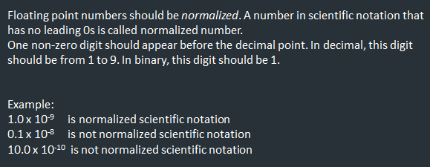
Floating Point Numbers :Normalized Scientific Notation

Slide 14
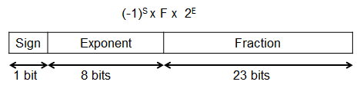
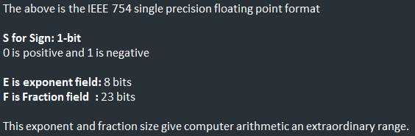
Floating Point Representation: IEEE 754 Standard
A floating point number is represented using three fields: sign bit, exponent and fraction field

Slide 15
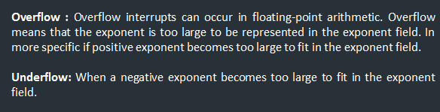
IEEE 754 Floating Point Standard Cntd…
Possibility : numbers(large)

Slide 16
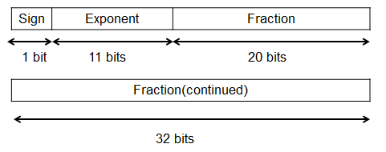
IEEE 754 Floating Point Standard Cntd…
Underflow or overflow problems: solved using exponent(larger)
The following is IEEE 754 double precision floating point format.
This floating point number takes two 32-bit word. S is single bit sign,
11-bits exponent field, 52-bits fraction field.

Slide 17

Biased Exponent Representation
IEEE 754 : exponent -biased representation
For single precision, IEEE 754 uses a bias of 127.
So -1 is represented as -1+127=126₁₀= 0111 1110₂(Exponent)
+1 is represented as 1+127=128₁₀= 1000 0000₂
For double precision, IEEE 754 uses a bias of 1023.

Slide 18
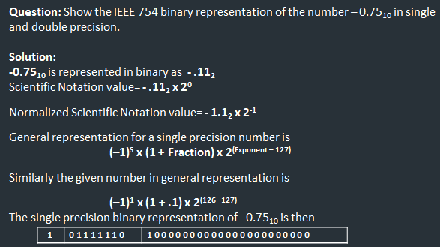
Exercise 1:

Slide 19
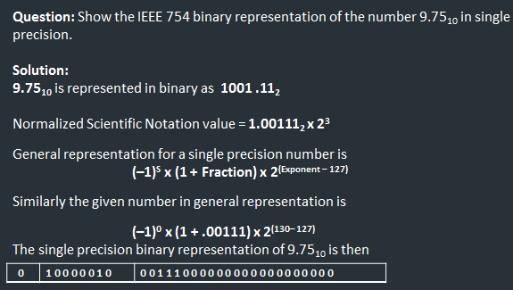
Exercise 2:

Slide 20
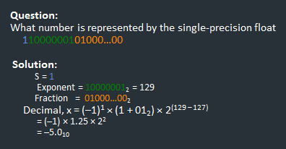
Exercise 3: Find the decimal value for the given IEEE 754 binary representation

Slide 21
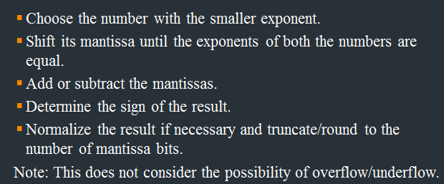

Slide 22
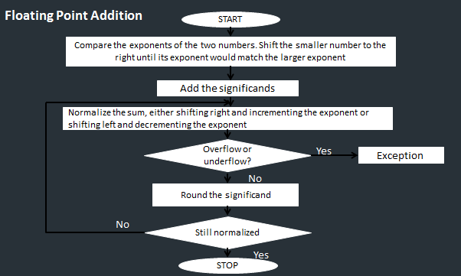

Slide 23
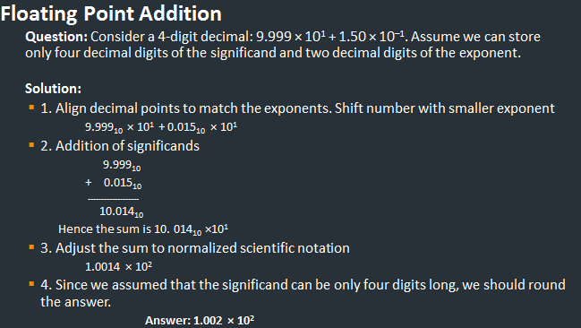

Slide 24
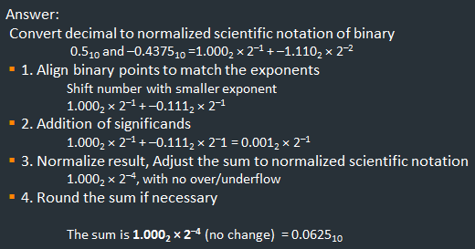
Floating Point Addition
Question: Add 0.5₁₀ and –0.4375₁₀ in binary.

Slide 25
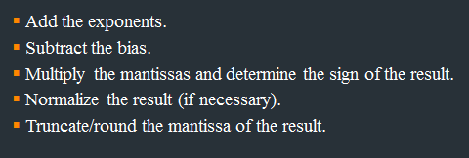
Floating Point Multiplication

Slide 26
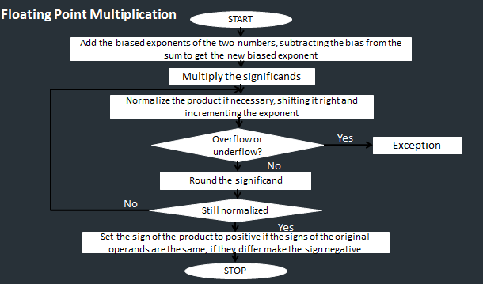

Slide 27
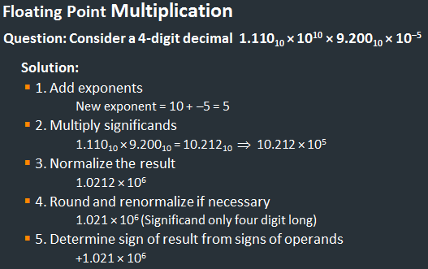

Slide 28
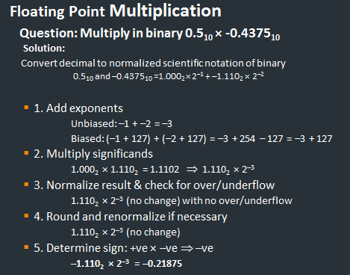

Slide 29
Floating point arithmetic: DIV rule
Subtract the exponents
Add the bias.
Divide the mantissas and determine the sign of the result.
Normalize the result if necessary.
Truncate/round the mantissa of the result.
Note: Multiplication and division does not require alignment of the
mantissas the way addition and subtraction does.

Slide 30
