Slide 1
Module 2
Data Representation And Computer Arithmetic
Non-numeric data (character codes)

Slide 2
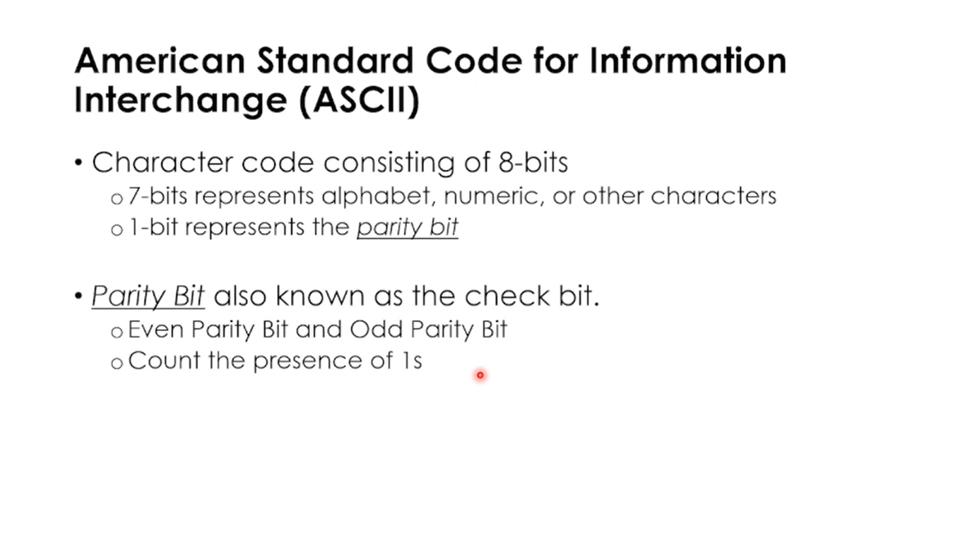

Slide 3
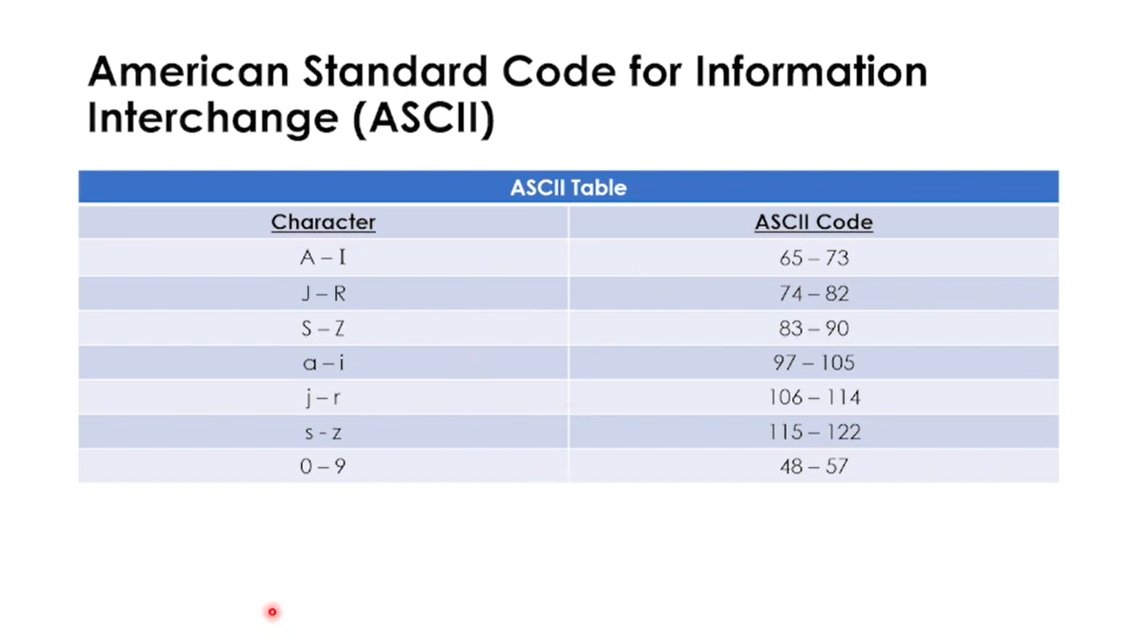

Slide 4
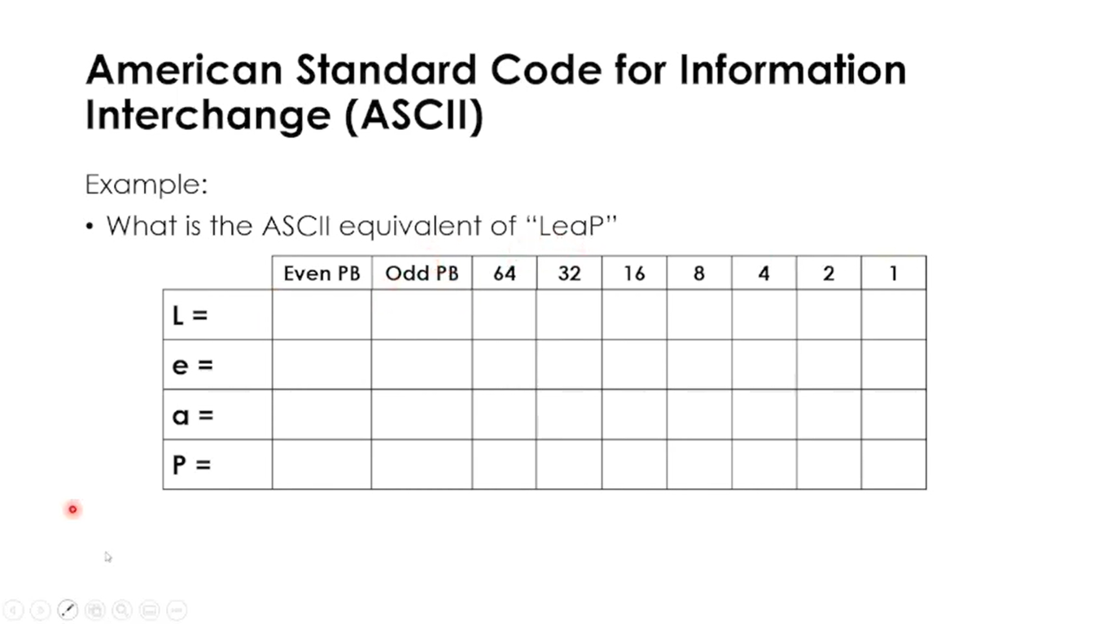

Slide 5
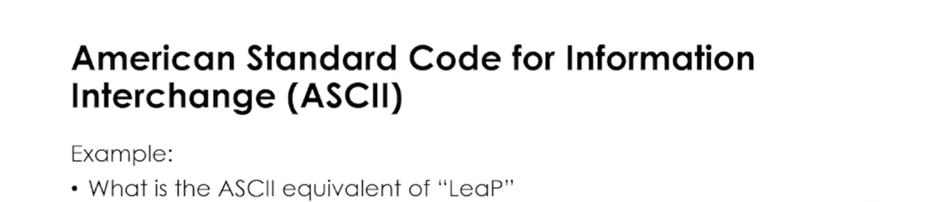
 | Even PB | Odd PB | 64 | 32 | 16 | 8 | 4 | 2 | 1
L = 76 | 1 | 0 | 1 | 0 | 0 | 1 | 1 | 0 | 0
e = 101 | 0 | 1 | 1 | 1 | 0 | 0 | 1 | 0 | 1
a = 97 | 1 | 0 | 1 | 1 | 0 | 0 | 0 | 0 | 1
P = 80 | 0 | 1 | 1 | 0 | 1 | 0 | 0 | 0 | 0

Slide 6
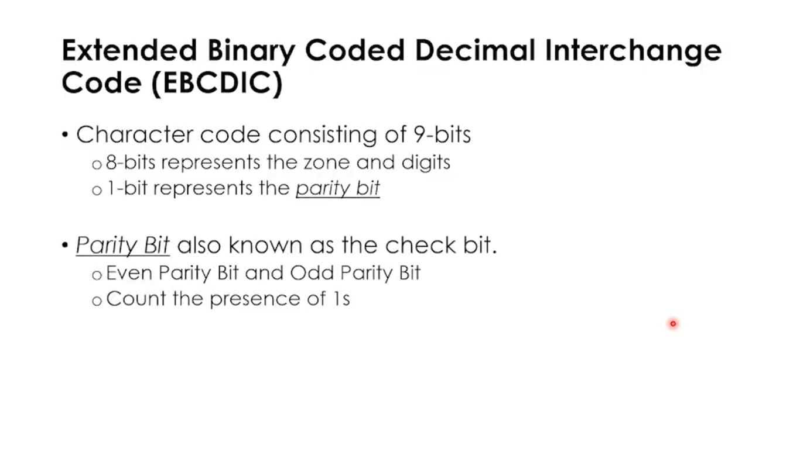

Slide 7
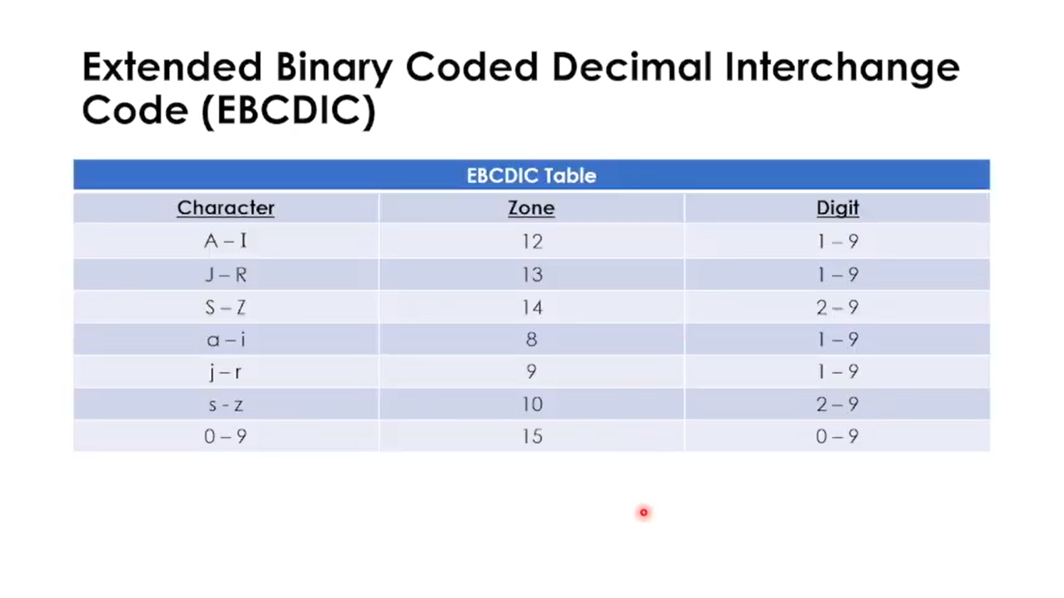

Slide 8
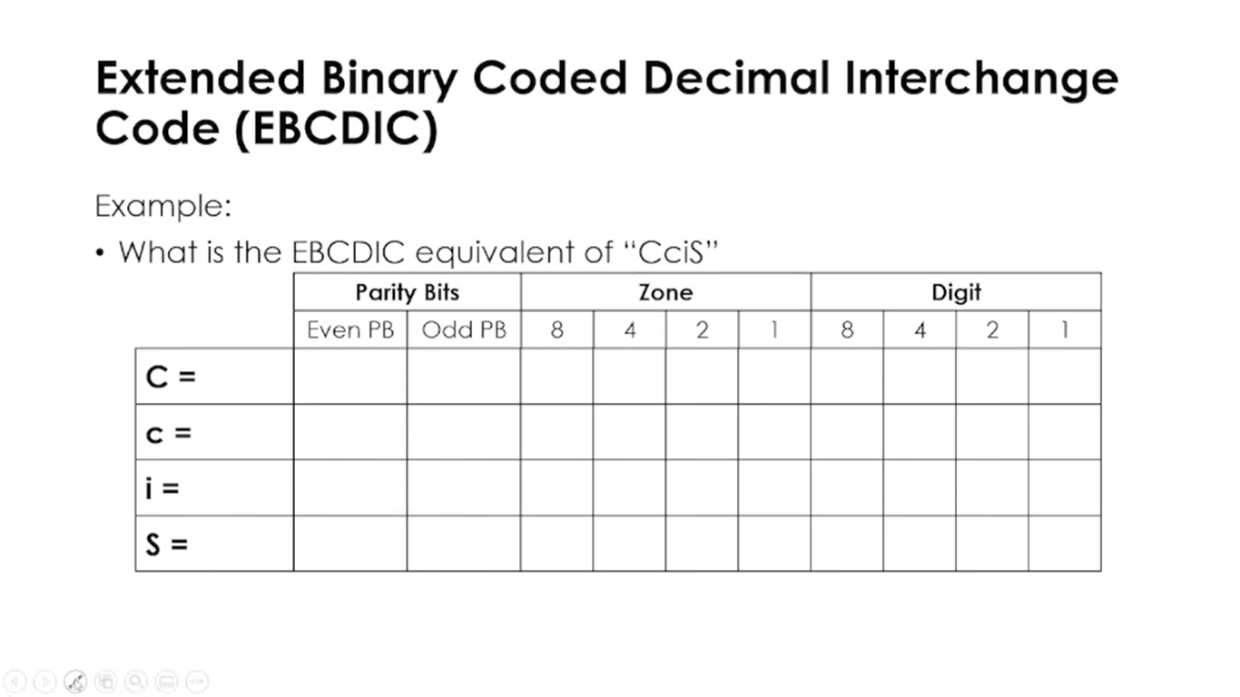

Slide 9
 | Parity Bits |  | Zone |  |  |  | Digit
 | Even PB | Odd PB | 64 | 32 | 16 | 8 | 8 | 4 | 2 | 1
C (12,3) | 0 | 1 | 1 | 1 | 0 | 0 | 0 | 0 | 1 | 1
c (8,3) | 1 | 0 | 1 | 0 | 0 | 0 | 0 | 0 | 1 | 1
i (8,9) | 1 | 0 | 1 | 0 | 0 | 0 | 1 | 0 | 0 | 1
S (14,2) | 0 | 1 | 1 | 1 | 1 | 0 | 0 | 0 | 1 | 0

Slide 10
Thank You
Thank You

