Slide 1
Instruction and Instruction Sequencing
Notes:
1

Slide 2
INSTRUCTION SET ARCHITECTURE:-Complete instruction set of the processor
BASIC 4 TYPES OF OPERATION:-
Data transfer between memory and processor register
Arithmetic and logic operation
Program sequencing and control
I/O transfer

Slide 3
Register transfer notation (RTN)
Transfer between processor registers & memory, between processor register & I/O devices
Memory locations, registers and I/O register names are identified by a symbolic name in uppercase alphabets
LOC,PLACE,MEM are the address of memory location
R1 , R2,… are processor registers
DATA_IN, DATA_OUT are I/O registers

Slide 4
Contents of location is indicated by using square brackets [ ]
RHS of RTN always denotes a values, and is called Source
LHS of RTN always denotes a symbolic name where value is to be stored and is called destination
Source contents are not modified
Destination contents are overwritten

Slide 5
Examples of RTN statements
R2 [LOCN]
R4 [R3] +[R2]

Slide 6
ASSEMBLY LANGUAGE NOTATION (ALN)
RTN is easy to understand and but cannot be used to represent machine instructions
Mnemonics can be converted to machine language, which processor understands using assembler
Eg:
MOVE LOCN, R2
ADD R3, R2, R4

Slide 7
TYPES OF INSTRUCTION
Three address instruction
Syntax: Operation source 1, source 2, destination
Eg: ADD D,E,F where D,E,F are memory location
Advantage: Single instruction can perform the complete operation
Disadvantage : Instruction code will be too large to fit in one word location in memory

Slide 8
TWO ADDRESS INSTRUCTION
Syntax : Operation source, destination
Eg: MOVE E,F MOVE D,F
ADD D,F OR ADD E,F
Perform ADD A,B,C using 2 instructions
MOVE B,C
ADD A,C
Disadvantage: Single instruction is not sufficient to perform the entire operation.

Slide 9
ONE ADDRESS INSTRUCTION
Syntax- Operation source/destination
In this type either a source or destination operand is mentioned in the instruction
Other operand is implied to be a processor register called Accumulator
Eg: ADD B (general)
Load D; ACC [memlocation _D]
ADD E; ACC (ACC) +(E)
STORE F; memlocation_ F (ACC )

Slide 10
Zero address instruction
Location of all operands are defined implicitly
Operands are stored in a structure called pushdown stack

Slide 11
Continued
If processor supports ALU operations one data in memory and other in register then the instruction sequence is
MOVE D, Ri
ADD E, Ri
MOVE Ri, F
If processor supports ALU operations only with registers then one has to follow the instruction sequence given below
LOAD D, Ri
LOAD E, Rj
ADD Ri, Rj
MOVE Rj, F

Slide 12
Instruction Formats
Example: Evaluate X=(A+B) ∗ (C+D)
Three-Address
ADD R1, A, B ; R1 ← M[A] + M[B]
ADD R2, C, D ; R2 ← M[C] + M[D]
MUL X, R1, R2 ; M[X] ← R1 ∗ R2

Slide 13
Instruction Formats
Example: Evaluate X=(A+B) ∗ (C+D)
Two-Address
MOV R1, A ; R1 ← M[A]
ADD R1, B ; R1 ← R1 + M[B]
MOV R2, C ; R2 ← M[C]
ADD R2, D ; R2 ← R2 + M[D]
MUL R1, R2 ; R1 ← R1 ∗ R2
MOV X, R1 ; M[X] ← R1

Slide 14
Instruction Formats
Example: Evaluate X=(A+B) ∗ (C+D)
One-Address
LOAD A ; AC ← M[A]
ADD B ; AC ← AC + M[B]
STORE T ; M[T] ← AC
LOAD C ; AC ← M[C]
ADD D ; AC ← AC + M[D]
MUL T ; AC ← AC ∗ M[T]
STORE X ; M[X] ← AC

Slide 15
Instruction Formats
Example: Evaluate X=(A+B) ∗ (C+D)
Zero-Address
PUSH A ; TOS ← A
PUSH B ; TOS ← B
ADD ; TOS ← (A + B)
PUSH C ; TOS ← C
PUSH D ; TOS ← D
ADD ; TOS ← (C + D)
MUL ; TOS ← (C+D)∗(A+B)
POP X ; M[X] ← TOS

Slide 16
Basic Instruction Cycle
Basic computer operation cycle
Fetch the instruction from memory into a control register (PC)
Decode the instruction
Locate the operands used by the instruction
Fetch operands from memory (if necessary)
Execute the operation in processor registers
Store the results in the proper place
Go back to step 1 to fetch the next instruction

Slide 17
INSTRUCTION EXECUTION & STRIAGHT LINE SEQUENCING
Address
Contents
}3-instruction program segment
Begin execution here i
i+4
i+8
Move A,R0
Add B,R0
Move R0,C
. . .
. . .
. .
A
B
Data for Program
C [A]+[B]
C
Notes:
}

Slide 18
PC – Program counter: hold the address of the next instruction to be executed
Straight line sequencing: If fetching and executing of instructions is carried out one by one from successive addresses of memory, it is called straight line sequencing.
Major two phase of instruction execution
Instruction fetch phase: Instruction is fetched form memory and is placed in instruction register IR
Instruction execute phase: Contents of IR is decoded and processor carries out the operation either by reading data from memory or registers.

Slide 19
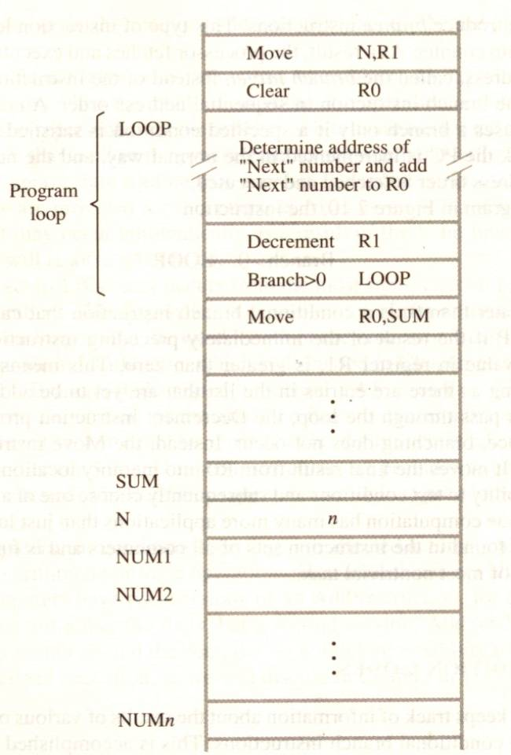
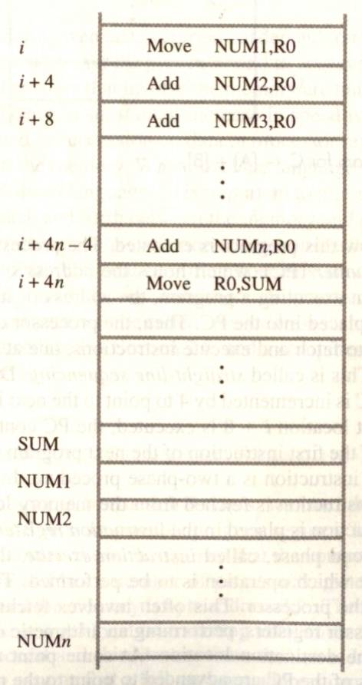
BRANCHING
A straight line program for adding n numbers
Using a loop to add n numbers

Slide 20
BRANCHING
Branch instruction are those which changes the normal sequence of execution.
Sequence can be changed either conditionally or unconditionally.
Accordingly we have conditional branch instructions and unconditional branch instruction.
Conditional branch instruction changes the sequence only when certain conditions are met.
Unconditional branch instruction changes the sequence of execution irrespective of condition of the results.

Slide 21
CONDITION CODES
CONDITIONAL CODE FLAGS: The processor keeps track of information about the results of various operations for use by subsequent conditional branch instructions
N – Negative 1 if results are Negative
0 if results are Positive
Z – Zero 1 if results are Zero
0 if results are Non zero
V – Overflow 1 if arithmetic overflow occurs
0 non overflow occurs
C – Carry 1 if carry and from MSB bit
0 if there is no carry from MSB bit

Slide 22
Conditional Branch Instructions
A: 1 1 1 1 0 0 0 0
Example:
A: 1 1 1 1 0 0 0 0
B: 0 0 0 1 0 1 0 0
+(−B): 1 1 1 0 1 1 0 0
1 1 0 1 1 1 0 0
C = 1
Z = 0
S = 1
V = 0

Slide 23
Overflow occurs when the magnitude of a number exceeds the range allowed by the size of the bit field

Slide 24
Status Bits
C_{n-1}
A
B
C_{n}
ALU
F
V
Z
S
C
F_{n-1}
Zero Check

Slide 25
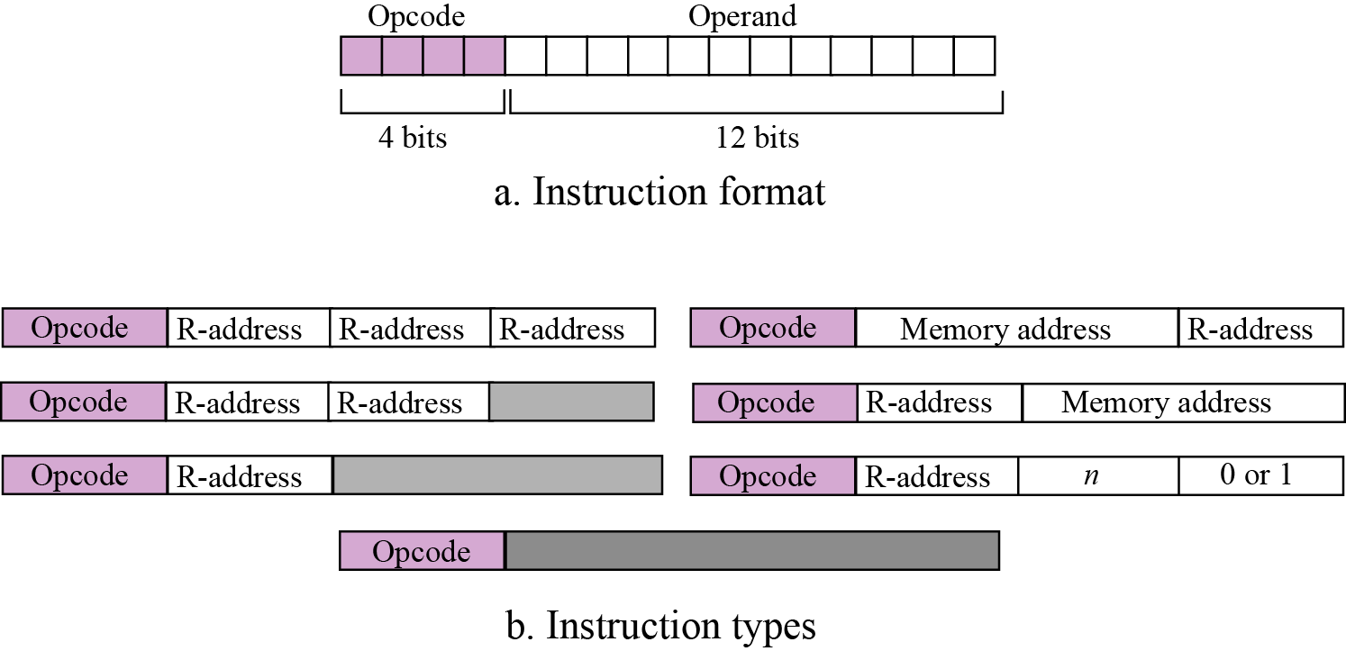
Figure Format and different instruction types

Slide 26
Processing the instructions
Simple computer, like most computers, uses machine cycles.
A cycle is made of three phases: fetch, decode and execute.
During the fetch phase, the instruction whose address is determined by the PC is obtained from the memory and loaded into the IR. The PC is then incremented to point to the next instruction.
During the decode phase, the instruction in IR is decoded and the required operands are fetched from the register or from memory.
During the execute phase, the instruction is executed and the results are placed in the appropriate memory location or the register.
Once the third phase is completed, the control unit starts the cycle again, but now the PC is pointing to the next instruction.
The process continues until the CPU reaches a HALT instruction.

Slide 27
Types of Addressing Modes
The different ways in which the location of the operand is specified in an instruction are referred to as addressing modes
Immediate Addressing
Direct Addressing
Indirect Addressing
Register Addressing
Register Indirect Addressing
Relative Addressing
Indexed Addressing

Slide 28
Immediate Addressing
Operand is given explicitly in the instruction
Operand = Value
e.g. ADD 5
Add 5 to contents of accumulator
5 is operand
No memory reference to fetch data
Fast
Limited range
Instruction
opcode
operand

Slide 29
Direct Addressing
Address field contains address of operand
Effective address (EA) = address field (A)
e.g. ADD A
Add contents of cell A to accumulator
Look in memory at address A for operand
Single memory reference to access data
No additional calculations to work out effective address
Limited address space

Slide 30
Direct Addressing Diagram
Instruction
Opcode
Address A
Memory
Operand
Notes:
6

Slide 31
Indirect Addressing (1)
Memory cell pointed to by address field contains the address of (pointer to) the operand
EA = [A]
Look in A, find address (A) and look there for operand
e.g. ADD (A)
Add contents of cell pointed to by contents of A to accumulator
Notes:
7

Slide 32
Indirect Addressing (2)
Large address space
2^{n} where n = word length
May be nested, multilevel, cascaded
e.g. EA = (((A)))
Draw the diagram yourself
Multiple memory accesses to find operand
Hence slower
Notes:
8

Slide 33
Indirect Addressing Diagram
Instruction
Opcode
Address A
Memory
Pointer to operand
Operand
Notes:
9

Slide 34
Register Addressing (1)
Operand is held in register named in address field
EA = R
Limited number of registers
Very small address field needed
Shorter instructions
Faster instruction fetch
Notes:
10

Slide 35
Register Addressing (2)
No memory access
Very fast execution
Very limited address space
Multiple registers helps performance
Requires good assembly programming or compiler writing
Notes:
11

Slide 36
Register Addressing Diagram
Instruction
Opcode
Register Address R
Registers
Operand
Notes:
12

Slide 37
Register Indirect Addressing
C.f. indirect addressing
EA = [R]
Operand is in memory cell pointed to by contents of register R
Large address space (2^{n})
One fewer memory access than indirect addressing
Notes:
13

Slide 38
Register Indirect Addressing Diagram
Instruction
Opcode
Register Address R
Memory
Registers
Pointer to Operand
Operand
Notes:
14

Slide 39
Indexed Addressing
EA = X + [R]
Address field hold two values
X = constant value (offset)
R = register that holds address of memory locations
or vice versa
(Offset given as constant or in the index register)
Add 20(R1),R2 or Add 1000(R1),R2
Notes:
15

Slide 40
Indexed Addressing Diagram
Instruction
Opcode
Register R
Constant Value
Memory
Registers
Pointer to Operand
+
Operand
Notes:
16

Slide 41
Relative Addressing
A version of displacement addressing
R = Program counter, PC
EA = X + (PC)
i.e. get operand from X bytes away from current location pointed to by PC
c.f locality of reference & cache usage
Notes:
17

Slide 42
Auto increment mode
The effective address of the operand is the contents of a register specified in the instruction.
After accessing the operand, the contents of this register are automatically incremented to point to the next item in the list
EA=[Ri]; Increment Ri ---- (Ri)+
Eg: Add (R2)+,R0

Slide 43
Auto decrement mode
The contents of a register specified in the instruction are first automatically decremented and are then used as the effective address of the operand
Decrement Ri; EA= [Ri] ----- -(Ri)

