Slide 1
MODULE 3 - Fundamentals of Computer Architecture Instruction Sets: Characteristics and Functions
Dr. A. Bhuvaneswari
Assistant Professor Sr.
VIT Chennai

Slide 2
Instruction Set Architecture
Software
Instruction Set
Hardware

Slide 3
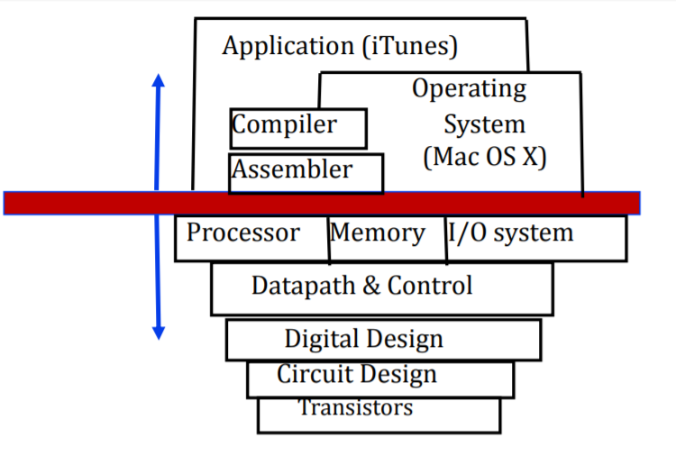
ISA…

Slide 4
Elements of an ISA…
Instructions
Instruction Formats
Addressing Modes
Condition Codes
Instruction sets

Slide 5
What is an Instruction Set?
The complete collection of instructions that are understood by a CPU
Machine Code
Binary
Usually represented by assembly codes
Notes:
2

Slide 6
Elements of an Instruction
Operation code (Op code)
Do this
Source Operand reference
To this
Result Operand reference
Put the answer here
Next Instruction Reference
When you have done that, do this...
Notes:
3

Slide 7
Instruction Representation
In machine code each instruction has a unique bit pattern
For human consumption (well, programmers anyway) a symbolic representation is used
e.g. ADD, SUB, LOAD
Operands can also be represented in this way
ADD A,B
Notes:
5

Slide 8
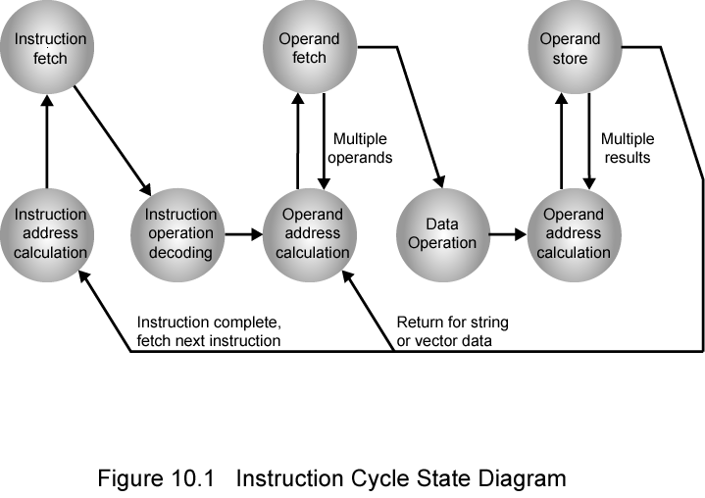
Instruction Cycle State Diagram
Instruction Fetch – Decode-Execute

Slide 9
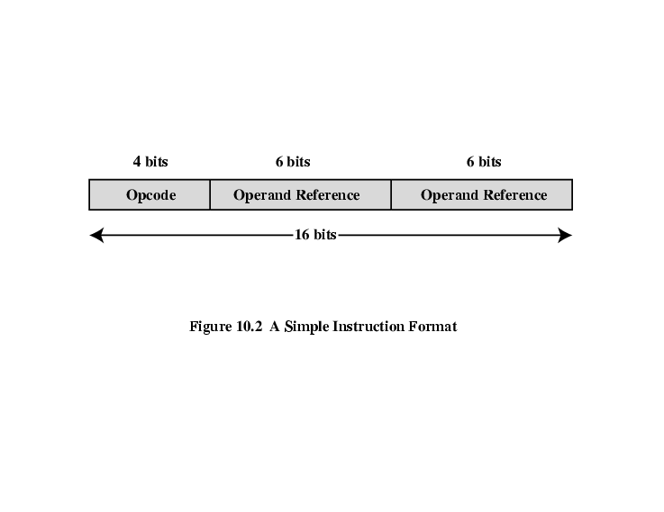
Simple Instruction Format

Slide 10
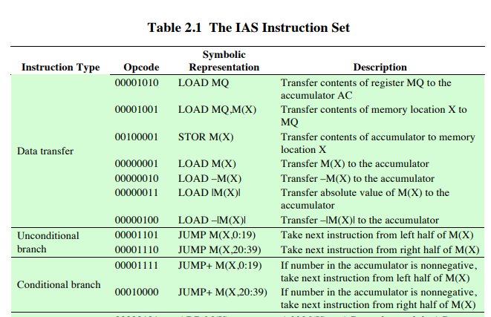

Slide 11
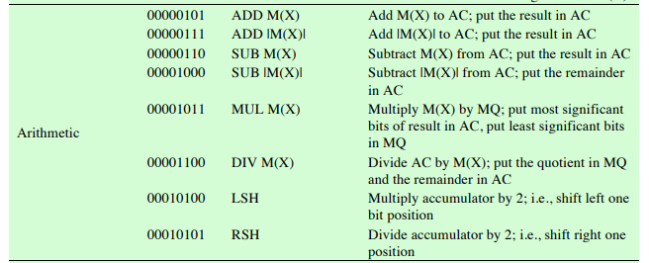

Slide 12
Instruction Types
Data processing
Data storage (main memory)
Data movement (I/O)
Program flow control
Notes:
6

Slide 13
INSTRUCTION FORMATS

Slide 14
Number of Addresses (a)
3 addresses
Operand 1, Operand 2, Result
a = b + c;
May be a forth - next instruction (usually implicit)
Not common
Needs very long words to hold everything
Notes:
7

Slide 15
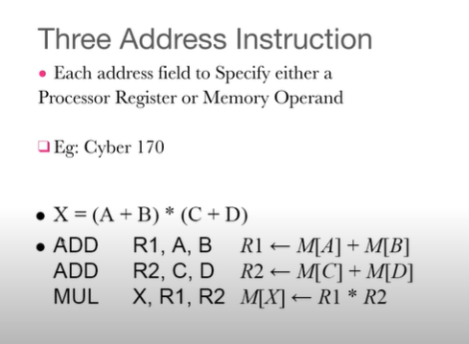

Slide 16
Number of Addresses (b)
2 addresses
One address doubles as operand and result
a = a + b
Reduces length of instruction
Requires some extra work
Temporary storage to hold some results
Notes:
8

Slide 17
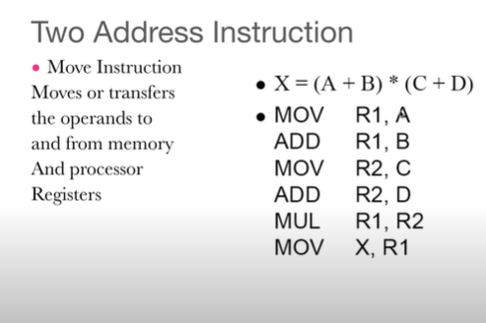

Slide 18
Number of Addresses (c)
1 address
Implicit second address
Usually a register (accumulator)
Common on early machines
Notes:
9

Slide 19
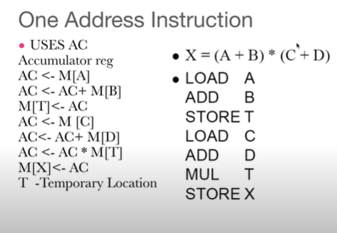

Slide 20
Number of Addresses (d)
0 (zero) addresses
All addresses implicit
Uses a stack
e.g. push a
push b
add
pop c
c = a + b
Notes:
10

Slide 21
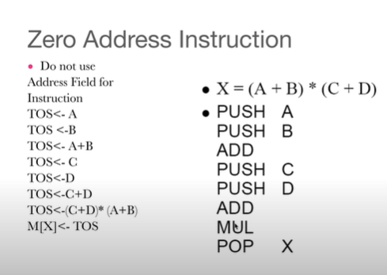

Slide 22
Characteristics of good ISA
Must be Clear
Less usage of complex instructions
Ease of compilation
Ease of implementation

Slide 23
Instruction Formats…
A machine has 24 bits instruction format. It has 32 registers and each of which is 32 bit long. It needs to support 49 instructions. Each instruction has two register operands and one immediate operand. If the immediate operand is signed integer, then the minimum value of it can be ________?

Slide 24
Instruction Formats…
A machine has 24 bits instruction format. It has 32 registers and each of which is 32 bit long. It needs to support 49 instructions. Each instruction has two register operands and one immediate operand. If the immediate operand is signed integer, then the minimum value of it can be ________?
Instruction = 24bits (opcode,reg1,reg2,immediate_operand)
Opcode implies the instruction number => 49 instructions can be represented using 6bits (2⁶=64 instructions and 2⁵=32 instructions )
32 Registers can be represented using 5bits (2⁵=32)
2 registers in instruction = 10 bits
Immediate operand = 8 bits (24-6-5-5)
Signed integer for immediate operand hence range = -128 to 127
Hence, minimum value = -128

Slide 25
Addressing Modes

Slide 26
Prerequisite - Introduction to parts of CPU
Arithmetic and Logic Unit (ALU)
It performs all the arithmetic and logical micro operations.
Floating Point Unit (FPU)
It performs operations on floating point numbers.
Memory Unit (MU)
It stores the set of instructions.
Control Unit (CU)
It supervises the sequence of micro operations.
Registers
Temporary storage area, which holds the data during the execution of an instruction.
CU
REGISTERS
ALU
FPU
MU

Slide 27
Prerequisite - Registers inside CPU
Accumulator
Flag Register / Program Status Word (PSW)
A (8-bit)
S | Z |  | A C |  | P |  | C Y
S = Sign, Z = Zero, CY = Carry, AC = Auxiliary Carry, P = Parity,
B (8-bit)
C (8-bit)
D (8-bit)
E (8-bit)
General Purpose Registers
H (8-bit)
L (8-bit)
PC (16-bit)
Index Registers
SP (16-bit)

Slide 28
Addressing Modes
Microprocessor executes the instructions stored in memory (RAM).
It executes one instruction at a time.
Each of the instruction contains operations and operands.
Operation specifies the type of action to be performed.
For example: ADD, SUB, MOV, INC, LOAD, STORE
Operands are the data on which the operation is to be performed.
MOV B, A ADD B
Here MOV is operation and (B & A) are operands.
Here ADD is operation and (B) is operand.

Slide 29
Addressing Modes
Operand can be place either in one of the processor register or in
memory.
There are different ways to get the operands.
The way in which the operand is taken from register or memory is named as addressing mode.

Slide 30
Addressing Modes
Immediate Addressing Mode
Register Addressing Mode
Register Indirect Addressing Mode
Direct Addressing Mode
Indirect Addressing Mode
Implied Addressing Mode
Relative Addressing Mode
Indexed Addressing Mode
Base Register Addressing Mode
Autoincrement or Autodecrement Addressing Mode

Slide 31
1. Immediate Addressing Mode
The operand is specified with in the instruction.
Operand itself is provided in the instruction rather than its address.
Move Immediate
MVI A , 15h A ← 15h
Here 15h is the immediate operand
Add Immediate
ADI 3Eh
A ← A + 3Eh
Here 3Eh is the immediate operand

Slide 32
2. Register Addressing Mode
The operand is specified with in one of the processor register.
Instruction specifies the register in which the operand is stored.
Move
C ← A Here A is the operand specified in register
MOV C , A
Add
Here B is the operand specified in register
ADD B
A ← A + B

Slide 33
3. Register Indirect Addressing Mode
The instruction specifies the register in which the memory address of operand is placed.
It do not specify the operand itself but its location with in the memory where operand is placed.
Move
A ← [[H][L]]
MOV A , M
It moves the data from memory location specified by HL register pair to A.

Slide 34
3. Register Indirect Addressing Mode
MOV A , M A ← [[H][L]]
It moves the data from memory location specified by HL register pair to A.
Before After
A
2807
2806
2805 | A9
2804
2803
2802
2801
2800
A | A9
2807
2806
2805 | A9
2804
2803
2802
2801
2800
H | 28
H | 28
L | 05
L | 05
A ← [2805]
A ← A9

Slide 35
4. Direct Addressing Mode
The instruction specifies the direct address of the operand.
The memory address is specified where the actual operand is.
Load Accumulator
LDA 2805h A ← [2805]
It loads the data from memory location 2805 to A.
Store Accumulator
STA 2803h [2803] ← A
It stores the data from A to memory location 2803.

Slide 36
4. Direct Addressing Mode
LDA 2805h A ← [2805]
It loads the data from memory location 2805 to A.
Before After
A
2807
2806
2805 | 5C
2804
2803
2802
2801
2800
A | 5C
2807
2806
2805 | 5C
2804
2803
2802
2801
2800
A ← [2805]
A ← 5C

Slide 37
4. Direct Addressing Mode
STA 2803h [2803] ← A
It stores the data from A to memory location 2803.
Before After
A | 9B
2807
2806
2805
2804
2803
2802
2801
2800
A | 9B
2807
2806
2805
2804
2803 | 9B
2802
2801
2800
[2803] ← A
[2803] ← 9B

Slide 38
5. Indirect Addressing Mode
The instruction specifies the indirect address where the effective address of the operand is placed.
The memory address is specified where the actual address of operand is placed.
Move
MOV A, 2802h A ← [[2802]]
It moves the data from memory location specified by the location 2802 to A.

Slide 39
5. Indirect Addressing Mode
MOV A, 2802h A ← [[2802]]
It moves the data from memory location specified by the location 2802 to A.
Before After
A
2807
2806 | FF
2805
2804
2803 | 06
2802 | 28
2801
2800
A | FF
2807
2806 | FF
2805
2804
2803 | 06
2802 | 28
2801
2800
A ← [[2802]]
A ← FF

Slide 40
6. Implied Addressing Mode
It is also called inherent addressing mode.
The operand is implied by the instruction.
The operand is hidden/fixed inside the instruction.
Complement Accumulator CMA
(Here accumulator A is implied by the instruction)
Complement Carry Flag CMC
(Here Flags register is implied by the instruction)
Set Carry Flag STC
(Here Flags register is implied by the instruction)

Slide 41
7. Relative Addressing Mode
In relative addressing mode, contents of Program Counter PC is added to address part of instruction to obtain effective address.
The address part of the instruction is called as offset and it can +ve or –ve.
When the offset is added to the PC the resultant number is the memory location where the operand will be placed.

Slide 42
7. Relative Addressing Mode
2807 | 22
2806 | FF
2805 | 6D
2804 | 59
2803 | 08
2802 | 2E
2801 | F3
2800 | 9F
2807 | 22
2806 | FF
2805 | 6D
2804 | 59
2803 | 08
2802 | 2E
2801 | F3
2800 | 9F
Actual Operand
Offset = 04h
PC | 2801
Effective address of operand = PC + 01 + offset
Effective address of operand = 2801 + 01 + 04

Slide 43
7. Relative Addressing Mode
2807 | 22
2806 | FF
2805 | 6D
2804 | 59
2803 | 08
2802 | 2E
2801 | F3
2800 | 9F
2807 | 22
2806 | FF
2805 | 6D
2804 | 59
2803 | 08
2802 | 2E
2801 | F3
2800 | 9F
Actual Operand
Offset = 03h
PC | 2803
Effective address of operand = PC + 01 + offset
Effective address of operand = 2803 + 01 + 03

Slide 44
8. Indexed Addressing Mode
In index addressing mode, contents of Index register is added to address part of instruction to obtain effective address.
The address part of instruction holds the beginning/base address and is called as base.
The index register hold the index value, which is +ve.
Base remains same, the index changes.
When the base is added to the index register the resultant number is the memory location where the operand will be placed.

Slide 45
8. Indexed Addressing Mode
Base = 2800h
Effective address of operand = Base + IX
2807 | 22
2806 | FF
2805 | 6D
2804 | 59
2803 | 08
2802 | 2E
2801 | F3
2800 | 9F
2807 | 22
2806 | FF
2805 | 6D
2804 | 59
2803 | 08
2802 | 2E
2801 | F3
2800 | 9F
2807 | 22
2806 | FF
2805 | 6D
2804 | 59
2803 | 08
2802 | 2E
2801 | F3
2800 | 9F
2807 | 22
2806 | FF
2805 | 6D
2804 | 59
2803 | 08
2802 | 2E
2801 | F3
2800 | 9F
IX | 0000
IX | 0001
IX | 0002
IX | 0003
2800h + 0000h = 2800h
2800h + 0001h = 2801h
2800h + 0002h = 2802h
2800h + 0003h = 2803h

Slide 46
8. Indexed Addressing Mode
Base = 2802h
Effective address of operand = Base + IX
2807 | 22
2806 | FF
2805 | 6D
2804 | 59
2803 | 08
2802 | 2E
2801 | F3
2800 | 9F
2807 | 22
2806 | FF
2805 | 6D
2804 | 59
2803 | 08
2802 | 2E
2801 | F3
2800 | 9F
2807 | 22
2806 | FF
2805 | 6D
2804 | 59
2803 | 08
2802 | 2E
2801 | F3
2800 | 9F
2807 | 22
2806 | FF
2805 | 6D
2804 | 59
2803 | 08
2802 | 2E
2801 | F3
2800 | 9F
IX | 0000
IX | 0001
IX | 0002
IX | 0003
2802h + 0000h = 2802h
2802h + 0001h = 2803h
2802h + 0002h = 2804h
2802h + 0003h = 2805h

Slide 47
9. Base Register Addressing Mode
In base register addressing mode, contents of base register is added to address part of instruction to obtain effective address.
It is similar to the indexed addressing mode except the register now is called as base instead of index.
The base register hold the beginning/base address.
The address part of instruction holds the offset.
Offset remains same, the base changes.
When the offset is added to the base register the resultant number is the memory location where the operand will be placed.

Slide 48
9. Base Register Addressing Mode
Offset= 0001h
Effective address of operand = Base Register + offset
2807 | 22
2806 | FF
2805 | 6D
2804 | 59
2803 | 08
2802 | 2E
2801 | F3
2800 | 9F
2807 | 22
2806 | FF
2805 | 6D
2804 | 59
2803 | 08
2802 | 2E
2801 | F3
2800 | 9F
2807 | 22
2806 | FF
2805 | 6D
2804 | 59
2803 | 08
2802 | 2E
2801 | F3
2800 | 9F
2807 | 22
2806 | FF
2805 | 6D
2804 | 59
2803 | 08
2802 | 2E
2801 | F3
2800 | 9F
Base | 2800
Base | 2801
Base | 2802
Base | 2803
2800h + 0001h = 2801h
2801h + 0001h = 2802h
2802h + 0001h = 2803h
2803h + 0001h = 2804h

Slide 49
9. Base Register Addressing Mode
Offset= 0003h
Effective address of operand = Base Register + offset
2807 | 22
2806 | FF
2805 | 6D
2804 | 59
2803 | 08
2802 | 2E
2801 | F3
2800 | 9F
2807 | 22
2806 | FF
2805 | 6D
2804 | 59
2803 | 08
2802 | 2E
2801 | F3
2800 | 9F
2807 | 22
2806 | FF
2805 | 6D
2804 | 59
2803 | 08
2802 | 2E
2801 | F3
2800 | 9F
2807 | 22
2806 | FF
2805 | 6D
2804 | 59
2803 | 08
2802 | 2E
2801 | F3
2800 | 9F
Base | 2800
Base | 2801
Base | 2802
Base | 2803
2800h + 0003h = 2803h
2801h + 0003h = 2804h
2802h + 0003h = 2805h
2803h + 0003h = 2806h

Slide 50
10. Autoincrement or Autodecrement Addressing Mode
It is similar to register indirect addressing mode.
Here the register is incremented or decremented before or after its value is used.

Slide 51
10. Autoincrement or Autodecrement Addressing Mode
HL pair incremented after its value is used
At start:
HL | 2802
2807 | 22
2806 | FF
2805 | 6D
2804 | 59
2803 | 08
2802 | 2E
2801 | F3
2800 | 9F
2807 | 22
2806 | FF
2805 | 6D
2804 | 59
2803 | 08
2802 | 2E
2801 | F3
2800 | 9F
2807 | 22
2806 | FF
2805 | 6D
2804 | 59
2803 | 08
2802 | 2E
2801 | F3
2800 | 9F
2807 | 22
2806 | FF
2805 | 6D
2804 | 59
2803 | 08
2802 | 2E
2801 | F3
2800 | 9F
HL | 2802
HL | 2803
HL | 2804
HL | 2805
1st Time
2nd Time
3rd Time
4th Time

Slide 52
10. Autoincrement or Autodecrement Addressing Mode
HL pair incremented before its value is used
At start:
HL | 2803
2807 | 22
2806 | FF
2805 | 6D
2804 | 59
2803 | 08
2802 | 2E
2801 | F3
2800 | 9F
2807 | 22
2806 | FF
2805 | 6D
2804 | 59
2803 | 08
2802 | 2E
2801 | F3
2800 | 9F
2807 | 22
2806 | FF
2805 | 6D
2804 | 59
2803 | 08
2802 | 2E
2801 | F3
2800 | 9F
2807 | 22
2806 | FF
2805 | 6D
2804 | 59
2803 | 08
2802 | 2E
2801 | F3
2800 | 9F
HL | 2804
HL | 2805
HL | 2806
HL | 2807
1st Time
2nd Time
3rd Time
4th Time

Slide 53
Discussion problem
Address
200
201
202
Memory
PC | 200
Load to AC | Mode
Address = 500
Next Instruction
450
700
800
900
325
300
PC = Program Counter R1 = Register
XR = Index Register AC = Accumulator
R1 | 400
XR | 100
399
400
Memory is having first instruction to load AC
Mode will specify the addressing mode to get operand.
Address field of instruction is 500.
AC
500
600
Find out the effective address of operand and operand value by considering different addressing modes.
702
800

Slide 54
Example problem
Address Memory
200
PC | 200
Load to AC | Mode
Address = 500
Next Instruction
450
700
800
900
325
300
1. Immediate Addressing Mode
R1 | 400
201
As instruction contains immediate number 500.
It is stored as address 201.
202
XR | 100
399
400
AC
Effective Address = 201
Operand = 500
500
600
702
AC | 500
800

Slide 55
Example problem
Address
200
201
202
Memory
PC | 200
Load to AC | Mode
Address = 500
Next Instruction
450
700
800
900
325
300
2. Register Addressing Mode
R1 | 400
Register R1 contains 400.
As operand is in register so no any memory location.
XR | 100
399
400
AC
Effective Address = Nil
Operand = 400
500
600
702
AC | 400
800

Slide 56
Example problem
Address
200
201
202
Memory
PC | 200
Load to AC | Mode
Address = 500
Next Instruction
450
700
800
900
325
300
3. Register Indirect Addressing Mode
R1 | 400
Register R1 contains 400.
So effective address of operand is 400.
The data stored at 400 is 700.
XR | 100
399
AC
400
Effective Address = 400
Operand = 700
500
AC | 700
600
702
800

Slide 57
Example problem
Address
200
201
202
Memory
PC | 200
Load to AC | Mode
Address = 500
Next Instruction
450
700
800
900
325
300
4. Direct Addressing Mode
R1 | 400
Instruction contains the address 500.
So effective address of operand is 500.
The data stored at 500 is 800.
XR | 100
399
400
AC
Effective Address = 500
Operand = 800
500
AC | 800
600
702
800

Slide 58
Example problem
Address
200
201
202
Memory
PC | 200
Load to AC | Mode
Address = 500
Next Instruction
450
700
800
900
325
300
5. Indirect Addressing Mode
R1 | 400
Instruction contains the address 500.
Address at 500 is 800.
So effective address of operand is 800.
The data stored at 800 is 300.
XR | 100
399
400
AC
Effective Address = 800 Operand = 300
500
600
702
AC | 300
800

Slide 59
Example problem
Address
200
201
202
Memory
PC | 200
Load to AC | Mode
Address = 500
Next Instruction
450
700
800
900
325
300
6. Relative Addressing Mode
R1 | 400
PC = 200.
Offset = 500.
Instruction is of 2 bytes.
So effective address = PC + 2 + offset = 200 + 500 +2 = 702 .
The data stored at 702 is 325.
XR | 100
399
400
AC
500
Effective Address = 702 Operand = 325
600
702
AC | 325
800

Slide 60
Example problem
Address
200
201
202
Memory
PC | 200
Load to AC | Mode
Address = 500
Next Instruction
450
700
800
900
325
300
7. Index Addressing Mode
R1 | 400
XR = 100.
Base = 500.
So effective address = Base + XR = 500 + 100 = 600 .
The data stored at 600 is 900.
XR | 100
399
400
AC
Effective Address = 600 Operand = 900
500
600
AC | 900
702
800

Slide 61
Example problem
Address
200
201
202
Memory
PC | 200
Load to AC | Mode
Address = 500
Next Instruction
450
700
800
900
325
300
8. Autoincrement Addressing Mode
R1 | 400
It is same as register indirect addressing mode except the contents of R1 are incremented after the execution.
R1 contains 400.
So effective address of operand is 400.
The data stored at 400 is 700.
XR | 100
399
AC
400
500
Effective Address = 400 Operand = 700
600
702
R1 | 401
AC | 700
800

Slide 62
Example problem
Address
200
201
202
Memory
PC | 200
Load to AC | Mode
Address = 500
Next Instruction
450
700
800
900
325
300
9. Autodecrement Addressing Mode
R1 | 400
It is same as register indirect addressing mode except the contents of R1 are decremented before the execution.
R1 contains 400.
R1 is first decremented to 399.
So effective address of operand is 399.
The data stored at 399 is 450.
XR | 100
399
AC
400
500
600
Effective Address = 399 Operand = 450
702
R1 | 399
800
AC | 450

Slide 63
Solution for problem
Addressing Mode | Effective Address | Operand
Immediate Addressing Mode | 201 | 500
Register Addressing Mode | Nil | 400
Register Indirect Addressing Mode | 400 | 700
Direct Addressing Mode | 500 | 800
Indirect Addressing Mode | 800 | 300
Relative Addressing Mode | 702 | 325
Indexed Addressing Mode | 600 | 900
Autoincrement Addressing Mode | 400 | 700
Autodecrement Addressing Mode | 399 | 450
Ali Asghar Manjotho, Lecturer CSE-MUET

Slide 64
INSTRUCTION TYPES

Slide 65

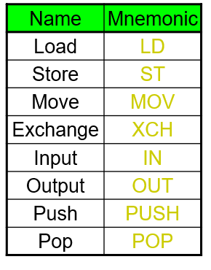
Instruction Types

Slide 66



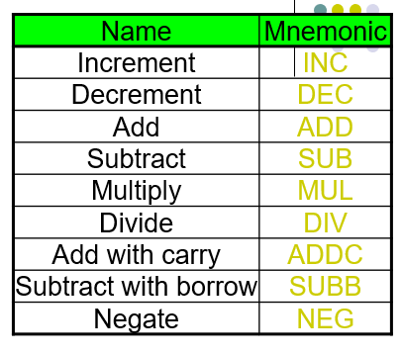
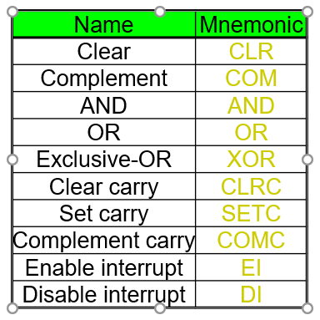
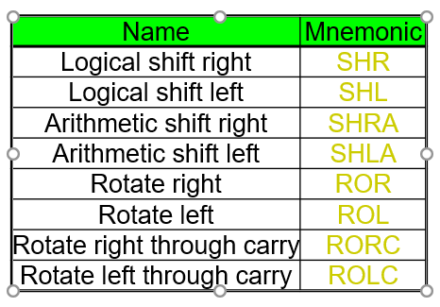
Instruction Types…

Slide 67

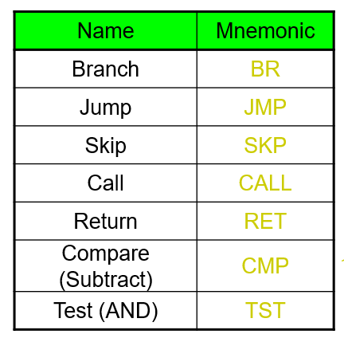
Instruction Types…

Slide 68

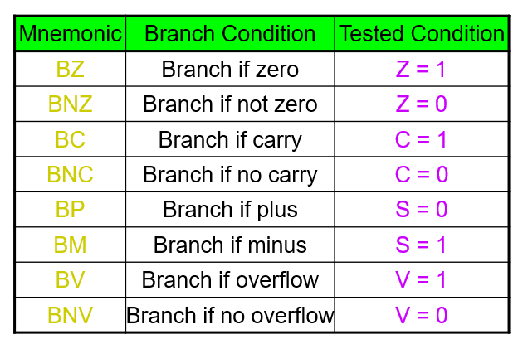
Instruction Types…

