Slide 1
MODULE 3 Fundamentals of computer architecture PART 1A
Dr. R. Girija,
SCOPE,
VIT University, Chennai campus

Slide 2
Fundamentals of Computer Architecture
ISA
Instruction Formats
Instruction types
Addressing Modes
Instruction execution (phases of instruction cycle)
Assembly language programming
Subroutine call and return mechanisms

Slide 3
Instruction Set Architecture
Software
Instruction Set
Hardware

Slide 4
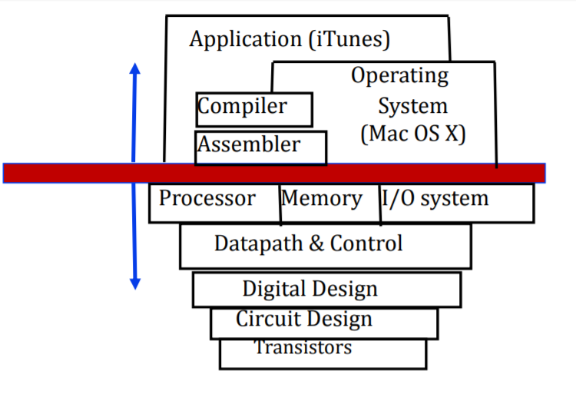
ISA…

Slide 5
Elements of an ISA…
Instructions
Instruction Formats
Addressing Modes
Condition Codes
Instruction sets

Slide 6
Characteristics of good ISA
Must be Clear
Less usage of complex instructions
Ease of compilation
Ease of implementation

Slide 7
INSTRUCTION FORMATS

Slide 8

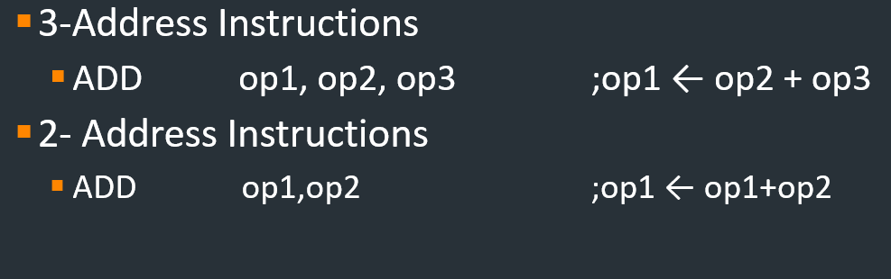
Instruction Formats

Slide 9
Instruction Formats…
1-Address Instructions
INC op1 ;op1 ←op1+1
0-Address Instructions
PUSH A TOS ← A

Slide 10

Instruction Formats…
Estimate this expression using all the instruction formats
$$(A+B)×(C+D)$$

Slide 11
Addressing Mode
Definition
Example: For tracking students names, “LIST” is maintained.
In case, for adding mobile number to student names; then use ‘TABLE’
Organised form: ?
DATA STRUCTURES: includes lists, arrays, linked list…..

Slide 12
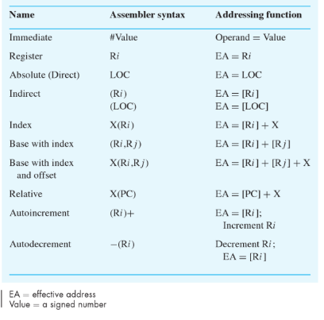
Types of addressing mode
Source: Computer Organization by HAMACHER

Slide 13
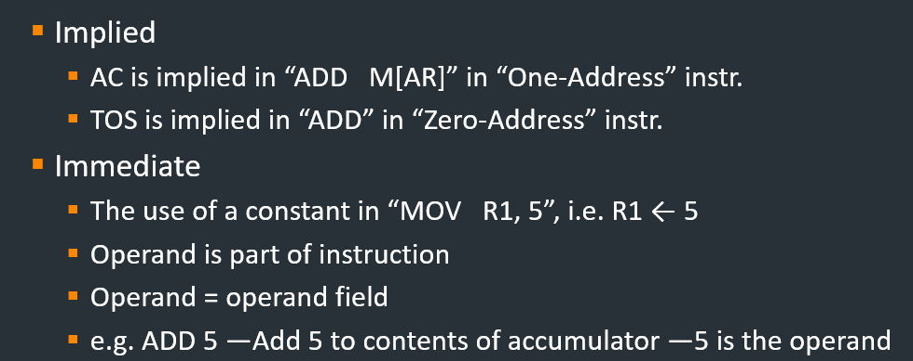
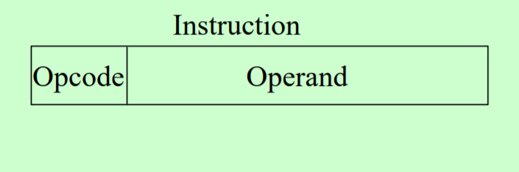
Addressing Modes…

Slide 14
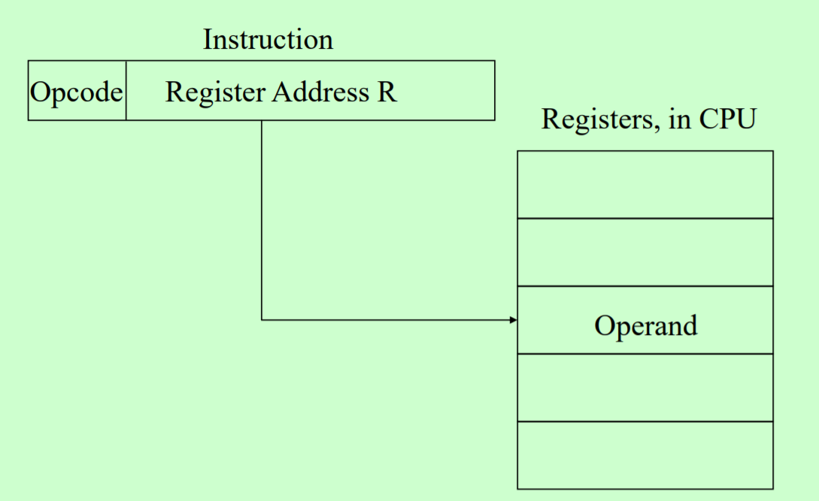
Register Mode
Register
Indicate which register holds the operand
Operand is held in register named in address filed
Effective Address = R

Slide 15
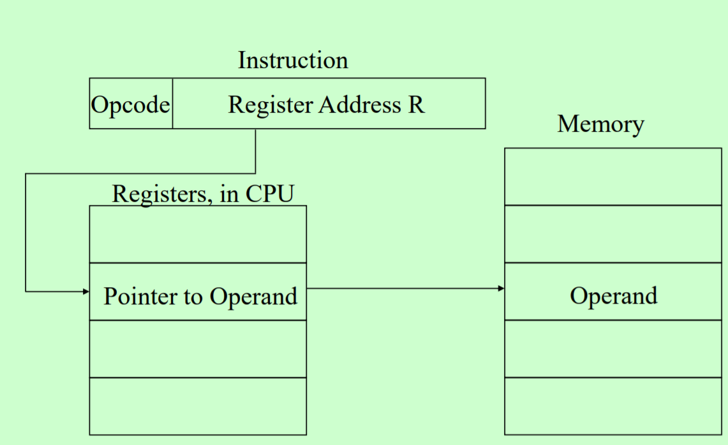
Register Indirect addressing mode

Slide 16
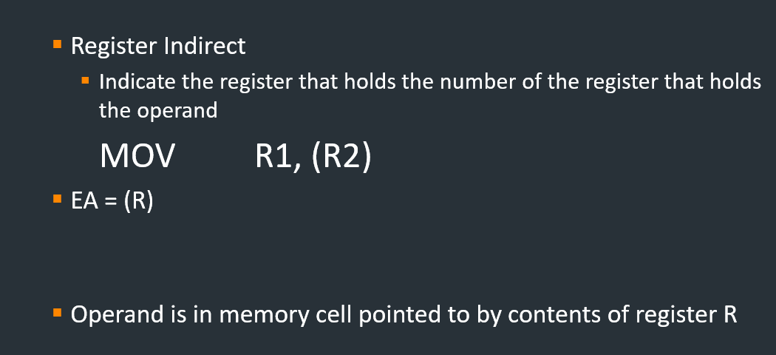
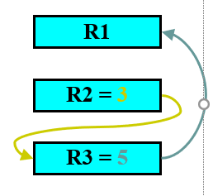
Register Indirect Addressing Mode

Slide 17
Autoincrement/ Autodecrement
Autoincrement / Autodecrement
It gets incremented or decremented by 1.

Slide 18
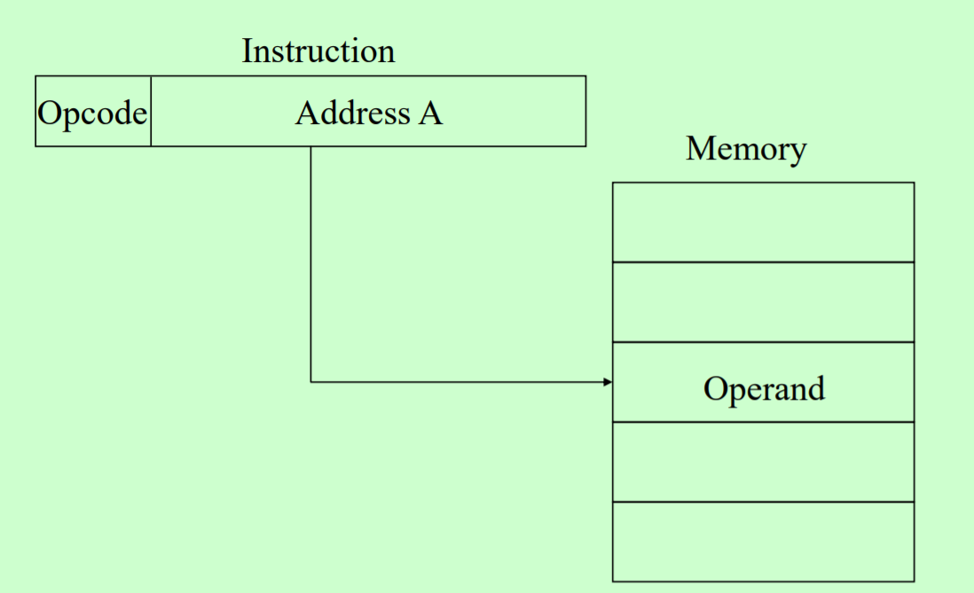
Direct Addressing Mode
Direct addressing mode

Slide 19
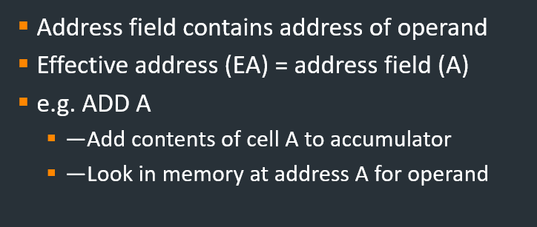
Direct Addressing Mode..

Slide 20

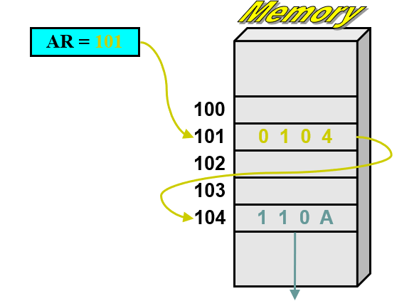
Indirect Addressing Mode

Slide 21
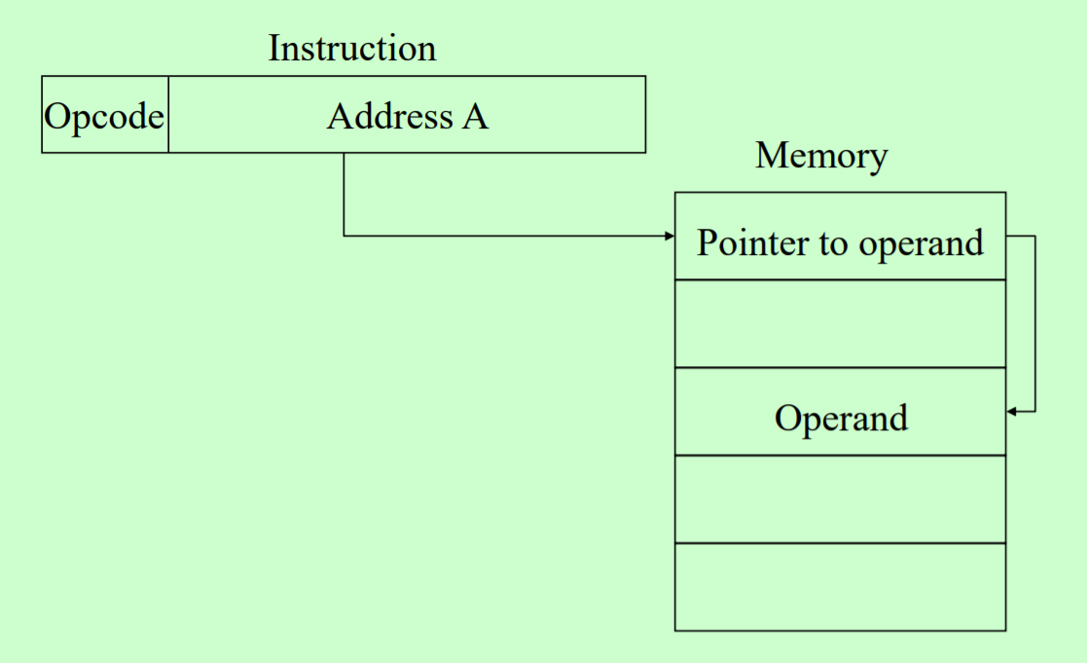
Indirect Addressing Mode

Slide 22
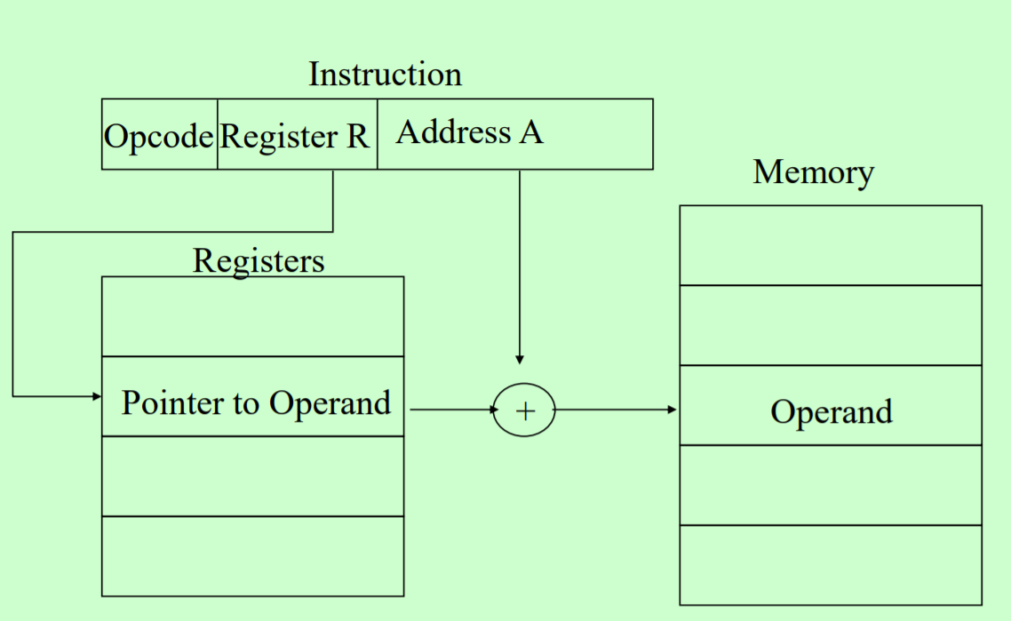
Displacement
—Relative
—Base register
—Indexing

Slide 23
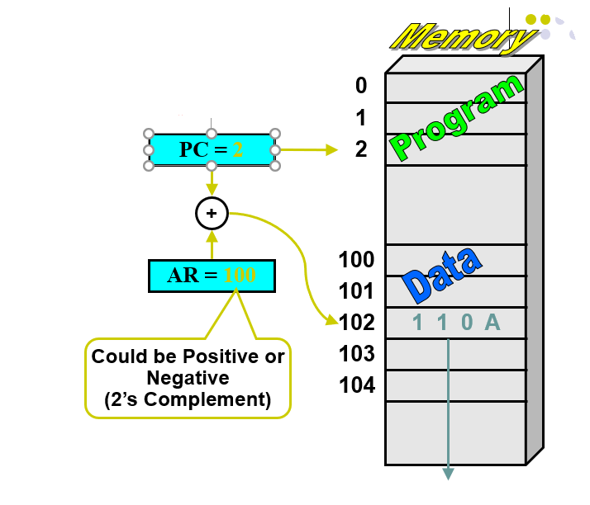
Relative Mode
Relative Address
EA = PC + Relative Addr
1000 ADD r1,r2
1002

Slide 24
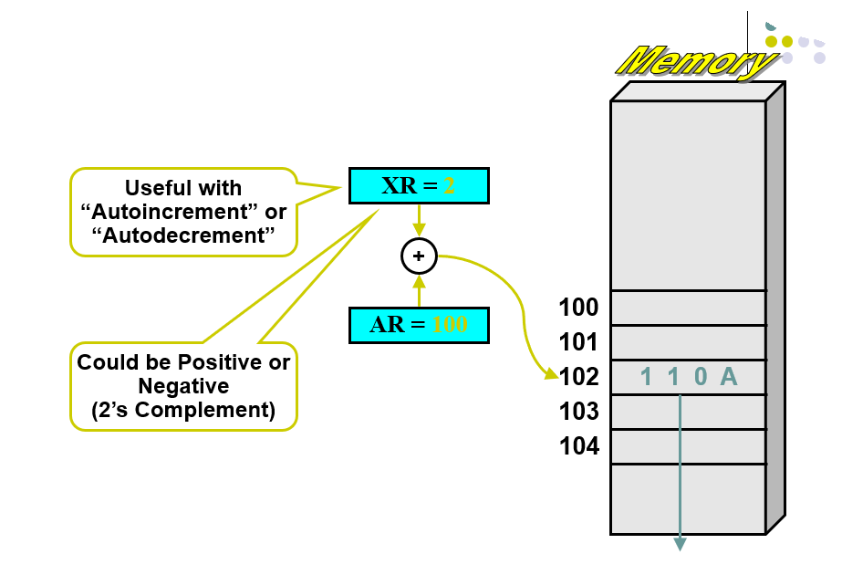
Indexed Mode…
Indexed
EA = Index Register + Relative Addr

Slide 25
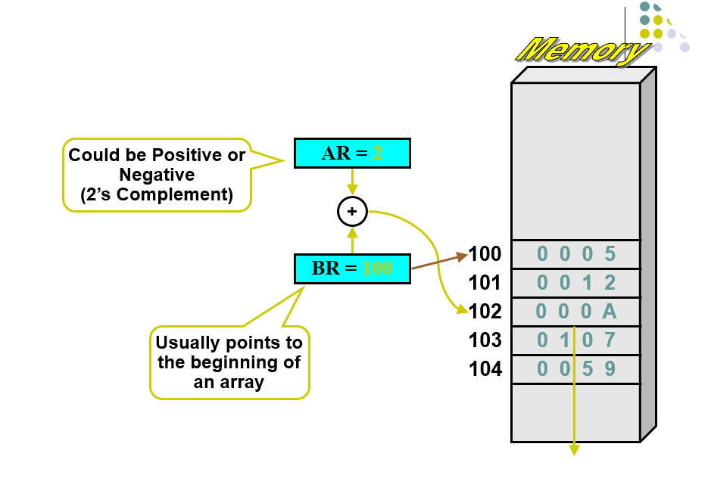
Base Register mode…
BR
EA = BR + Relative Addr

Slide 26
Assembly Language Notation

Slide 27
Assembly Language
It is the format to represent the machine instructions and programs.
MOVE LOC, R1 ;it transfers from memory location LOC to R1
ADD R1, R2, R3 ;Add two numbers placed in R1 and R2;
Sum is placed in R3

Slide 28
INSTRUCTION TYPES

Slide 29

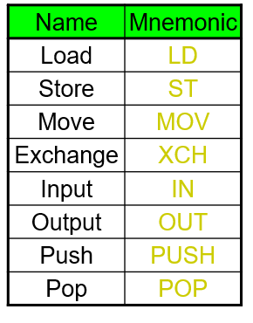
Instruction Types

Slide 30



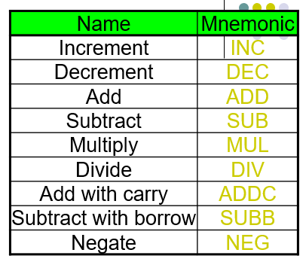
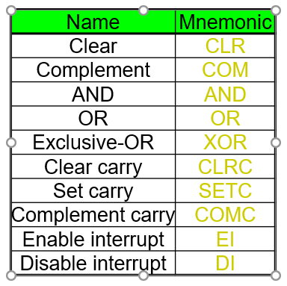
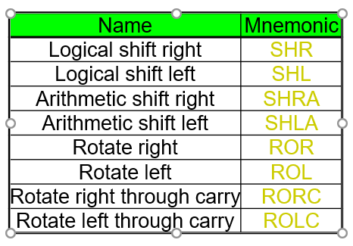
Instruction Types…

Slide 31

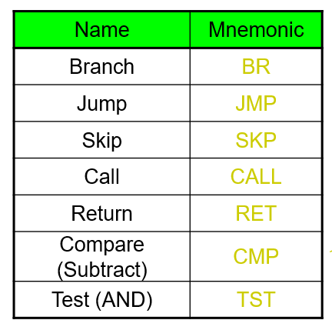
Instruction Types…

Slide 32

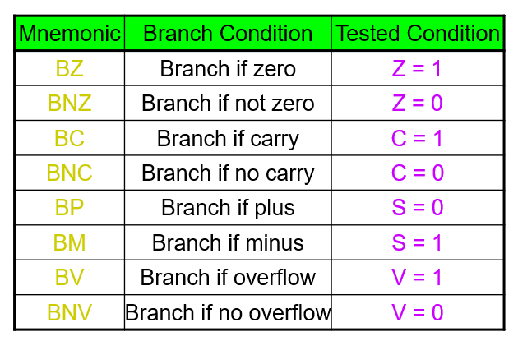
Instruction Types…

