Slide 1
Chapter 7. Basic Processing Unit

Slide 2
Overview
Instruction Set Processor (ISP)
Central Processing Unit (CPU)
A typical computing task consists of a series of steps specified by a sequence of machine instructions that constitute a program.
An instruction is executed by carrying out a sequence of more rudimentary operations.

Slide 3
Some Fundamental Concepts

Slide 4
Fundamental Concepts
Processor fetches one instruction at a time and perform the operation specified.
Instructions are fetched from successive memory locations until a branch or a jump instruction is encountered.
Processor keeps track of the address of the memory location containing the next instruction to be fetched using Program Counter (PC).
Instruction Register (IR)

Slide 5
Executing an Instruction
Fetch the contents of the memory location pointed to by the PC. The contents of this location are loaded into the IR (fetch phase).
IR ← [[PC]]
Assuming that the memory is byte addressable, increment the contents of the PC by 4 (fetch phase).
PC ← [PC] + 4
Carry out the actions specified by the instruction in the IR (execution phase).

Slide 6
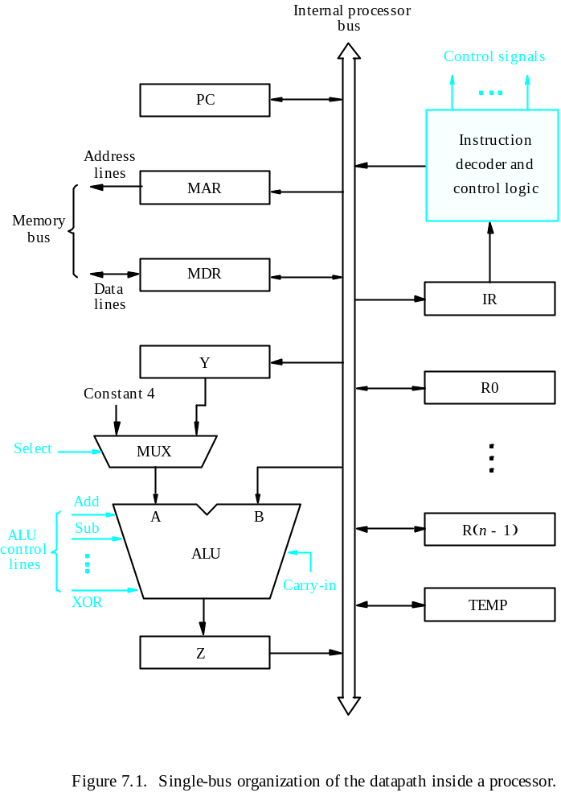
Processor Organization
MDR HAS TWO INPUTS AND TWO OUTPUTS
Datapath
Textbook Page 413

Slide 7
Executing an Instruction
Transfer a word of data from one processor register to another or to the ALU.
Perform an arithmetic or a logic operation and store the result in a processor register.
Fetch the contents of a given memory location and load them into a processor register.
Store a word of data from a processor register into a given memory location.

Slide 8
Register Transfers
Internal processor
b
us
R
i
in
R
i
R
i
out
Y
in
Y
Constant 4
Select
MUX
A
B
ALU
Z
in
Z
Z
out
Figure 7.2. Input and output gating for the registers in Figure 7.1.

Slide 9
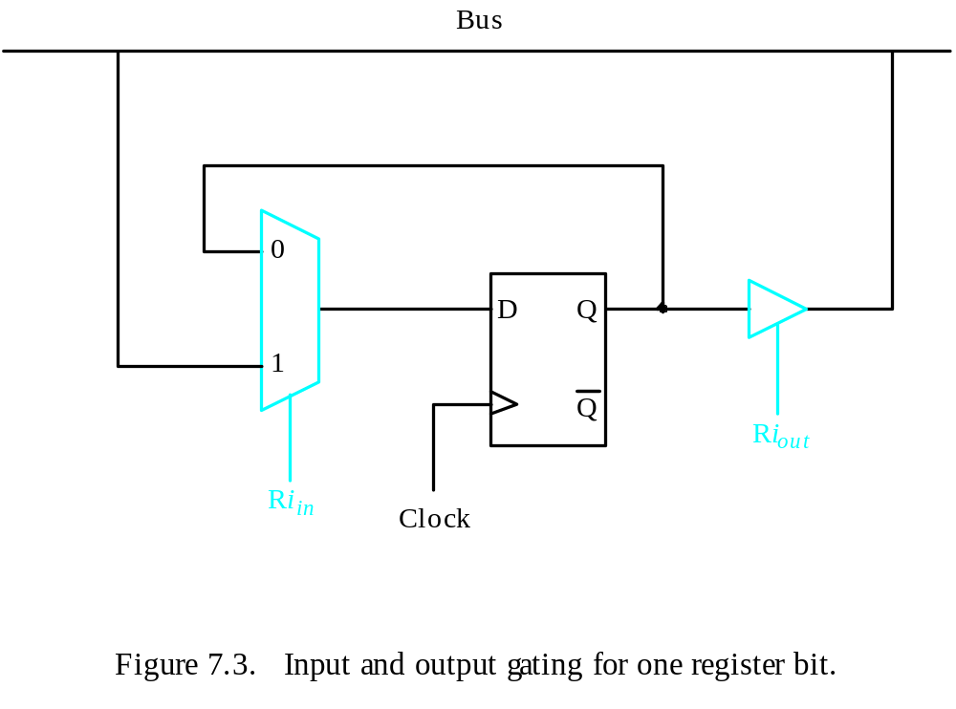
Register Transfers
All operations and data transfers are controlled by the processor clock.
Figure 7.3. Input and output gating for one register bit.

Slide 10
Performing an Arithmetic or Logic Operation
The ALU is a combinational circuit that has no internal storage.
ALU gets the two operands from MUX and bus. The result is temporarily stored in register Z.
What is the sequence of operations to add the contents of register R1 to those of R2 and store the result in R3?
  R1out, Yin
  R2out, SelectY, Add, Zin
  Zout, R3in

Slide 11
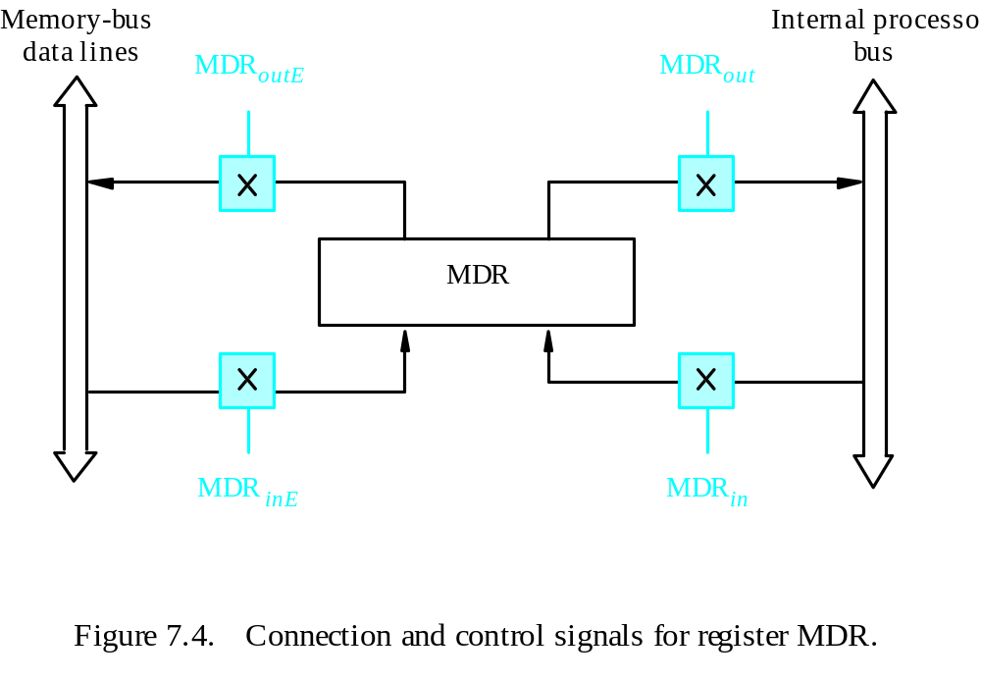
Fetching a Word from Memory
Address into MAR; issue Read operation; data into MDR.
Figure 7.4. Connection and control signals for register MDR.

Slide 12
Fetching a Word from Memory
The response time of each memory access varies (cache miss, memory-mapped I/O,…).
To accommodate this, the processor waits until it receives an indication that the requested operation has been completed (Memory-Function-Completed, MFC).
Move (R1), R2
MAR ← [R1]
Start a Read operation on the memory bus
Wait for the MFC response from the memory
Load MDR from the memory bus
R2 ← [MDR]

Slide 13
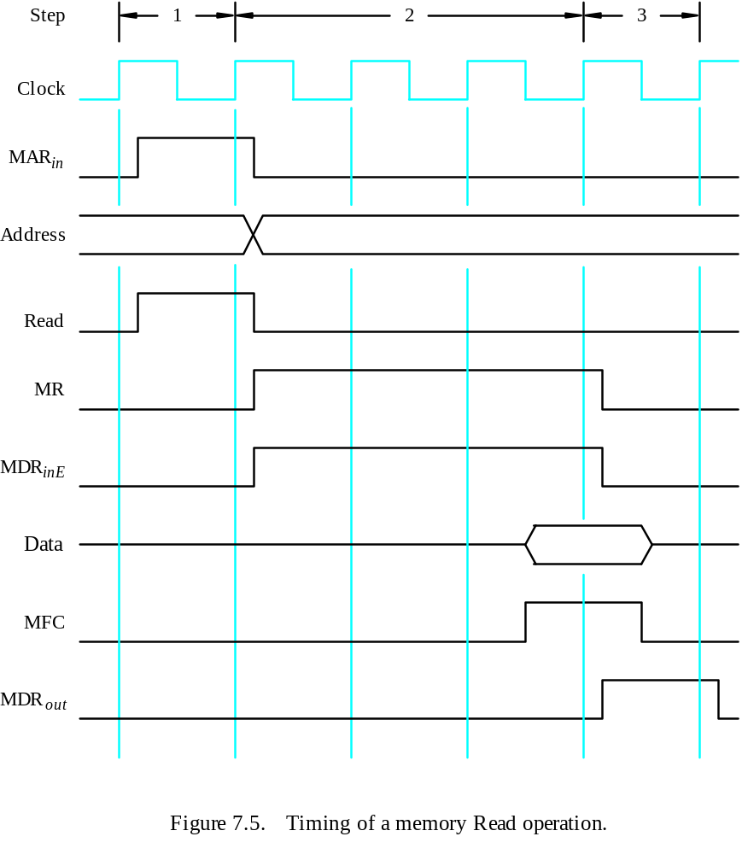
Timing
MAR ← [R1]
Assume MAR
is always available
on the address lines
of the memory bus.
Start a Read operation on the memory bus
Wait for the MFC response from the memory
Load MDR from the memory bus
R2 ← [MDR]

Slide 14
Execution of a Complete Instruction
Add (R3), R1
Fetch the instruction
Fetch the first operand (the contents of the memory location pointed to by R3)
Perform the addition
Load the result into R1

Slide 15
Architecture
Internal processor
b
us
R
i
in
R
i
R
i
out
Y
in
Y
Constant 4
Select
MUX
A
B
ALU
Z
in
Z
Z
out
Figure 7.2. Input and output gating for the registers in Figure 7.1.

Slide 16
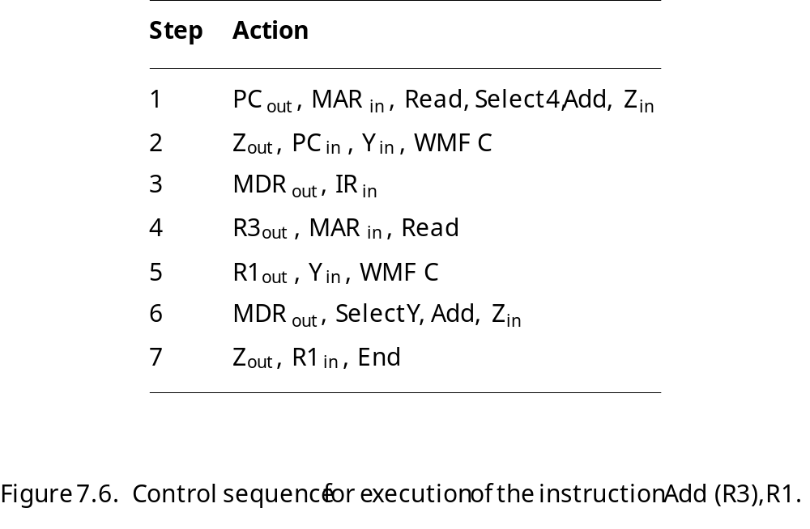
Execution of a Complete Instruction
Add (R3), R1

Slide 17
Execution of Branch Instructions
A branch instruction replaces the contents of PC with the branch target address, which is usually obtained by adding an offset X given in the branch instruction.
The offset X is usually the difference between the branch target address and the address immediately following the branch instruction.
Conditional branch

Slide 18
Execution of Branch Instructions
Step
Action
1
PC
out
,
MAR
in
,
Read,
Select4,
Add,
Z
in
2
Z
out
,
PC
in
,
Y
in
,
WMF
C
3
MDR
out
,
IR
in
4
Offset-field-of-IR
out
,
Add,
Z
in
5
Z
out
,
PC
in
,
End
Figure 7.7. Control sequence for an unconditional branch instruction.

Slide 19
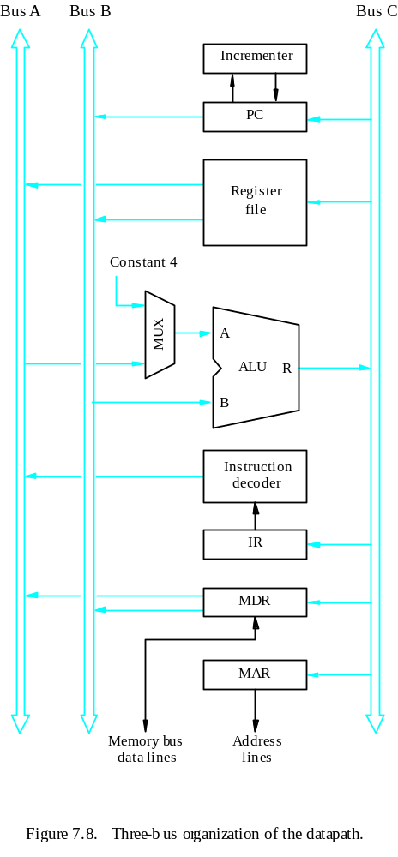
Multiple-Bus Organization

Slide 20
Multiple-Bus Organization
Add R4, R5, R6
Step
Action
1
PC
out
,
R=B,
MAR
in
,
Read,
IncPC
2
WMF
C
3
MDR
outB
,
R=B,
IR
in
4
R4
outA
,
R5
outB
,
SelectA,
Add,
R6
in
,
End
Figure 7.9. Control sequence for the instruction. Add R4,R5,R6,
for the three-bus organization in Figure 7.8.

Slide 21
Quiz
What is the control sequence for execution of the instruction
Add R1, R2
including the instruction fetch phase? (Assume single bus architecture)

