Slide 1
Module I: Part B

Slide 2
Computer Architecture
Abstract representation of the components of the computer and its organization is called architecture of a computer System.
The following parts are the key components of a computer system.
Central processing unit
Storage unit
I/O unit.

Slide 3
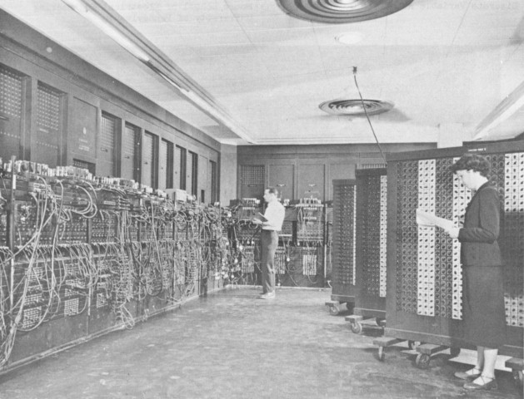
ENIAC
It is the first general purpose digital computer.
Programmed manually with switches and cables.
image courtesy :www.computerhope.com

Slide 4
Major hurdles of ENIAC
Size is too high
Huge space required to keep the system.
Plugging or unplugging the cables or switches was required to alter the program
So the job of entering the instructions and altering the instructions with switches and cables were absolutely hard.

Slide 5
If the set of instructions to the computer (i.e. program) could be represented in a storage suitable for performing tasks, then the process of programming could be easier.
If the data stored along with set of instructions, programming process could be facilitated.
These reasons motivated the development of stored program concept.

Slide 6
Stored Program Concept
Stored program concept is introduced by John von Neumann in 1940s.
The idea of a stored program is to store the instructions and data electronically as binary numbers in a storage space associated with a computer.
The storage space is called as memory.
Any data such as input or instruction is stored as a binary number in the memory.

Slide 7
How to implement the Stored-Program Concept in reality?
To Implement the stored-program concept, there are multiple layers of abstractions required both in the hardware and software.
The most important among them is the instruction set architecture (ISA) -abstraction between the lowest level software interface and the underlying hardware.

Slide 8
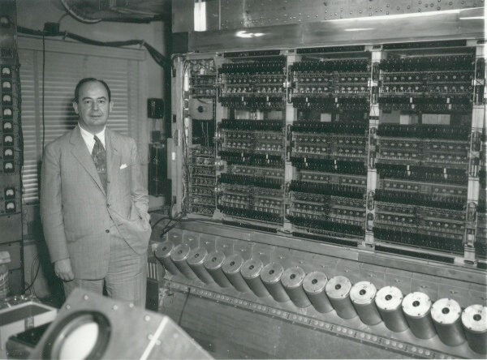
Von Neumann machine
Image courtesy: www.medium.com

Slide 9
Von Neumann Architecture
Central Processing Unit
Control Unit
Output Device
Input Device
Arithmetic and Logic Unit
Address
Bus
Data Bus
Storage unit/ Memory Unit
Stores both instructions and data

Slide 10
Von Neumann architecture
There are four sub-components in von Neumann architecture:
Memory
IO devices such as input and output devices
Arithmetic-Logic Unit
Control Unit
There is a 5th key player in the architecture, i.e. a wire, or bus, that connects the components together
Bus is used for the data flows from one sub-component to another.
Three types of buses i.e. communication lines are there: address lines, data lines and control lines.

Slide 11
Von Neumann Architecture
Major principles
Data and instructions stored together in the storage unit / Memory unit.
Memory unit is a collection of locations and each location is designated with an address.
Central processing unit fetches the instruction and data from the memory unit.
The central processing unit process the data
Program and data cannot be accessed simultaneously

Slide 12
The working of von Neumann model
The central processing unit, decides the instruction to be executed next and keep its address in the address line i.e. address bus.
ADD AL,BL
The address bus is a uni-directional bus connected from central processing unit to memory unit.
From the memory unit, the instruction or data placed into the data bus which carries data from the memory to the central processing unit.

Slide 13
Working continues…
The instructions gets decoded at the control unit.
Processor executes the task according to the instruction.
The arithmetic and logical operations are performed in the arithmetic and logic unit(ALU)
The execution of program is a sequential process, other than branching instruction execution.
The output of the execution may store in the memory or send to the output unit.

Slide 14
Types of instructions
Data Transfer Instructions – transfers data from a source to a destination. The source and destination can be memory locations or registers that are associated with CPU.
Arithmetic Instructions–performs arithmetic operations such as addition, subtraction, multiplication, division etc. It is performed by ALU.
Logical Instructions- Performs logical operations
Control transfer instructions – The flow of sequential execution can be changed with a branch instruction, it can be made according to any condition.

Slide 15
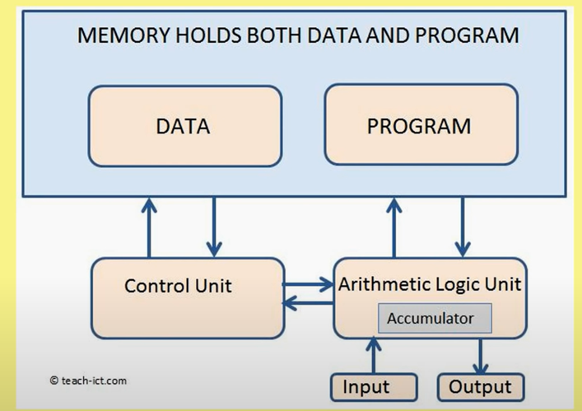

Slide 16
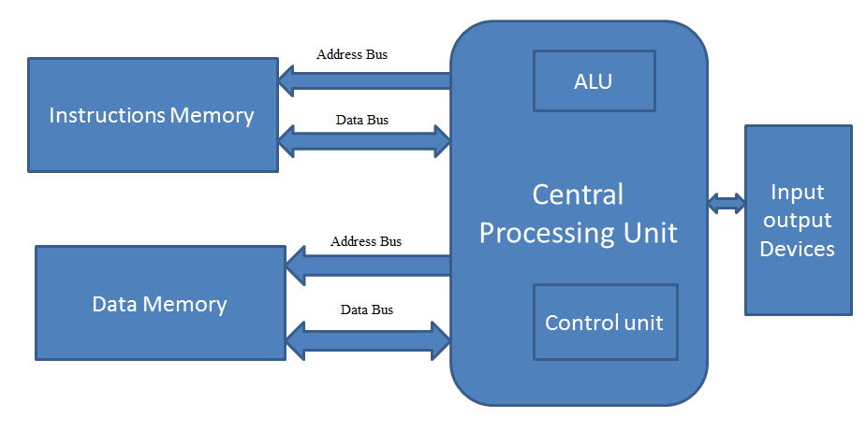
Harvard Architecture

Slide 17
Harvard Architecture
Principles
In Harvard architecture concept, Memory for data was separated from the memory for instruction. This concept is known as the
Parallel access of data and instructions are possible
Modern processors uses Harvard architecture

Slide 18
Advantages of Harvard Architecture
Separate data path and instruction path is available.
Fetching of data and instructions can be done simultaneously
Different sized cells can be allowed in both the memories.

Slide 19
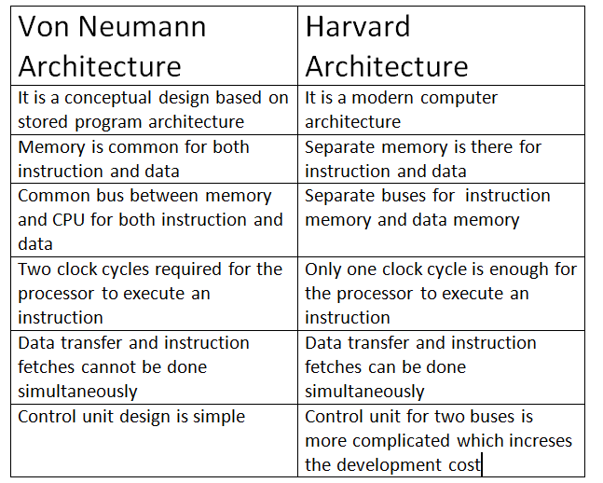
Comparison of von Neumann and Harvard Architecture

Slide 20
Performance of computer
Clock is used to synchronize the working of a unit
Clock Cycle: Discrete time intervals at which the events happen in a computer system
The length of each clock cycle is considered as clock period.
A clock period is also called tick, clock tick etc.

Slide 21
Performance matrix of a computer system
Execution time: It is the time taken to finish a task
- CPU execution time is a combination of user CPU time and system CPU time
Throughput: It is defined as the total quantity of completed work in a specific period of time.

Slide 22
Relation between the time of execution and performance
For a given task, in order to maximize the performance of a computer, we need to minimize the time required for execution or response time.
For a computer system A, the performance is calculated by the following formula
Performance of A= 1/Execution time of A
i.e. Performance_{A}= 1/Execution time_{A}

Slide 23

Continued…
i.e. we assume two computers X and Y, the relation between the performances can be represented by the below formula, if the performance of X is more than the performance of Y.

Slide 24


Continued…
Computer X is ‘n’ times faster than computer Y
can be represented by the following formula,

Slide 25


CPU performance and its factors
The above formula tells that the CPU performance can be improved by reducing either the number of clock cycles required for a program or by reducing the length of the clock cycle.

Slide 26
Performance Evaluation
The gain in performance can be achieved by improving some resources of a computer. It can be calculated using Amdhal’s law.
Amdhal’s law states that, the performance improvement to be gained from using some faster mode of execution is limited by the fraction of the time the faster mode can be used.

Slide 27
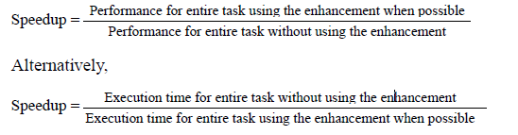
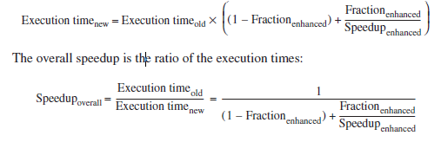
Amdhal’s law
Amdhal’s law defines speed up

Slide 28
Sample Problem
Consider a CPU used in Web servicing. We need to enhance the processor by increasing the computation speed 10 times faster on computation process in web service applications. We assume that, 30% of the time the original processor is spending for computation process and 70% of the time is waiting for the i/o devices. By incorporating the enhancement, then, what will be the overall speed up gain?

Slide 29
Solution
Fraction_{enhanced}=30% =0.3
Speed_{enhanced} =10
Speedup_{overall} = 1/(1-0.3)+(0.3/10)
= 1/0.7+0.03
=1/0.73
͌ 1.369

Slide 30
Memory Location, Addresses, and Operation
n
bits
Memory consists of many millions of storage cells, each of which can store 1 bit.
Data is usually accessed in n-bit groups. n is called word length.
first word
second word
•
•
•
i
th word
•
•
•
last word
Figure 2.5. Memory words.
Notes:
30

Slide 31
MEMORY LOCATIONS AND ADDRESSES
Main memory is the second major subsystem in a computer. It consists of a collection of storage locations, each with a unique identifier, called an address.
Data is transferred to and from memory in groups of bits called words. A word can be a group of 8 bits, 16 bits, 32 bits or 64 bits (and growing).
If the word is 8 bits, it is referred to as a byte. The term “byte” is so common in computer science that sometimes a 16-bit word is referred to as a 2-byte word, or a 32-bit word is referred to as a 4-byte word.

Slide 32
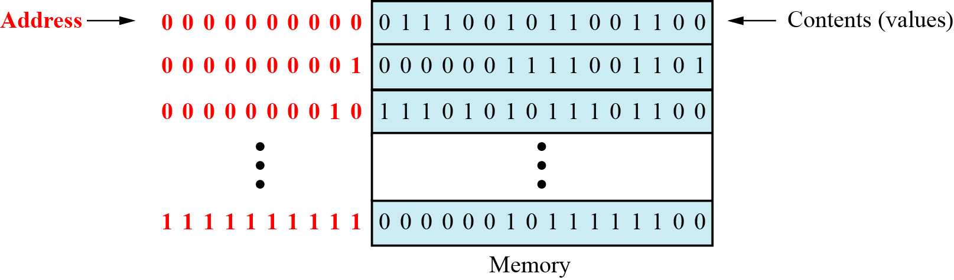
Figure 5.3 Main memory

Slide 33
Address space
To access a word in memory requires an identifier. Although programmers use a name to identify a word (or a collection of words), at the hardware level each word is identified by an address.
The total number of uniquely identifiable locations in memory is called the address space.
For example, a memory with 64 kilobytes (16 address line required) and a word size of 1 byte has an address space that ranges from 0 to 65,535.

Slide 34
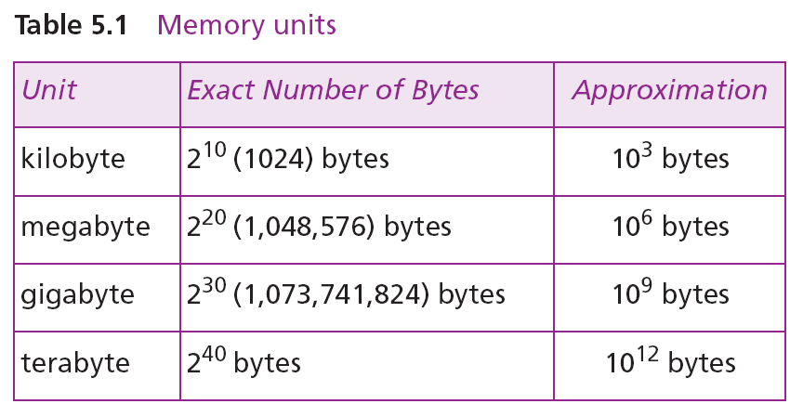

i
Memory addresses are defined using unsigned binary integers.

Slide 35
Example 1
A computer has 32 MB (megabytes) of memory. How many bits are needed to address any single byte in memory?
Solution
32 mB
MB – 2^20 2^5
The memory address space is 32 MB, or 2²⁵ (2⁵ × 2²⁰). This means that we need log₂ 2²⁵, or 25 bits, to address each byte.
Example 2
A computer has 128 MB of memory. Each word in this computer is eight bytes. How many bits are needed to address any single word in memory?
Solution
The memory address space is 128 MB, which means 2²⁷. However, each word is eight (2³) bytes, which means that we have 2²⁴ words. This means that we need log₂ 2²⁴, or 24 bits, to address each word.

Slide 36
References
Computer Architecture- A Quantitative Approach by John L. Hennessy, David A.Patterson
Computer Organization by Car-Hamacher,5th edition
Computer Organization and Architecture by william Stallings

