Slide 1
Memory System Organization & Architecture I
Dr. Ganala Santoshi
SCOPE
VIT Chennai
The content is prepared from the textbook : David A. Patterson and . John
L. Hennessy Computer Organization and Design-The Hardware/Software Interface 5th edition, Morgan Kaufmann, 2011
July 8, 2020
MSO

Slide 2
Principle of locality
Principle of locality A small set of address spaces will be accessed at an instant of operation, even though system have huge set of address spaces.
Temporal locality Data location will be referenced again soon, if the data location is referenced in previous instruction.
Spatial locality If a data location is referenced, data loca-
tions with nearby addresses will tend to be referenced soon.
Is it only with memory system or happening in our life. If Yes : How human activities can be related to Temporal locality and Spatial locality....???
MSO

Slide 3
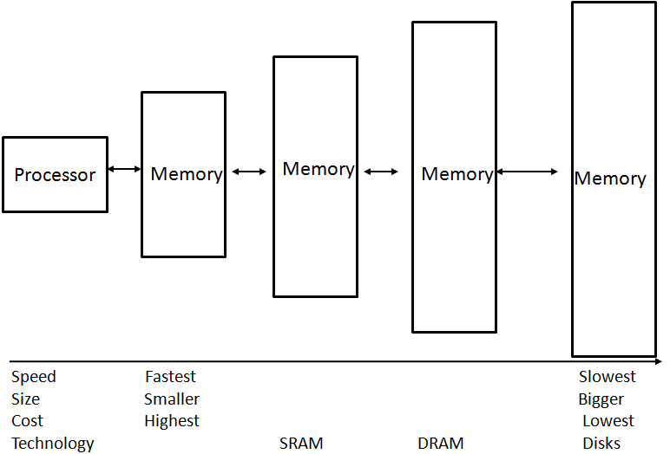
Memory hierarchy
Figure: The basic structure of a memory hierarchy
Why only these parameters : Speed, Size, Cost and Technology related. How they are related.
MSO

Slide 4
Memory hierarchy
Memory hierarchy :
Multiple levels of memories,
Distance from the processor,
More the distance or Less the distance,
Size of the memories,
Access time.
Relate 1,2,3,4 & 5.
How they are inter-related.
Any thing can be omitted and added to the list.
MSO

Slide 5
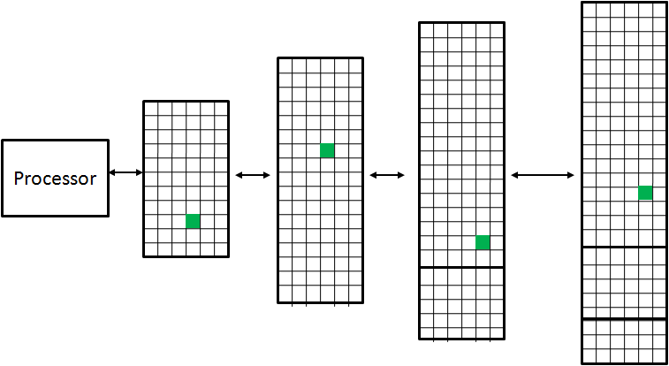
Small unit of data transfer between the levels
Figure: Information movement between the memory levels.1
Block (or line) :
Small unit of information, which can present or not present at memory level. Such small unit of information may have different names, at different levels of memory. Small unit of information moves between the memory levels.
MSO

Slide 6
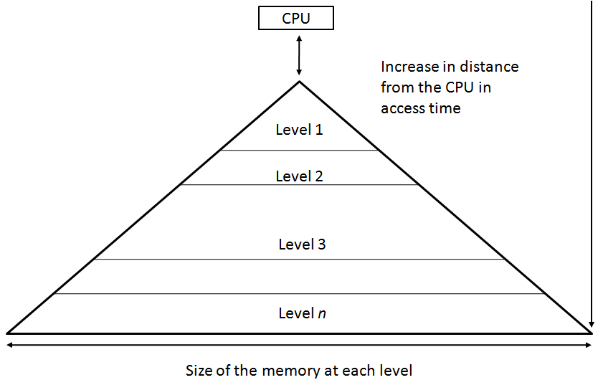
Data transfer between the levels
Figure: Information movement between the memory levels..2
OS allows the processor have immediate access to level 1. If found OK. Otherwise access mechanism will escalate to higher levels, but it has effect on Speed / Time.
MSO

Slide 7
Memory Technologies
Memory Technologies
1. STATIC Random Access Memory - Static RAM,
3. DYNAMIC Random Access Memory - Dynamic RAM,
Flash Memory,
Disk Memory,
How 1,2,3 and 4 are different in technologies. What are the differences in technologies.
Find the appropriate place for application.
MSO

Slide 8
Memory Technologies
2 primary differences : Between the technologies of Magnetic disks and Semiconductor memory :
Magnetic Disks have a slower access time. Because they are mechanical devices in nature. Flash memory is 1000 times and DRAM is 100,000 times as fast compared to it, yet they are cheaper per bit.
Disk is 10 to 100 time cheaper. Magnetic disks are nonvolatile like ash. Like ash memory there is no write wear-out problem.
Technological difference between SRAM & DRAM....??
MSO

Slide 9
More on disks...
Surface of the disk is further divide into concentric circles. Each circle is known as Track. In turn, each Track contains sectors. Each sector typically contain 512 to 4906 bytes in size. A three-stage process:
Seek,
Rotational latency and
Transfer time
Task - I :
Consider a disk which rotate at a speed range of 5400 RPM to 15,000 RPM. To calculate the average rotational latency at 5400 RPM can be done with the formula as : Average rotational latency = 0.5 rotation / 5400 RPM = 0.0056 Secs = 5.6 ms. [Time units converted from minutes to seconds to milliseconds]
Task II, Task III.....
MSO

Slide 10
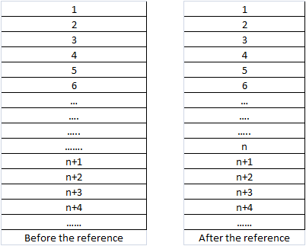
What & Where is Cache....
Figure: Before and After referencing Cache
In between the processor and main memory. Close to processor and main memory. Before and after a reference is made. If not Found in reference, will be brought from next higher levels.
I am talking about...n, look at before (absent) and after (present) referencing.
MSO

Slide 11
HIT or MISS / Hit Time & Miss Time
Hit rate : Found: It is the fraction of memory accesses found in a level of the memory hierarchy.
Miss rate : Not Found : It is the fraction of memory accesses not found in a level of the memory hierarchy.
Hit time : It is the time required to access a level of the memory hierarchy, including the time needed to determine whether the access is a hit or a miss.
Miss penalty : It is the time required to fetch a block into a level of the memory hierarchy from the next level, including the time to access the block, transmit it from one level to the other, insert it in the level that experienced the miss, and then pass the block to the requester.
Hit or Miss..Which is better & Why.
MSO

Slide 12
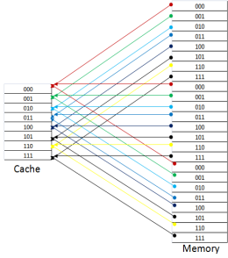
Direct Mapping
Figure: Memory to Cache : To a single location
One memory block - ONLY One POSSIBLE cache line (1 : 1) Address of MEMORY BLOCK - Address of CACHE LINE
Simple and Easy Calculation :
(Memory BLOCK number) modulo (Number of LINES in the cache)
MSO

Slide 13
Calculation...Direct Mapping
If the number of entries in the cache is a power of 2, then modulo can be computed simply by using the low-order log2 (cache size in blocks) bits of the address.
Thus, an 8-block cache uses the three lowest bits (8 = 2³) of the block address.
Task - IV
Let the cache consists of Y number lines and main memory with X number of blocks. Using the concept of direct mapping, analyze the following...
Scenario I : X = Y Scenario II : X > Y Scenario III : X < Y
Show the effect of direct mapping, with explanation. X & Y can be any number. [Must be convertible to power of 2...Think Why]
MSO

Slide 14
Issues with Direct Mapping
Go and check the Cache.
From the previous discussion, it can be ascertained that, a single line of cache can contain the contents of different blocks of main memory. The following question need to be answered..
How do we know whether the data in the cache corresponds to a requested word? (Because single location can contain contents of number of different locations)
That is, how do we know whether a requested word is in the cache or not? (Is it the word, Is it my request or something else)
MSO

Slide 15
Issues with Direct Mapping...II
Solution to the issues of....
Tag : A field in a table used for a memory hierarchy that contains the address information required to identify whether the associated block in the hierarchy corresponds to a requested word (Few Bits)
Valid bit : A field in the tables of a memory hierarchy that indicates that the associated block in the hierarchy contains valid data. (V / N)
MSO

Slide 16
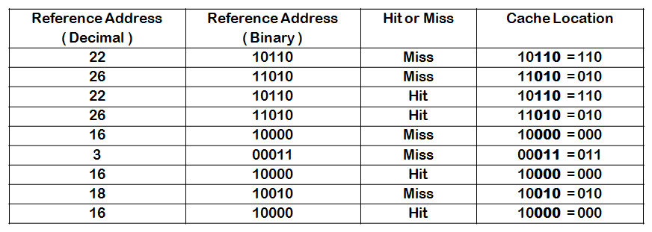
Accessing the Cache
Figure: Hit / Miss & Location in Cache & Word in Memory
Cache contains 8 lines. Number of bits required to reference the cache is 3. So, 3 low-order bits of a memory address gives the line number of the cache. The word address for the value 18 is 10010. It should be brought into cache line 2. Because the low order bits are 010. But that line is already occupied by the value 26 whose address is 11010. Hence there must be a replacement.
MSO

Slide 17
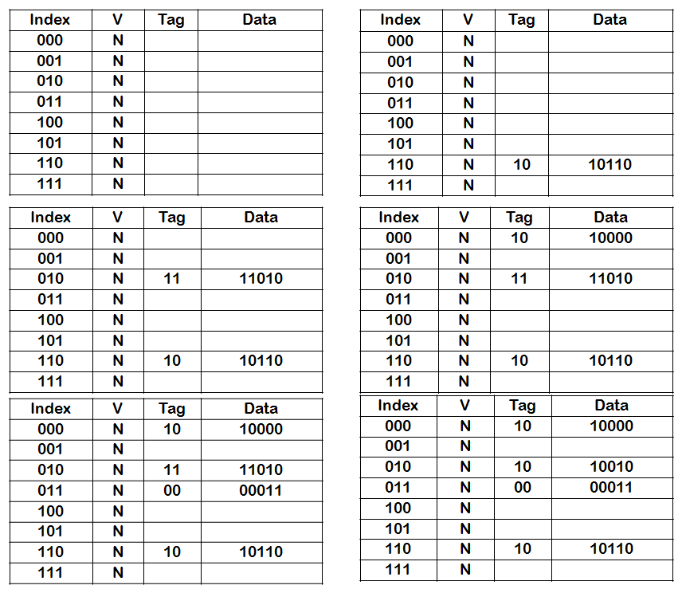
Accessing the Cache..II
Figure: Hit / Miss & Location in Cache & Word in Memory
MSO

Slide 18
Accessing the Cache..III
The cache is initially empty, with all valid bits (V entry in cache) turned off (N).
The processor requests the following addresses: 10110 − M − First Reference,
11010 − M − First Reference, 10110 − M − Second Reference, 11010 − H − Second Reference, 10000 − M − First Reference, 00011 − M − First Reference, 10000 − H − Second Reference, 10010 − M − First Reference, and 10000 − H − Second Reference.
H = Hit & M = Miss
Full memory address of the word is concatenation of tag field j and the index i. Alternately it can be written as j × 8 + i.
MSO

Slide 19
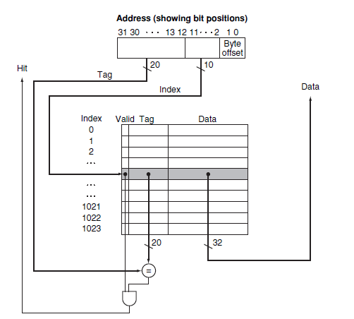
Accessing the Cache..IV
Figure: Schematic diagram
MSO

Slide 20
Accessing the Cache..V
Consider a scenario....
32-bit addresses and direct-mapped cache
Cache size is 2^{n} blocks, so ^{n} bits are used for the index
Block size is 2^{m} words (2^{m}+2 bytes), so m bits are used for the word within the block, and two bits are used for the byte part of the address
Size of the tag field = 32 − (n + m + 2)
Th e total number of bits in a direct-mapped cache = 2^{n} × (block size + tag size + valid field size).
Block size is 2^{m} words (2^{m+5} bits), and we need 1 bit for the valid field.
The number of bits in such a cache = 2^{n} × (2^{m} × 32 + (32 − n −
m − 2) + 1) = 2^{n} × (2^{m} × 32 + 31 − n − m).
MSO

Slide 21
Accessing the Cache..VI
Tag of the cache is compared with the upper portion of the memory address to check whether the entry in the cache matches to the requested address or not.
Memory address length = 32 bits. Cache = 1024 lines
10 bits are used to index the cache
leaving 32 10 2 = 20 bits to be compared against the tag.
When HIT : Tag and Upper 20 bits of the address are matching & Valid Bit = Y (ON),
Desired word is supplied to the processor Otherwise, a MISS
MSO

Slide 22
Accessing the Cache..V
Task ..VI
Assume memory address = 32 bits of length. Cache = 16 KiB of data. Block = 4 lines. Then how many bits are required in direct mapped cached operation
16 KiB is 4096 (2¹²) words.
Block size of 4 words (2²)
Number of Blocks = 1024 (2¹⁰) blocks Each block has 4 × 32 or 128 bits + tag
2¹⁰ × (4 × 32 + (32 − 10 − 2 − 2) + 1) = 2¹⁰ × 147 = 147
Kibibits
MSO

Slide 23
Handling Cache Misses
Cache miss :
Requested data is not found in the cache. Cache miss.
If the requested data is present in the cache it reports a HIT, continues execution, as nothing happened
Misses requires extra work compared to hit
The cache miss need to be handled in collaboration with processor control unit and memory access to refill the cache.
MSO

Slide 24
Handling Writes
Handling Writes
Write-through : Update both the cache and the next level of the memory hierarchy, ensuring that data is always consistent between the two.
Write buffer : A queue that holds data while the data is waiting to be written to memory.
Write-back : A scheme that handles writes by updating values only to the block in the cache, then writing the modified block to the next level of the hierarchy when the block is replaced.
MSO

Slide 25
Measuring and Improving Performance of the Cache:
Two techniques are generally considered in improving the cache performance.
On reducing the miss rate by reducing the probability that two different memory blocks will contend for the same cache location.
Reduce the miss penalty by adding an additional level to the hierarchy. This technique, called multilevel caching.
Have a look at : Improving Direct-Mapped Cache Performance by the Addition of a Small Fully-Associative Cache and Prefetch Buffers.
MSO

Slide 26
How to measure and improve the cache performance :
Time taken by the CPU can be divided as follows :
The clock cycles that the CPU spends executing the program and
The clock cycles that the CPU spends waiting for the memory system.
Cost (time) incurred for the cache hits are already included in CPU execution cycles. Let A = CPU time, B = CPU execution clock cycles, C = Memory-stall clock cycles and D = Clock cycle time, A = ( B +
C) × D
MSO

Slide 27
Measuring and Improving Cache Performance :
Memory-stall clock cycles = sum of the stall cycles coming from reads + coming from writes:
Memory-stall clock cycles = (Read-stall cycles + Write-stall cycles)
The read-stall cycles = Number of read accesses per program, the miss penalty in clock cycles for a read, and the read miss rate:
Read-stall cycles = Reads / Program × Read miss rate × Read miss penalty
MSO

Slide 28
Calculating Cache Performance
Consider a scenario, in which instruction cache miss rate = 2% and data cache miss rate = 4%. Process has a CPI = 2 without memory stall. Miss penalty is 100 for all types of misses. Frequency of loads and stores is 36%. How much faster would be the processor that run with a perfect cache.
Instruction miss cycles = I X 2% X 100 = 2.00 X I
As the frequency of all loads and stores is 36%, we can find the number of memory miss cycles for data references:
Data miss cycles = I X 36% X 4% X 100 = 1.44 X I
The total number of memory-stall cycles is 2.00 I+ 1.44 I = 3.44 I. This is more than three cycles of memory stall per instruction.
Accordingly, the total CPI including memory stalls is 2 + 3.44 =
5.44. Since there is no change in instruction count or clock rate.
CPI_{stall} / CPI_{stall} = 5.44 / 2 = 2.72
Performance with the perfect cache is better by 2.72
MSO

Slide 29
Average memory access time - AMAT :
AMAT = Time for a hit + Miss rate X Miss penalty
Calculate the average memory access time per instruction : Clock cycle time = 1ns
Miss penalty = 20 clock cycles
Miss rate = 0.05 misses per instruction
Cache access time (including hit detection) = 1 clock cycle Write stall = Ignored
Read misses penalty = Read misses penalty
= 1 + 0.05 X 20
= 2 clock cycles
= or 2 ns.
MSO

Slide 30
Fully Associative & Set-associative cache:
Fully Associative cache : A cache structure in which a block can be placed in any location in the cache.
Set-associative cache : A cache that has a fixed number of locations (at least two) where each block can be placed
MSO

Slide 31
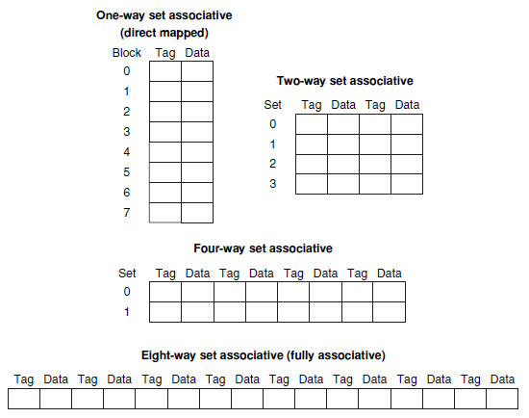
Fully Associative & Set-associative cache:
Figure: Fully Associative and Set-associative cache
Cache has 8 locations. Set = Tag & Data
8 Blocks = 8 sets = 8 way set associative = Fully set associative mapping
Associative mapping = multiples of sets = Cache locations (2 way set or 4 way set )
1 set = 1 way = Direct mapping
MSO

Slide 32
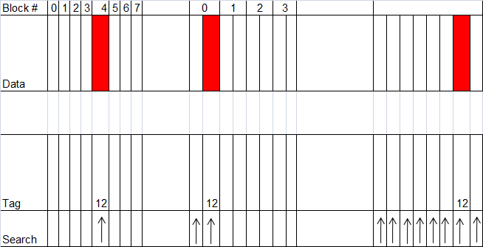
Direct & Fully Associative & Set-associative cache:
Figure: Direct and Fully Associative and Set-associative cache
Direct mapped cache : Memory Block 12, Total cache have : 8 locations, Cache location = 12 modulo 8 = 4,
Two-way set-associative cache : No. of Sets = 4, Cache location = 12 modulo 4 = 0, Set No. = 4, Each set has 2 locations, memory block could be in either element of the set.
Fully associative placement : Block address 12 can appear in any of the 8 cache locations
MSO

Slide 33
Misses and Associativity in Caches
Task...VII
Consider a scenario: No. of caches = 3
Each consist of 4 one-word blocks.
Fully associate caches = 1, 2 way set associate cache = 1 and Direct mapped cache = 1
Calculate the number of misses for each cache organization for the given the sequence of block addresses : 0, 8, 0, 6, and 8.
MSO

Slide 34
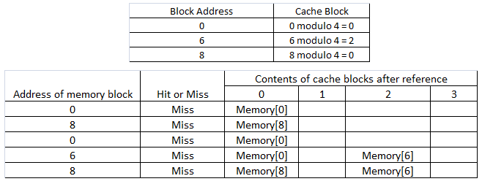
Number of misses : Direct mapped cache
Figure: Direct-mapped cache references
No. of access 5 = No. of misses = 5.
MSO

Slide 35
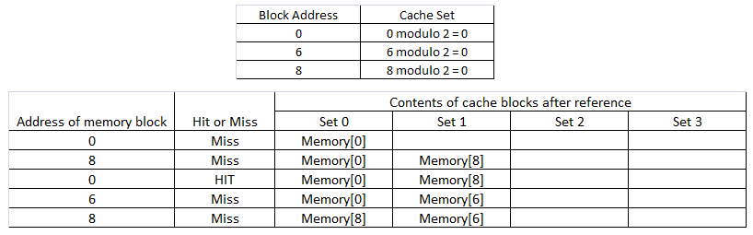
Number of misses :Two-way set-associative cache
Figure: Two-way set-associative cache references
No. of misses = 4
MSO

Slide 36
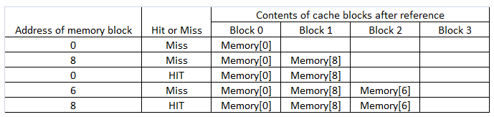
Number of misses :Fully associative cache
Figure: Fully associative cache references
No. of misses = 3.
MSO

Slide 37
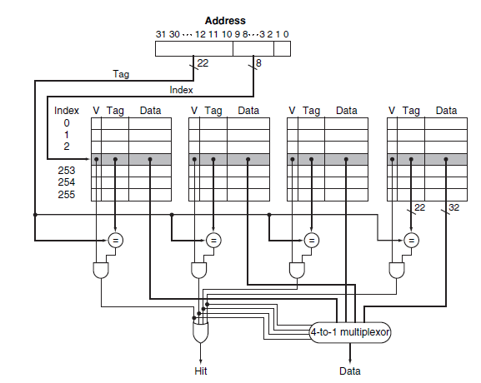
Four-way set-associative cache
Figure: Four-way set-associative cache
MSO

Slide 38
Four-way set-associative cache
Comparators determine which element of the selected set (if any) matches the tag.
Output of the comparators is used to select the data from one of the four blocks of the indexed set, using a multiplexor with a decoded select signal.
In some implementations, the Output enable signals on the data portions of the cache RAMs can be used to select the entry in the set that drives the output.
The Output enable signal comes from the comparators, causing the element that matches to drive the data outputs.
This organization eliminates the need for the multiplexor.
MSO

Slide 39
Four-way set-associative cache
Task...VIII
Consider the given scenario..
Number of cache blocks = 4096, Block size = 4 word
Address = 32 bit
Find the total number of..
Number of sets
Total number of tag bits for caches for
Direct mapped,
2 way set associative Fully set associate
MSO

Slide 40
2 & 4 set associative mapped cache...
For Direct mapped cache....
There are 16 (= 2⁴) bytes per block, a 32-bit address yields 32−4
= 28 bits to be used for index and tag.
Direct-mapped cache has the same number of sets as blocks, and hence 12 bits of index, since log₂ (4096) =12;
Total number is (28 − 12) × 4096 = 16 × 4096 = 66 K tag bits.
For 2 way set associative.... Number of sets = 2048
Total number of tag bits = (28 − 11) × 2 × 2048 = 34 × 2048 =
70 Kbits.
MSO

Slide 41
2 & 4 set associative mapped cache...
For 4 way set associative cache...
Number of sets = 1024
Total number of tag bits is (28 − 10) × 4 × 1024 = 72 × 1024
=74 K tag bits.
For fully set associative cache...
No. of sets = 1, 1 set with 4096 blocks
Tag length = 28 bits, leading to 28 × 4096 × 1 = 115 K tag bits.
MSO

