Slide 1
UNIT-5: The Memory System
Fundamental Concepts

Slide 2
Memory Basic Concepts
Maximum size of the Main Memory
byte-addressable
CPU-Main Memory Connection
Processor
k
-bit
Memory
address bus
MAR
n
-bit
data bus
Up to 2
k
addressable
MDR
locations
Word length =
n
bits
Control lines
R
/
W
( , MFC, etc.)

Slide 3
Memory Basic Concepts(Contd.,)
Measures for the speed of a memory:
Memory access time.
Memory cycle time.
An important design issue is to provide a computer system with as large and fast a memory as possible, within a given cost target.
Several techniques to increase the effective size and speed of the memory:
Cache memory (to increase the effective speed).
Virtual memory (to increase the effective size).

Slide 4
The Memory System
Semiconductor RAM memories

Slide 5
Internal Organization of Memory Chips
Each memory cell can hold one bit of information.
Memory cells are organized in the form of an array.
One row is one memory word.
All cells of a row are connected to a common line, known as the “word line”.
Word line is connected to the address decoder.
Sense/write circuits are connected to the data input/output lines of the memory chip.

Slide 6
Internal Organization of Memory Chips (Contd.,)
7
7
1
1
0
0
W
0
•
•
•
FF
FF
A
0
W
1
•
•
•
A
1
Address
Memory
decoder
•
•
•
•
•
•
•
•
•
•
•
•
•
•
•
•
•
•
cells
A
2
A
3
W
15
•
•
•
Sense / Write
Sense / Write
Sense / Write
R
/
W
circuit
circuit
circuit
CS
Data input
/output lines:
b
7
b
1
b
0

Slide 7
SRAM Cell
Two transistor inverters are cross connected to implement a basic flip-flop.
The cell is connected to one word line and two bits lines by transistors T1 and T2
When word line is at ground level, the transistors are turned off and the latch retains its state
Read operation: In order to read state of SRAM cell, the word line is activated to close switches T1 and T2. Sense/Write circuits at the bottom monitor the state of b and b’
b
′
b
T
T
1
X
Y
2
Word line
Bit lines

Slide 8
Asynchronous DRAMs
Static RAMs (SRAMs):
Consist of circuits that are capable of retaining their state as long as the power is applied.
Volatile memories, because their contents are lost when power is interrupted.
Access times of static RAMs are in the range of few nanoseconds.
However, the cost is usually high.
Dynamic RAMs (DRAMs):
Do not retain their state indefinitely.
Contents must be periodically refreshed.
Contents may be refreshed while accessing them for reading.

Slide 9
Fast Page Mode
Suppose if we want to access the consecutive bytes in the selected row.
This can be done without having to reselect the row.
Add a latch at the output of the sense circuits in each row.
All the latches are loaded when the row is selected.
Different column addresses can be applied to select and place different bytes on the data lines.
Consecutive sequence of column addresses can be applied under the control signal CAS, without reselecting the row.
Allows a block of data to be transferred at a much faster rate than random accesses.
A small collection/group of bytes is usually referred to as a block.
This transfer capability is referred to as the
fast page mode feature.

Slide 10
Synchronous DRAMs
Operation is directly synchronized
with processor clock signal.
The outputs of the sense circuits are
connected to a latch.
During a Read operation, the
contents of the cells in a row are
loaded onto the latches.
During a refresh operation, the
contents of the cells are refreshed
without changing the contents of
the latches.
Data held in the latches correspond
to the selected columns are transferred
to the output.
For a burst mode of operation,
successive columns are selected using
column address counter and clock.
CAS signal need not be generated
externally. A new data is placed during
raising edge of the clock
Refresh
counter
Row
Ro
w
address
decoder
Cell array
latch
Row/Column
address
Column
Co
lumn
Read/Write
address
decoder
circuits & latches
counter
Clock
R
A
S
Mode register
C
A
S
and
Data input
Data output
R
/
W
timing control
register
register
C
S
Data

Slide 11
Latency, Bandwidth, and DDRSDRAMs
Memory latency is the time it takes to transfer a word of data to or from memory
Memory bandwidth is the number of bits or bytes that can be transferred in one second.
DDRSDRAMs-Double-Data-Rate-SDRAM
Cell array is organized in two banks

Slide 12
Memory Controller (contd..)
Row/Column
Address
address
R
A
S
R
/
W
Memory
C
A
S
Request
controller
R
/
W
Processor
Memory
C
S
Clock
Clock
Data

Slide 13
Read-Only Memories (ROMs)
SRAM and SDRAM chips are volatile:
Lose the contents when the power is turned off.
Many applications need memory devices to retain contents after the power is turned off.
For example, computer is turned on, the operating system must be loaded from the disk into the memory.
Store instructions which would load the OS from the disk.
Need to store these instructions so that they will not be lost after the power is turned off.
We need to store the instructions into a non-volatile memory.
Non-volatile memory is read in the same manner as volatile memory.
Separate writing process is needed to place information in this memory.
Normal operation involves only reading of data, this type
of memory is called Read-Only memory (ROM).

Slide 14
Read-Only Memories (Contd.,)
Read-Only Memory:
Data are written into a ROM when it is manufactured.
Programmable Read-Only Memory (PROM):
Allow the data to be loaded by a user.
Process of inserting the data is irreversible.
Storing information specific to a user in a ROM is expensive.
Providing programming capability to a user may be better.
Erasable Programmable Read-Only Memory (EPROM):
Stored data to be erased and new data to be loaded.
Flexibility, useful during the development phase of digital systems.
Erasable, reprogrammable ROM.
Erasure requires exposing the ROM to UV light.

Slide 15
Read-Only Memories (Contd.,)
Electrically Erasable Programmable Read-Only Memory (EEPROM):
To erase the contents of EPROMs, they have to be exposed to ultraviolet light.
Physically removed from the circuit.
EEPROMs the contents can be stored and erased electrically.
Flash memory:
Has similar approach to EEPROM.
Read the contents of a single cell, but write the contents of an entire block of cells.

Slide 16
Speed, Size, and Cost
A big challenge in the design of a computer system is to provide a sufficiently large memory, with a reasonable speed at an affordable cost.
Static RAM:
Very fast, but expensive, because a basic SRAM cell has a complex circuit making it impossible to pack a large number of cells onto a single chip.
Dynamic RAM:
Simpler basic cell circuit, hence are much less expensive, but significantly slower than SRAMs.
Magnetic disks:
Storage provided by DRAMs is higher than SRAMs, but is still less than what is necessary.
Secondary storage such as magnetic disks provide a large amount
of storage, but is much slower than DRAMs.

Slide 17
Memory Hierarchy
Pr
ocessor
Fastest access is to the data held in
processor registers. Registers are at
the top of the memory hierarchy.
Relatively small amount of memory that
can be implemented on the processor
chip. This is processor cache.
Two levels of cache. Level 1 (L1) cache
is on the processor chip. Level 2 (L2)
cache is in between main memory and
processor.
Next level is main memory, implemented
as SIMMs. Much larger, but much slower
than cache memory.
Next level is magnetic disks. Huge amount
of inexpensive storage.
Speed of memory access is critical, the
idea is to bring instructions and data
that will be used in the near future as
close to the processor as possible.
Re
gisters
Increasing
Increasing
Increasing
size
speed
cost per bit
Primary
L1
cache
Secondary
L2
cache
Main
memory
Magnetic disk
secondary
memory

Slide 18
The Memory System
Cache Memories

Slide 19
Cache Memory
Processor is much faster than the main memory.
Speed of the main memory cannot be increased beyond a certain point.
Cache memory is an architectural arrangement which makes the main memory appear faster to the processor than it really is.
Cache memory is based on the property of computer programs known as “locality of reference”.

Slide 20
Locality of Reference
Analysis of programs indicates that many instructions in localized areas of a program are executed repeatedly during some period of time, while the others are accessed relatively less frequently.
Temporal locality of reference:
Recently executed instruction is likely to be executed again very soon.
Spatial locality of reference:
Instructions with addresses close to a recently instruction are likely
to be executed soon.

Slide 21
Cache memories
Processor
Cache
Main
memory
Processor issues a Read request, a block of words is transferred from the main memory to the cache, one word at a time.
Subsequent references to the data in this block of words are found in the cache.
At any given time, only some blocks in the main memory are held in the cache. Which blocks in the main memory are in the cache is determined by a “mapping function”.
When the cache is full, and a block of words needs to be transferred
from the main memory, some block of words in the cache must be
replaced. This is determined by a “replacement algorithm”.

Slide 22
Cache Hit
Existence of a cache is transparent to the processor. The processor issues Read and Write requests in the same manner.
If the data is in the cache it is called a Read or Write hit.
Read hit:
The data is obtained from the cache.
Write hit:
Cache has a replica of the contents of the main memory.
Contents of the cache and the main memory may be updated simultaneously. This is the write-through protocol.
Update the contents of the cache, and mark it as updated by setting a bit known as the dirty bit or modified bit. The contents of the main memory are updated when this block is replaced. This is write-back or copy-back protocol.

Slide 23
Cache Miss
If the data is not present in the cache, then a Read miss or Write miss occurs.
Read miss:
Block of words containing this requested word is transferred from the memory.
After the block is transferred, the desired word is forwarded to the processor.
The desired word may also be forwarded to the processor as soon as it is transferred without waiting for the entire block to be transferred. This is called load-through or early-restart.
Write-miss:
Write-through protocol is used, then the contents of the main memory are updated directly.
If write-back protocol is used, the block containing the
addressed word is first brought into the cache. The desired word
is overwritten with new information.

Slide 24
Cache Coherence Problem
A bit called as “valid bit” is provided for each block.
If the block contains valid data, then the bit is set to 1, else it is 0.
Valid bits are set to 0, when the power is just turned on.
When a block is loaded into the cache for the first time, the valid bit is set to 1.
Data transfers between main memory and disk occur directly bypassing the cache.
When the data on a disk changes, the main memory block is also updated.
However, if the data is also resident in the cache, then the valid bit is set to 0.
What happens if the data in the disk and main memory changes and the write-back protocol is being used?
In this case, the data in the cache may also have changed and is indicated by the dirty bit.
The copies of the data in the cache, and the main memory are different. This is called the cache coherence problem.
One option is to force a write-back before the main memory is updated from the disk.

Slide 25
Mapping Functions
Mapping functions determine how memory blocks are placed in the cache.
A simple processor example:
Cache consisting of 128 blocks of 16 words each.
Total size of cache is 2048 (2K) words.
Main memory is addressable by a 16-bit address.
Main memory has 64K words.
Main memory has 4K blocks of 16 words each.
Three mapping functions:
Direct mapping
Associative mapping
Set-associative mapping.

Slide 26
Direct Mapping
Main
Block j of the main memory maps to j modulo 128 of
the cache. 0 maps to 0, 129 maps to 1.
More than one memory block is mapped onto the same
position in the cache.
May lead to contention for cache blocks even if the
cache is not full.
Resolve the contention by allowing new block to
replace the old block, leading to a trivial replacement
algorithm.
Memory address is divided into three fields:
- Low order 4 bits determine one of the 16
words in a block.
- When a new block is brought into the cache,
the the next 7 bits determine which cache
block this new block is placed in.
- High order 5 bits determine which of the possible
32 blocks is currently present in the cache. These
are tag bits.
Simple to implement but not very flexible.
memory
Block 0
Cache
Block 1
tag
Block 0
tag
Block 1
Block 127
Block 128
tag
Block 127
Block 129
T
ag
Block
W
ord
Block 255
5
7
4
Block 256
Main memory address
Block 257
Block 4095

Slide 27
Associative Mapping
Main
Block 0
memory
Main memory block can be placed into any cache
position.
Memory address is divided into two fields:
- Low order 4 bits identify the word within a block.
- High order 12 bits or tag bits identify a memory
block when it is resident in the cache.
Flexible, and uses cache space efficiently.
Replacement algorithms can be used to replace an
existing block in the cache when the cache is full.
Cost is higher than direct-mapped cache because of
the need to search all 128 patterns to determine
whether a given block is in the cache.
Cache
Block 1
tag
Block 0
tag
Block 1
Block 127
Block 128
tag
Block 127
Block 129
Tag
Word
Block 255
12
4
Block 256
Main memory address
Block 257
Block 4095

Slide 28
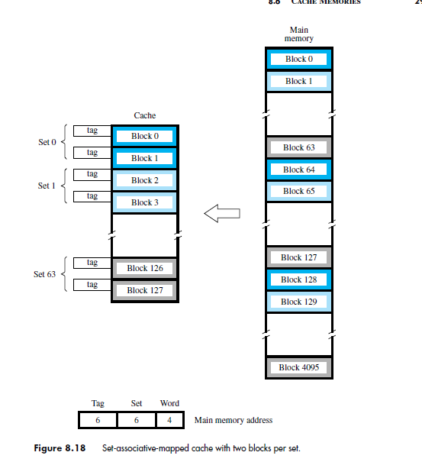
Set-Associative mapping
Blocks of cache are grouped into sets.
Mapping function allows a block of the main
memory to reside in any block of a specific set.
Divide the cache into 64 sets, with two blocks per set.
Memory block 0, 64, 128 etc. map to block 0, and they
can occupy either of the two positions.
Memory address is divided into three fields:
- 6 bit field determines the set number.
- High order 6 bit fields are compared to the tag
fields of the two blocks in a set.
Set-associative mapping combination of direct and
associative mapping.
Number of blocks per set is a design parameter.
- One extreme is to have all the blocks in one set,
requiring no set bits (fully associative mapping).
- Other extreme is to have one block per set, is
the same as direct mapping.

Slide 31
Replacement Algorithms
For direct mapping where there is only one possible line for a block of memory, no replacement algorithm is needed.
For associative and set associative mapping, however, an algorithm is needed.
For maximum speed, this algorithm is implemented in the hardware. Four of the most common algorithms are:
Least Recently Used:- This replaces the candidate line in cache memory that has been there the longest with no reference to it.
first In first Out:- This replaces the candidate line in the cache that has been there the longest.
Least frequently Used:- This replaces the candidate line in the cache that has had the fewest references.
Random Replacement:- This algorithm randomly chooses a line to be replaced from among the candidate lines. This yields only slightly inferior performance than other algorithms.

Slide 32
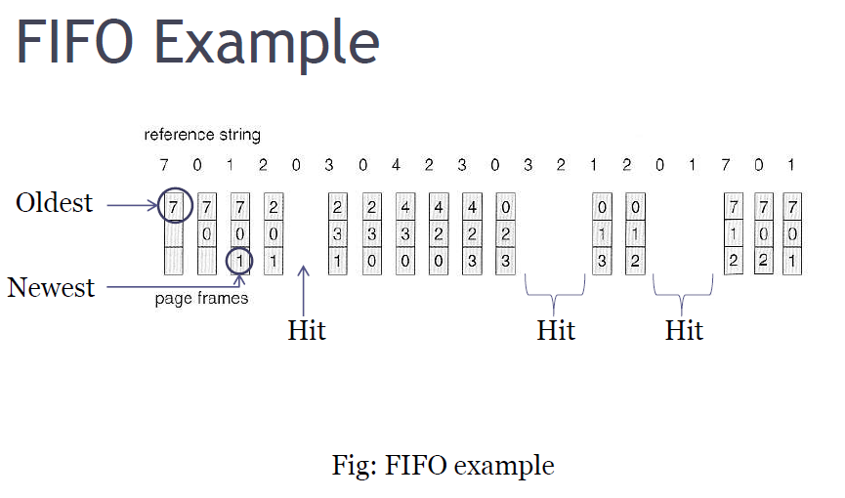
FIFO (First In First Out)
Pages in main memory are kept in a list
First in first out is very easy to implement
The FIFO algorithm select the page for replacement that has been in memory the longest time

Slide 33
FIFO (First In First Out)
Advantages:
FIFO is easy to understand.
It is very easy to implement.
Disadvantages:
The oldest block in memory may be often used.

Slide 34
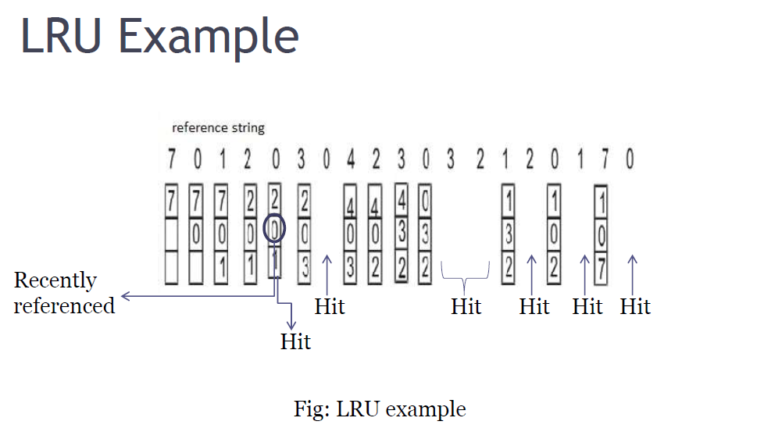
LRU (Least Recently Used)
The least recently used page replacement algorithm keeps track page uses over a
short period of time.

Slide 35
LRU (Least Recently Used)
Advantages:
LRU page replacement algorithm is quiet efficient.
Disadvantages:
Implementation difficult. This algorithm requires keeping track of what was used when, which is expensive if one wants to make sure
the algorithm always discards the least recently used item.

Slide 36
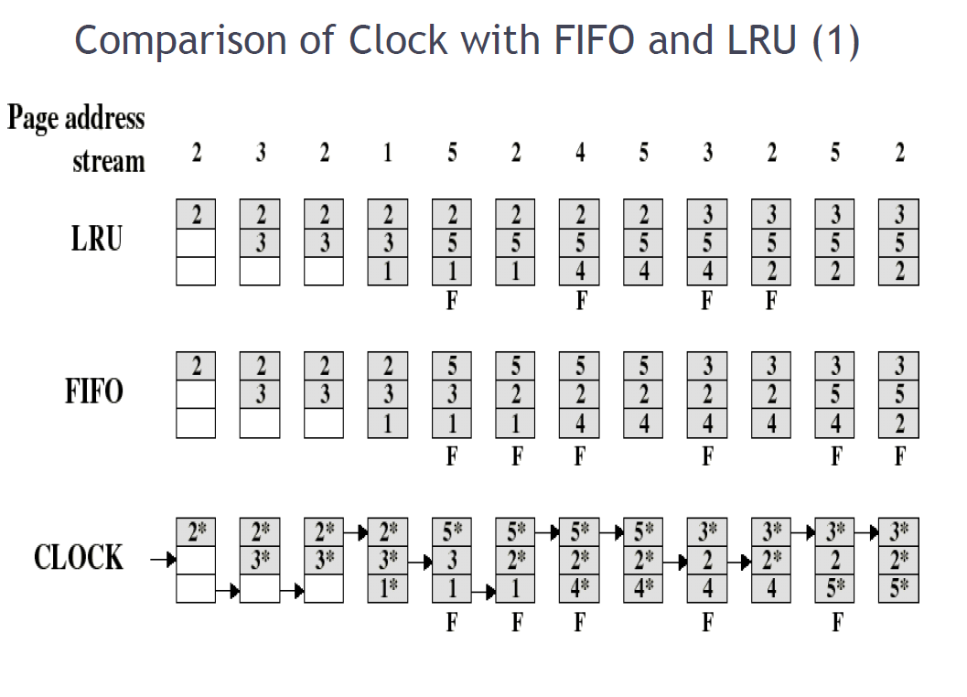
Comparison of Clock with FIFO and LRU

Slide 37
LFU (Least Frequently Used)
The Least-Frequently-Used (LFU) Replacement technique replaces the least-frequently block in use when an eviction must take place.
Software counter associated with each block, initially zero is required in this algorithm.
The operating system checks all the blocks in the cache at each clock interrupt.
The R bit, which is '0' or '1', is added to the counter for each block. Consequently, the counters are an effort to keep track of the frequency of referencing each block.
When a block must be replaced, the block that has the lowest counter is selected for the replacement.

Slide 38
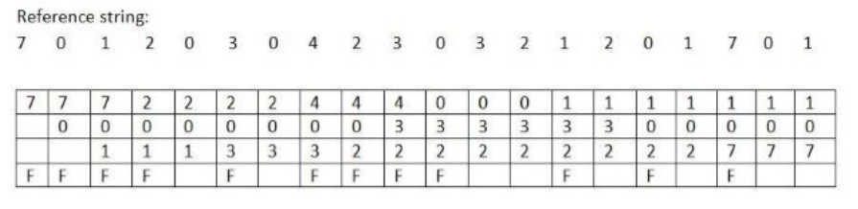
LFU (Least Frequently Used)
Number of page faults = 12.
Number of page hits= 8.

Slide 39
LFU (Least Frequently Used)
Advantages:
Frequently used block will stay longer than (fifo)
Disadvantages:
Older blocks are less likely to be removed , even if they are on longer frequently used because this algorithm never forgets anything.
Newer blocks are more likely to be replaced even if they are frequently used.
Captures only frequency factor.

Slide 40
Random Replacement
When we need to evict a page, choose one randomly
Advantage:
Extremely simple
Disadvantages:
Can easily make "bad" choices by swapping out pages right before they are needed.

Slide 41
The Memory System
Performance considerations

Slide 42
Performance Considerations
A key design objective of a computer system is to achieve the best possible performance at the lowest possible cost.
Price/performance ratio is a common measure of success.
Performance of a processor depends on:
How fast machine instructions can be brought into the processor for execution.
How fast the instructions can be executed.

Slide 43
Interleaving
Divides the memory system into a number of memory modules. Each module has its own address buffer register (ABR) and data buffer register (DBR).
Arranges addressing so that successive words in the address space are placed in different modules.
When requests for memory access involve consecutive addresses, the access will be to different modules.
Since parallel access to these modules is possible, the average rate of fetching words from the Main Memory can be increased.

Slide 44
Methods of Address Layouts
k
bits
m
bits
m
bits
k
bits
Module
Address in module
MM address
Address in module
Module
MM address
ABR
DBR
ABR
DBR
ABR
DBR
ABR
DBR
ABR
DBR
ABR
DBR
Module
Module
Module
Module
Module
Module
0
i
n
-
1
0
i
2
k
-
1
Consecutive words are placed in a module.
High-order k bits of a memory address determine the module.
Low-order m bits of a memory address determine the word within a module.
When a block of words is transferred from main memory to cache, only one module is busy at a time.
Consecutive words are located in consecutive modules.
Consecutive addresses can be located in consecutive modules.
While transferring a block of data, several memory modules can be kept busy at the same time.

Slide 45
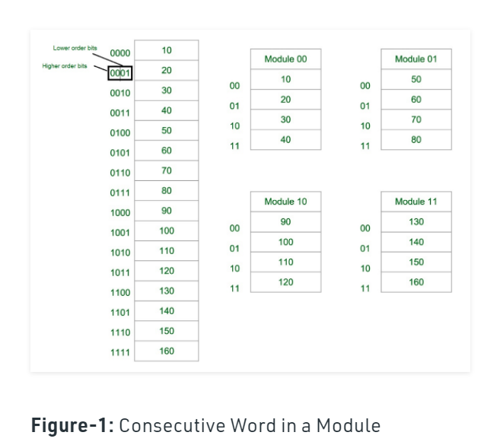

Slide 46
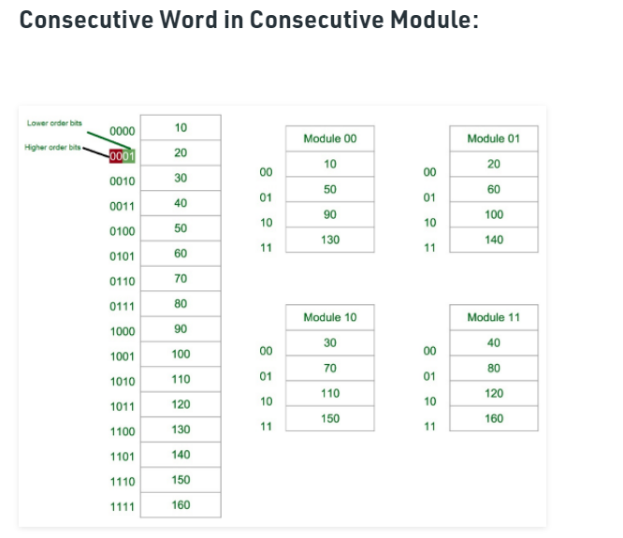

Slide 47
Hit Rate and Miss Penalty
Hit rate
Miss penalty
Hit rate can be improved by increasing block size, while keeping cache size constant
Block sizes that are neither very small nor very large give best results.
Miss penalty can be reduced if load-through approach is used when loading new blocks into cache.

Slide 48
Caches on the Processor Chip
In high performance processors 2 levels of caches are normally used.
Avg access time in a system with 2 levels of caches is
T _{ave} = h1c1+(1-h1)h2c2+(1-h1)(1-h2)M

Slide 49
Other Performance Enhancements
Write buffer
Write-through:
Each write operation involves writing to the main memory.
If the processor has to wait for the write operation to be complete, it slows down the processor.
Processor does not depend on the results of the write operation.
Write buffer can be included for temporary storage of write requests.
Processor places each write request into the buffer and continues execution.
If a subsequent Read request references data which is still in the write buffer, then this data is referenced in the write buffer.
Write-back:
Block is written back to the main memory when it is replaced.
If the processor waits for this write to complete, before reading the new block, it is slowed down.
Fast write buffer can hold the block to be written, and the new
block can be read first.

Slide 50
Other Performance Enhancements (Contd.,)
Prefetching
New data are brought into the processor when they are first needed.
Processor has to wait before the data transfer is complete.
Prefetch the data into the cache before they are actually needed, or a before a Read miss occurs.
Prefetching can be accomplished through software by including a special instruction in the machine language of the processor.
Inclusion of prefetch instructions increases the length of the programs.
Prefetching can also be accomplished using hardware:
Circuitry that attempts to discover patterns in memory references and then prefetches according to this pattern.

