Slide 1
Computer Architecture And Organization
Module 5
Interfacing and Communication

Slide 2
INPUT/OUTPUT
Exchange of data between the computer and other devices
Interacting with computer using input/output devices
Human operator: use keyboard to input data and views the output on the display screen
Computers communicate with other computer over the internet
Exchanging data from/to the computer is the basic feature

Slide 3
INPUT/OUTPUT DEVICES
Keyboard
Mouse
Digital Camera
Scanners
Joy stick
Microphone
Monitor
Projector
Printer
Speaker
Plotters
Head Phones

Slide 4
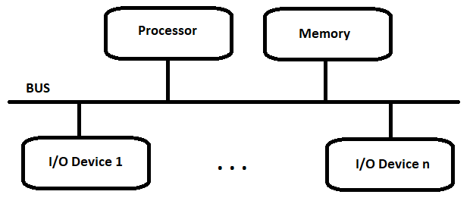
Accessing IO Devices
Single-Bus Structure
All the connected devices can share information by bus

Slide 5
Cont…
Bus consists of three lines for carrying the address, data & control
Every I/O has unique set of addresses
Generally Processor controls the bus by sending the address and the control signals
The processor place the device address, The device recognize the address and responds to the command (read/write)
The requested data transferred over the data lines

Slide 6
Memory-mapped IO
The shared address space for both the memory and I/O
The instruction used for accessing memory could be utilized for accessing the I/O device
Most processor follows memory-mapped I0
Few like Intel processors have special I/O instruction to address the Input/Output devices

Slide 7
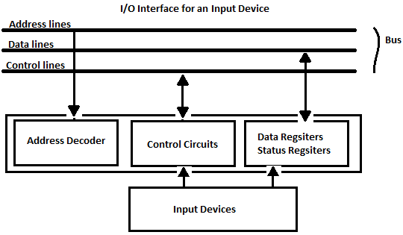
I/O Interface
A H/W required to fuse the IO devices with the processor through bus is called as I/O Interface

Slide 8
Cont…
The address decoder helps the device to decode identify its own address
Data registers holds the data(8 or 16 bit) to be transferred from/to the processor
The status register holds data resulted from the operation of the system
The data and status registers connected to the data bus
The address decoder is connected to the address lines
The control circuits responds with read/write operation based on the signals from the control lines
The IO devices are slower than the processor.

Slide 9
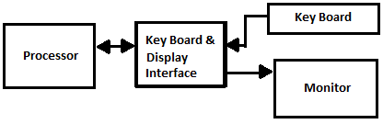
Eg: Key Board & Display Interface

Slide 10
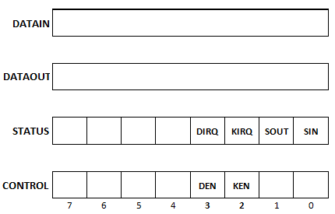
Cont…
The interface consists of the following registers
Data register (DATAIN & DATAOUT)
Status Register consists of single bit status flag (SIN,SOUT,DIRQ,KIRQ)
Control Register

Slide 11
Cont..
SIN flag represents keyboard status
SIN flag set to 1 when key is pressed(data is ready) and it get reset when the processor had read the data
SOUT flag represents display status
Similar to SIN flag
KIRQ ,DIRQ flag bits represent the interrupt to the processor( if 1 interrupt request is send to the processor, after the processor service the interrupt request it get reset) by the Keyboard and Display respectively
DEN,KEN are control flag bits used to enable and disable the display and the keyboard respectively

Slide 12
Program-Controlled IO Program to read char from keyboard and echo the same to the display
WAITKB : TESTBIT #0,STATUS (test the 0th SIN bit of the status register for 1)
BRACNCH =0 WAITKB (if zero jump to the label WAITKB )
MOVE DATAIN,R1 (else read the DATAIN register and move data to R1 register
of the Processor)
WAITD: TESTBIT #1,STATUS (read the 1st bit of the status register for 1)
BARNCH =0 WAITD (if zero jump to the label WAITD )
MOVE R1,DATAOUT (else send the data from R1 register to DATAOUT register of the
interface)

Slide 13
Interrupts
In the programmed control led IO, the processor has to continuously monitor the devices for any input/output data
This process over burden the process to monitor the IO devices at a regular an intervals
An alternate approach to perform IO operation i.e. when the IO devices are ready to transfer or receive the data then it can notify the processor by means of interrupts

Slide 14
Cont…
Interrupt is an hardware signal send by the peripherals to the processor
The processor no longer has to monitor the IO peripherals
How the processor react for an Interrupt?
In abstract, The processor pause its ongoing process execution, It acknowledges the interrupting device and executes the Interrupt Service Routine(ISR) ,after the execution of ISR the processor resumes the execution of the ongoing process.

Slide 15
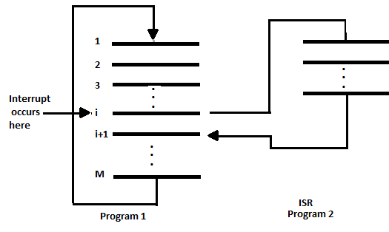
Interrupt Service Routine
A set of instruction meant for doing process on interrupt
Eg: printing routine to the display
A sub-routine called on interrupt request

Slide 16
Resuming to original process
After the execution of the ISR the processor resumes the original program and continue its execution
The processor store the information (state) about the original process before calling the ISR. This cause delay in executing ISR. This delay is called as Interrupt Latency
Most processors only save a minimal amount of data (state) like program counter, Processor status registers and data registers

Slide 17
Interrupt Acknowledgement
The processor informs the device about the recognition of the interrupt
Generally ,processor send an explicit ACK control signal
By doing data transfer the processor informs the device
interrupt the executing program & Can alter the expected events sequence
These changes can often be unacceptable, and should not be permitted
For example, the processor may not want the same device to interrupt while executing its ISR

Slide 18
Interrupt Flag
In general, the Processors allows to enable or disable such interruptions as required
Enabling/Disabling the Interrupt Flag
The processor avoids interrupt request from devices while executing the ISR by disabling the interrupt flag
The processor gets ready to accept interrupt after the ISR by enabling the Interrupt Flag

Slide 19
Handling Multiple Interrupting Devices
Multiple independent I/O devices capable of generating interrupt request could associated to the processor & main memory through bus lines
Every /any device can raise interrupt request at any time or any two/more devices can raise interrupt request at the same time
The processor has to know
which device has generated an interrupt?
which ISR should be executed?
can other device interrupt the processor? ,while the processor is executing ISR for some device
To select the INT requests, If two INR are signaled at the same time

Slide 20
Cont..
Over the single control line all the devices are connected to the processor, how does the processor knows INT requested sending device which are coupled to this common line
The processor reads the status flags data available in the device sending an interrupt request
Every device's status register has an IRQ flag bit, which it sets to 1 when requesting an interrupt
Simple way to identify the interrupting device is by having ISR poll on all the connected devices
The first encountered device with IRQ bit set should be serviced
Disadvantage of polling: spending time to check the status bits of all the devices

Slide 21
Vectored Interrupts
A interrupting device inform special code to the processor to identify itself
The code/address points to the starting address of an ISR for that device
The bit size of the code may vary from 4-8 bits
The processor can immediately start processing the ISR
This scheme of handling interrupt is called as vectored Interrupts

Slide 22
Interrupt Priority
I / O devices are grouped into priorities order
The priority level is used. It range from high priority to low priority devices
The interrupt request from the high priority devices are served first
If two devices are sending IRQ at same time the processor resolve by priority and selects the device with highest priority
The priorities can be fixed one and programmable with privileged instruction

Slide 23
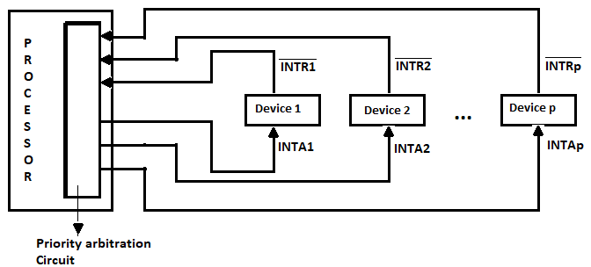
Cont…

Slide 24
Exception
Interrupt event : The IO devices send IRQ to the processor
Interrupt can be also be raised through exceptions(Interrupt event)
Memory error-check code to detect error in the stored data is a kind of exception
Illegal OP-code field
Division by zero
Privilege exception raised by the processor if the non-privilege user program tries to execute privilege instruction

Slide 25
Direct Memory Access (DMA)
MOV DATAIN,R0 - is a simple data transfer instruction to transfer a data from the IO to the processor
Data transfer can be like moving of data
memory -> processor register
processor register -> memory
memory -> memory
memory -> IO
IO -> memory
IO -> IO
Register to register

Slide 26
Cont…
The processor has to do data transfer ,it sends address signal and control signal.
It has to wait for the memory , IO devices to complete the data transfer ,expect the data transfer between register to register
It burdens the processor ie more delay for waiting the IO devices and memory
It blocks the processor to execute the other instructions
To over come this DMA controllers are used

Slide 27
Cont…
DMA controller take care of data transfer from memory← → IO without the intervention of the processor
This mechanism is known as Direct Memory Access
The processor will be free from involving in the data transfer
The DMA controller take care of issuing control signals, address signals and movement of data (counting the data)
The DMA take the control of the bus from the processor during direct memory access

Slide 28
Cont…
To initiate the data transfer, the processor sends the address, word count and the direction of the transfer to the DMA controller
After receiving the DMA performs the data transfer and informs the process about the transfer complete by means of interrupt
During the DMA the processor can execute the other instrcutions

Slide 29
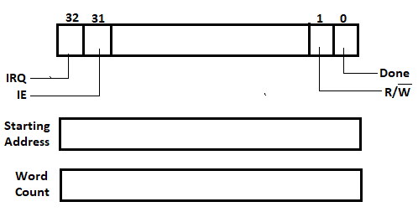
Registers in DMA Controller

Slide 30
Cont…
Address register contains the starting address of the block
The word count register contains ,how many words should move from the starting address
The DMA controller automatically increments the address pointer until the word count registers becomes zero
The status register inform about DMA operation ( done or not)
Read/Write gives the direction of the data flow
The control registers IE is set to interrupt the processor after DMA process
DMA can also initiate the DMA process, it interrupts the processor by setting the IRQ control flag

Slide 31
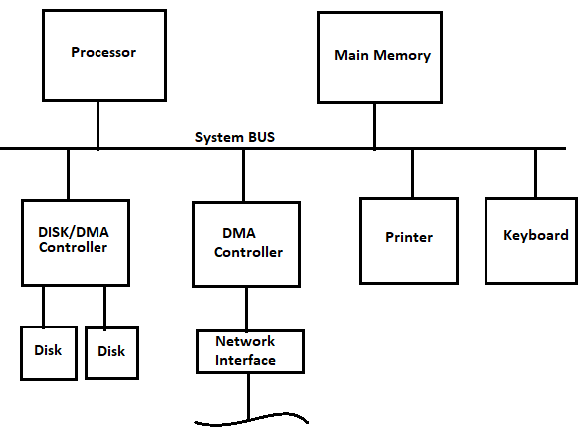
Interfacing DMA controller

Slide 32
Cont…
DMA always given higher priority than the processor during the data transfer
High speed peripherals are given highest priority in DMA controller
The DMA controller can get the access to memory by getting(stealing) the bus control cycles from processor this is known as cycle-stealing
DMA can do bulk data transfer from the memory without intervension
DMA posses internal data buffers to match the data transfer speed among the slow devices

Slide 33
Types of Buses
Address Bus
Data Bus
Control Bus

Slide 34
Synchronous Bus
Synchronous bus (e.g., processor-memory buses)
All devices derive timing information from a common clock.
Equal time intervals.
Advantage:
It needs very little thought and can work very quickly.
Disadvantages:
Every device communicating on the bus must use same clock rate
To avoid clock skew, they cannot be long if they are fast

Slide 35
Asynchronous Bus
It is not clocked, so a handshaking protocol is required and additional control lines are needed.
Advantages:
Can accommodate a wide range of devices and device speeds
Can be lengthened without worrying about clock skew or synchronization problem.
Disadvantage: slow

Slide 36
Synchronous Bus
CPU
Main Memory
Bus Adaptor
Asynchronous Bus
I/O Devices
I/O Devices
I/O Devices

Slide 37
Bus arbitration
The processor always be the master of all the bus lines
Arbitration ,a method of selecting the next bus master from the multiple bus access request
Two approaches
Centralized
Decentralized

Slide 38
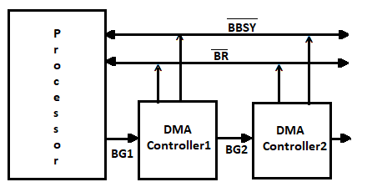
Centralized arbitration :Daisy Chain

Slide 39
Cont…
DMA sends Bus Request (BR) to the processor
If the processor is ready to grant access in responds to the BR , it sends Bus grant (BG1) signal to the first connected DMA controller Informing that, it may use the bus once it is free
The DMA controller1 receives the acknowledgement from the processor. If the DMA 1 had requested the bus it will become the bus master other wise it will forward the acknowledgement to the next DMA with BG2 signal
The mechanism of using acknowledgment if it belongs to requested one, or else forwarding the acknowledgement to the next device is called as Daisy Chain
The processor sends Bus Busy signal to prevent other device to access the bus

Slide 40
Distributed arbitration
No central device like processor to grant bus access
Each device is assigned with 4-bit code ,the device places the code to request the bus access
One or more devices may place their code on the bus to gain access
The winner is selected from the interaction of the signal code over the bus during contention

Slide 41
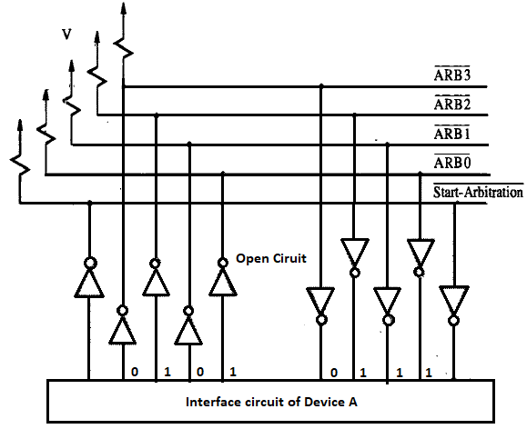
Example

Slide 42
Cont…
Consider two device A (0101) and B (0110) send the code over the bus
The OR operation was performed with available code on the bus
The code 0111 is seen by both A and B
Both the devices compares the seen code with their code from the LSB
If it find any change in the bit values it put zero on the lower bits o the bus
The device checks the bit from the LSB it finds the difference in the 2nd bit, so it puts the zero on the bus like 0100
Now after the OR operation the code will be 0110 hence the device B gains the bus control
Device B will temporarily disable the code on the bus

Slide 43
BUSES
Provides interconnection between processor, memory and IO devices acting a communication path to perform data transfer
Carries address, data and control signals separately
The data size vary from byte, word, long word
Control signal like Read/Write as single line,1 means read & 0 means write
Supports to interrupt signal and arbitration
Bus carries timing signal

Slide 44
Types of BUSES
Vary with timing signal
Synchronous BUS
Asynchronous BUS

Slide 45
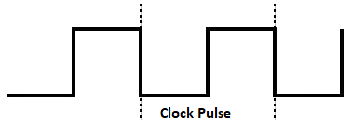
Synchronous Bus
Clock signal –generally a square generated using a clock circuitry
Every processing devices uses clock pulse to trigger the state change , either at the pulse Edge or level of the square signal

Slide 46
Cont…
When all the device uses a common clock then it is said to be synchronous
Each pulse in the clock is the bus cycle where the data transfer occurs
There will be Master-Slave devices, The device which controls the bus is master and other devices are slave
The master signals the address , control signals
In read cycle slave put the data over the data lines , master reads the data into its buffer
In write cycle master puts the data on bus where the slave reads the data from the bus

Slide 47
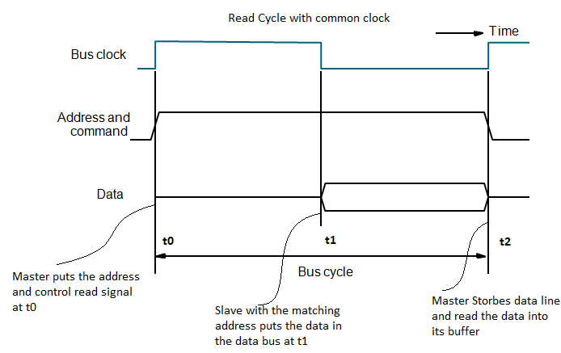
Read cycle

Slide 48
Asynchronous BUS
Handshaking signals are used between the master and the slave before the actual data transfer
No common clock is used, the master and slave use may two different clocks with varying speed
Two control signals to perform handshake
Master-ready (Asserted by the masterdevice to show that the data is ready)
Slave-ready (Slave asserted as a response to indicate that it is ready to transfer data)

Slide 49
Handshake Protocol
For read cycle
The master puts the address and the control signal on the bus
Then it asserts the handshake signal Master-ready on the bus
These signals are visible to all the slave devices since they use the same common bus
The respective slave puts the data and the signals Slave-ready signal
It strobes data from the bus lines into it buffer after the Slave-ready signal

Slide 50
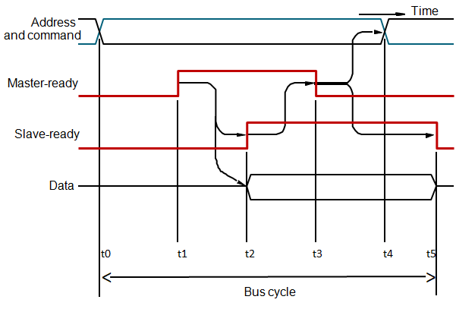
Read cycle using Handshake

Slide 51
Cont…
t0- Master puts the slave address ,read signal on the bus; which is visible to all the slave devices
t1- Master asserts signal high(Master-ready ), to inform the command and address is ready, small skew delay in t0-t1 to match the variance in the speed and propagation delay
t2 – specified slave decode the address ,command and puts the data on the data bus from its register, by asserting the Slave-ready signal on the bus it informs master that data is ready for reading

Slide 52
t3-the master receives the handshake signals and strobe the data
t4- Master takes the address and the command off
t5- the slave device removes the data and slave ready signal when it notices the 1 to 0 transition of the master-ready signal

Slide 53
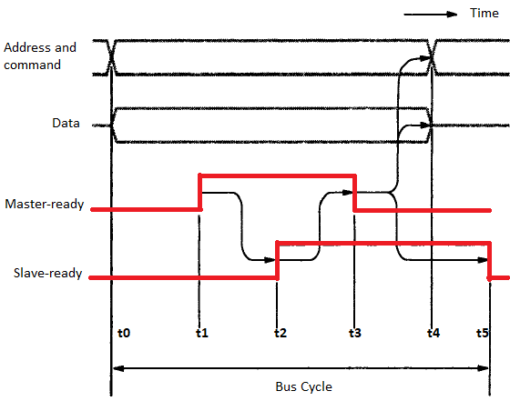
Write Cycle using Handshake

