Slide 1
Interfacing and Communication Module 5 PART B

Slide 2
Interrupt
To avoid the problem of CPU enters into the program loop in the case of Programmed i/o.
To keep the CPU as much busy as possible.
During data exchange with the processor, I/O module interrupts the processor to request for service.
The method starts executing up on interrupt request. This method is known as Interrupt-service routine.

Slide 3
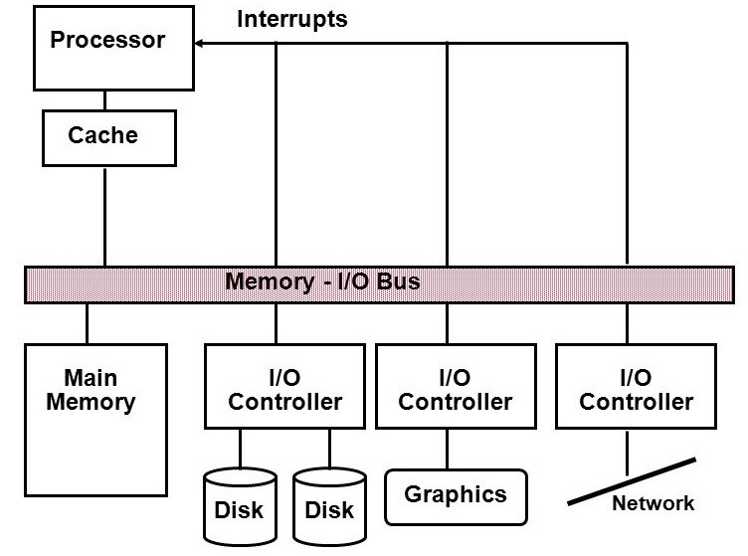
A Typical I/O System

Slide 4
Interrupt Processing
The device transmits a signal interrupt.
The processor must finish executing the current instructions before replying To the interrupt.
The processor checks for incoming interrupt signal, verifies whether an error occurs and sends an acknowledgement for the interrupt received.

Slide 5
Device controller or other system hardware may also emanate an interrupt
Processor finishes execution of current instruction.
Processor signals acknowledgment of interrupt.
Processor pushes PSW and PC onto control Stack.
Processor loads new PC value based on interrupt

Slide 6
Save remainder of process state information.
Process interrupt.
Restore process state information.
Restore old PSW and PC.
(PSW : program status word. PC : Program Counter)

Slide 7
Design issues
Having multiple I/O devices exists, the processor must be able to know which device has interrupted the processor.
There are four design issues to accomplish the above task.

Slide 8
Multiple interrupt lines.
Software poll.
Daisy chain (hardware poll, vectored).
Bus arbitration (vectored)

Slide 9
Enabling and disabling Interrupts
Give programmer complete control overs events to occur during the program execution.
Interrupt causes to transfer of CPU attention to some other task.
Interrupt is triggered and then ISR associated with that particular interrupt will be resumed.

Slide 10
Priorities and vectors
There are two methods through which interrupts can be made more specific.
Priorities
CPU allotment is done on priority basis. Priorities are numbered according the requirement. Lower value indicates higher priority.
Vectors
Determine the code to be called for each type of interrupt.

Slide 11
Prioritized interrupts
device 1
device 2
device n
interrupt
acknowledge
CPU
L1 L2 .. Ln
If all devices ask interrupt simultaneously, only the highest priority receives it

Slide 12
Interrupt vectors
Allows the particular code to handle the I/O device service request..
Interrupt vector table:
Interrupt Handler 0
Interrupt Handler 0
Interrupt Handler 0
Interrupt Handler 0
Interrupt Handler 0
Interrupt Vector Table Head

Slide 13
Interrupt sequence
CPU acknowledges request.
Device sends vector.
CPU calls handler.
Software processes request.
CPU restores state to foreground program.

Slide 14
Sources of interrupt overhead
Handler execution time.
Interrupt mechanism overhead.
Register save/restore.
Pipeline-related penalties (branch penalty)
Cache-related penalties.

Slide 15
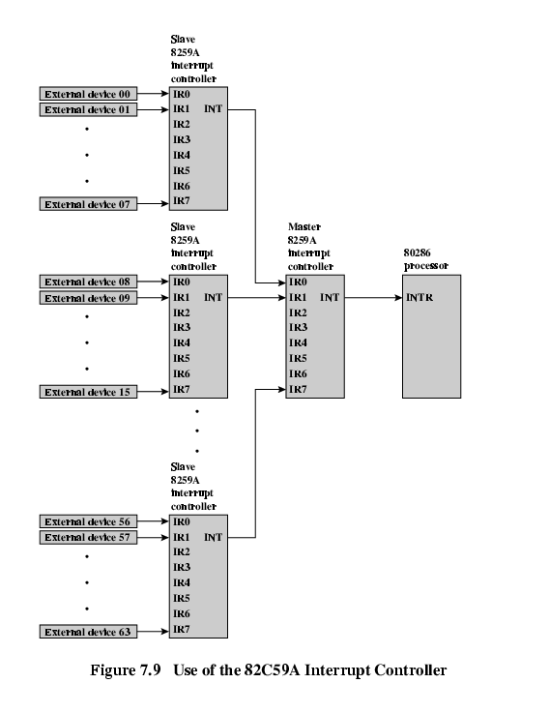
82C59A Interrupt Controller

Slide 16
The Intel 80386 processor allows two interrupt line.
INTR : Interrupt Request line.
INTA : Interrupt Acknowledgement line.
To Handle I/O devices, it is connected with 82C59A Interrupt controller. All external devices are connected with 82C59A.

Slide 17
I/O System Interconnect Issues
All of the system 's essential components , i.e. processor, main memory and I / o devices can be linked via a bus whose principal purpose is to transfer data between devices..
Console Controller
CPU
Main Memory
I/O Modules
Omnibus

Slide 18
Advantages
Versatile – New devices that use the same bus protocol can easily be added and switched between computer systems.
Low cost – a single set of wires is shared in multiple ways.
Disadvantages
Creates a communication bottleneck – bus bandwidth limits the maximum I/O throughput.
The maximum bus speed is largely limited by
The length of the bus.
The number of devices connected to the bus.

Slide 19
Bus Characteristics
The device that initiates data transfer is called as a master or an Initiator.
The device which follows the instructions of the master is called as a slave or target.
Bus Master
Control lines: Master initiates requests
Bus Slave
Data lines: Data can go either way

Slide 20
Types of Buses
Address Bus
Data Bus
Control Bus

Slide 21
Synchronous Bus
Synchronous bus (e.g., processor-memory buses)
All devices derive timing information from a common clock.
Equal time intervals.
Advantage:
It needs very little thought and can work very quickly.
Disadvantages:
Every device communicating on the bus must use same clock rate
To avoid clock skew, they cannot be long if they are fast

Slide 22
Asynchronous Bus
It is not clocked, so a handshaking protocol is required and additional control lines are needed.
Advantages:
Can accommodate a wide range of devices and device speeds
Can be lengthened without worrying about clock skew or synchronization problem.
Disadvantage: slow

Slide 23
Synchronous Bus
CPU
Main Memory
Bus Adaptor
Asynchronous Bus
I/O Devices
I/O Devices
I/O Devices

Slide 24
References
David A. Patterson and . John L. Hennessy “Computer Organization and Design-The Hardware/Software Interface” 5th edition, Morgan Kaufmann, 2011.
Carl Hamacher, Zvonko Vranesic, Safwat Zaky, Computer organization, Mc Graw Hill, Fifth edition ,Reprint 2011.
W. Stallings, Computer organization and architecture, Prentice-Hall, 8th edition, 2009

