Slide 1
Module 7 FLYNN’S CLASSIFICATION Part 1
Assistant Professor, SCOPE, VIT, Chennai, India

Slide 2


1
YES….within 30ms
Addition of 2 Integers (1 pair)
GOOD…

Slide 3
Answer???
Number of Computers?
1
Number of Processors?
1
Number of Operations / Instructions?
1 (Addition)
Number of Data?
1 pair (6 & 20)
Execution Time (Minimum) ?
30ms

Slide 4
2
Will you wait for 18 hours at least?
Addition of 80,00,000 pairs of Integers
What???
Why??
Am a Single Processor System

Slide 5
Answer??
Number of Computers?
1
Number of Processors?
1
Number of Operations / Instructions?
1 (Addition)
Number of Data?
80,00,000 pairs
Execution Time (Minimum) ?
18 Hrs

Slide 6
3
Will you wait for 12 hours at least?
Will you do 5,000 Different Tasks?
What???
Why??
Am a Single Processor System

Slide 7
Answer???
Number of Computers?
1
Number of Processors?
1
Number of Operations / Instructions?
5,000
Number of Data?
Same / Different Data
Execution Time (Minimum) ?
12 Hrs

Slide 8


4
Answer within 50 minutes
Addition of 80,000 pairs of Integers
8000
Processor 5
Addition of 80,000 pairs of Integers
8000
Processor 4
8000
Processor 3
8000
Processor 2
8000
Processor 1
8000
Processor 6
8000
Processor 7
8000
Processor 8
8000
Processor 9
8000
Processor 10
System

Slide 9
Answer???
Number of Computers?
1
Number of Processors?
10
Number of Operations / Instructions?
1 (Addition)
Number of Data?
80,000
Execution Time (Minimum) ?
50 minutes

Slide 10
Flynn’s Taxonomy
Taxonomy to classify parallel processing systems
Introduced by Flynn in 1966
Based on
Parallelism implementation
Number of Instruction stream and Data stream

Slide 11
Architectural Classification
SISD – Single Instruction Single Data
SIMD – Single Instruction Multiple Data
MISD – Multiple Instruction Single Data
MIMD – Multiple Instruction Multiple Data

Slide 12
Architectural Classification
Uniprocessor – SISD
Multiprocessor – MIMD
Separate programs run on different processors
SPMD (Single Program Multiple Data)
Different sections of same program run over different processors
MISD
Stream processor – series of computation on single data stream
Example: Encrypt, compress, transmit, uncompress, decrypt

Slide 13
Taxonomy of Parallel Processor Architecture
Processor
SISD
SIMD
MISD
MIMD
Uni Processor

Slide 14
SISD
Instruction Steam
Instruction Steam
Control Unit
Processing Unit
Data Steam
Memory
Control Processing Unit

Slide 15
Taxonomy of Parallel Processor Architecture
Processor
SISD
SIMD
MISD
MIMD
Vector Processor
Array Processor

Slide 16
SIMD – Distributed Memory
Instruction Steam
PU1
Data Steam
Mem1
Instruction Steam
CU
PU2
Data Steam
Mem2
PUn
Data Steam
Memn
Instruction Steam

Slide 17
SIMD
Same Instruction Sequence is applied to different data sets like vector processor
Vectors of data
Synchronized parallel execution units that are respond to single instruction
Each execution unit has its own address registers that have different data
Serial Hardware → SISD, Parallel Hardware → SIMD
Ex: addition of 64 numbers in the form of 64 data streams to 64 ALUs to perform 64 sums in a parallel manner

Slide 18
SIMD
Each Instruction is executed on different data set by the different parallel processors
Ex: Vector and Array Processors
Processing Unit has its own Data Memory

Slide 19
SIMD
Advantages
Gradually reduce the cost of control unit by increasing the execution units
Reduced Instruction bandwidth & space
SIMD – Only one copy of code simultaneously executed
MIMD – need copy in every processor
Best in dealing with arrays in for loop
It provides Data-level-Parallelism
Performing same operation on identically structured & independent data
Can’t handle switch-case
Each execution unit performs different task on its data that depends on data of switch-case value

Slide 20
Taxonomy of Parallel Processor Architecture
Processor
SISD
SIMD
MISD
MIMD

Slide 21
MISD
Single data set is passed to a set of parallel processors
Each processor executes its own instruction sequence on the data
Not Exist in real time

Slide 22
Taxonomy of Parallel Processor Architecture
Processor
SISD
SIMD
MISD
MIMD
Shared Mem
(Tightly Coupled)
Distributed Mem (Loosly Coupled)
SMP/UMA
NUMA
Clusters

Slide 23
MIMD
Different instruction sequence on different set of data by the parallel processors
2 Types
SMP (Symmetric Multiprocessor)
NUMA (Non Uniform Memory Access)
SMP
Processors share memory by their shared Bus and other interconnecting technologies
Uniform Memory Access Time

Slide 24
MIMD
NUMA
Memory Access Time differs based on its location
Advantages of SMP
Performance
Availability
Incremental Growth

Slide 25
MIMD (Distributed Memory)
Instruction Steam
Inter connecting Technology
CU1
Instruction Steam
PU1
Data Steam
M1
CU2
Instruction Steam
PU2
Data Steam
M2
Instruction Steam
Instruction Steam
CUn
Instruction Steam
PUn
Mn
Data Steam

Slide 26
MIMD (Shared Memory)
Shared Memory
CU1
Instruction Steam
PU1
Data Steam
CU2
Instruction Steam
PU2
Data Steam
CUn
Instruction Steam
PUn
Data Steam

Slide 27
MIMD
Perception | Loosly Coupled | Tightly Coupled
Physical | I/O level communication | Memory level communication
 | Local main memory | Shared main memory
 | No shared memory page access | Overlapping page access
Logical | Cooperative Processors | Word-by-Word interaction
 | Autonomous Processor | Master – Slave Processors

Slide 28
Multimedia Processor
Processor Type | Multimedia Processor
SISD | Intel Pentium 4
SIMD | SSE instructions of x86
MISD | Not yet implemented
MIMD | Intel Core i7

Slide 29
Multimedia Processor
SIMD in x86: Multimedia Extension
Subword parallelism → inspiration of MMX instructions of the x86
By introducing more instructions
SSE (Streaming SIMD Extension)
AVX (Advanced Vector Extension)

Slide 30
Vector
Vector Architecture / SIMD
Seymour Cray by 1970
Access data from memory → store them in the set of register as per the order of fetching
Apply instruction on the stored data sequentially using pipelined execution units
write result back into registers

Slide 31
Vector Vs Scalar
Single vector instruction is equivalent to executing an entire loop → bandwidth needed for IF & ID reduced
Different computations generate different results in the same vector → no check for data hazard by the compiler
Hardware checks the data hazard for each vector operand → not for every element in the vector → It saves energy

Slide 32
Vector Vs Scalar
Memory – Vector elements are stored as adjacent – latency is only one to access entire vector rather then accessing a word from the vector
Loop is implemented as a vector instruction → may expect branch hazard
Save bandwidth
Hazard checking
Power & Energy Consumption

Slide 33
Taxonomy of Parallel Processor Architecture
Processor
SISD
SIMD
MISD
MIMD
Uni Processor
Shared Mem
(Tightly Coupled)
Distributed Mem (Loosly Coupled)
Vector Processor
Array Processor
Cluters
SMP/UMA
NUMA

Slide 34
Problem
Execute the loop below as efficiently as possible. We have two different machines, a MIMD machine and a SIMD machine.
for (i=0; i < 5000; i++)
for (j=0; j < 6000; j++)
T[i][j] = A[i][j] + (2 * B[i][j])
(i) For a 6 CPU MIMD machine, show the sequence of MIPS instructions that you would execute on each CPU. What is the speedup for this MIMD machine?
(ii) For an 10-wide SIMD machine (i.e., 10 parallel SIMD functional units), write an assembly program in using your own SIMD extensions to MIPS to execute the loop. Compare the number of instructions executed on the SIMD machine to the MIMD machine.
David A. Patterson and . John L. Hennessy ―Computer Organization and Design-The Hardware/Software Interface‖ 5th edition, Morgan Kaufmann, 2011.

Slide 35
References
David A. Patterson and . John L. Hennessy ―Computer Organization and Design-The Hardware/Software Interface‖ 5th edition, Morgan Kaufmann, 2011.
W. Stallings, Computer organization and architecture, Prentice-Hall, 8th edition, 2009
Ajit Pal, IIT Kharagpur, High Performance Computer Architecture, NPTEL
Jatindra Kumar deka, IIT Guwahati, Computer Organization and Architecture, NPTEL

Slide 36
Instruction level Paralleism

Slide 37
Pipelining
Pipelining helps to overlap the execution of instructions and improve performance.
This parallel evaluation of instructions by overlapping instructions is called instruction-level parallelism(ILP).

Slide 38
Pipelined performance
An instruction execution typically takes 5 steps ( with reference to MIPS multicycle data path architecture):
Fetch the instruction from instruction memory.
Decode the instruction and get the data from registers.
Execute the operation.
Fetch data from data memory.
Write the result into registers.

Slide 39
Pipelined performance example
Lets consider the operation time for the functional units as:
Memory access :200ps
ALU operation: 200ps
Register read or write : 100ps
Total time for each instruction:
Instruction class | Instruction fetch | Register read | ALU operation | Data access | Register write | Total time
Load | 200 | 100 | 200 | 200 | 100 | 800
Store | 200 | 100 | 200 | 200 |  | 700
Arithmetic ins | 200 | 100 | 200 |  | 100 | 600

Slide 40
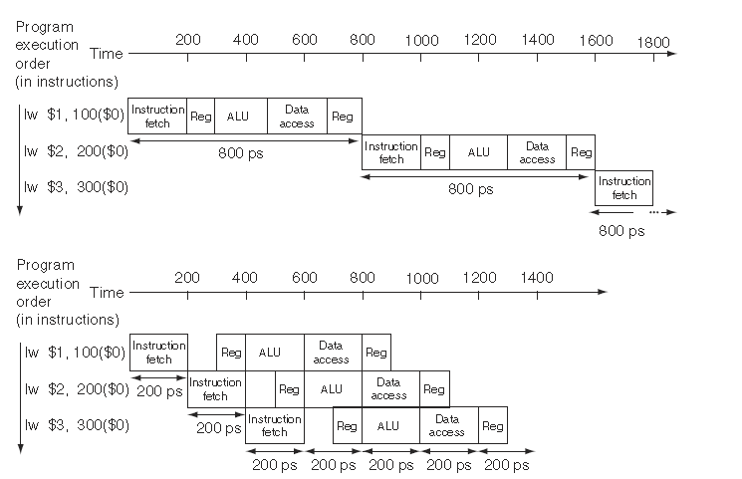
Non-pipelined vs pipelined execution

Slide 41

Pipeline speedup
Pipeline speedup $=\frac{time non pipelined}{time pipelined}$
Consider executing ‘n’ instructions on a k-stage pipelined processor:
Non-pipelined processor: kn
Pipelined processor : (k-1)+n
speedup $=\frac{kn}{\left(k−1\right)+n}$

Slide 42
problem
Consider a 11-stage instruction cycle. Find out the speedup achieved if a set of 50 instructions is run on a processor without pipelining and on the processor with pipelining.

Slide 43
Hazards in pipeline
Hazard: A situations in pipelining when the next instruction cannot execute in the following clock cycle.
There are three types of hazards
Structural hazard
Data hazard
Control hazard

Slide 44
Structural hazrds
An occurrence in which a planned instruction cannot execute in the proper clock cycle because the hardware cannot support the combination of instructions that are set to execute in the given clock cycle.

Slide 45
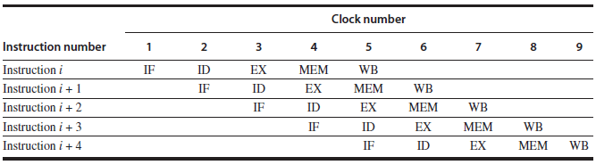
In the above picture, 4th cycle of first instruction and 1st cycle of fourth instruction are trying access memory. If there is a single memory, that will lead to structural hazard.

Slide 46
Data Hazard
An occurrence in which a planned instruction cannot execute in the proper clock cycle because data that is needed to execute the instruction is not yet available.
For example, consider the following instructions
I1: Add $s0, $t0, $t1
I2: Sub $t2, $s0, $t3
Until I1 instruction is executed, I2 can’t as the data computed in I1 is required to compute I2. so there will be 3 stalls.

Slide 47
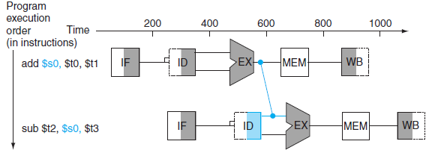
Forwarding ( bypassing): A method of resolving a data hazard by retrieving the missing data element from internal buffers rather than waiting for it to arrive from programmer-visible registers or memory.

Slide 48
Hazards contd..
Control hazard (branch hazard). An occurrence in which the proper instruction cannot execute in the proper clock cycle because the instruction that was fetched is not the one that is needed; that is, the flow of instruction addresses is not what the pipeline expected. (conditional statements in the program)

Slide 49
Solutions to control hazards
Static branch prediction
Branch taken
Branch untaken
Delayed branch

Slide 50
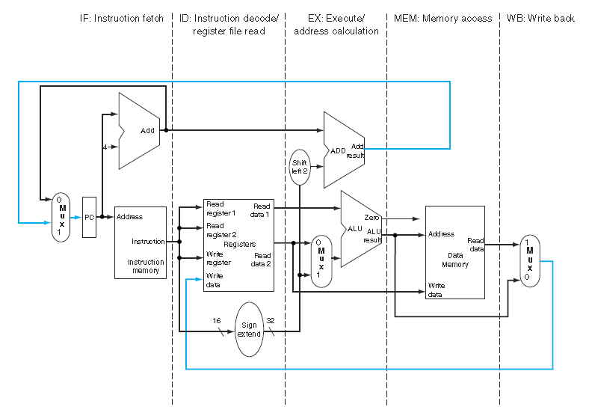
Pipelined data path
Consider the single cycle data path architecture.

Slide 51
We know in single cycle data path architecture, every instruction execute in one cycle. Objective is to redesign the single cycle data path architecture to execute instructions in pipelined fashion.
For this purpose, we break the data path architecture into five components:
IF : Instruction Fetch
ID : Instruction decode and register file read
EX: Execution or address calculation
MEM: Data memory access
WB: Write Back

Slide 52
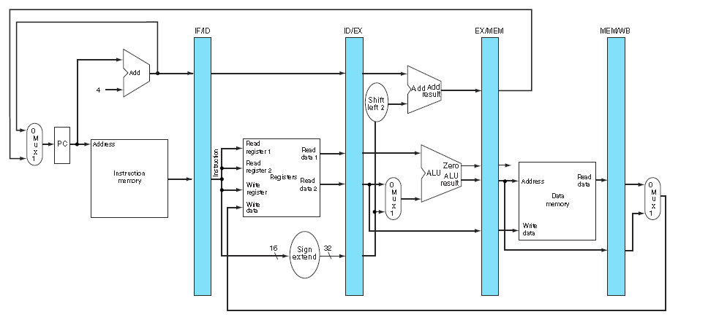
Pipelined version of single cycle data path architecture

Slide 53
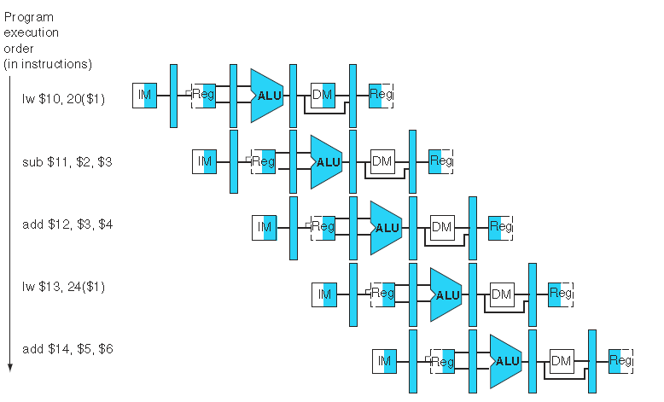
Multiple clock cycle pipeline diagram

Slide 54
Reference links
Computer Architecture –A Quantitative Approach –Hennessy and Patterson ( Appendix A for pipelining)

