Slide 1

Module 8: Overview of Shared Memory and Distributed Memory Architecture

Slide 2
Single core
Single core processor has only one core and it can process only one operation at a time.
Problems:
The clock time has to be increased to execute the tasks faster in the processor.
The increase in clock time drastically increases the heat dissipation and power consumption to high levels which degrades the processor performance.

Slide 3
Multicore Architectures
Two or more independent processors are combined into a single integrated circuit.
Thus the processing power is increased while keeping clock speeds at an efficient level.
A processor with 2 cores can process the instructions with similar speed when compared to a single core processor running at twice the clock speed, yet the energy consumption by the dual core processor would still be less.
Multi-core processors comes under MIMD Category.

Slide 4
Memory and Communication
Main memory in the parallel architectures is of two types
Shared Memory
Distributed Memory

Slide 5
Shared Memory Architecture
General Characteristics:
The same memory resources will be shared by multiple processors but they can operate independently.
Changes made by one processor in a memory location will be visible to all the other processors.
It can be classified as two main classes such as
UMA and
NUMA.

Slide 6
Uniform Memory Access(UMA):
Known as Symmetric Multiprocessor (SMP)
The time taken by any processor to access any word in main memory is same (Uniform access times to memory)
Cache Coherent UMA(CC-UMA)- Changes made by one processor in a memory location will be known by all other processors. It will be accomplished at the hardware level.

Slide 7
Symmetric multiprocessor Architecture
CPU
CPU
CPU
CPU
Cache
Cache
Cache
Cache
BUS
Primary memory
I/O Devices

Slide 8
Non-Uniform Memory Access(NUMA)
Two or more SMPs will be physically linked.
The memory of one SMP can be directly accessed by another.
Access time to all memories will not be uniform for all processors.
Since all the processors access the memory through the link in general it will be slower.
Cache Coherent NUMA (CC-NUMA) is also there.

Slide 9
Distributed multiprocessors (NUMA)
CPU
CPU
CPU
Cache
Cache
Cache
Memory
I/O Devices
Memory
I/O Devices
Memory
I/O Devices
Interconnection Network
9

Slide 10
Advantages and Issues of Shared Memory
Advantages:
It is easy to program since all processors has single view of data.
Faster communication between the processors.
Issues:
Leads to contention since several processors try to access same memory location causing access time degradation.
Lack of coherency of data.

Slide 11
Advantages and Issues of Distributed Memory
Advantages:
Scalability – The memory size will increase proportionately with the increase in processor number.
Rapid access to its local memory without interference and overhead.
Issues:
The issue with distributed memory is how to distribute the data over the memories.
Data communication between processors has to be taken care by the programmer.

Slide 12
Cache Coherence in SMP
x
x
x
x
P1
P2
P3
Pn
Multiple copies of x
What if P1 updates x?
12

Slide 13
The Cache Coherence Problem
P
P
A = 7
3
A = 5
A = 5
Cache
Cache
1
2
A = 5
Memory
13

Slide 14
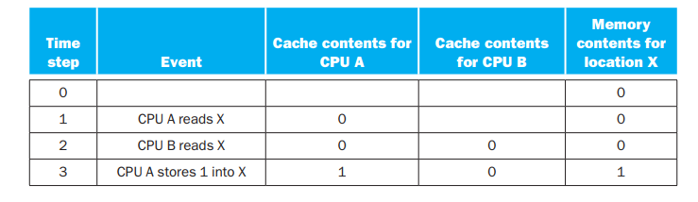
Cache Coherence Problem
Example : X- memory location, A&B - Processors
Assume write through protocol is being followed.
14

Slide 15
Cache Coherence Protocols
Cache coherence protocols are the one that maintain coherency among the processors.
These protocols track the state of any data block that is being shared among the processors.
Snooping - popular one among cache coherence protocols.
Snooping Protocols:
Bus activities will be monitored by the cache controller and the appropriate coherency commands will be carried out when necessary.
15

Slide 16
Single Processor caching
Hit: data in the cache
Miss: data is not in the cache
x
Memory
x
Cache
Hit rate: h
Miss rate: m = (1-h)
P

Slide 17
Cache Coherence Policies
Writing to Cache in 1 processor case
Write Through
Write Back

Slide 18
Writing in the cache
x
Memory
x’
Memory
x
Memory
x
Cache
x’
Cache
x’
Cache
P
P
P
Before
Write through
Write back

Slide 19
Cache Coherence
x
x
x
x
P1
P2
P3
Pn
Multiple copies of x
What if P1 updates x?

Slide 20
Cache Coherence Policies
Writing to Cache in n processor case
Write Update - Write Through
Write Invalidate - Write Back
Write Update - Write Back
Write Invalidate - Write Through

Slide 21
Write-invalidate
x
x’
x
x
x
x’
I
x’
I
P1
P2
P3
P1
P2
P3
P1
P2
P3
Before
Write Through
Write back

Slide 22
Write-Update
x
x’
x
x
x
x’
x’
x’
x’
P1
P2
P3
P1
P2
P3
P1
P2
P3
Before
Write Through
Write back

Slide 23
Snooping Protocols
Snooping protocols are based on watching bus activities and carry out the appropriate coherency commands when necessary. Global memory is moved in blocks, and each block has a state associated with it, which determines what happens to the entire contents of the block. The state of a block might change as a result of the operations Read-Miss, Read-Hit, Write-Miss, and Write-Hit.

Slide 24
Write Invalidate Write Through
Multiple processors can read block copies from main memory safely until one processor updates its copy. At this time, all cache copies are invalidated and the memory is updated to remain consistent.

Slide 25
Write Through- Write Invalidate (cont.)
State
Description
Valid
[VALID]
The copy is consistent with global memory
Invalid
[INV]
The copy is inconsistent

Slide 26
Write Through- Write Invalidate (cont.)
Event
Actions
Read Hit
Use the local copy from the cache.
Read Miss
Fetch a copy from global memory. Set the state of this copy to Valid.
Write Hit
Perform the write locally. Broadcast an Invalid command to all caches. Update the global memory.
Write Miss
Get a copy from global memory. Broadcast an invalid command to all caches. Update the global memory. Update the local copy and set its state to Valid.
Replace
Since memory is always consistent, no write back is needed when a block is replaced.

Slide 27
Example 1
X = 5
P reads X
Q reads X
Q updates X, X=10
Q reads X
Q updates X, X=15
P updates X, X=20
Q reads X
M
C
C
P
Q

Slide 28
Write through write invalidate
Complete the table
Memory
P’s
Cache
Q’s
Cache
Event
X
X
State
X
State
0
Original value
5
1
P reads X
(Read Miss)
5
5
VALID

Slide 29
Write Back- Write Invalidate (ownership)
A valid block can be owned by memory and shared in multiple caches that can contain only the shared copies of the block. Multiple processors can safely read these blocks from their caches until one processor updates its copy. At this time, the writer becomes the only owner of the valid block and all other copies are invalidated.

Slide 30
Write Back- Write Invalidate (cont.)
State
Description
Shared
(Read-Only) [RO]
Data is valid and can be read safely. Multiple copies can be in this state
Exclusive
(Read-Write) [RW]
Only one valid cache copy exists and can be read from and written to safely. Copies in other caches are invalid
Invalid
[INV]
The copy is inconsistent

Slide 31
Ownership (cont.)
Event
Action
Read Hit
Use the local copy from the cache.
Read Miss:
If no Exclusive (Read-Write) copy exists, then supply a copy from global memory. Set the state of this copy to Shared (Read-Only). If an Exclusive (Read-Write) copy exists, make a copy from the cache that set the state to Exclusive (Read-Write), update global memory and local cache with the copy. Set the state to Shared (Read-Only) in both caches.

Slide 32
Ownership (cont.)
Write Hit
If the copy is Exclusive (Read-Write), perform the write locally. If the state is Shared (Read-Only), then broadcast an Invalid to all caches. Set the state to Exclusive (Read-Write).
Write Miss
Get a copy from either a cache with an Exclusive (Read-Write) copy, or from global memory itself. Broadcast an Invalid command to all caches. Update the local copy and set its state to Exclusive (Read-Write).
Block Replacement
If a copy is in an Exclusive (Read-Write) state, it has to be written back to main memory if the block is being replaced. If the copy is in Invalid or Shared (Read-Only) states, no write back is needed when a block is replaced.

Slide 33
Example –2
Complete the table (Ownership)
Memory
P’s
Cache
Q’s
Cache
Event
X
X
State
X
State
0
Original value
5
1
P reads X
(Read Miss)
5
5
RO

Slide 34
Write Once
This write-invalidate protocol, which was proposed by Goodman in 1983 uses a combination of write-through and write-back. Write-through is used the very first time a block is written. Subsequent writes are performed using write back.

Slide 35
Write Once (cont.)
State
Description
Invalid
[INV]
The copy is inconsistent.
Valid
[VALID]
The copy is consistent with global memory.
Reserved
[RES]
Data has been written exactly once and the copy is consistent with global memory. There is only one copy of the global memory block in one local cache.
Dirty
[DIRTY]
Data has been updated more than once and there is only one copy in one local cache. When a copy is dirty, it must be written back to global memory

Slide 36
Write Once (Cont.)
Event
Actions
Read Hit
Use the local copy from the cache.
Read Miss
If no Dirty copy exists, then supply a copy from global memory. Set the state of this copy to Valid. If a dirty copy exists, make a copy from the cache that set the state to Dirty, update global memory and local cache with the copy. Set the state to VALID in both caches.

Slide 37
Write Once (Cont.)
Write Hit
If the copy is Dirty or Reserved, perform the write locally, and set the state to Dirty. If the state is Valid, then broadcast an Invalid command to all caches. Update the global memory and set the state to Reserved.
Write Miss
Get a copy from either a cache with a Dirty copy or from global memory itself. Broadcast an Invalid command to all caches. Update the local copy and set its state to Dirty.
Block Replacement
If a copy is in a Dirty state, it has to be written back to main memory if the block is being replaced. If the copy is in Valid, Reserved, or Invalid states, no write back is needed when a block is replaced.

Slide 38
Write update and partial write through
In this protocol an update to one cache is written to memory at the same time it is broadcast to other caches sharing the updated block. These caches snoop on the bus and perform updates to their local copies. There is also a special bus line, which is asserted to indicate that at least one other cache is sharing the block.

Slide 39
Write update and partial write through (cont.)
State
Description
Valid Exclusive
[VAL-X]
This is the only cache copy and is consistent with global memory
Shared
[SHARE]
There are multiple caches copies shared. All copies are consistent with memory
Dirty
[DIRTY]
This copy is not shared by other caches and has been updated. It is not consistent with global memory. (Copy ownership)

Slide 40
Write update and partial write through (cont.)
Event
Action
Read Hit
Use the local copy from the cache. State does not change
Read Miss:
If no other cache copy exists, then supply a copy from global memory. Set the state of this copy to Valid Exclusive. If a cache copy exists, make a copy from the cache. Set the state to Shared in both caches. If the cache copy was in a Dirty state, the value must also be written to memory.

Slide 41
Write update and partial write through (cont.)
Write Hit
Perform the write locally and set the state to Dirty. If the state is Shared, then broadcast data to memory and to all caches and set the state to Shared. If other caches no longer share the block, the state changes from Shared to Valid Exclusion.
Write Miss
The block copy comes from either another cache or from global memory. If the block comes from another cache, perform the update and update all other caches that share the block and global memory. Set the state to Shared. If the copy comes from memory, perform the write and set the state to Dirty.
Block Replacement
If a copy is in a Dirty state, it has to be written back to main memory if the block is being replaced. If the copy is in Valid Exclusive or Shared states, no write back is needed when a block is replaced.

Slide 42
Write Update Write Back
This protocol is similar to the pervious one except that instead of writing through to the memory whenever a shared block is updated, memory updates are done only when the block is being replaced.

Slide 43
Write Update Write Back (cont.)
State
Description
Valid Exclusive
[VAL-X]
This is the only cache copy and is consistent with global memory
Shared Clean
[SH-CLN]
There are multiple caches copies shared.
Shared Dirty
[SH-DRT]
There are multiple shared caches copies. This is the last one being updated. (Ownership)
Dirty
[DIRTY]
This copy is not shared by other caches and has been updated. It is not consistent with global memory. (Ownership)

Slide 44
Write Update Write Back (cont.)
Event
Action
Read Hit
Use the local copy from the cache. State does not change
Read Miss:
If no other cache copy exists, then supply a copy from global memory. Set the state of this copy to Valid Exclusive. If a cache copy exists, make a copy from the cache. Set the state to Shared Clean. If the supplying cache copy was in a Valid Exclusion or Shared Clean, its new state becomes Shared Clean. If the supplying cache copy was in a Dirty or Shared Dirty state, its new state becomes Shared Dirty.

Slide 45
Write Update Write Back (cont.)
Write Hit
If the sate was Valid Exclusive or Dirty, Perform the write locally and set the state to Dirty. If the state is Shared Clean or Shared Dirty, perform update and change state to Shared Dirty. Broadcast the updated block to all other caches. These caches snoop the bus and update their copies and set their state to Shared Clean.
Write Miss
The block copy comes from either another cache or from global memory. If the block comes from another cache, perform the update, set the state to Shared Dirty, and broadcast the updated block to all other caches. Other caches snoop the bus, update their copies, and change their state to Shared Clean. If the copy comes from memory, perform the write and set the state to Dirty.
Block Replacement
If a copy is in a Dirty or Shared Dirty state, it has to be written back to main memory if the block is being replaced. If the copy is in Valid Exclusive, no write back is needed when a block is replaced.

Slide 46
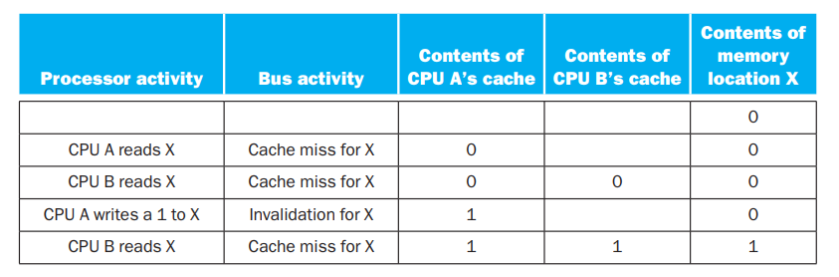
Write invalidate protocol
If a processor needs to write something to the data item it should have exclusive access to that item.
Exclusive access means when the write occurs, no other readable or writable copies of an item exist
If any other caches has that item it will be invalidated.
46

Slide 47
An Example Snooping Protocol
Invalidation-based
Each cache block is in one of three states
Shared:
Cache content has the clean data & according to the existing contents in memory
Any processor can read the data block.
Exclusive:
Only one cache has the correct value of the data block.
Write to the data can be done by that processor only.
Invalid:
block contains no valid data
47

Slide 48
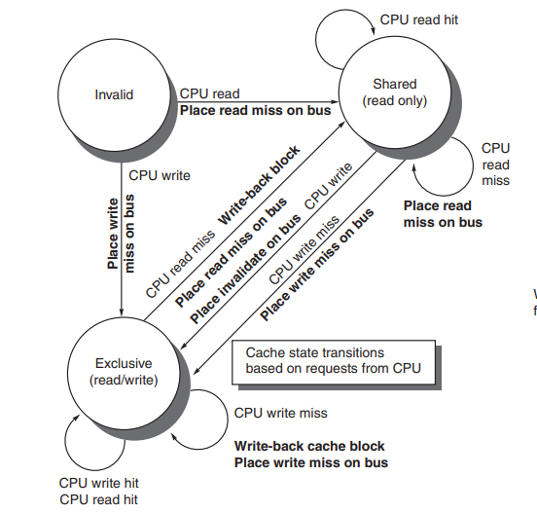
State transitions (CPU side)(Hennessey and Patterson Fig 5.6)
48

Slide 49
Reference Book
1.“Computer Organization and Design-The Hardware/Software Interface” by Hennessey and Patterson.

