Slide 1
Software Engineering
Module 5 : Verification and Validation
Prof. Nachiyappan S
Prof. Braveen M

Slide 2
Topics to be Covered
Evolution
Software Testing
Software Testability
Test Characteristics
Testing Approaches
Types of Testing
Manual
Automated
Inspection, Management and Formal Reviews

Slide 3
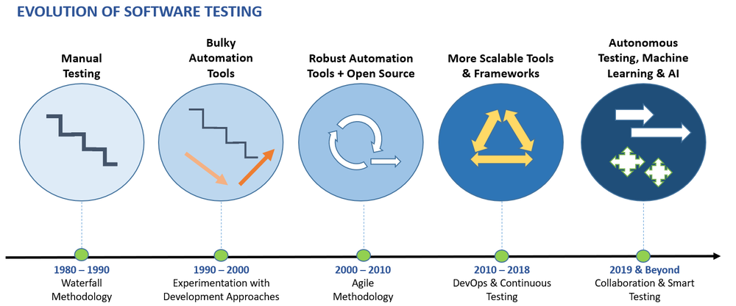
Evolution

Slide 4

Software Testing
Process to identify Correctness, Completeness and Quality of a Software
A Good Test has high probability of finding errors
Software Testability: How easily a “PROGRAM” can be tested?

Slide 5
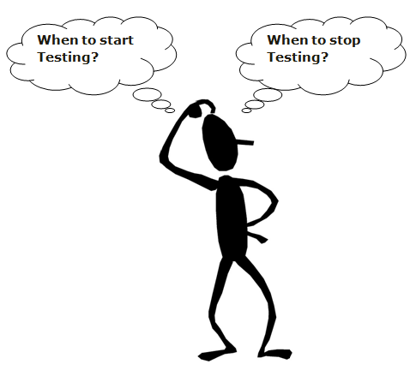
When to Start & Stop?
Start at Early Stage to reduce cost and work
Requirement Phase to Deployment Phase
Deadlines, Completion of Test Case, Completion of Functional, Code Coverage, Bug Rate (Minimum)

Slide 6
Verification & Validation
Verification | Validation
Are we building the product right? | Are we building the right product?
Verification first (Code, Documentation) | Validation after Verification (Overall Product)
Done by Developers | Done by Testers
Static Activities (Collecting Reviews, Walkthroughs, inspection) | Dynamic (Software Execution)
Objective Process | Subjective Process

Slide 7
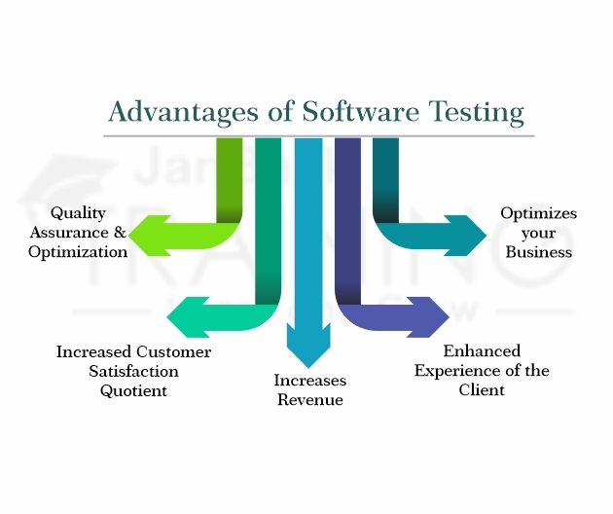
Why Software Testing?

Slide 8
Characteristics of Testable Software
Operable
(Better it works, easy to test)
Observable
(Incorrect outputs are identified)
Controllable
(States & Variables Controlled by Tester)
Decomposable
(Independent Modules)

Slide 9
Characteristics of Testable Software
Simple
Functional
Structural
Code
Stable
(Changes are not frequent)
Understandable
(Documentation available)

Slide 10
Test Characteristics
High Probability of Finding Errors
Not Redundant
Best of Breed
Neither Too Simple nor Too Complex

Slide 11
Testing Approaches
Whitebox
Blackbox

Slide 12

White Box Testing
It tests internal structure, design and coding
Also called as Glass box testing
Code is Visible
Verifies flow of inputs and outputs
Performed by Developers

Slide 13
Verifies What?
Internal Structure
Broken Paths
Flow of Inputs
Expected Output
Conditional Loops

Slide 14
How to Perform?
Understand the Source Code
Create Test Cases and Execute

Slide 15
White Box Testing Techniques
Statement Coverage
Branch Coverage
Path Coverage

Slide 16
Statement Coverage
Input A & B
C = A + B
If C > 100
Print “SUCCESS”
ONE PRINT STATEMENT (+VE Case)

Slide 17
Branch Coverage
Input A & B
C = A + B
If C > 100
Print “SUCCESS”
Else
Print “FAILURE”
ONE PRINT STATEMENT (+VE Case)
ONE PRINT STATEMENT (-VE Case)

Slide 18
Path Coverage
Input A & B
C = A + B
If C > 100
Print “SUCCESS”
END IF
if A > 50
Print “FAILURE”
END IF

Slide 19
Advantages
Efficient in Finding Errors
Programmers introspection Possible
Helps in Optimizing the Code
Maximum Coverage is Obtained

Slide 20
Disadvantages
Requires High Level Knowledge
Requires Code Access
Unable to Find Unimplemented or Missing Features

Slide 21
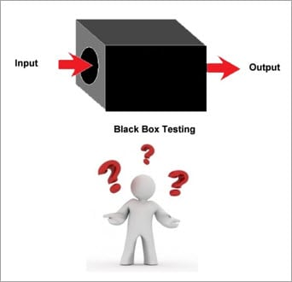
Black Box Testing
Also called as FUNCTIONAL TESTING
Not aware of Internals
Tester is aware of What the Program should do
No Knowledge on “How it Does”

Slide 22
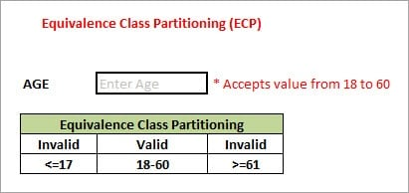
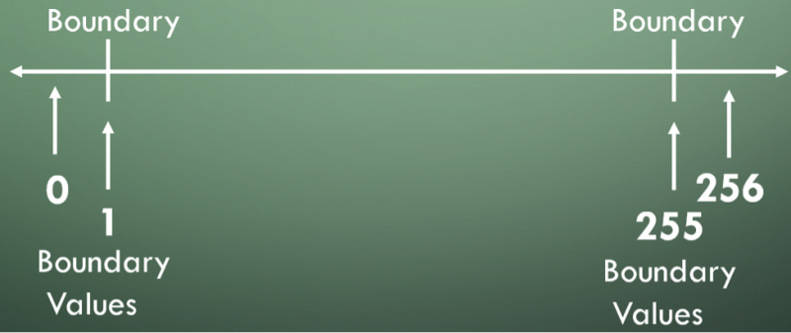
Black Box Testing
Equivalence Partitioning
Boundary Value Analysis

Slide 23
Advantages
Efficient for Large Segment for Codes
Code Access is not Required

Slide 24
Disadvantages
Limited Coverage
Inefficient (Tester has limited Knowledge)

Slide 25
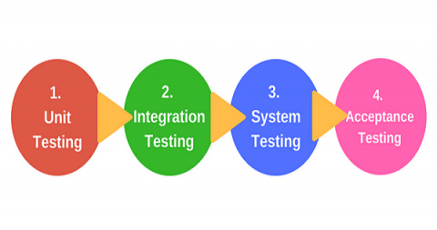
Manual Testing
Testing a Software Manually for Detecting Errors
No Automated Tools / Scripts

Slide 26

Unit Testing
First Level of Testing
Also called as Component Testing
Checks whether a particular module / component is developed correctly or not
Done by “DEVELOPERS”

Slide 27
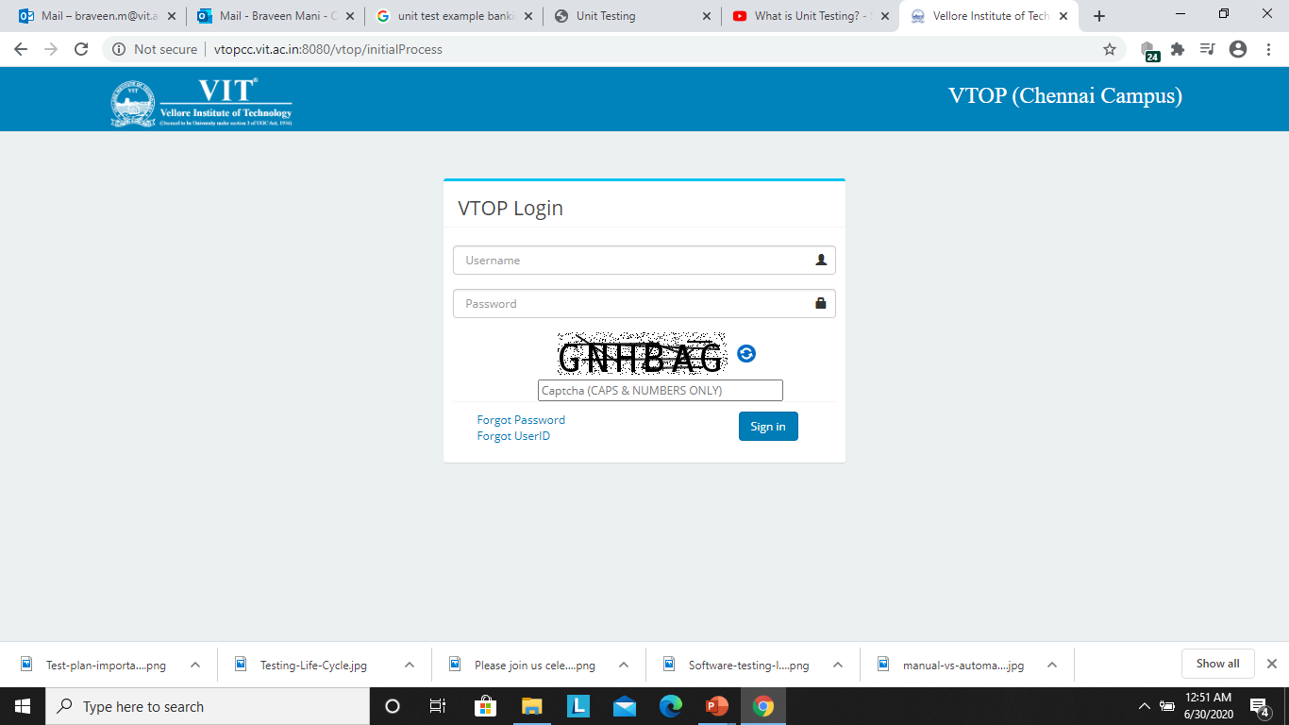
Unit Testing
Example: VIT Login Credentials
Test cases
Valid Login ID & Password
Invalid Login ID & Password
Captcha Mismatch
Empty Login ID, Password & Captcha

Slide 28

Integration Testing
Individual Modules / Components are combined and tested as a group
Data Transfer between the modules is checked
Done by “TESTERS”

Slide 29
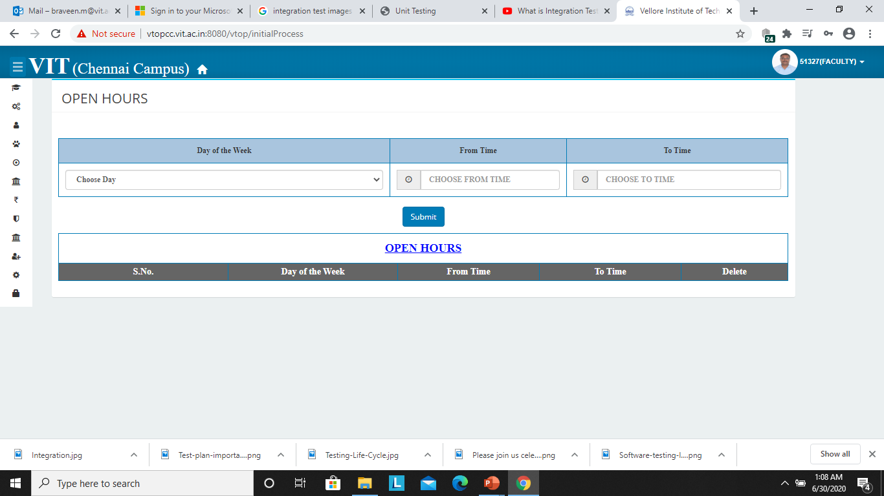
Integration Testing
On Successful Login, VIT allows the user to access Second Module / Component
Imagine, Second Module not Developed then ? ? ?

Slide 30
Integration Testing
Develop a Dummy Page (Stub / Driver)
Stub: Login Page to Dummy Page
Driver: Dummy Page to Login Page

Slide 31
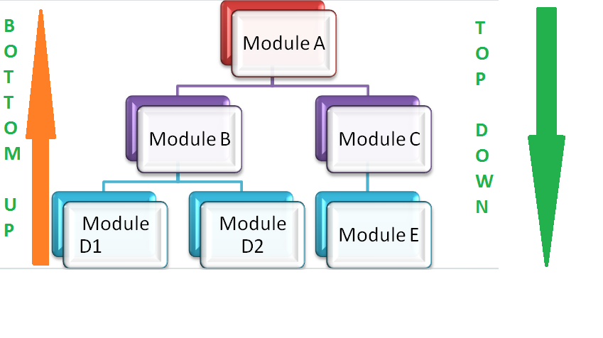
Integration Testing Approaches

Slide 32


Integration Testing (Bottom Up)
Consumes Less Amount of Time
Simple to Create Test Conditions
Requires Several Number of Drivers
Poor Support for Early Release of Products

Slide 33
Integration Testing (Top Down)
Faults / Errors are easily Detected
Crucial Models are tested thoroughly
Less Time
Require Stubs

Slide 34
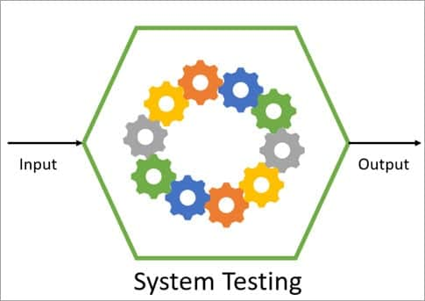
System Testing
Validates complete fully and integrated software product
Evaluate End to End Specifications

Slide 35
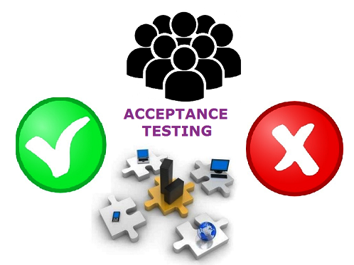
Acceptance Testing
Determines whether the software has met the requirements and satisfied customers
Evaluate System Compliance with Business Requirements
Alpha Test
Beta Test (Feedback from Customers)

Slide 36

Automated Testing
Testing a Software Manually for Detecting Errors
No Automated Tools / Scripts

Slide 37
When Automation?
Large & Critical Projects
Stable Requirements
Accessing the Application for Load & Stress with Multiple Users
Time Constraint (if any)

Slide 38
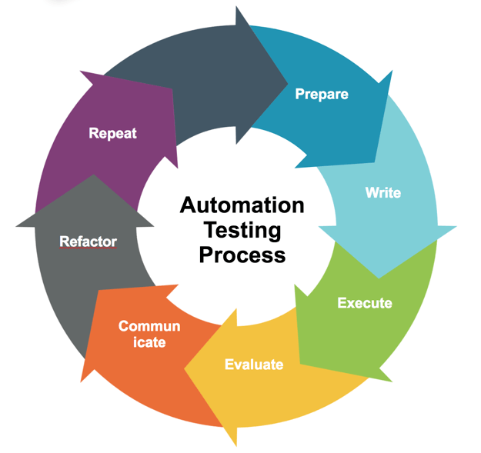
Automated Testing

Slide 39
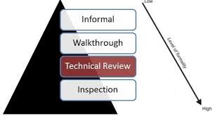
Inspection Vs Review
IEEE Standard for Software Review define 5 types namely:
Management
Technical
Inspections
Walk-Through
Audit

Slide 40

Management Review
To Monitor the Progress
Status of Plans and Schedules
Confirm Requirements
Evaluate

Slide 41

Review Decisions
Corrective Actions
Changes in Resource Allocation
Changes to Scope of the objectives

Slide 42
Software Products - Review
Audit Reports
Contingency Plans
Installation Plans
Risk Management Plans
Software Quality Assurance (SQA)

Slide 43

Management Reviewers
Decision Maker
Review Leader
Recorder
Management Staff
Technical Staff

Slide 44

Management Review Outputs
Project Under Review
Review Team Members
Review Objects
Inputs / Outputs
Defects
Actions

Slide 45

Technical Reviews
Conforms to Specifications
Adheres to Regulations, Standards, Guidelines and Plans
Changes properly implemented
(Change Specification)

Slide 46
Technical Reviews
Software Requirements Specification
Software Design Description
Software Test Documentation
Software User Documentation
Installation Procedure
Release Notes

Slide 47
Technical Reviewers
Decision Maker
Review Leader
Recorder
Technical Staff

Slide 48
Technical Review Outputs
Project Under Review
Review Team Members
Review Objectives
Software Project Reviewed
Resolved and Unresolved Defects
List of Management Issues
Actions

Slide 49
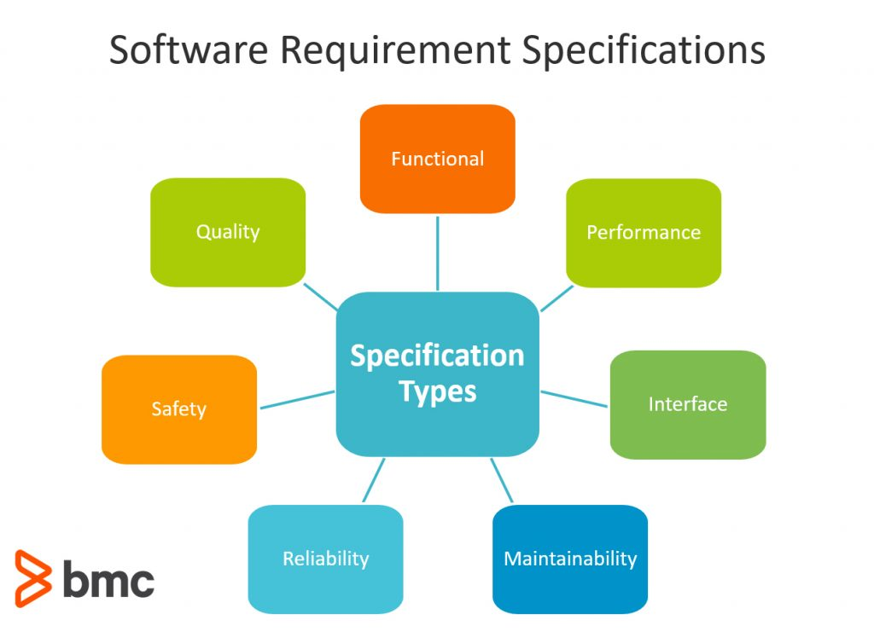
Inspection
Software Requirements Specification
Software Design Description
Source Code
Software Test Documentation
Software User Documentation
Manual / Release Notes

Slide 50
Inspection Roles
Inspection Leader
Reader
Recorder
Author
Inspector

Slide 51
Inspection Outputs
Project under inspection
Inspect Team Members
Meeting Duration
Software Product
Objectives / Status
Defects
Rework and Completion Time

Slide 52

Walk Through
Evaluate a Software Product
Educate Audience
Find Anomalies
Alternative implementations
Evaluate Performance

Slide 53
Walk Through Roles
Walk Through Leader
Recorder
Author
Team Member

Slide 54

Walk Through Outputs
Actions, Due-Dates
Walk through Team Members
Objectives
Dispose unresolved anomalies

Slide 55

Inspection
Specification
Quality Attributes
Regulations, Standards & Guidelines
Identify Deviations

Slide 56
Summary
Software Testing Fundametals
Approaches of Software Testing
Types of Testing
Unit
Integration
System
Acceptance
Management, Technical, Formal and Audits

Slide 57
THANK YOU

