Slide 1
Software Re-Engineering & Reverse Engineering
Dr. K. Pradeep,
VIT Chennai

Slide 2
Topics to be covered
Software Re-Engineering
Inventory Analysis
Document Restructuring
Code Restructuring
Forward Engineering
Data Restructuring
Reverse Engineering

Slide 3
What is Software Re-Engineering
Software Re-Engineering is the examination and alteration of a system or application that had been developed earlier to reconstitute it in a new form.

Slide 4
What is Software Re-Engineering
The principles of Re-Engineering when applied to the software development process is called software re-engineering.
It affects positively at software cost, quality, service to the customer and speed of delivery.

Slide 5
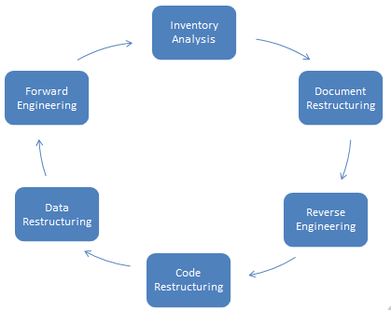
Software Re-engineering

Slide 6
Inventory Analysis
Every Organization should maintain a database (Inventory) of application that had been developed.
The inventory contains detailed information (e.g. Name, Description, Size, Age) about each of the developed application.
Depending upon the need the inventory is sorted to identify the re-engineering candidate.
Selected candidate appear for re-engineering and resources are accordingly allocated.

Slide 7
Document Restructuring
Documentation is vital to explain how the application needs to be operated and used constructively.
Documentation is a time consuming task / activity.
The update task of documentation is hindered by lack of adequate resources.
Since the re-developed system / application is highly critical to the business, it must be carefully and completely re-documented

Slide 8
Reverse Engineering
The term reverse engineering actually originated from Hardware world.
It explains the reconstruction of an existing object.
It starts from final product and ends with design specification i.e., it is a backward process.
It analyses the program to create higher level of abstractions.
Reverse engineering tools extract data, architectural and procedural design from existing system.

Slide 9
Code Restructuring
It is a process that is applied to legacy software in order to improve the performance and coding cost.
Restructuring tool is applied only to specific, identified modules.
To perform this activity,
Initially analyse the source code using a specific tool.
Check for violations in the programming constructs.
Using modern language rewrite the violated code.
Review and test the resultant code to ensure that it is free from anomalies.

Slide 10
Data Restructuring
Data restructuring begins with a reverse engineering activity.
Data architecture is analyzed to identify data objects and data structures of the existing system.
Weak data structures are identified and re-engineered.
This activity results in architectural or code level changes, as data architecture has high influence over the program architecture.

Slide 11
Forward Engineering
Also called renovation or reclamation.
It is used to alter the existing functionalities of the system or application by deploying advanced new features to improve the overall quality.
Forward engineering consumes more time compared to reverse engineering.
Final product of forward engineering needs to be complete and exact.

Slide 12
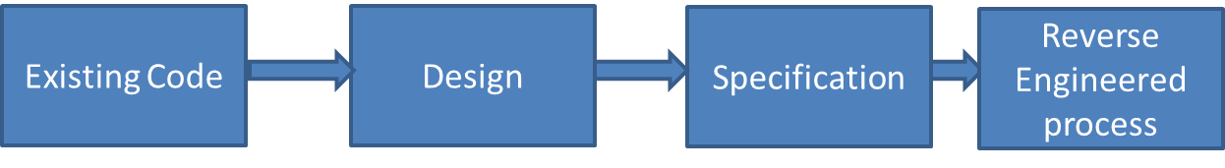
Reverse Engineering
Reverse Engineering Process

Slide 13
Reverse Engineering
It is the process that works from backward by analysing the software system to extract design and implementation information.
It is used as a learning tool.
The abstraction level of information is extracted using this process.

Slide 14
Levels of Reverse Engineering
Abstraction level
Low level abstraction (Design representation)
Higher level of abstraction (Program and data structure )
Relatively high level of abstraction (Object models, data/ control flow)
High level of abstraction (ER Models)

Slide 15
Completeness level
1. Completeness level is ensured based on the details provided in the abstraction level.
2.Completeness decreases as abstraction level increases.

Slide 16
Directionality level
1. The extracted information from source code will be directed to developers

Slide 17
Reverse Engineering to Understand Data
The first task in the re-engineering process is to understand the data structures which creates the base for the new refined system database.
Global data structures such as files and databases are re-engineered to adapt to new database system.
Internal data structures such as class definition, program variables are identified.
Database structures such as data objects and relationship among objects are understood to create new database schema.

Slide 18
Steps to define new DB model
(1) An initial object model is built.
(2) Candidate keys are identified by examining the attributes. Those attributes that point to another record or table and serve as pointers are designated as candidate keys.
(3) The tentative classes are refined.
(4) Generalizations are identified and accordingly defined.
(5) Associations are identified by applying techniques that are similar to CRC approach.
Finally transformations are applied for mapping the old DB to new DB

Slide 19
Reverse Engineering to Understand Process
Extract procedural abstraction from varying levels such as system, component, pattern and statement.
Knowledge on over all functionality helps in understanding the interoperability issue among applications.
A block diagram is used to represent the interactions between functional abstractions.
Each of the individual components’ processing functionality is narrated.

Slide 20
Reverse Engineering User Interfaces
The present user interface’s structure and behaviour are studied for re-building the new interface.
Merlo and colleagues defined 3 basic question to understand UI..
The basic actions like keystrokes and mouse clicks that needs to be captured for processing by the user interface.
The sort of behavioral response that needs to be generated by the system based on these actions.
In what way, a precise as well as an equivalent replacement could be brought in to change the existing user interface.
Its worthwhile to develop new UI rather than altering the old GUI

Slide 21
Summary
Software Re-Engineering is an alteration of a system, developed to reconstitute it in a new form.
Software Re-Engineering steps has been discussed.
Reverse engineering starts from final product and ends with design specification .
Reverse engineering is a backward process.

