Slide 1

Software Engineering
Module 7-Product & Process Metrics,Quality standards & models-ISO, TQM,six-sigma
Dr. E . Umamaheswari & Dr.M.Sivabalakrishnan
VIT Chennai

Slide 2
Outline
Product & Process Metrics
Quality Standards & Models
Quality Models
ISO
TQM,
Six-Sigma
Summary
Hot Questions

Slide 3
Product and Process metrics
Dr. E . Umamaheswari & Dr.M.Sivabalakrishnan

Slide 4


METRICS
IEEE A Quantitate Measure Of The Degree To Which System, Component, or Process Posses A Given Attribute
:A metric is a quantifiable measure that is used to track and assess the status of a specific process.
Dr. E . Umamaheswari & Dr.M.Sivabalakrishnan

Slide 5
FRAMEWORK FOR PRODUCT METRICS
1. METRICS 3. MEASUREMENT
2. MEASURES 4. INDICATORS
Dr. E . Umamaheswari & Dr.M.Sivabalakrishnan

Slide 6


MEASURES
Provides A Quantitive Indication Of Extent , Amount , Dimension Capacity Or Size Of Some Attribute Of A Product Or Process
In a data context, measures are the numbers or values that can be summed and/or averaged.
For example, let’s say you have 50 TVs sold and 30 radios sold.
Dr. E . Umamaheswari & Dr.M.Sivabalakrishnan

Slide 7


In such products the term product and process metrics describes characteristics of product like capacity, fuel ,fuel tank ,size and one of the most important thing brand
Hyundai creta
Price – ₹ 14.92 lakhs
Seating capacity -5
Fuel economy-20km/l
Dimensions – 4.3 meter Length x 1.79meter
width 1.63 meter height
Fuel tank capacity – 50 liter
Brand Hyundai
Maruti Suzuki baleno
Price – ₹ 9.03 lakhs
Fuel economy-24 km/l
Dimensions 3.99 meter length x 1.74meter width x
1.51meter height
Brand Maruti Suzuki
Dr. E . Umamaheswari & Dr.M.Sivabalakrishnan

Slide 8
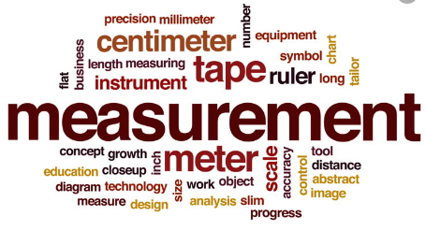
MEASUREMENT
The Act Of Determining The Measure
Dr. E . Umamaheswari & Dr.M.Sivabalakrishnan

Slide 9
Software Measurement Process Architecture

Slide 10
INDICATORS
A Metric Or Combination Of Metrics That Provides Insight Into The Software Process ,A Software Product Or Process Itself.
An indicator is a qualitative or quantitative factor or variable that provides a simple and reliable mean to express achievement, the attainment of a goal, or the results stemming from a specific change
Dr. E . Umamaheswari & Dr.M.Sivabalakrishnan

Slide 11

What is Product & Process Metrics ?
It Describes the characteristics of the product such as size, complication, design features, performance, and level of quality.
Dr. E . Umamaheswari & Dr.M.Sivabalakrishnan

Slide 12

Software relatedness with product process Metrics
It must be convenient to the user
The software should be start at all search engines
It must have integrity to produce results accurately
Dr. E . Umamaheswari & Dr.M.Sivabalakrishnan

Slide 13

Why We Have The Software Product Metrics ?
Helps Software Engineers To Be Better Understand The Attributes Of Models And Asses The Quality Of Software
Dr. E . Umamaheswari & Dr.M.Sivabalakrishnan

Slide 14

Why We Have The Software
Product Metrics ?[Continued…]
Helps Software Engineers To Gain Insight Into The Design And Construction Of Software
Dr. E . Umamaheswari & Dr.M.Sivabalakrishnan

Slide 15

Why We Have The Software
Product Metrics ?[Continued…]
Focus On Attributes Of Software Of Software Engineering Work Products Resulting From Analysis, design,coding And Testing
Dr. E . Umamaheswari & Dr.M.Sivabalakrishnan

Slide 16

Why We Have The Software Product Metrics ?[Continued…]
Provide A Systematic Way To Access Quality Based On Set Of Clearly Defined Rules
Dr. E . Umamaheswari & Dr.M.Sivabalakrishnan

Slide 17
Why We Have The Software Product Metrics ?[Continued…]
Provide An “On The Spot” Rather Than “After-the-fact” Insight Into The Software Development
Dr. E . Umamaheswari & Dr.M.Sivabalakrishnan

Slide 18

WHAT IS Process and Project Indicators ?
PROJECT INDICATOR
Process indicators: are those indicators that are used to measure project processes or activities
FOR EXAMPLE
PROJECT INDICATOR
Dr. E . Umamaheswari & Dr.M.Sivabalakrishnan

Slide 19
Why are Standards Important?
Standards provide encapsulation of best, or at least most appropriate, practice
• Standards provide a framework around which the quality assurance process may be implemented
• Standards assist in continuity of work when it’s carried out by different people throughout the software product lifecycle

Slide 20

What is ISO
ISO [International organization for standardization] is a non-governmental organization established in 1946 in Geneva, Switzerland

Slide 21
Introduction to ISO 9000
The ISO 9000 family of standards is related to quality management systems and designed to help organizations ensure that they meet the needs of customers and other stakeholders while meeting statutory and regulatory requirements.
ISO 9000 deals with the fundamentals of quality management systems, including the eight management principles on which the family of standards is based.

Slide 22








Eight Quality Management Principles
Customer focus
Involvement of people
Leadership
System approach to management
Continual improvement
Process approach
Factual approach to decision- making
Mutually beneficial supplier relationships

Slide 23
ISO 9000 Series
ISO 9000
Explains fundamental quality concepts and provides guidelines for the selection and application of each standard
ISO 9001
Model for quality assurance in design, development, production, installation and servicing.
ISO 9002
Model for quality assurance in the production and installation of manufacturing systems

Slide 24
ISO 9003
Quality assurance in final inspection and testing.
ISO
9004
Guidelines for the applications of standards in quality management and quality systems.
Dr. E . Umamaheswari & Dr.M.Sivabalakrishnan

Slide 25
ISO - 9001 Elements
Quality System Requirements
Management Responsibility
Quality system
Contract review
Design Control
Document control
Purchasing
Purchaser supplied product
Product identification and traceability
Process control
Inspection and testing
Inspection, measuring and test equipment
Inspection and test status
Control of non-conforming product
Corrective action
Handling, storage, preservation, packaging and shipping
Quality records
Internal quality audits
Training
Servicing
Statistical techniques
Software Quality Responsibilities
Management Responsibility
Quality system
Contract review
Design Control
Document control
Purchasing
-
Product identification and traceability
Process control
Inspection and testing
-
Inspection and test status
-
Corrective action
-
Quality records
Internal quality audits
Training
-
Statistical techniques

Slide 26
Advantages
Quality is maintained,
ISO registration also has a significant bearing on market credibility as well.
Opportunity to compete with larger companies,
More time spent on customer focus,
Confirmation that your company is committed to quality
May facilitate trade and increased market opportunities
Increase customer confidence and satisfaction

Slide 27
What Is Total Quality Management?
TQM is that the integration of all functions and processes within a corporation so as to realize continuous improvement of the standard of products and services. The goal is customer satisfaction.

Slide 28
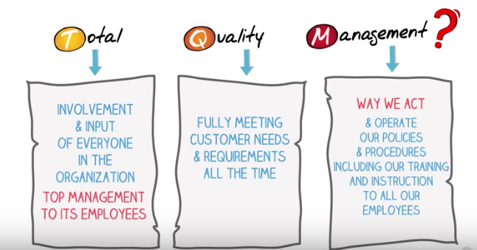
Term of TQM
Buy Cars

Slide 29
Seven quality management principles
Customer focus.
Leadership.
Engagement of people.
Process approach.
Improvement.
Evidence-based decision making.
Relationship management.

Slide 30
Stages of TQM
Quality Control
Monitoring variations
Quality Assurance
Standards based
Quality Improvement
Process oriented
Quality Management
Internally motivated
Total Quality Management
Changed organizational

Slide 31
TQM to Software Development Process
One of Deming ideas was the Plan, Do, Check, Action, which is usually shortened to PDCA. We can use PDCA cycle because the basic idea, for software processes development to gain software quality

Slide 32
Process To Obtain TQM By PDCA
Select the project during which TQM to be achieved
Grasp this status
Analyze the cause
Determine the corrective action
Implement corrective action
Check the consequences in terms of quality
Take appropriate action
Conclude and future plans to get TQM
The PDCA cycle, also known as the Shewhart Cycle or the Deming Cycle, is a popular TQM problem-solving tool.
Dr. E . Umamaheswari & Dr.M.Sivabalakrishnan

Slide 33

PLAN
Select the project during which TQM To Be Implemented
-Project background and reasons for selection
- Set a target
-Prepare a schedule of activities
Grasp the present status
Analyze the cause and Determine the Corrective Action
-Prepare cause and effect diagram
-Prepare a hypothesis and verify
presumably causes
-Document the corrective action

Slide 34

DO
Implement the corrective action
Prepare instructions and flow charts for complicated procedures
Adequate training must be provided
Follow the plan exactly
Record any division from plan and collect the data on results
Dr. E . Umamaheswari & Dr.M.Sivabalakrishnan

Slide 35

CHECK
Check the Effect of corrective action – Compare over all results
– Analyse failure to realize results
– Results achieved

Slide 36
ACT
• Check appropriate action – Documentation, standardisation and control
– Training
– Decide on future plans
– The documented seven internal control tools could also be utilized in this process

Slide 37

SIX SIGMA
Six Sigma seeks to enhance the standard of process outputs by identifying and removing the causes of defects.
Six Sigma approach may be a collection of managerial and statistical concept and techniques that focuses on reducing variation in processes and preventing deficiencies in product. The concept of Variation states “NO two items are going to be perfect ly identical.”

Slide 38
HISTORY of SIX SIGMA
The term “Six Sigma” was coined by Bill Smith, an engineer with Motorola
Late 1970s - Motorola started experimenting with problem solving through statistical analysis
1987 - Motorola officially launched it’s Six Sigma program
Motorola saved more than $ 15 billion in the first 10 years of its Six Sigma effort

Slide 39
HISTORY of SIX SIGMA
he term “Six Sigma” was coined by Bill Smith, an engineer with Motorola
Late 1970s - Motorola started experimenting with problem solving through statistical analysis
1987 - Motorola officially launched it’s Six Sigma program
Motorola saved more than $ 15 billion in the first 10 years of its Six Sigma effort

Slide 40
Approches of SIX SIGMA
DMAIC Approach
This Is Organizational Based
DMADV
This Is Based On Customer Needs And Satifactions

Slide 41
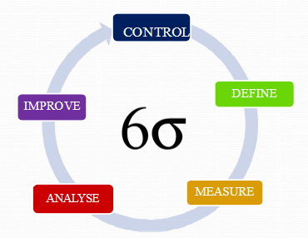
DMAIC Approches
1. Defidne
Define the system, the voice of the customer and their requirements, and therefore the project goals, specifically.
2. Measure
Measure key aspects of the present process and collect relevant data.
3. Analyse
Analyze the info to research and verify cause-and effect relationships. Determine what the relationships are, and plan to make sure that all factors have been considered. hunt down root explanation for the defect under investigation
Dr. E . Umamaheswari & Dr.M.Sivabalakrishnan

Slide 42
DMAIC Approches cont...
4. Improve
Improve or optimize the present process based upon data analysis using techniques like design of experiments, poka yoke or mistake proofing, and standard work to make a replacement, future state process. found out pilot runs to determine process capability.
5. Control
Control the longer term state process to make sure that any deviations from target are corrected before they end in defects. Implement control systems like statistical process control, production boards, visual workplaces, and continuously monitor the method.
Dr. E . Umamaheswari & Dr.M.Sivabalakrishnan

Slide 43
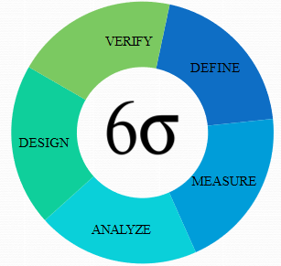
DMADV Approches of SIX SIGMA
1.Define
Define design goals that are according to customer demands and therefore the enterprise strategy
2. Measure
Measure and identify CTQs (characteristics that are Critical To Quality), product capabilities, production process capability, and risks
3. Analyze
Analyze to develop and style alternatives
Dr. E . Umamaheswari & Dr.M.Sivabalakrishnan

Slide 44
DMADV Approches of SIX SIGMA cont..
4.Design
Design an improved alternative, best suited per analysis within the previous step
5. Verify
Verify the planning, found out pilot runs, implement the assembly process and hand it over to the method owner
Dr. E . Umamaheswari & Dr.M.Sivabalakrishnan

Slide 45
Difference between DMAIC VS DMADV
DMAIC | DMADV
Defines a business process | Define customer needs
Measuring current process | Measure customer needs & specification
Identify root cause of the recurring problems | Analyze options to meet customer satisfaction.
Improvements made to reduce defects | Model is deigned to meet customer needs
Keep check on future performance | Model put through simulation tests for verification
Dr. E . Umamaheswari & Dr.M.Sivabalakrishnan

Slide 46
TQM vs. Six Sigma
TQM views quality as conformance to internal requirements, Six Sigma focuses on improving quality by reducing the number of defects.
Total Quality Management and Six Sigma is that TQM delivers superior quality manufactured goods whereas six sigma on the other hand results in better results. Total Quality management refers to continuous effort by employees to ensure high quality products. The process of Six Sigma incorporates many small changes in the systems to ensure effective results and better customer satisfaction.

Slide 47
Summary
Product metrics describe the characteristics of the product such as size, complexity, design features, performance, and quality level.
Process metrics can be used to improve software development and maintenance
ISO -quality standard is a set of requirements that affect virtually all aspects of the operations of corporate enterprises, non-profit organizations and government entities
Total quality management (TQM) is the continual process of detecting and reducing or eliminating errors in manufacturing, improving the customer experience, and ensuring that employees are up to speed with training.
Six Sigma is a production philosophy that uses data, processes, and tools to nearly eliminate defects and bring performance close to perfection
Dr. E . Umamaheswari & Dr.M.Sivabalakrishnan

Slide 48
Hot Questions
A manufacturing company wants to get ISO certification for their products. Can you give the sufficient information about the various ISO Quality metrics which are available?
Electronics have become an important part of human life. Samsung Electronics is used every work done by the human being. cooking food, health, in driving, in watching and many other things you will see the existence of electronics around. Discuss about the six sigma application in samsung
Dr. E . Umamaheswari & Dr.M.Sivabalakrishnan

