Slide 1
Unit-6
Indexing in Databases

Slide 2
Indexing in Databases
Indexing is a way to optimize the performance of a database by minimizing the number of disk accesses required when a query is processed. It is a data structure technique which is used to quickly locate and access the data in a database.
Indexes are created using a few database columns.
The first column is the Search key that contains a copy of the primary key or candidate key of the table. These values are stored in sorted order so that the corresponding data can be accessed quickly. Note: The data may or may not be stored in sorted order.
The second column is the Data Reference or Pointer which contains a set of pointers holding the address of the disk block where that particular key value can be found.

Slide 3
To store the data in a dense or sparse format:

Slide 4
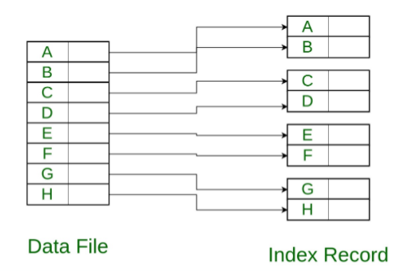
Dense Index:
For every search key value in the data file, there is an index record.
This record contains the search key and also a reference to the first data record with that search key value.

Slide 5
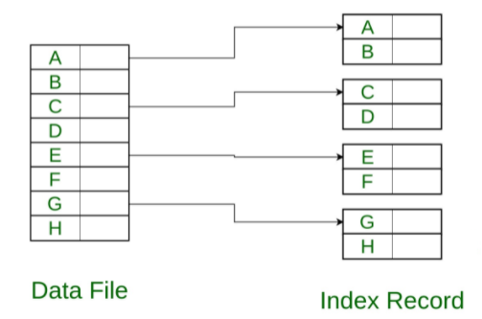
Sparse Index:
The index record appears only for a few items in the data file. Each item points to a block as shown.

Slide 6
Indexing
Single Level Indexing
Primary Indexing
Cluster Indexing
Secondary Indexing
Multi Level Indexing
B Tree
B+ Tree

Slide 7
B-Tree
Balance m-way tree
A node can have more than one key and more than two children
Maintains sorted data
All leaf nodes must be at same level
B-tree of order m has following properties:
Every node has maximum m children
Minimum children:
Leaf-0, Root-2
Internal nodes- ceil(m/2)
Every node has maximum (m-1) keys
Minimum keys:
Root-1, all other nodes- ceil(m/2)-1
Note- Insertion always takes place in the leaf node.

Slide 8
Construct a B- tree of order 4 with following values:
5, 3, 21, 9,1,13,2,7,10,12,4,8

Slide 9
Note-In addition to the practice problems what we discussed in class, assume some random numbers and perform the B- tree insertion, deletion(leaf & intermediate) node

