Slide 1
CSE2005
MODULE4
TRANSACTION PROCESSING

Slide 2

Transaction - Definition
A transaction is a unit of program execution that accesses and possibly updates various data items.
Image Source: https://toppng.com/icon-phone-transactions-transprent-free-mobile-transaction-icon-PNG-free-PNG-Images_128650?search-result=cell-phone-icon

Slide 3
Read operations (database retrieval, such as SQL SELECT)
Write operations (modify database, such as SQL INSERT, UPDATE, DELETE)
Transaction: A logical unit of database processing
Example: Bank balance transfer of $100 dollars from a checking account to a saving account in a BANK database

Slide 4
A Transaction is…………………
stand-alone, specified in a high level language like SQL submitted interactively, or
consist of database operations embedded within a program (most transactions)

Slide 5
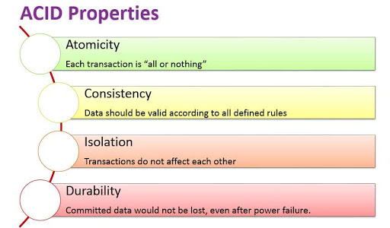
Transaction Properties – ACID Properties
Image Source: http://answers.mindstick.com/qa/51741/what-is-acid-property-in-dbms-and-also-define-the-concept-state-of-transaction

Slide 6
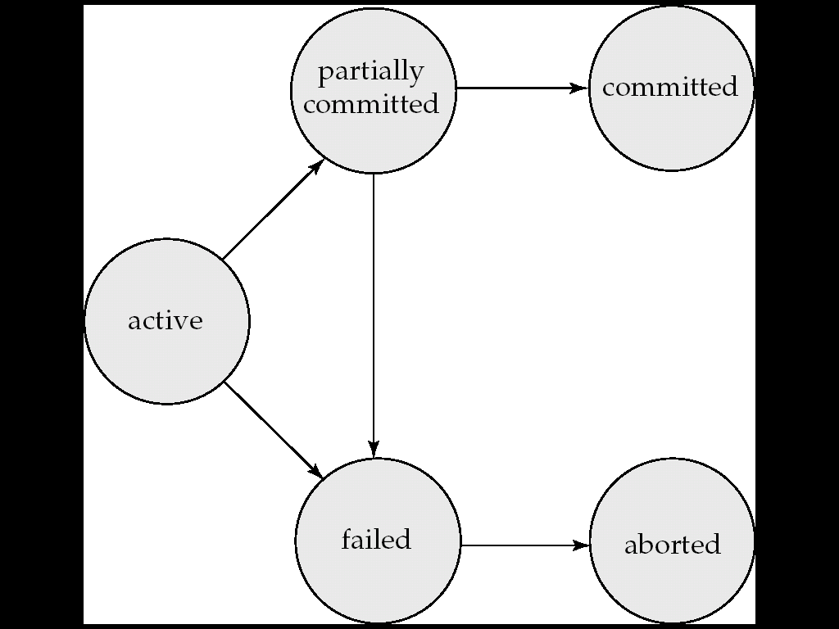
Transaction States
Image Source: Database System Concepts by Abraham Silberschatz, Henry F.Korth and S.Sudarshan, Tata Mc Graw Hill, 2011

Slide 7
Basic operations on an item X:
read_item(X): Reads a database item named X into a program variable. To simplify our notation, we assume that the program variable is also named X.
write_item(X): Writes the value of program variable X into the database item named X.

Slide 8
Recovery Manager will keep in track of:
1. begin_transaction:
2. read or write:
3.end_ transaction:
whether the changes (writes) introduced by transaction can be permanently applied to the database (commit transaction);
or whether the transaction has to be rolled back (abort transaction) because it violates concurrency control or for some other reason.
4. commit_transaction:
5. Abort or Roll back_transaction:

Slide 9
SYSTEM OPERATIONS DURING RECOVERY
System operations used during recovery :
undo(X): Similar to rollback except that it applies to a single write operation rather than to a whole transaction.
redo(X): This specifies that a write operation of a committed transaction must be redone to ensure that it has been applied permanently to the database on disk.

Slide 10
Serializability
In concurrency control of DB transaction schedule is serializable
i.e executed serially, without overlapping of time
WHAT IS A SCHEDULE?
Collection of transactions

Slide 11
2 types of serializability
Conflict serializability
View serializability

Slide 12
Assume B fails then it is rollback to initial of transaction T1 Then problem would be in T2 since its committed (non-recoverable) But T1 is recoverable
Recoverable Schedule
Schedule(S)
T1 | T2
R(A)
A=A+50
W(A) | R(A)
 | A=A+50
 | W(A)
R(B)
B=B-50
W(B)

Slide 13
Examples: serializability
Schedule(S)
T1 | T2
R(A)
W(A)
 | R(A)
 | W(A)
Schedule(S)
T1 | T2
 | R(A)
 | W(A)
R(A)
W(A)
Schedule(S)
T1 | T2
R(A)
 | R(A)
 | R(A)
W(A)

Slide 14
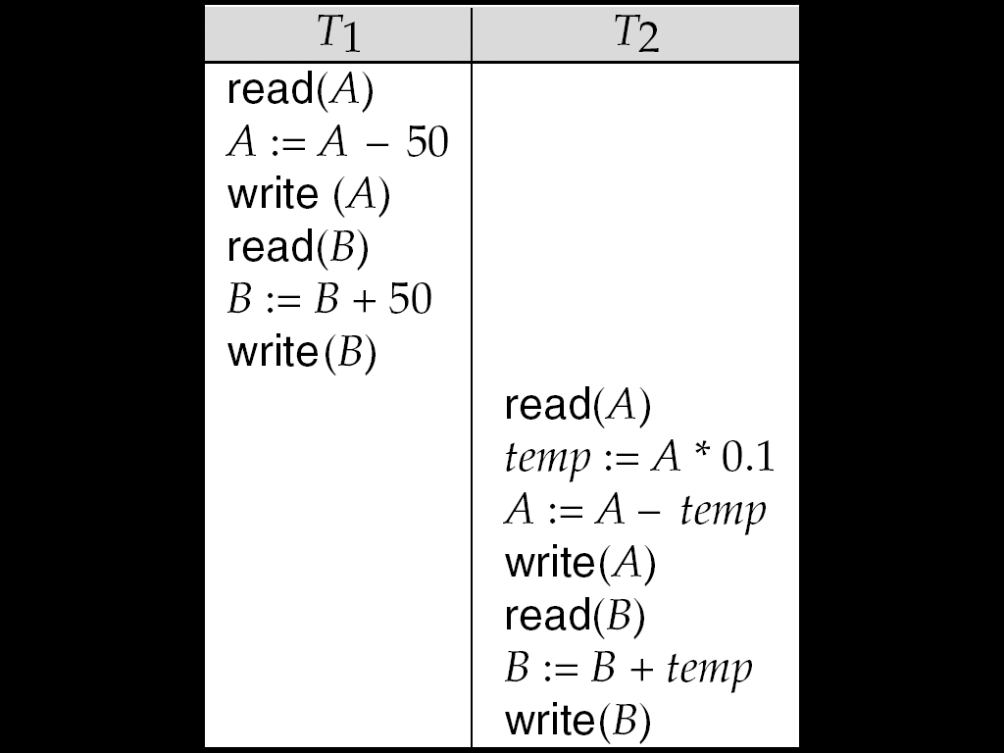
Schedule - 1
Let T₁ transfer $50 from A to B, and T₂ transfer 10% of the balance from A to B.
A serial schedule in which T₁ is followed by T₂ :
Image Source: Database System Concepts by Abraham Silberschatz, Henry F.Korth and S.Sudarshan, Tata Mc Graw Hill, 2011

Slide 15
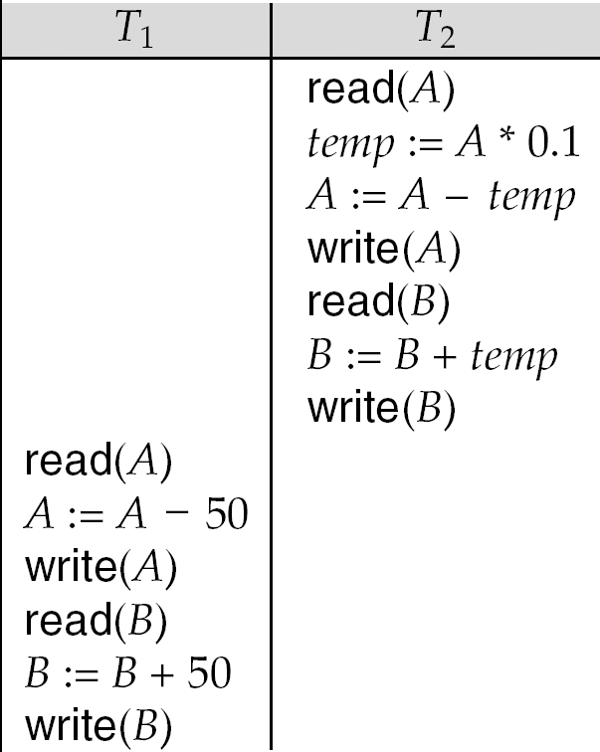
Schedule - 2
A serial schedule where T₂ is followed by T₁ is shown below:
Image Source: Database System Concepts by Abraham Silberschatz, Henry F.Korth and S.Sudarshan, Tata Mc Graw Hill, 2011

Slide 16
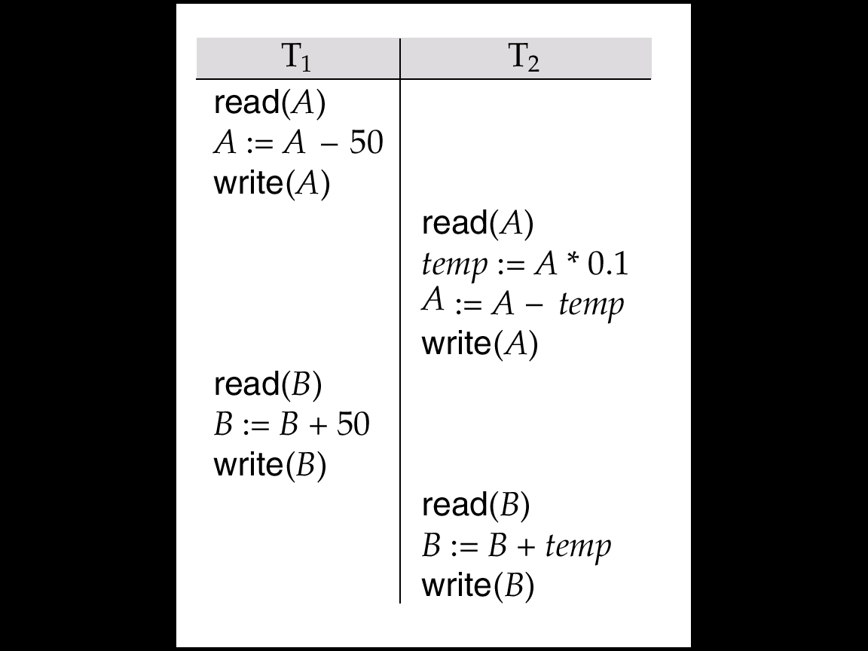
Schedule - 3
Let T₁ and T₂ be the transactions defined previously. The following schedule is not a serial schedule, but it is equivalent to Schedule 1.
In Schedules 1, 2 and 3, the sum A + B is preserved.

Slide 17
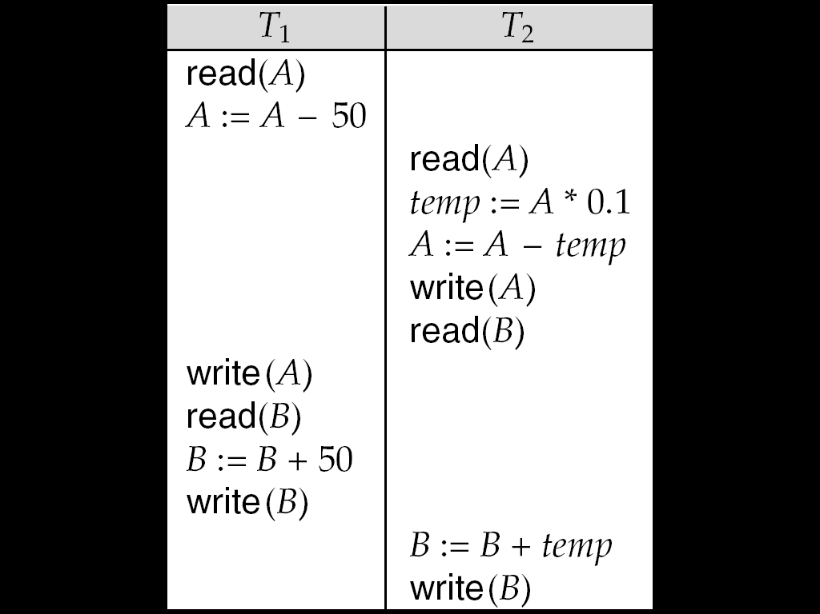
Schedule - 4
The following concurrent schedule does not preserve the value of (A + B ).
Image Source: Database System Concepts by Abraham Silberschatz, Henry F.Korth and S.Sudarshan, Tata Mc Graw Hill, 2011

Slide 18
Conflict Pairs
Instructions l_{i} and l_{j} of transactions T_{i} and T_{j} respectively, conflict if and only if there exists some item Q accessed by both l_{i} and l_{j}, and at least one of these instructions wrote Q.
1. l_{i} = read(Q), l_{j} = read(Q). l_{i} and l_{j} don’t conflict. 2. l_{i} = read(Q), l_{j} = write(Q). They conflict. 3. l_{i} = write(Q), l_{j} = read(Q). They conflict 4. l_{i} = write(Q), l_{j} = write(Q). They conflict

Slide 19
In short-Conflict Pairs
R-------------W
W------------R
W------------W
Note:If write() check for conflict R() and W() in all transactions

Slide 20
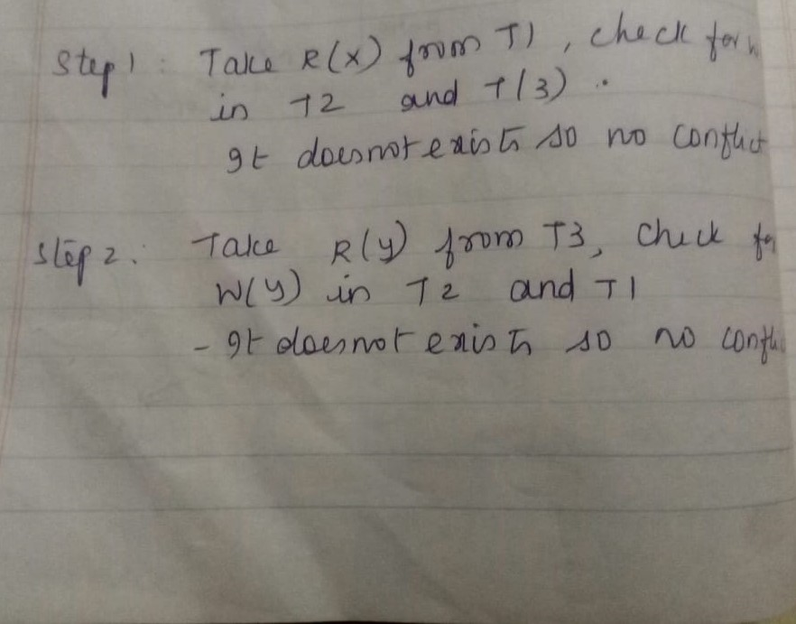
Conflict serializability
Schedule(S)
T1 | T2 | T3
R(X)
 |  | R(Y)
 |  | R(X)
 | R(Y)
 | R(Z)
 |  | W(Y)
 | W(Z)
R(Z)
W(X)
W(Z)

Slide 21
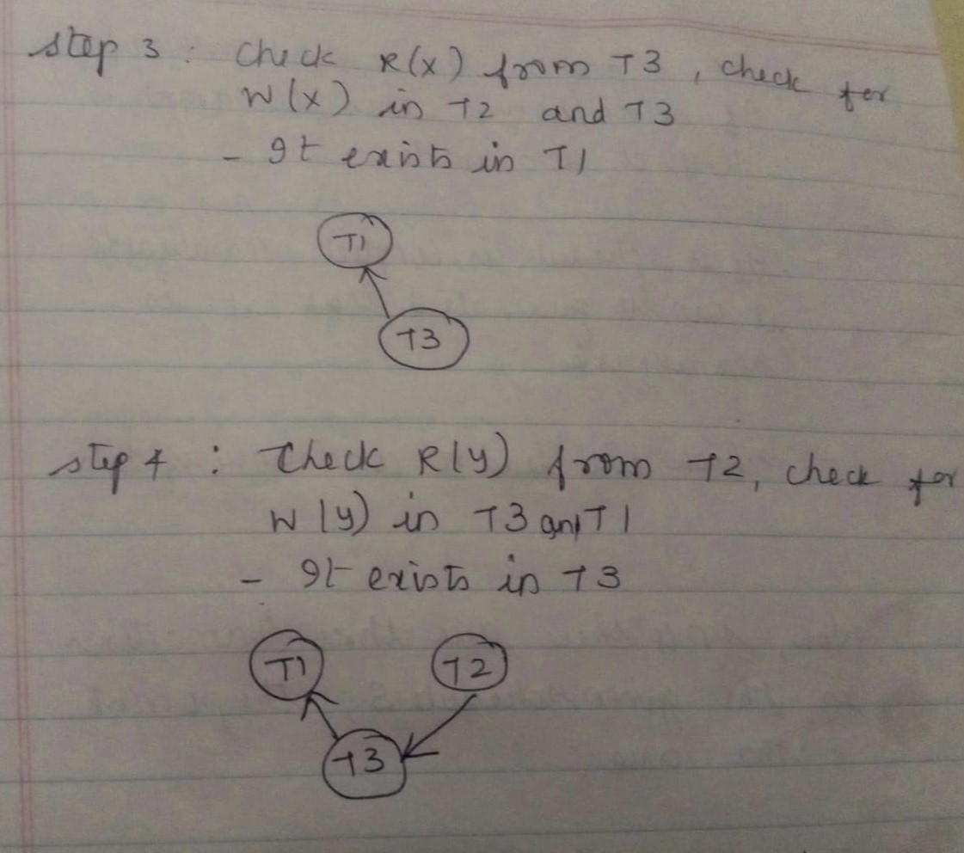
Conflict serializability
Schedule(S)
T1 | T2 | T3
R(X)
 |  | R(Y)
 |  | R(X)
 | R(Y)
 | R(Z)
 |  | W(Y)
 | W(Z)
R(Z)
W(X)
W(Z)

Slide 22
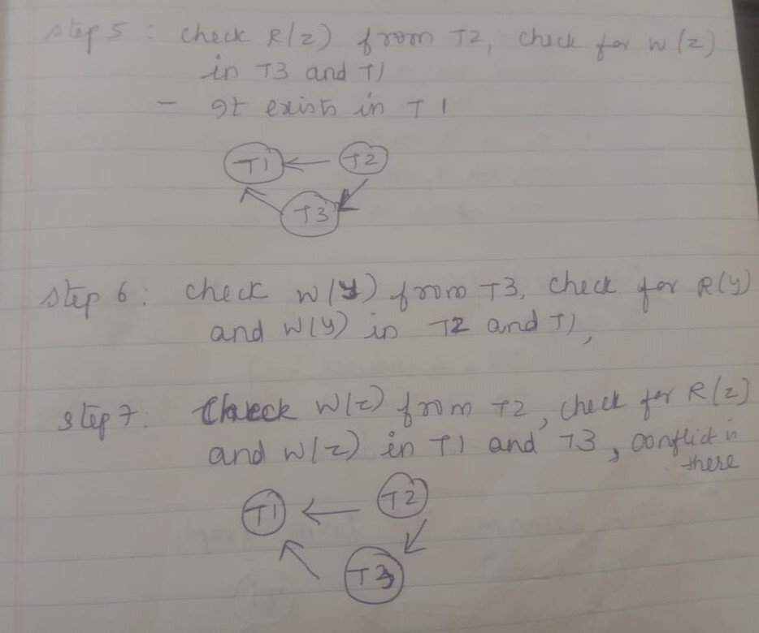
Conflict serializability
Schedule(S)
T1 | T2 | T3
R(X)
 |  | R(Y)
 |  | R(X)
 | R(Y)
 | R(Z)
 |  | W(Y)
 | W(Z)
R(Z)
W(X)
W(Z)

Slide 23
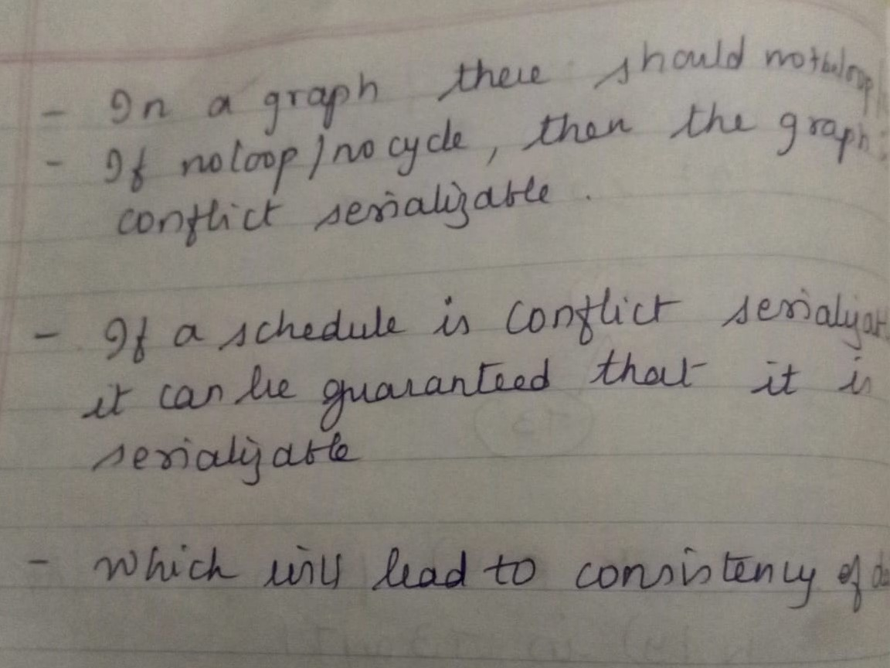
Conflict serializability
Schedule(S)
T1 | T2 | T3
R(X)
 |  | R(Y)
 |  | R(X)
 | R(Y)
 | R(Z)
 |  | W(Y)
 | W(Z)
R(Z)
W(X)
W(Z)

Slide 24
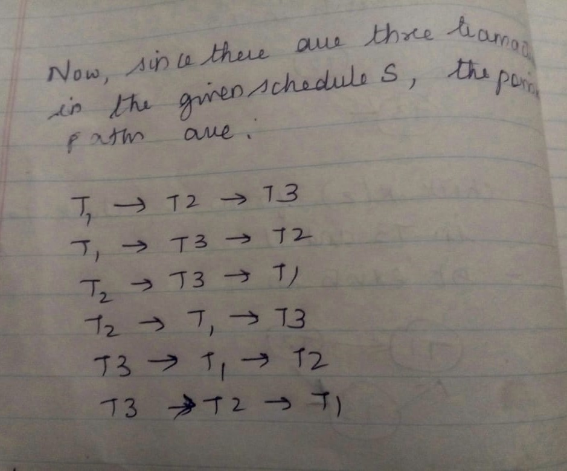
Conflict serializability
Schedule(S)
T1 | T2 | T3
R(X)
 |  | R(Y)
 |  | R(X)
 | R(Y)
 | R(Z)
 |  | W(Y)
 | W(Z)
R(Z)
W(X)
W(Z)

Slide 25
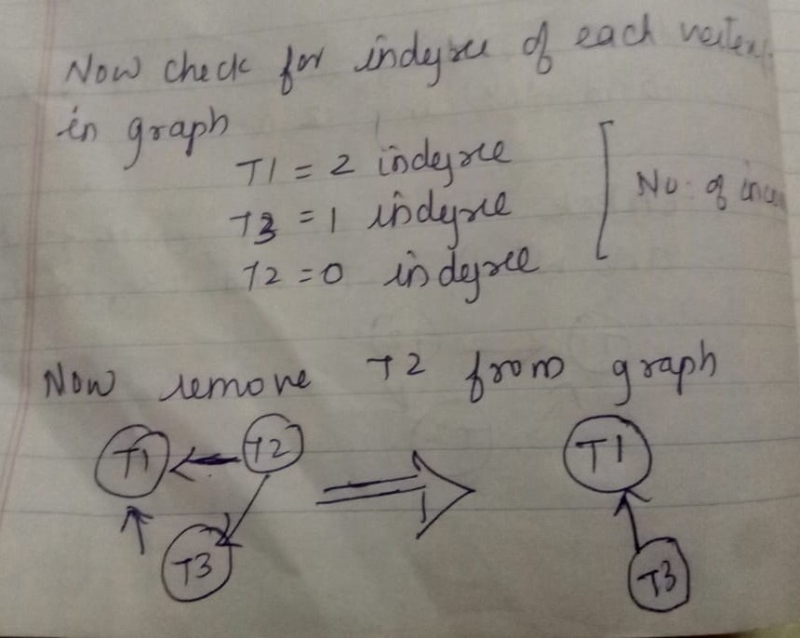
Conflict serializability
Schedule(S)
T1 | T2 | T3
R(X)
 |  | R(Y)
 |  | R(X)
 | R(Y)
 | R(Z)
 |  | W(Y)
 | W(Z)
R(Z)
W(X)
W(Z)

Slide 26
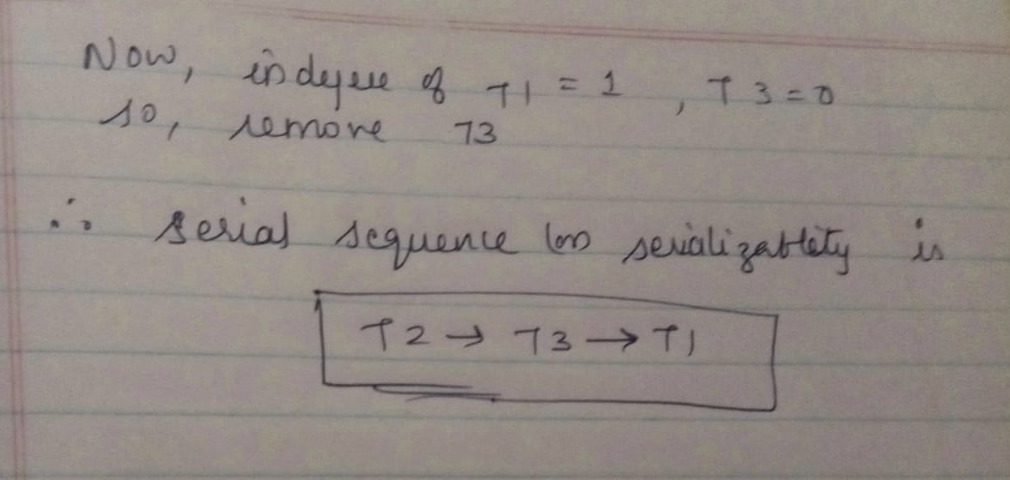
Conflict serializability
Schedule(S)
T1 | T2 | T3
R(X)
 |  | R(Y)
 |  | R(X)
 | R(Y)
 | R(Z)
 |  | W(Y)
 | W(Z)
R(Z)
W(X)
W(Z)

Slide 27
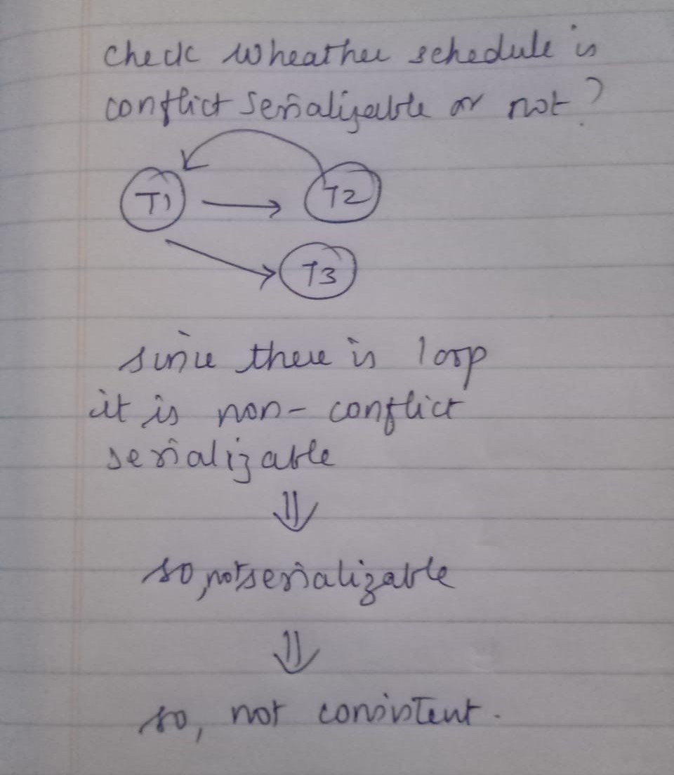
View serializability
Schedule(S)
T1 | T2 | T3
R(A)
 | W(A)
W(A)
 |  | W(A)

Slide 28
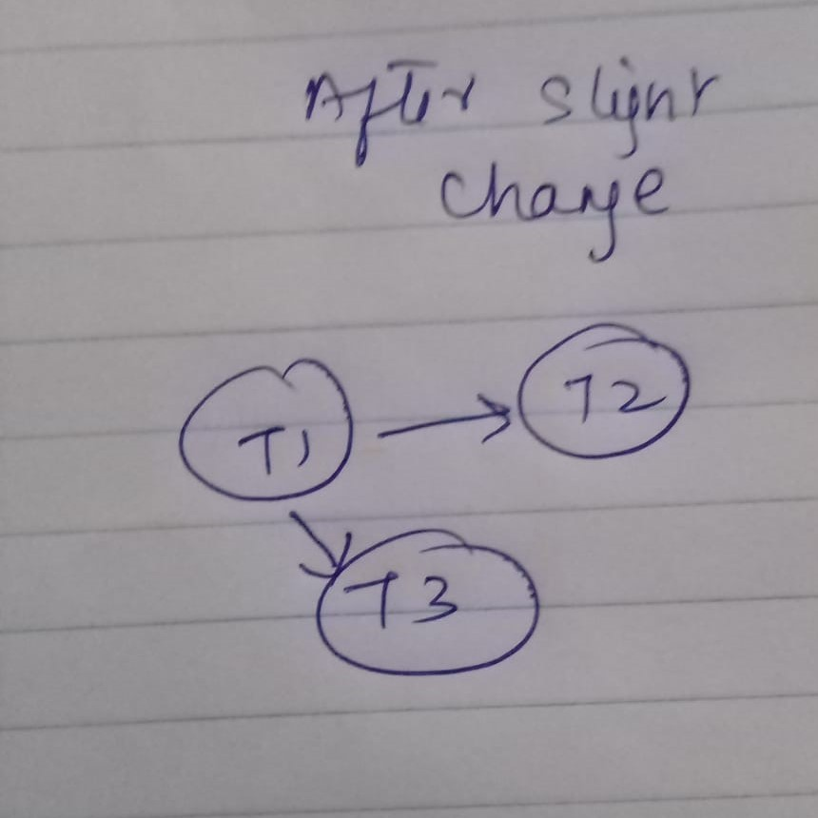
View serializability
Schedule(S)
T1 | T2 | T3
R(A)
W(A)
 | W(A)
 |  | W(A)
Two schedules are said to be view equivalent if the order of initial read, final write and update operations is the same in both the schedules. If a schedule is view equivalent to its serial schedule then it is called View Serializable Schedule.

Slide 29
Conflict Serializability | View Serializability
Two schedules are said to be conflict equivalent if all the conflicting operations in both the schedule get executed in the same order. If a schedule is a conflict equivalent to its serial schedule then it is called Conflict Serializable Schedule. | Two schedules are said to be view equivalent if the order of initial read, final write and update operations is the same in both the schedules. If a schedule is view equivalent to its serial schedule then it is called View Serializable Schedule.
If a schedule is view serializable then it may or may not be conflict serializable. | If a schedule is conflict serializable then it is also view serializable schedule.
Conflict equivalence can be easily achieved by reordering the operations of two transactions therefore, Conflict Serializability is easy to achieve. | Viewequivalence is rather difficult to achieve as both transactions should perform similar actions in a similar manner. Thus, View Serializability is difficult to achieve.

