Slide 1
UNIT-5

Slide 2
Database Concurrency Control
1 Purpose of Concurrency Control
To enforce Isolation (through mutual exclusion) among conflicting transactions.
To preserve database consistency through consistency preserving execution of transactions.
To resolve read-write and write-write conflicts.
Example:
In concurrent execution environment if T1 conflicts with T2 over a data item A, then the existing concurrency control decides if T1 or T2 should get the A and if the other transaction is rolled-back or waits.

Slide 3
Lock-Types
1. Binary Lock
Locking is an operation which secures
(a) permission to Read
(b) permission to Write a data item for a transaction.
Example:
Lock (X). Data item X is locked in behalf of the requesting transaction.
Unlocking is an operation which removes these permissions from the data item.
Example:
Unlock (X): Data item X is made available to all other transactions.
Lock and Unlock are Atomic operations.

Slide 4
Lock-Types
2. Two locks modes:
(a) shared (read) (b) exclusive (write).
Shared mode: shared lock (X)
More than one transaction can apply share lock on X for reading its value but no write lock can be applied on X by any other transaction.
Exclusive mode: Write lock (X)
Only one write lock on X can exist at any time and no shared lock can be applied by any other transaction on X.
Conflict matrix

Slide 5
Two kinds of Concurrency Control Protocol
Lock based Protocol
Timestamp based protocol

Slide 6
Lock based Protocol
Simple Locking Protocol
Lock before accessing the item and unlock wen the operation is done.
2-Phase Locking Protocol
Simple 2-PL
Conservative 2-PL
Strict 2-PL
Rigorous 2-PL

Slide 7
Simple 2-Phase Locking Protocol
Growing Phase
Shrinking Phase
Lock Point

Slide 8
Database Concurrency Control
Simple Two-Phase Locking Techniques:
Transaction locks data items incrementally. This may cause deadlock which is dealt with.
Two Phases:
(a) Locking (Growing)
(b) Unlocking (Shrinking).
Locking (Growing) Phase:
A transaction applies locks (read or write) on desired data items one at a time.
Unlocking (Shrinking) Phase:
A transaction unlocks its locked data items one at a time.
Requirement:
For a transaction these two phases must be mutually exclusively, that is, during locking phase unlocking phase must not start and during unlocking phase locking phase must not begin.

Slide 9
Database Concurrency Control
Simple Two-Phase Locking Techniques: Essential components
Lock conversion
Lock upgrade: existing read lock to write lock
if Ti has a read-lock (X) and Tj has no read-lock (X) (i ≠ j) then
convert read-lock (X) to write-lock (X)
else
force Ti to wait until Tj unlocks X
Lock downgrade: existing write lock to read lock
Ti has a write-lock (X) (*no transaction can have any lock on X*)
convert write-lock (X) to read-lock (X)

Slide 10
Simple Two-Phase Locking Protocol
Ensure serializability
It has the following limitations:
Dead lock
Cascading rollback
Unnecessary wait due to early lock

Slide 11
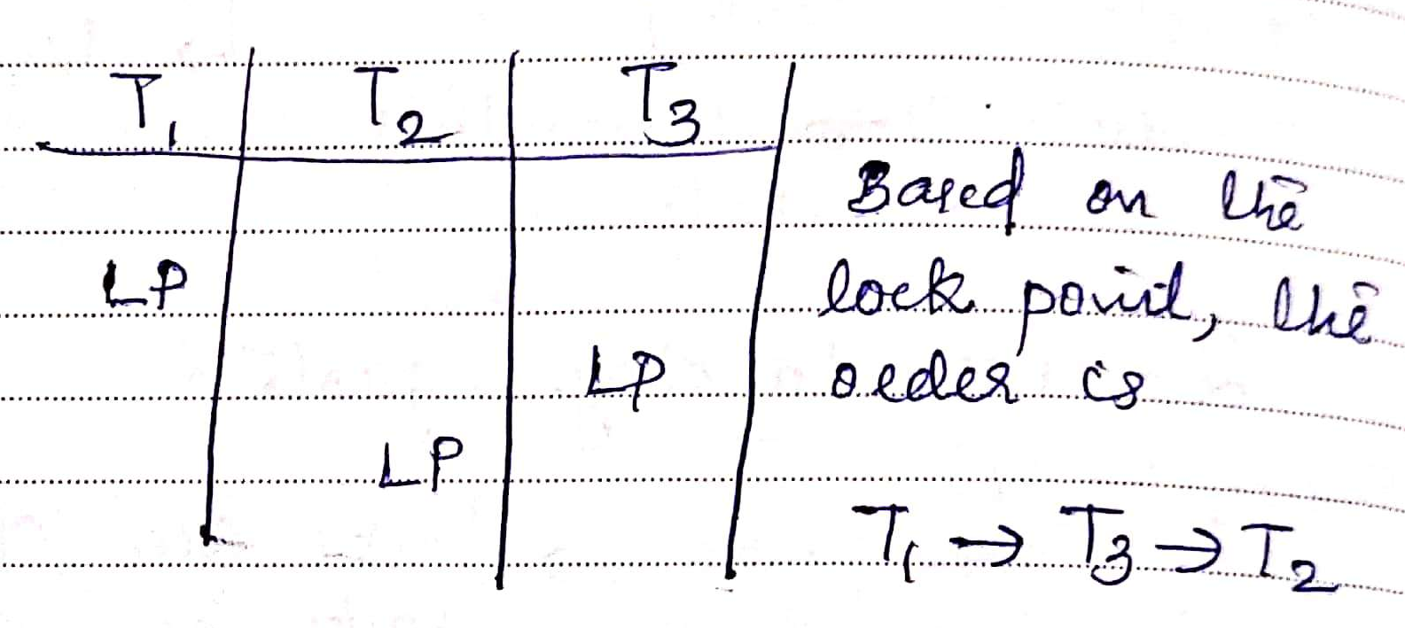

Slide 12
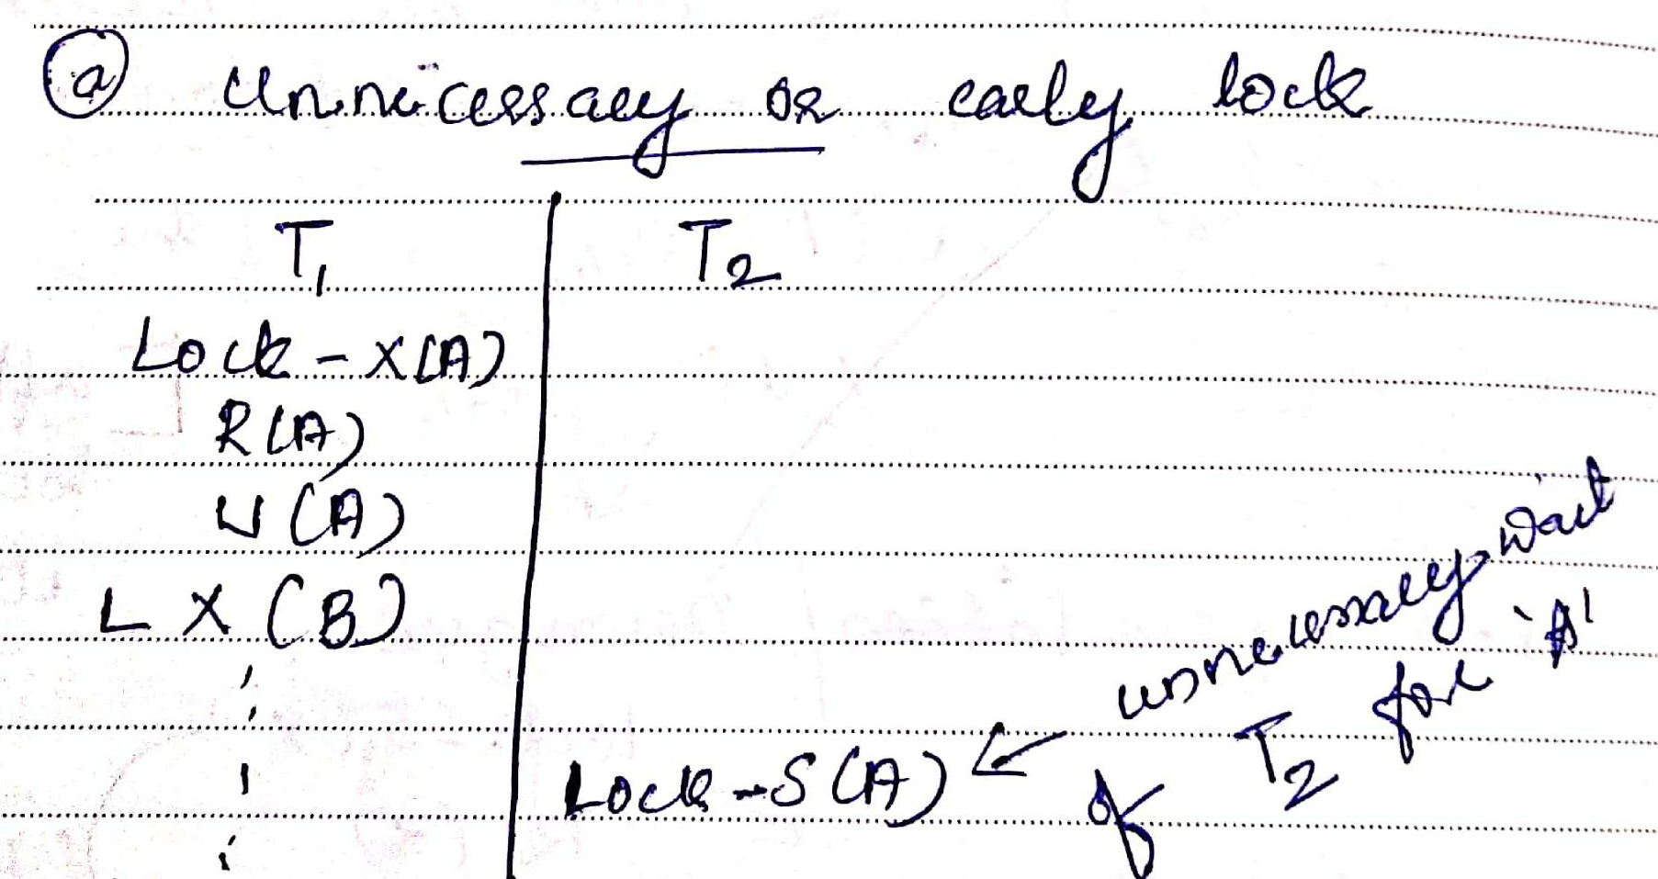

Slide 13
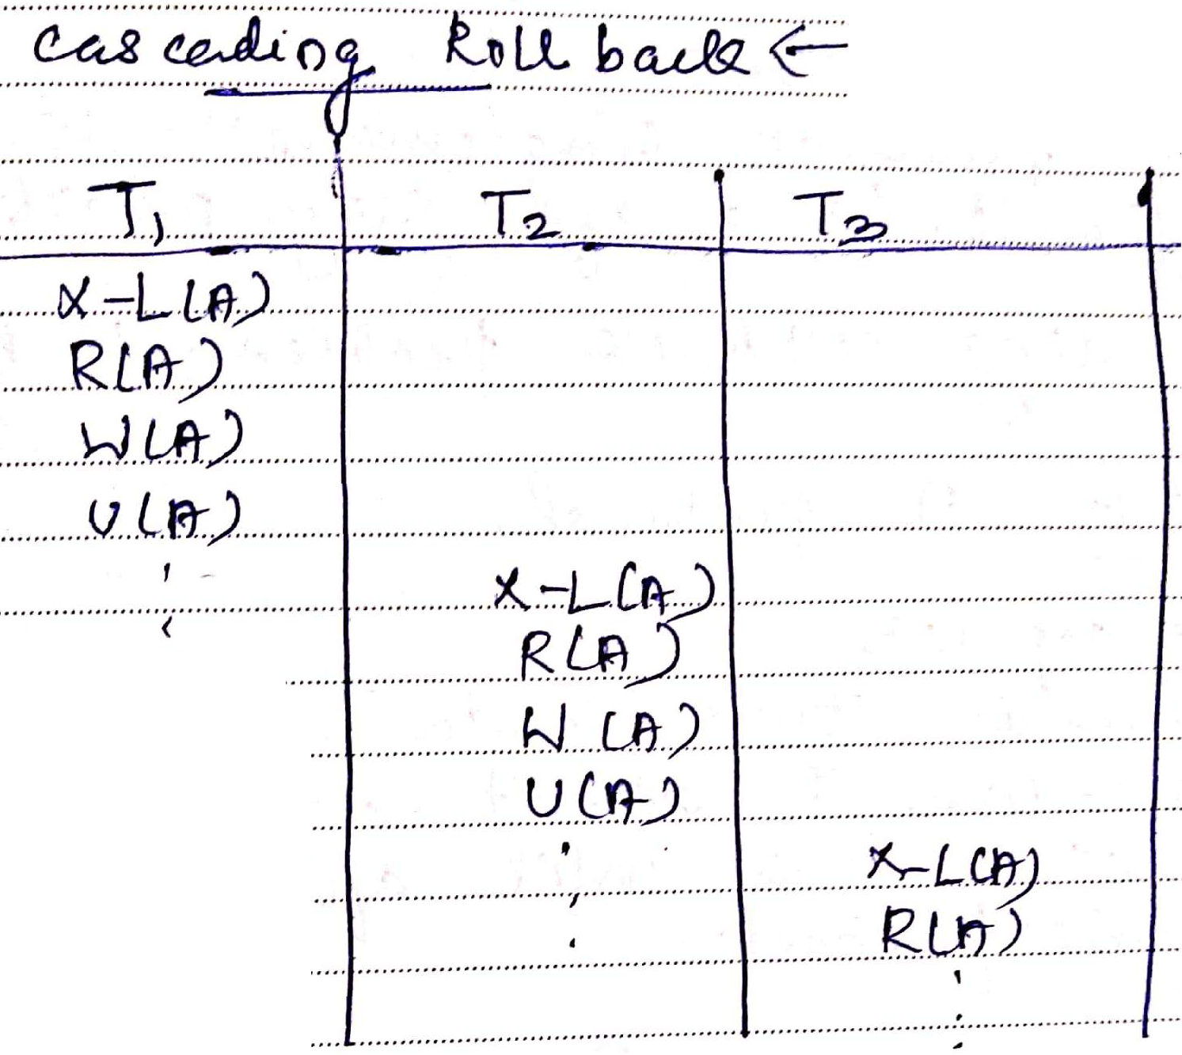

Slide 14
Database Concurrency Control
Dealing with Deadlock and Starvation
Deadlock
T’1 T’2
read_lock (Y); T1 and T2 did follow two-phase
read_item (Y); policy but they are deadlock
read_lock (X);
read_item (Y);
write_lock (X);
(waits for X) write_lock (Y);
(waits for Y)
Deadlock (T’1 and T’2)

Slide 15
Database Concurrency Control
Two-Phase Locking Techniques:
Basic:
Transaction locks data items incrementally. This may cause deadlock which is dealt with.
Conservative:
Prevents deadlock by locking all desired data items before transaction begins execution.
Strict:
A stricter version of Basic algorithm where unlocking (exclusive locks) is performed after a transaction terminates (commits or aborts). This is the most commonly used two-phase locking algorithm.
Rigorous:
- A more stricter version of Basic algorithm where unlocking is performed after a transaction terminates (commits or aborts)

Slide 16
Database Concurrency Control
Timestamp based concurrency control algorithm
Timestamp
A monotonically increasing variable (integer) indicating the age of an operation or a transaction. A larger timestamp value indicates a more recent event or operation.
Timestamp based algorithm uses timestamp to serialize the execution of concurrent transactions.

Slide 17
Database Concurrency Control
Timestamp based concurrency control algorithm
Basic Timestamp Ordering
1. Transaction T issues a write_item(X) operation:
If read_TS(X) > TS(T) or if write_TS(X) > TS(T), then an younger transaction has already read the data item so abort and roll-back T and reject the operation.
If the condition in part (a) does not exist, then execute write_item(X) of T and set write_TS(X) to TS(T).
2. Transaction T issues a read_item(X) operation:
If write_TS(X) > TS(T), then an younger transaction has already written to the data item so abort and roll-back T and reject the operation.
If write_TS(X) ≤ TS(T), then execute read_item(X) of T and set read_TS(X) to the larger of TS(T) and the current read_TS(X).

