Slide 1

Chapter 14
Indexing Structures for Files
Copyright © 2004 Ramez Elmasri and Shamkant Navathe

Slide 2
Chapter Outline
Types of Single-level Ordered Indexes
  Primary Indexes
  Clustering Indexes
  Secondary Indexes
Multilevel Indexes
Dynamic Multilevel Indexes Using B-Trees and B+-Trees
Indexes on Multiple Keys
Chapter 14-<number>

Slide 3
Indexes as Access Paths
  A single-level index is an auxiliary file that makes it more efficient to search for a record in the data file.
  The index is usually specified on one field of the file (although it could be specified on several fields)
  One form of an index is a file of entries <field value, pointer to record>, which is ordered by field value
  The index is called an access path on the field.
Chapter 14-<number>

Slide 4
Indexes as Access Paths (contd.)
  The index file usually occupies considerably less disk blocks than the data file because its entries are much smaller
  A binary search on the index yields a pointer to the file record
  Indexes can also be characterized as dense or sparse.
    A dense index has an index entry for every search key value (and hence every record) in the data file.
    A sparse (or nondense) index, on the other hand, has index entries for only some of the search values
Chapter 14-<number>

Slide 5
Indexes as Access Paths (contd.)
Example: Given the following data file:
EMPLOYEE(NAME, SSN, ADDRESS, JOB, SAL, ... )
Suppose that:
record size R=150 bytes
block size B=512 bytes
r=30000 records
Then, we get:
blocking factor Bfr= B div R= 512 div 150= 3 records/block
number of file blocks b= (r/Bfr)= (30000/3)= 10000 blocks
For an index on the SSN field, assume the field size V_{SSN}=9 bytes,
assume the record pointer size P_{R}=7 bytes. Then:
index entry size R_{I}=(V_{SSN}+ P_{R})=(9+7)=16 bytes
index blocking factor Bfr_{I}= B div R_{I}= 512 div 16= 32 entries/block
number of index blocks b= (r/ Bfr_{I})= (30000/32)= 938 blocks
binary search needs log₂bI= log₂938= 10 block accesses
This is compared to an average linear search cost of:
(b/2)= 30000/2= 15000 block accesses
If the file records are ordered, the binary search cost would be:
log₂b= log₂30000= 15 block accesses
Chapter 14-<number>

Slide 6
Types of Single-Level Indexes
Primary Index
  Defined on an ordered data file
  The data file is ordered on a key field
  Includes one index entry for each block in the data file; the index entry has the key field value for the first record in the block, which is called the block anchor
  A similar scheme can use the last record in a block.
  A primary index is a nondense (sparse) index, since it includes an entry for each disk block of the data file and the keys of its anchor record rather than for every search value.
Chapter 14-<number>

Slide 7
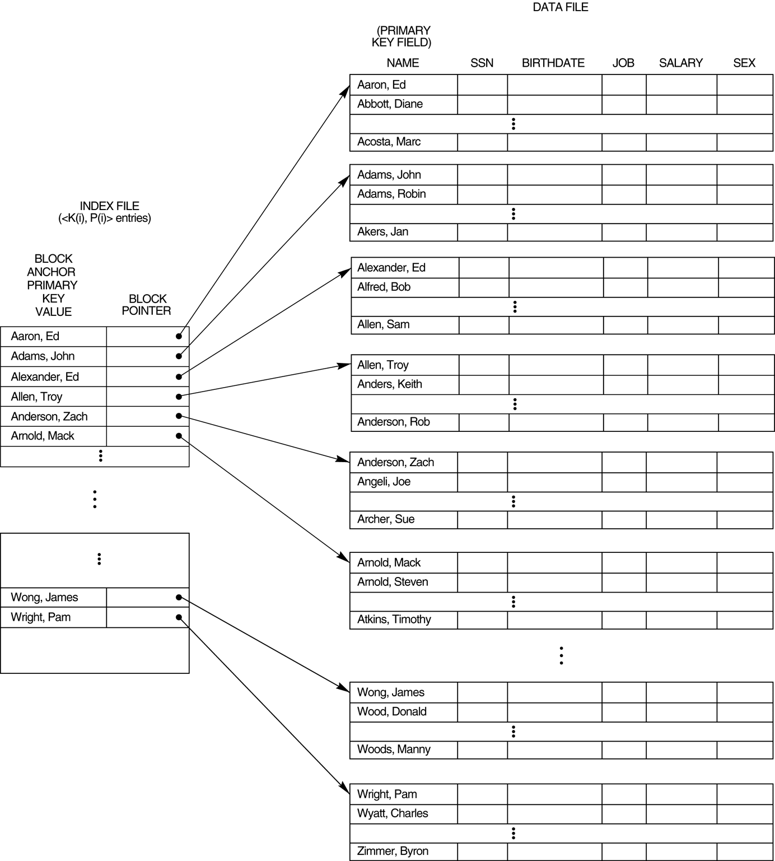
FIGURE 14.1
Primary index on the ordering key field of the file shown in Figure 13.7.
Chapter 14-<number>

Slide 8
Types of Single-Level Indexes
Clustering Index
  Defined on an ordered data file
  The data file is ordered on a non-key field unlike primary index, which requires that the ordering field of the data file have a distinct value for each record.
  Includes one index entry for each distinct value of the field; the index entry points to the first data block that contains records with that field value.
  It is another example of nondense index where Insertion and Deletion is relatively straightforward with a clustering index.
Chapter 14-<number>

Slide 9
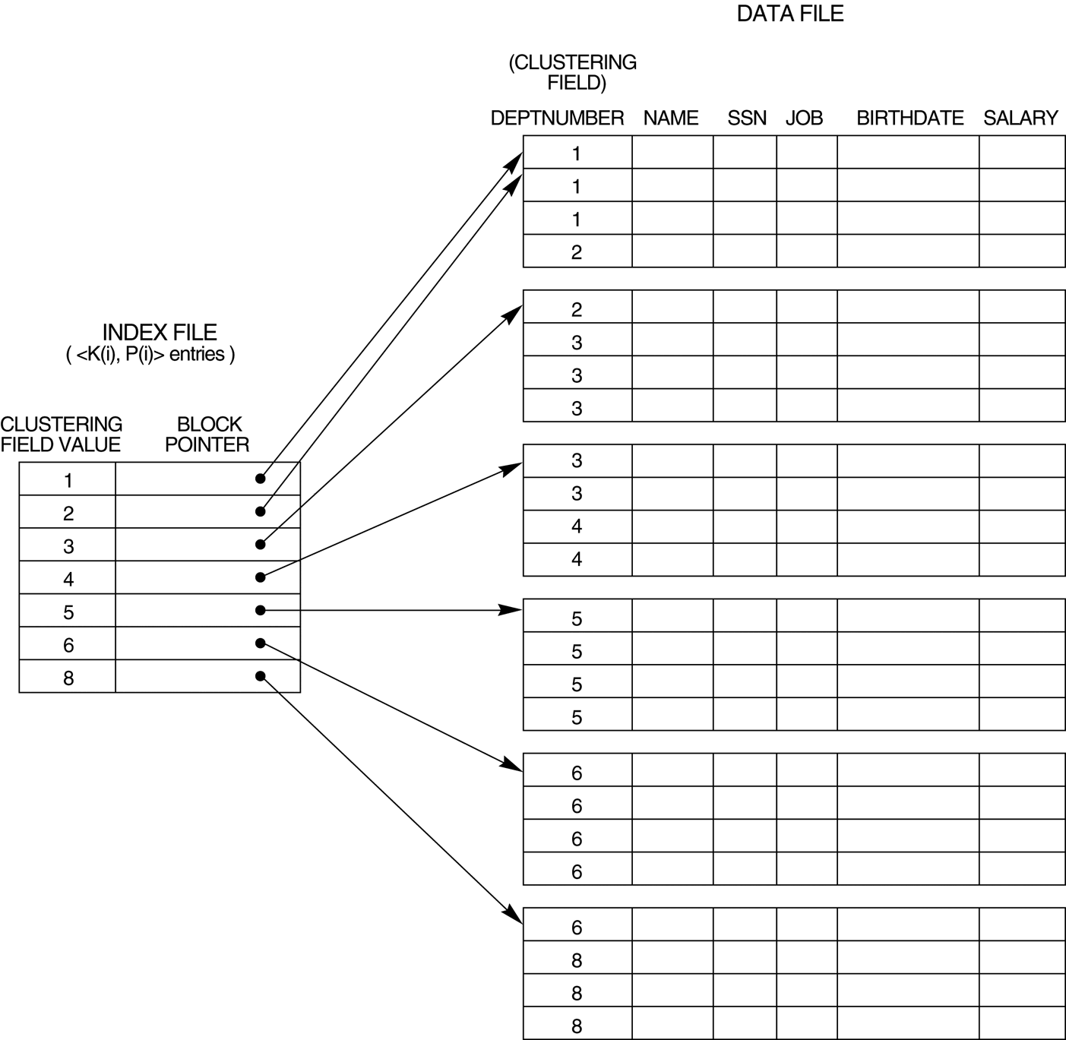
FIGURE 14.2
A clustering index on the DEPTNUMBER ordering nonkey field of an EMPLOYEE file.
Chapter 14-<number>

Slide 10
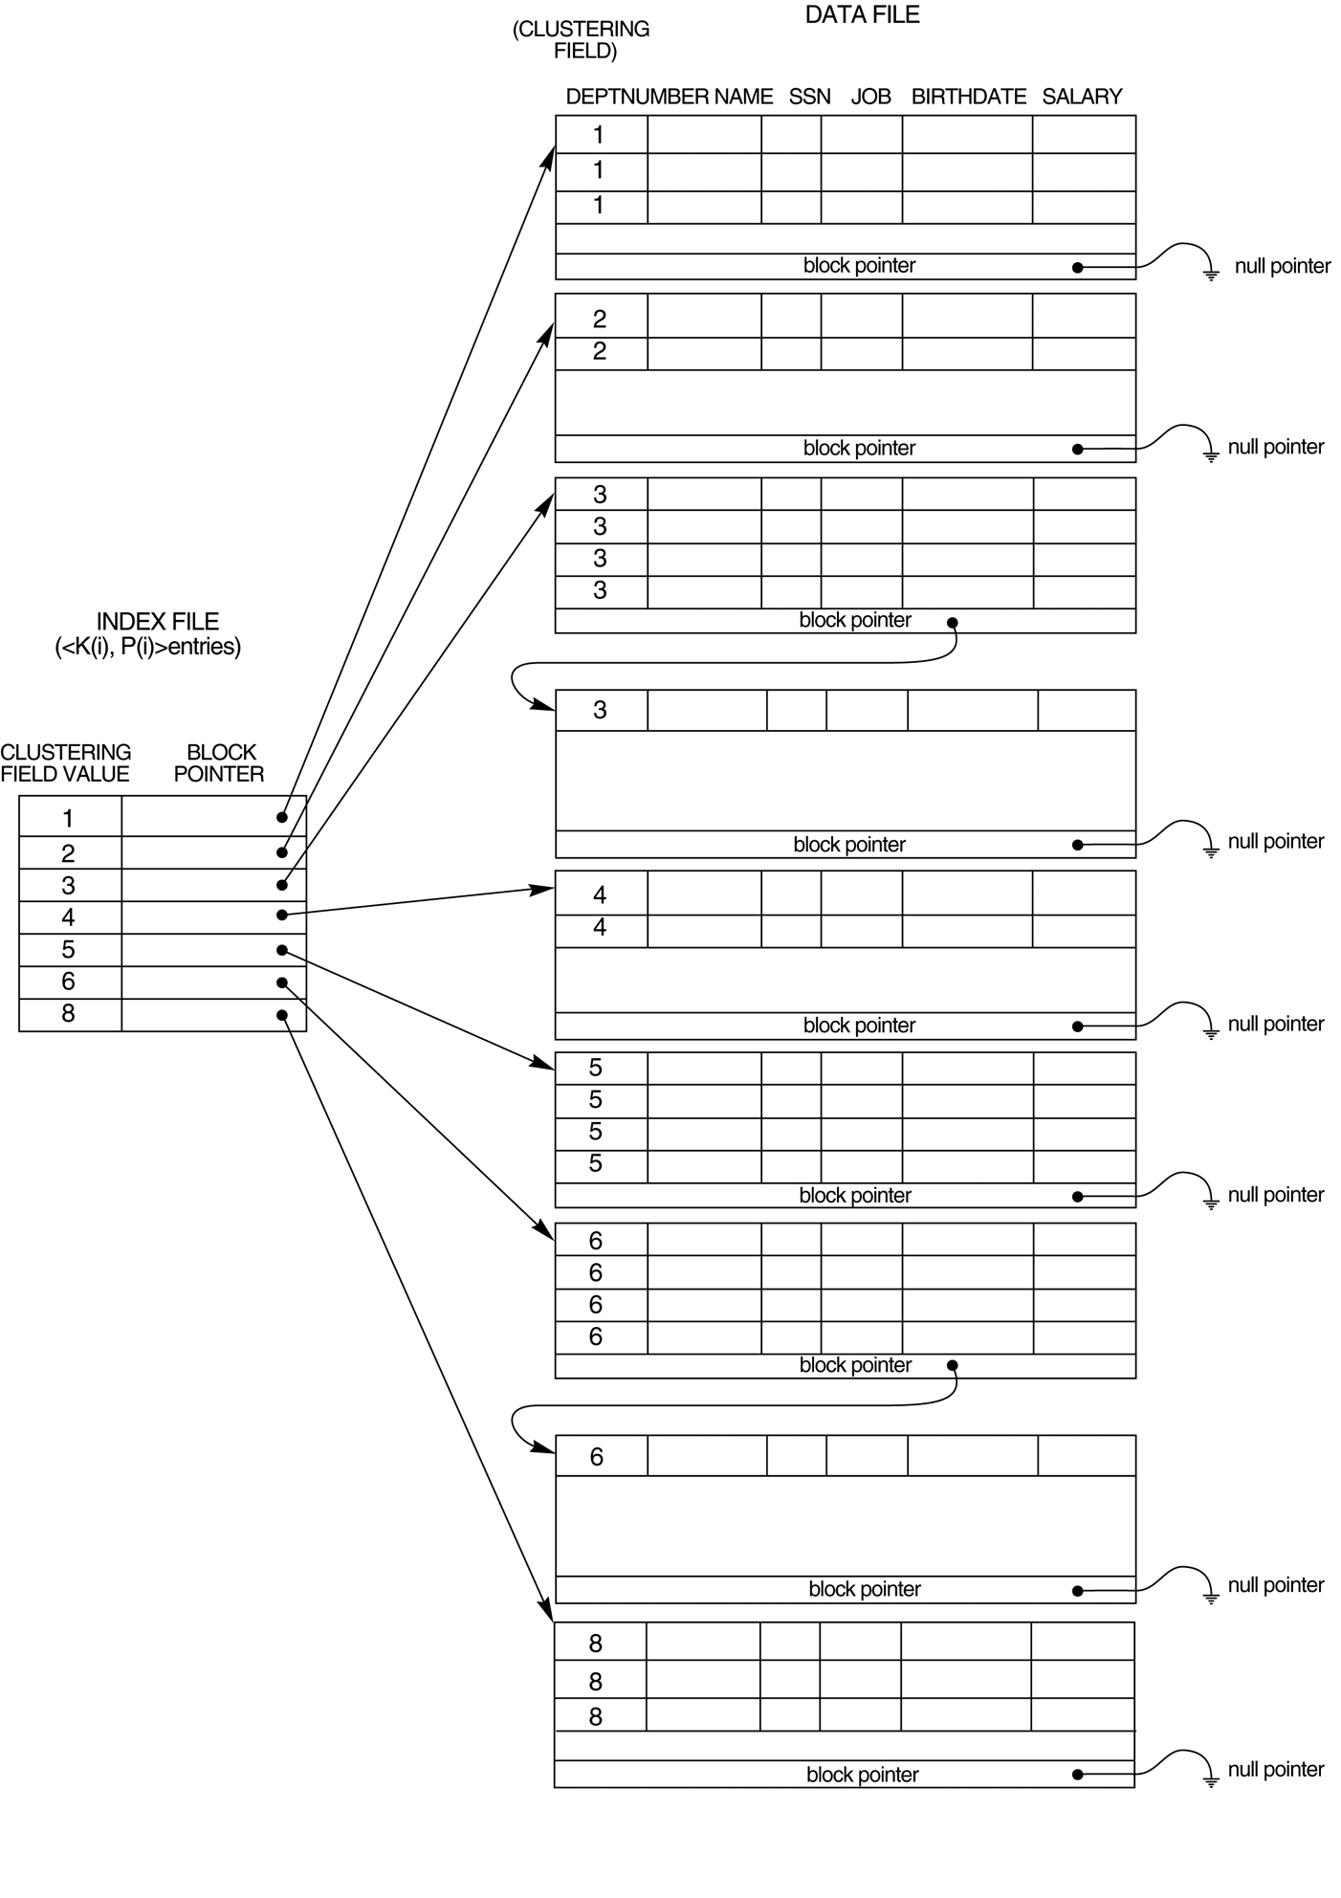
FIGURE 14.3
Clustering index with a separate block cluster for each group of records that share the same value for the clustering field.
Chapter 14-<number>

Slide 11
Types of Single-Level Indexes
Secondary Index
  A secondary index provides a secondary means of accessing a file for which some primary access already exists.
  The secondary index may be on a field which is a candidate key and has a unique value in every record, or a nonkey with duplicate values.
  The index is an ordered file with two fields.
    The first field is of the same data type as some nonordering field of the data file that is an indexing field.
    The second field is either a block pointer or a record pointer. There can be many secondary indexes (and hence, indexing fields) for the same file.
  Includes one entry for each record in the data file; hence, it is a dense index
Chapter 14-<number>

Slide 12
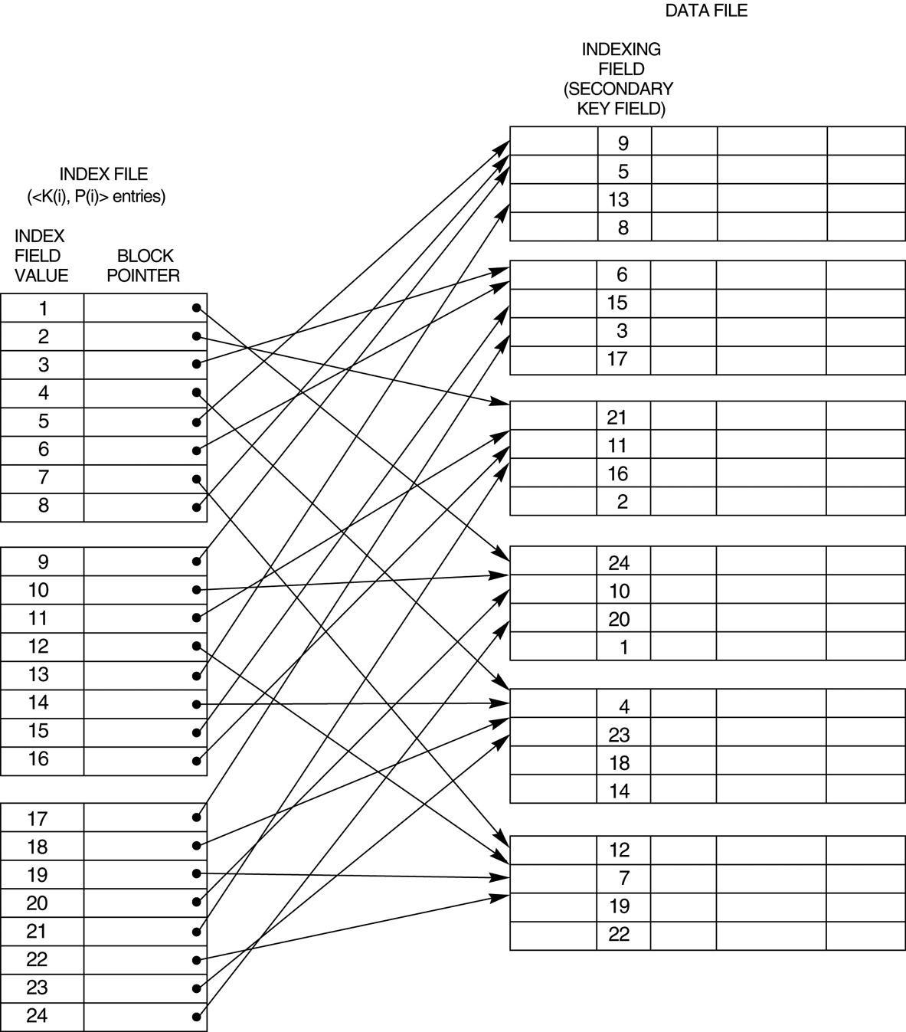
FIGURE 14.4
A dense secondary index (with block pointers) on a nonordering key field of a file.
Chapter 14-<number>

Slide 13
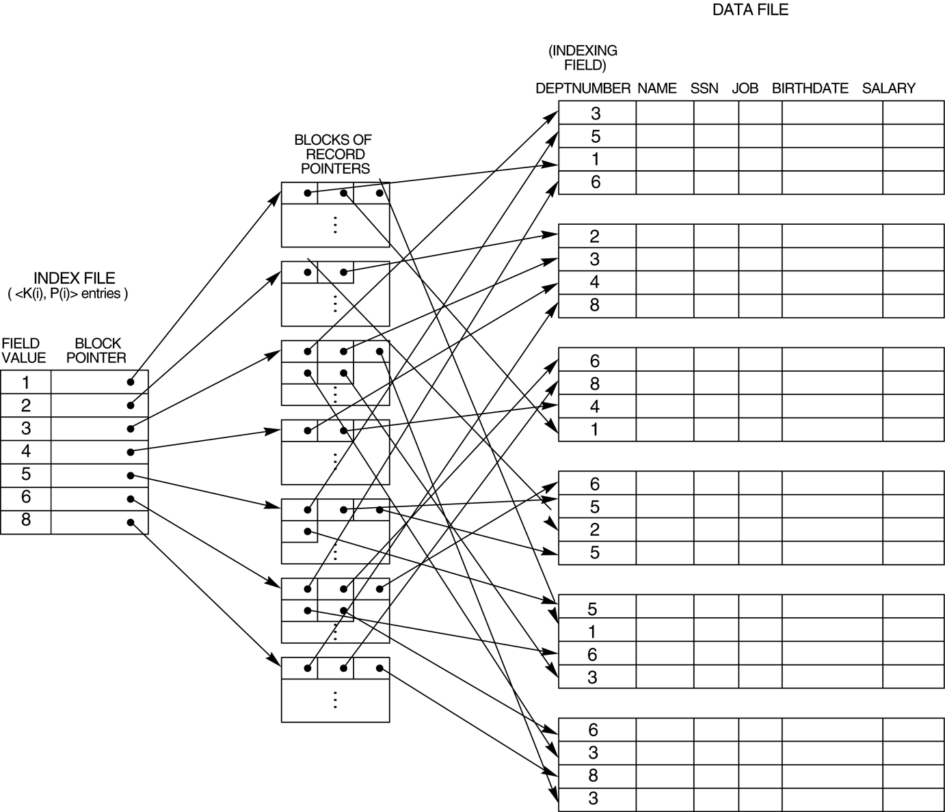
FIGURE 14.5
A secondary index (with recored pointers) on a nonkey field implemented using one level of indirection so that index entries are of fixed length and have unique field values.
Chapter 14-<number>

Slide 14
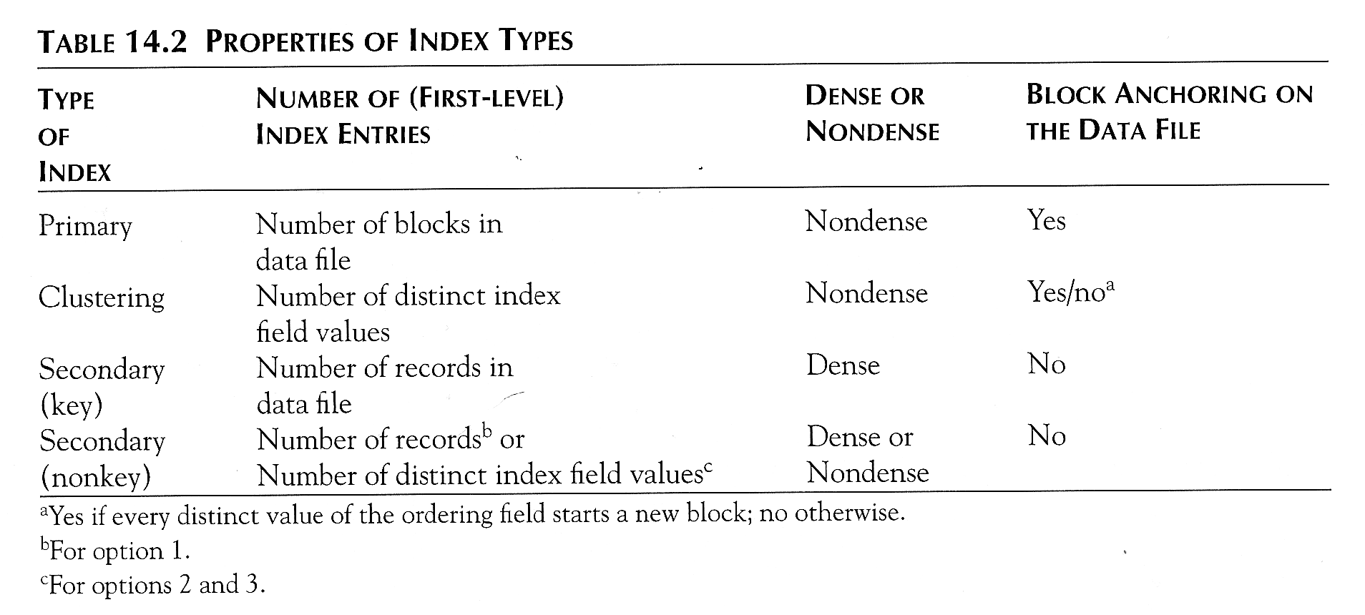
Chapter 14-<number>

Slide 15
Multi-Level Indexes
Because a single-level index is an ordered file, we can create a primary index to the index itself ; in this case, the original index file is called the first-level index and the index to the index is called the second-level index.
We can repeat the process, creating a third, fourth, ..., top level until all entries of the top level fit in one disk block
A multi-level index can be created for any type of first-level index (primary, secondary, clustering) as long as the first-level index consists of more than one disk block
Chapter 14-<number>

Slide 16
Multi-Level Indexes
First (or base) level
  considers the index file as an ordered file with a distinct value for each K(i).
  create a primary index for the first level.
Second level.
  Index to the first level
  Second level is a primary index So use block anchors so that the second level has one entry for each block of the first level.
  The blocking factor bfr_{i} for the second level and for all subsequent levels is the same as that for the first-level index because all index entries are the same size..
  Each has one field value and one block address.
If the first level has r₁ entries, and the blocking factor (fan-out) for the index is bfr_{i} = fo, then
  the first level needs ⎡(r₁/fo)⎤ blocks,
  which is the number of entries r₂ needed at the second level of the index.
Chapter 14-<number>

Slide 17
Multi-Level Indexes
We can repeat this process for the second level.
The third level
  which is a primary index for the second level
  has an entry for each second-level block,
  so the number of third-level entries is r₃ = ⎡(r₂/fo)⎤.
we require a second level only if the first level needs more than one block of disk storage, and, similarly, we require a third level only if the second level needs more than one block.
We can repeat the preceding process until all the entries of some index level t fit in a single block.
This block at the t^{th} level is called the top index level.
Chapter 14-<number>

Slide 18
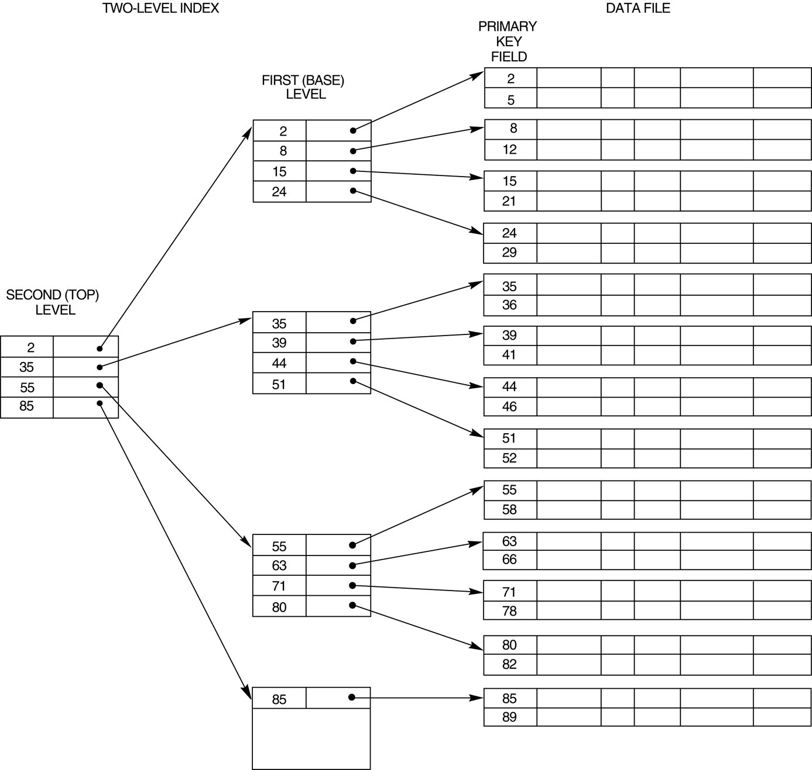
FIGURE 14.6
A two-level primary index resembling ISAM (Indexed Sequential Access Method) organization.
Chapter 14-<number>

Slide 19
Multi-Level Indexes
Such a multi-level index is a form of search tree ; however, insertion and deletion of new index entries is a severe problem because every level of the index is an ordered file.
Chapter 14-<number>

Slide 20
Search Trees.
A search tree is slightly different from a multilevel index.
A search tree of order p
  is a tree such that each node contains at most p − 1 search values
  p pointers in the order <P₁, K₁, P₂, K₂, … , P_{q−1}, K_{q−1}, P_{q}>, where q ≤ p.
Each P_{i} is a pointer to a child node (or a NULL pointer), and each K_{i} is a search value from some ordered set of values.
All search values are assumed to be unique.
Chapter 14-<number>

Slide 21
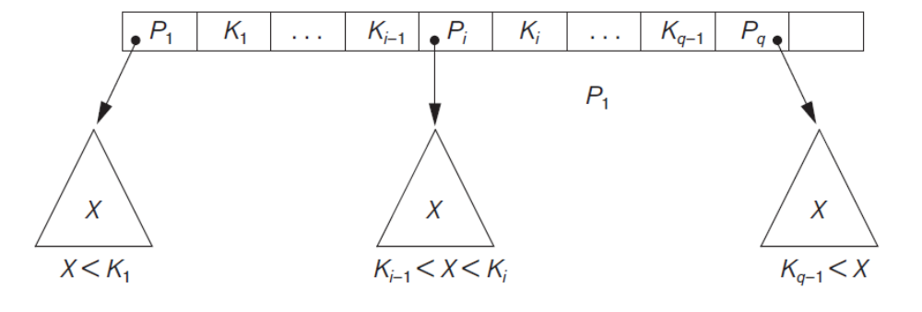

FIGURE 14.8
A node in a search tree with pointers to subtrees below it.
Two constraints must hold at all times on the search tree:
1. Within each node, K1 < K2 < ... < Kq−1.
2. For all values X in the subtree pointed at by Pi, we have Ki-1 < X < Ki
for 1 < i < q; X < Ki for i = 1; and Ki-1 < X for i = q
Chapter 14-<number>

Slide 22
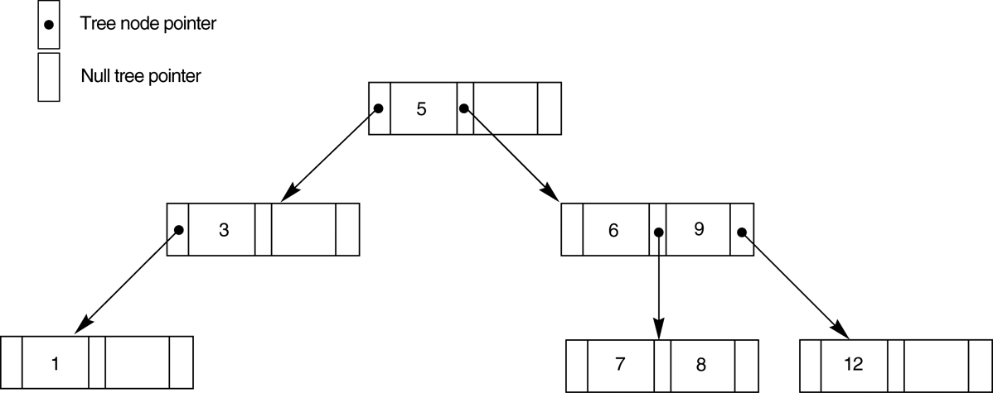
FIGURE 14.9
A search tree of order p = 3.
Chapter 14-<number>

Slide 23
Search Trees
We can use a search tree as a mechanism to search for records stored in a disk file.
The values in the tree can be the values of one of the fields of the file, called the search field
Each key value in the tree is associated with a
  pointer to the record in the data file having that value.
  pointer to the disk block containing that record.
When a new record is inserted in the file, we must update the search tree by inserting an entry in the tree containing the search field value of the new record and a pointer to the new record.
Algorithms are necessary for inserting and deleting search values into the search tree.
  do not guarantee that a search tree is balanced.
Chapter 14-<number>

Slide 24
Goals for balancing a search tree
To guarantee that nodes are evenly distributed, so that the depth of the tree is minimized for the given set of keys
The tree does not get skewed with some nodes being at very deep levels
Minimizing the number of levels in the tree.
Make sure that the index tree does not need too much restructuring as records are inserted into and deleted from the main file.
The nodes to be as full as possible and do not want any nodes to be empty if there are too many deletions.
Record deletion may leave some nodes in the tree nearly empty, thus wasting storage space and increasing the number of levels.
The B-tree addresses both of these problems by specifying additional constraints on the search tree.
Chapter 14-<number>

Slide 25
Dynamic Multilevel Indexes Using B-Trees and B+-Trees
Because of the insertion and deletion problem, most multi-level indexes use B-tree or B+-tree data structures, which leave space in each tree node (disk block) to allow for new index entries
These data structures are variations of search trees that allow efficient insertion and deletion of new search values.
In B-Tree and B+-Tree data structures, each node corresponds to a disk block
Each node is kept between half-full and completely full
Chapter 14-<number>

Slide 26
Dynamic Multilevel Indexes Using B-Trees and B+-Trees (contd.)
Insertion
  An insertion into a node that is not full is quite efficient; if a node is full the insertion causes a split into two nodes
  Splitting may propagate to other tree levels
Deletion
  A deletion is quite efficient if a node does not become less than half full
  If a deletion causes a node to become less than half full, it must be merged with neighboring nodes
Chapter 14-<number>

Slide 27
Difference between B-tree and B+-tree
In a B-tree, pointers to data records exist at all levels of the tree
In a B+-tree, all pointers to data records exists at the leaf-level nodes
A B+-tree can have less levels (or higher capacity of search values) than the corresponding B-tree
Chapter 14-<number>

Slide 28
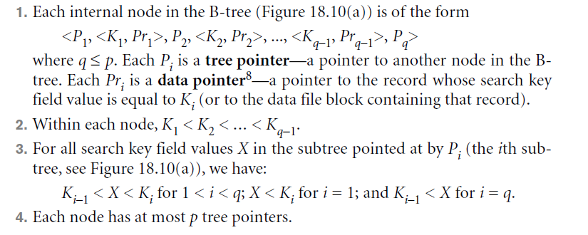
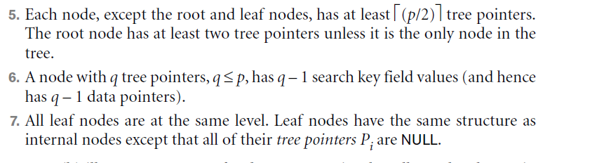
B Tree
Chapter 14-<number>

Slide 29
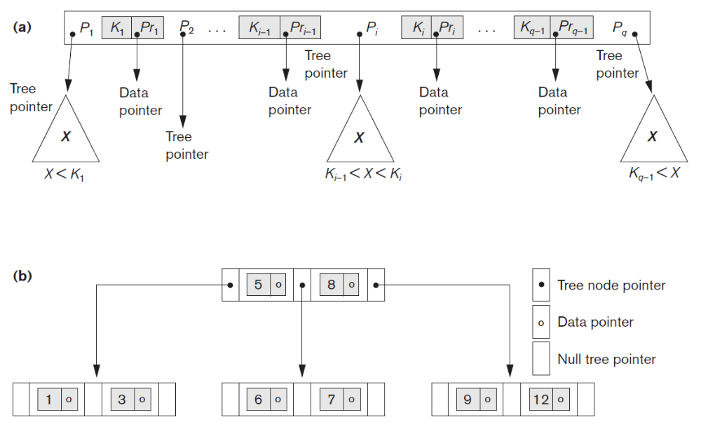
B-tree structures. (a) A node in a B-tree with q – 1 search values. (b) A B-tree of order p = 3. The values were inserted in the order 8, 5, 1, 7, 3, 12, 9, 6.
Chapter 14-<number>

Slide 30
calculate the order p of a B-tree
suppose that the search key field is V = 9 bytes long, the block size is B = 512 bytes, a record pointer is Pr = 7 bytes, and a block pointer is P = 6 bytes.
An internal node of the B-tree can have up to p tree pointers and p – 1 search field values; these must fit into a single block.
  (p * P) + ((p – 1) * (Pr + V) ≤ B
  (P * 6) + ((P − 1) *(7 + 9) ≤ 512
  (22 * p) ≤ 528
We can choose p to be the largest value satisfying the above inequality, which gives p = 23.
Chapter 14-<number>

Slide 31
calculate the number of blocks and levels for a B-tree.
Suppose that the search field is a non ordering key field, and we construct a B-tree on this field with p = 23.
Assume that each node of the B-tree is 69 percent full. Each node, on the average, will have p * 0.69 = 23 * 0.69 or approximately 16 pointers and, hence, 15 search key field values.
The average fan-out fo = 16.
Start at the root and see how many values and pointers can exist, on the average, at each subsequent level.
Root: 1 node 15 key entries 16 pointers
Level 1: 16 nodes 240 key entries 256 pointers
Level 2: 256 nodes 3840 key entries 4096 pointers
Level 3: 4096 nodes 61,440 key entries
Chapter 14-<number>

Slide 32
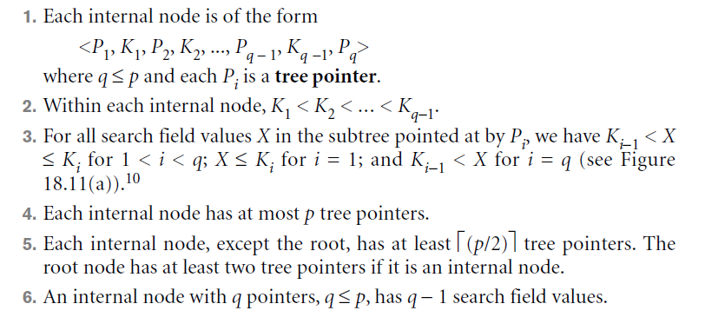
structure of the internal nodes of a
B⁺-tree of order p
Chapter 14-<number>

Slide 33
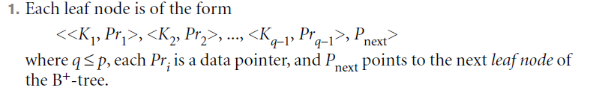
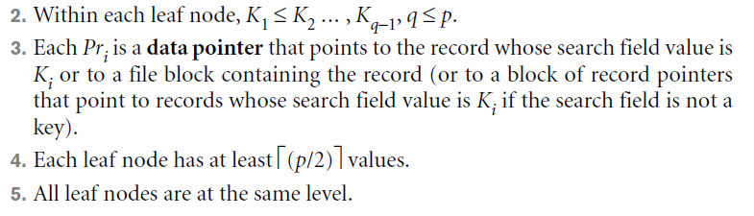
structure of the leaf nodes of a B+-tree of order p
Chapter 14-<number>

Slide 34
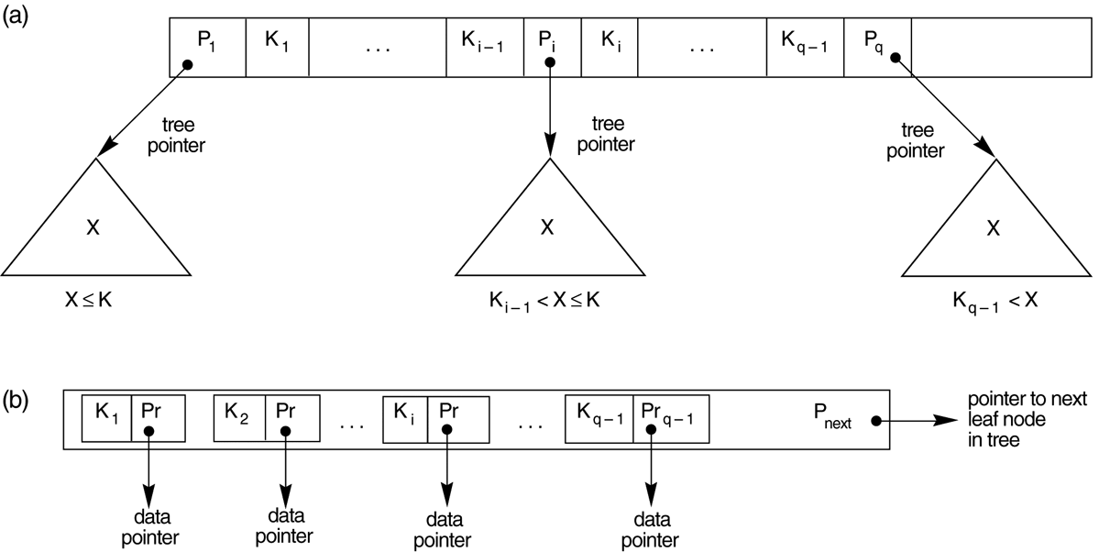
FIGURE 14.11
The nodes of a B+-tree. (a) Internal node of a B+-tree with q –1 search values. (b) Leaf node of a B+-tree with q – 1 search values and q – 1 data pointers.
Chapter 14-<number>

Slide 35
calculate the order p of a B+-tree
suppose that the search key field is V = 9 bytes long, the block size is B = 512 bytes, a record pointer is Pr = 7 bytes, and a block pointer is P = 6 bytes.
An internal node of the B+-tree can have up to p tree pointers and p – 1 search field values; these must fit into a single block.
  (p * P) + ((p – 1) * V) ≤ B
  (P * 6) + ((P − 1) * 9) ≤ 512
  (15 * p) ≤ 521
We can choose p to be the largest value satisfying the above inequality, which gives p = 34.
This is larger than the value of 23 for the B-tree, resulting in a larger fan-out and more entries in each internal node of a B+-tree than in the corresponding B-tree.
Chapter 14-<number>

Slide 36
calculate the order p for the leaf nodes of the B+-tree
  (p_{leaf} * (Pr + V)) + P ≤ B
  (p_{leaf} * (7 + 9)) + 6 ≤ 512
  (16 * p_{leaf}) ≤ 506
Each leaf node can hold up to pleaf = 31 key value/data pointer combinations, assuming that the data pointers are record pointers.
Chapter 14-<number>

Slide 37
calculate the number of blocks
and levels for a B⁺-tree.
Assume that each node of the B⁺-tree is 69 percent full. Each node, on the average, will have p * 0.69 = 34 * 0.69 or approximately 23 pointers and, hence, 22 search key field values.
Each leaf node, on the average, will hold 0.69 * p_{leaf} = 0.69 * 31 or approximately 21 data record pointers.
A B+-tree will have the following average number of entries at each level.
Root: 1 node 22 key entries 23 pointers
Level 1: 23 nodes 506 key entries 529 pointers
Level 2: 529 nodes 11,638 key entries 12,167 pointers
Leaf level: 12,167 nodes 255,507 data record pointers
Chapter 14-<number>
Chapter 14-<number>

Slide 38
Insertion in a B+-tree
When a leaf node is full and a new entry is inserted there, the node overflows and must be split.
  The first j = ⎡((pleaf + 1)/2)⎤ entries in the original node are kept there, and the remaining entries are moved to a new leaf node.
  The jth search value is replicated in the parent internal node, and an extra pointer to the new node is created in the parent.
  These must be inserted in the parent node in their correct sequence.
If the parent internal node is full, the new value will cause it to overflow also, so it must be split.
  The entries in the internal node up to Pj—the jth tree pointer after inserting the new value and pointer, where j = ⎣((p + 1)/2)⎦ are kept, while the jth search value is moved to the parent, not replicated.
  A new internal node will hold the entries from Pj+1 to the end of the entries in the node
  This splitting can propagate all the way up to create a new root node and hence a new level for the B+-tree.
Chapter 14-<number>

Slide 39
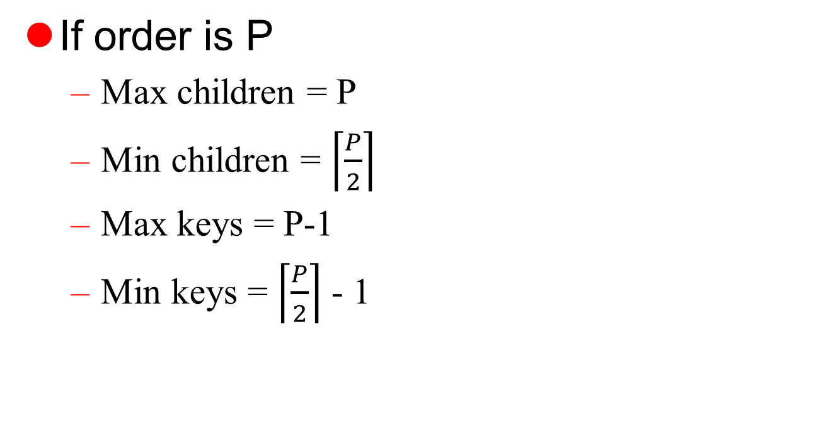
B+-tree Insertion / Deletion
Chapter 14-<number>

Slide 40
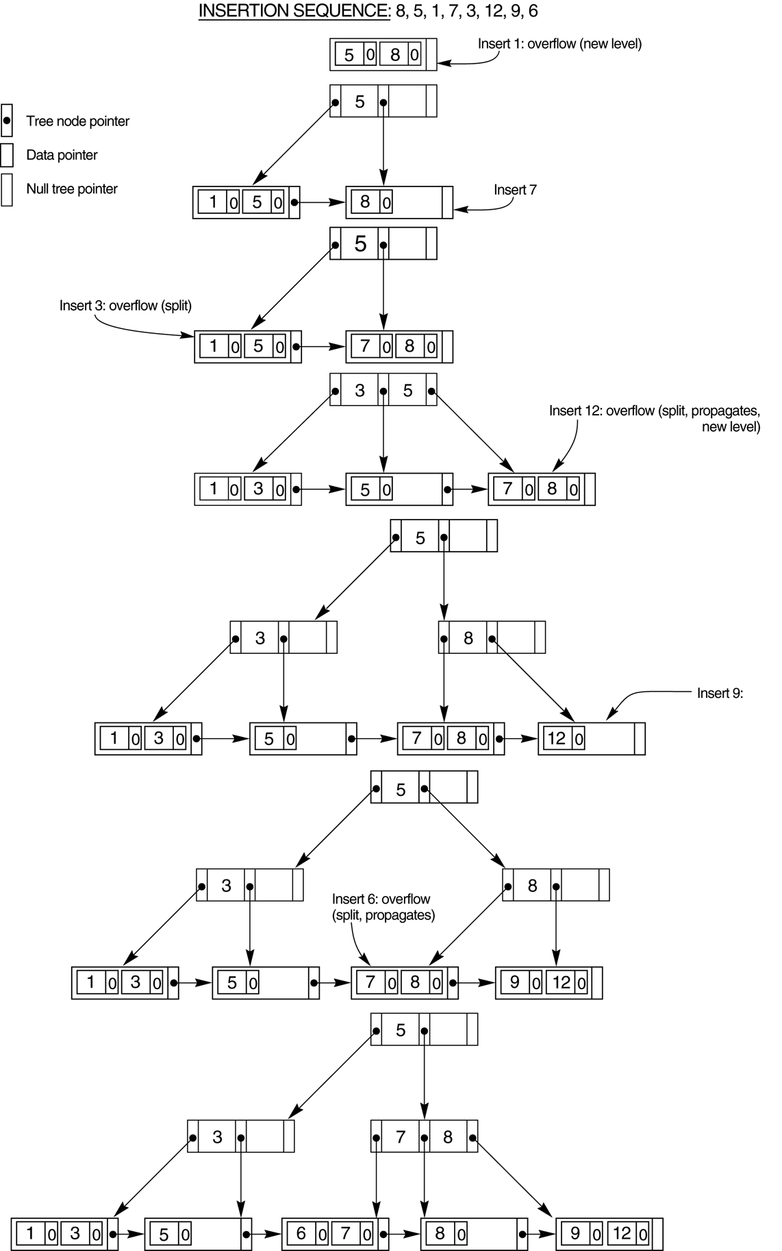
Chapter 14-<number>

Slide 41
Chapter 14-<number>

Slide 42
FIGURE 14.12
An example of insertion in a B+-tree with q = 3 and p_{leaf} = 2.
Chapter 14-<number>

Slide 43
Deletion from a B+-tree
When an entry is deleted, it is always removed from the leaf level.
If it happens to occur in an internal node, it must also be removed from there.
  The value to its left in the leaf node must replace it in the internal node because that value is now the right most entry in the subtree.
Deletion may cause underflow by reducing the number of entries in the leaf node to below the minimum required
  we try to find a sibling leaf node—a leaf node directly to the left or to the right of the node with underflow and redistribute the entries among the node and its sibling so that both are at least half full;
  otherwise, the node is merged with its siblings and the number of leaf nodes is reduced.
A common method is to try to redistribute entries with the left sibling; if this is not possible, an attempt to redistribute with the right sibling is made. If this is also not possible, the three nodes are merged into two leaf nodes.
  underflow may propagate to internal nodes because one fewer tree pointer and search value are needed.
  This can propagate and reduce the tree levels
Chapter 14-<number>

Slide 44
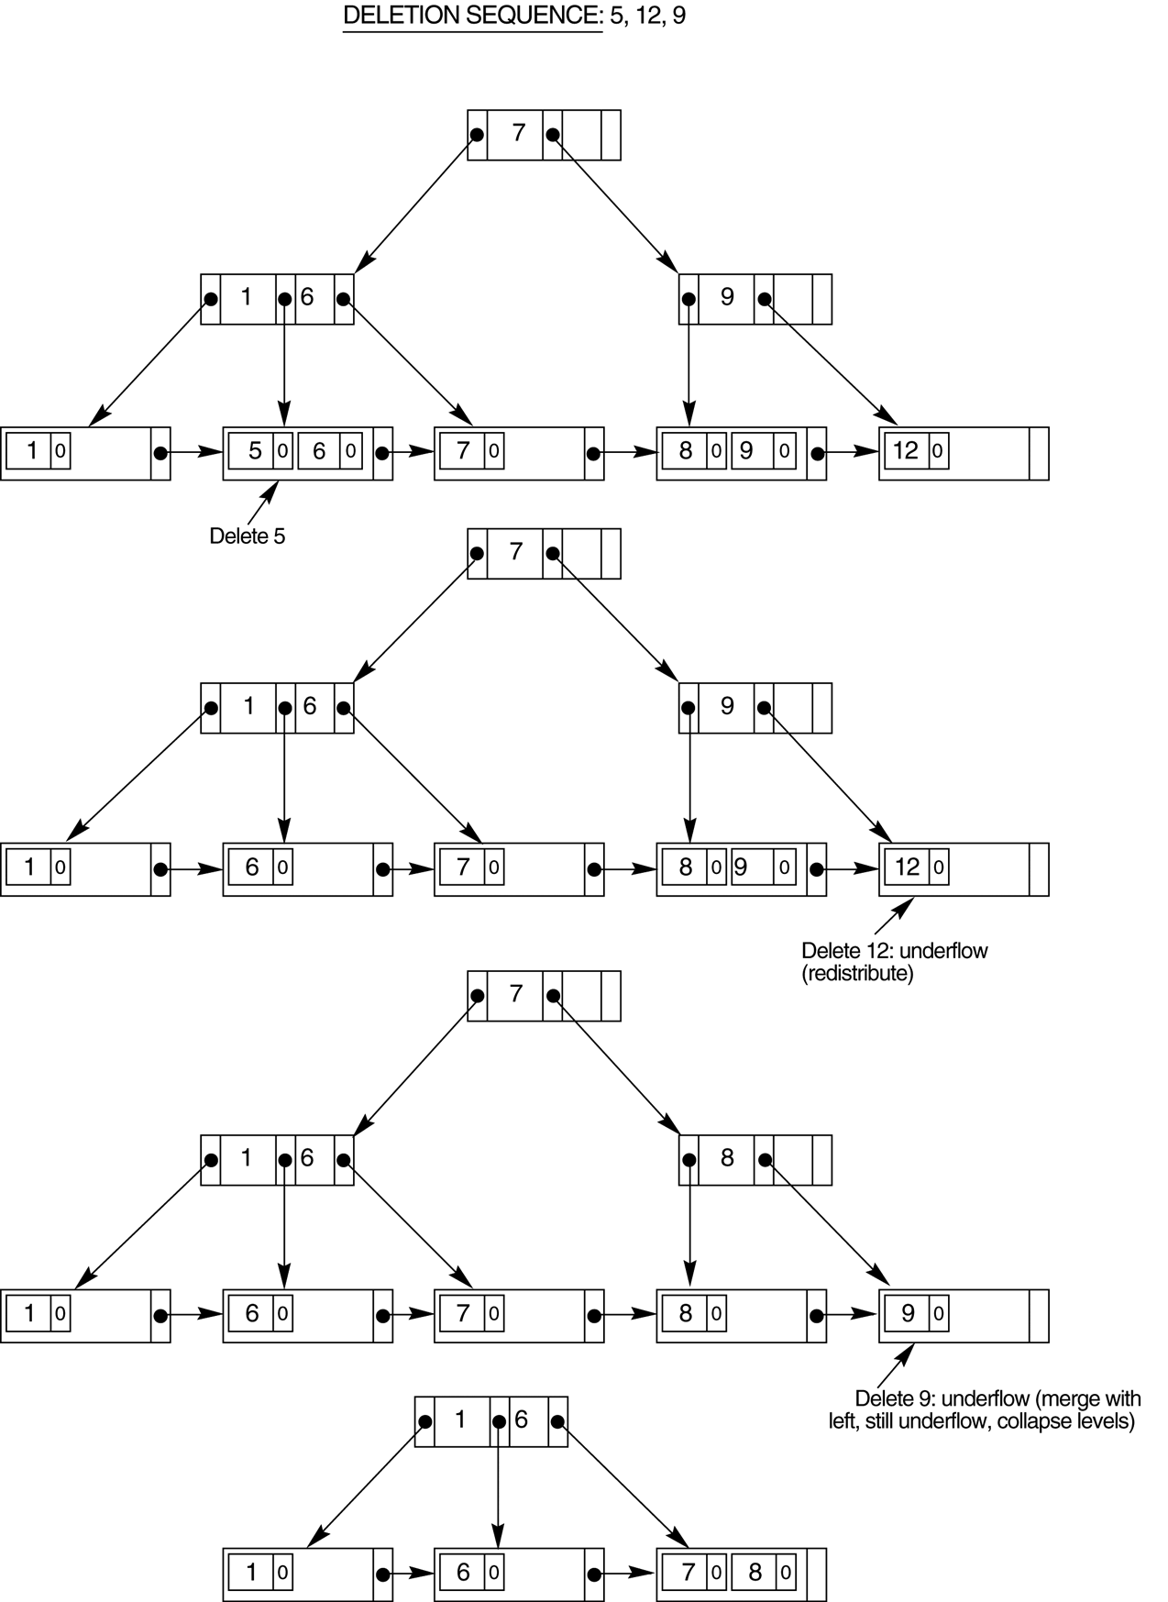
FIGURE 14.13
An example of deletion from a
B+-tree.
Chapter 14-<number>

