Slide 1

PHYSICAL DATABASE DESIGN

Slide 2
OUTLINE
Indexing:
Single level indexing,
multi-level indexing,
dynamic multilevel indexing.

Slide 3
BASICS
Indexing mechanisms used to speed up access to desired data.
  E.g., author catalog in library
Search Key - attribute to set of attributes used to look up records in a file.
An index file consists of records (called index entries) of the form
Index files are much smaller than the original file
Two basic kinds of indices:
  Ordered indices: search keys are stored in sorted order
  Hash indices: search keys are distributed uniformly across “buckets” using a “hash function”.
Search key
Pointer

Slide 4
WHY INDEXING?
Access types supported efficiently. E.g.,
  records with a specified value in the attribute
  or records with an attribute value falling in a specified range of values.
Access time
Insertion time
Deletion time
Space overhead

Slide 5
Types of Indexing
Single Level Indexing
  Primary Indexing
  Clustered Indexing
  Secondary Indexing(Dense)
Multilevel Indexing

Slide 6
WHY B TREE?
Reduces the number of reads made on the disk
B Trees can be easily optimized to adjust its size (that is the number of child nodes) according to the disk size
It is a specially designed technique for handling a bulky amount of data.
It is a useful algorithm for databases and file systems.
A good choice to opt when it comes to reading and writing large blocks of data

Slide 7
A B-tree is a tree data structure that keeps data sorted and allows searches, insertions, and deletions in logarithmic amortized time.

Slide 8
B TREE
According to Knuth's definition, a B-tree of order m is a tree which satisfies the following properties:
Every node has at most m children.
Every non-leaf node (except root) has at least ⌈m/2⌉ child nodes.
The root has at least two children if it is not a leaf node.
A non-leaf node with k children contains k − 1 keys.

Slide 9
The left subtree of the node will have lesser values than the right side of the subtree. This means that the nodes are also sorted in ascending order from left to right.
If order of the tree is P;
  Maximum No.of Keys =P-1
  Minimum No.of Keys = [P/2]-1
  Minimum No.of Children =P/2
  Maximum No.of Children =P

Slide 10
Three main Operations in B Tree
Insertion
Deletion
Searching

Slide 11
Insertion
Inserting an element on a B-tree consists of two events:
  searching the appropriate node to insert the element
  splitting the node if required.
  Insertion operation always takes place in the bottom-up approach.

Slide 12
Insertion
If the tree is empty, allocate a root node and insert the key.
Update the allowed number of keys in the node.
Search the appropriate node for insertion.
If the node is full, follow the steps below.
Insert the elements in increasing order.
Now, there are elements greater than its limit. So, split at the median.
Push the median key upwards and make the left keys as a left child and the right keys as a right child.
If the node is not full, follow the steps below.
Insert the node in increasing order.

Slide 13
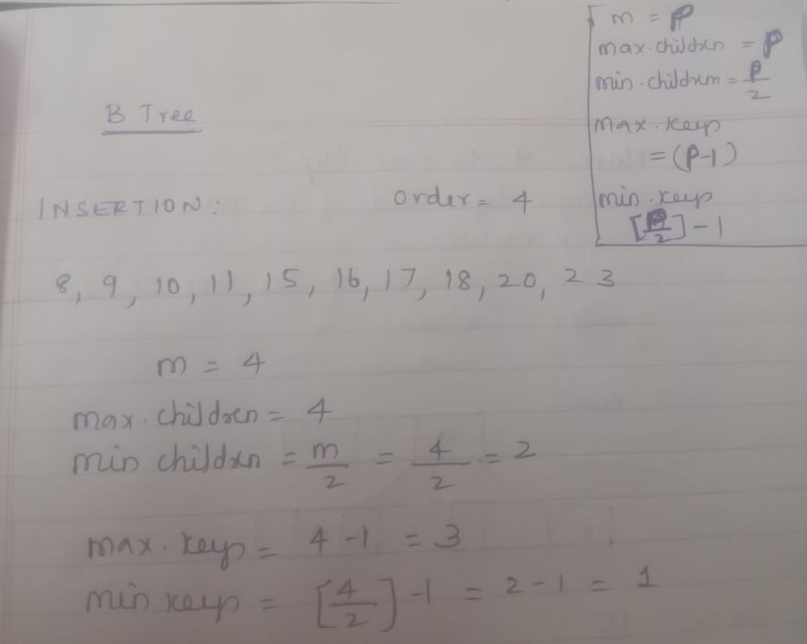
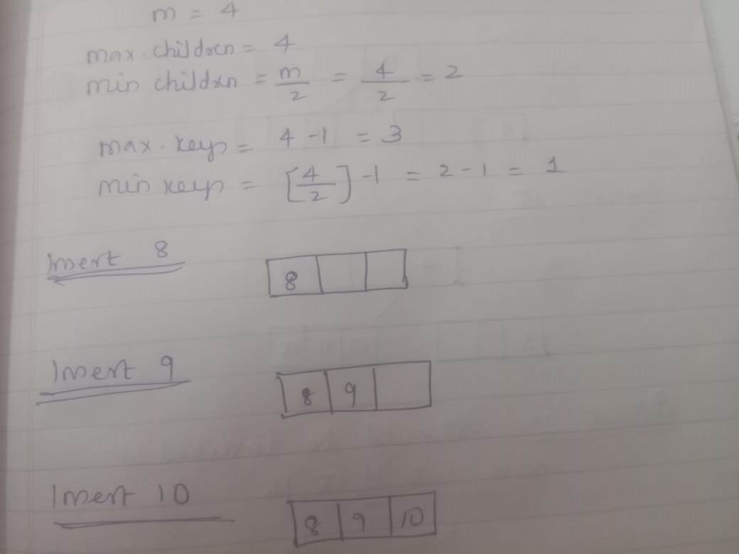
Assume order is 4 ---------------8,9,10,11,15,16,17,18,20,23

Slide 14
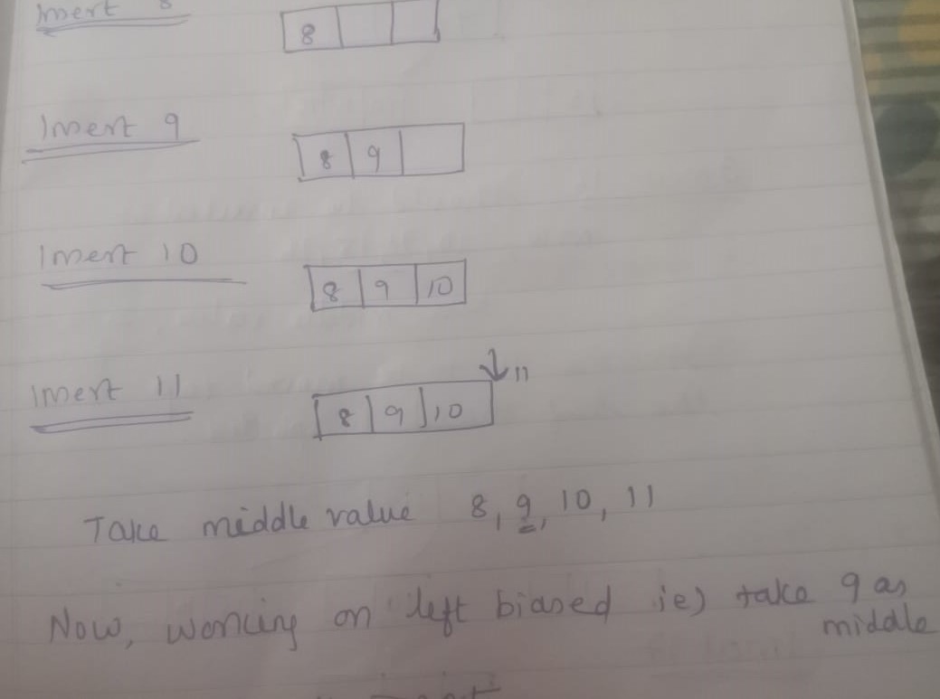
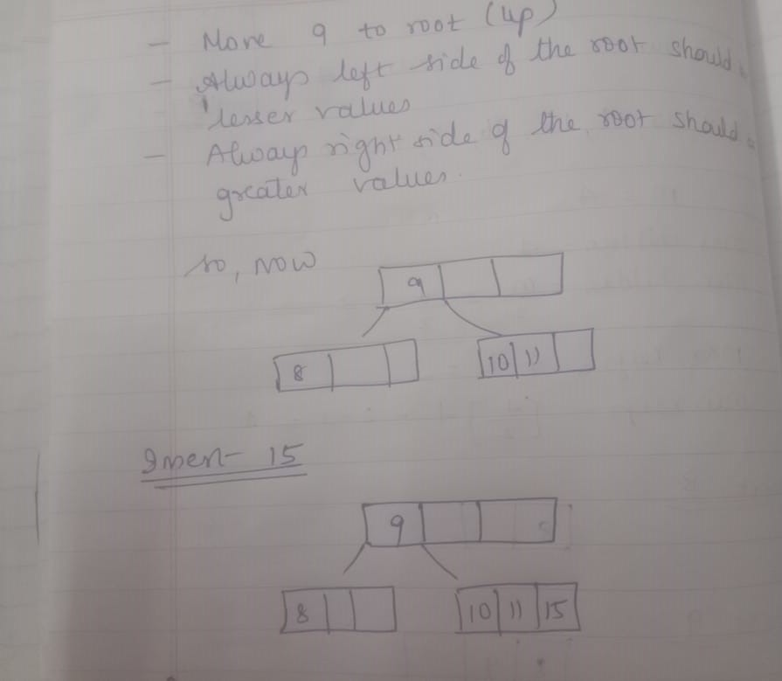
Assume order is 4 ---------------8,9,10,11,15,16,17,18,20,23

Slide 15
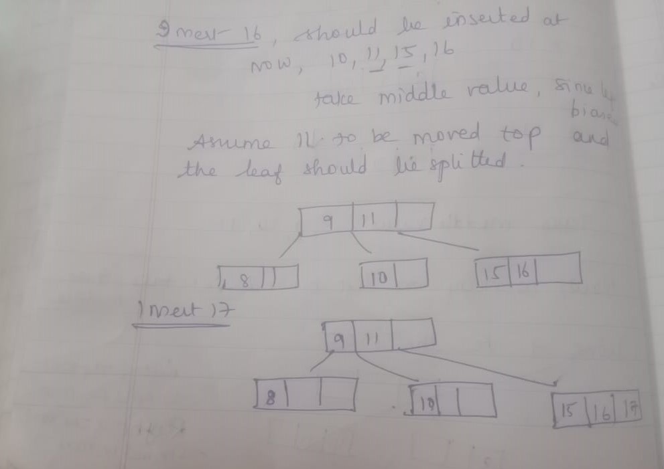
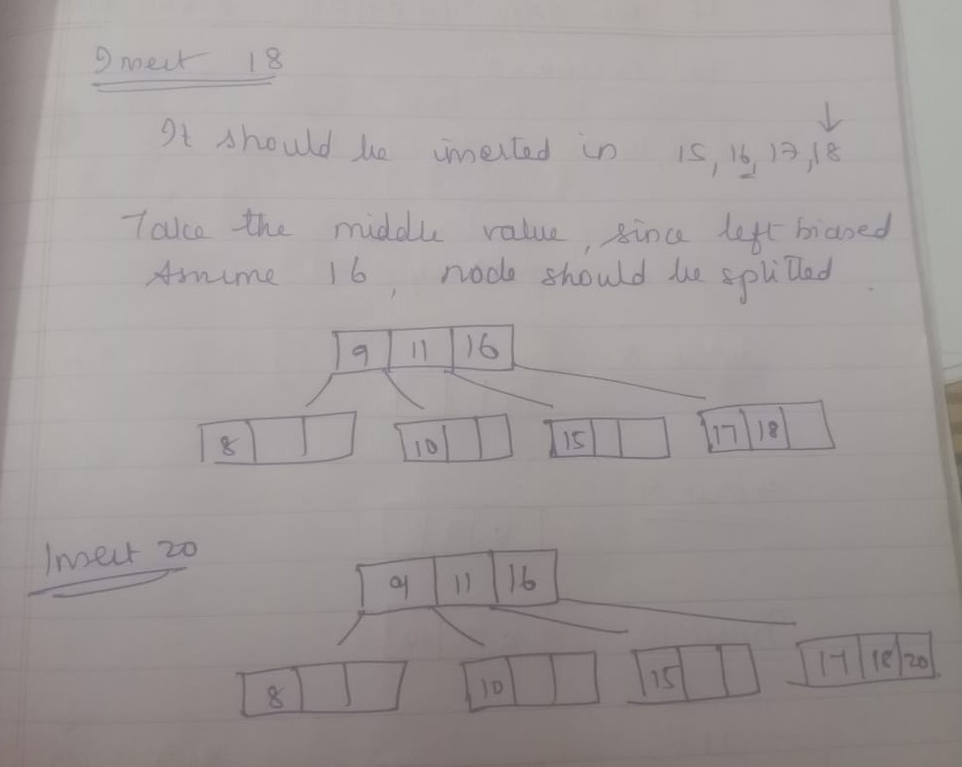
Assume order is 4 ---------------8,9,10,11,15,16,17,18,20,23

Slide 16
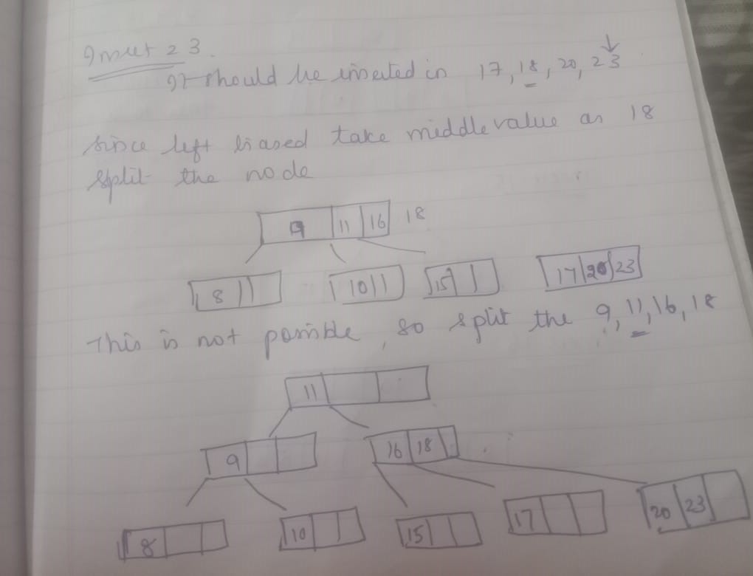
THE FINAL B TREE………

Slide 17
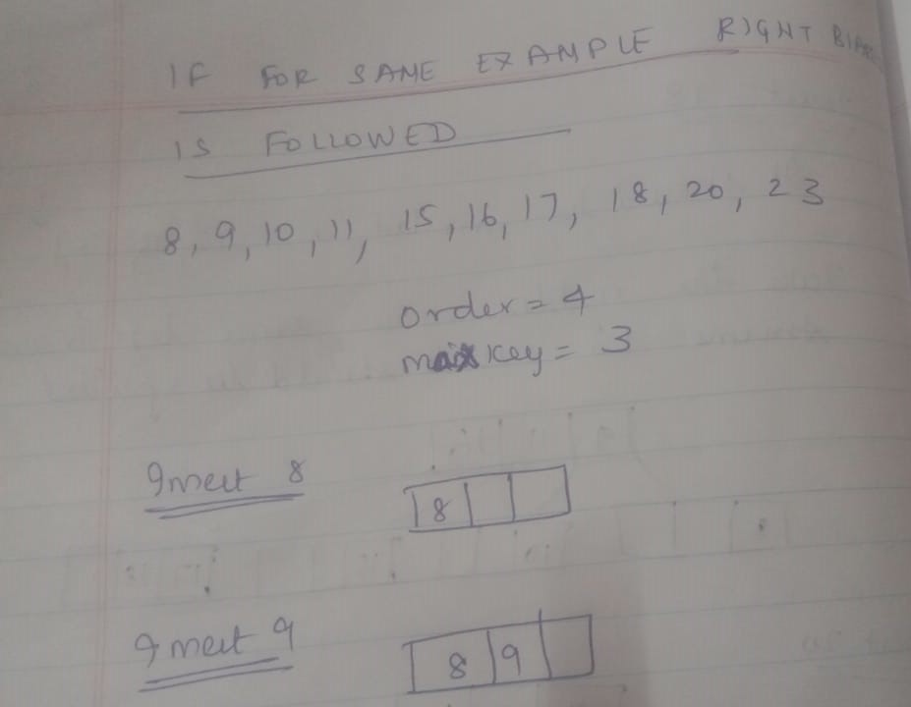
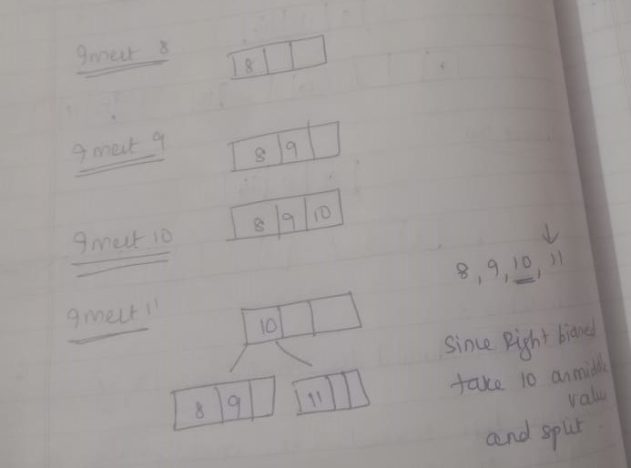
Assume order is 4 ---------------8,9,10,11,15,16,17,18,20,23
(Note: Right biased)

Slide 18
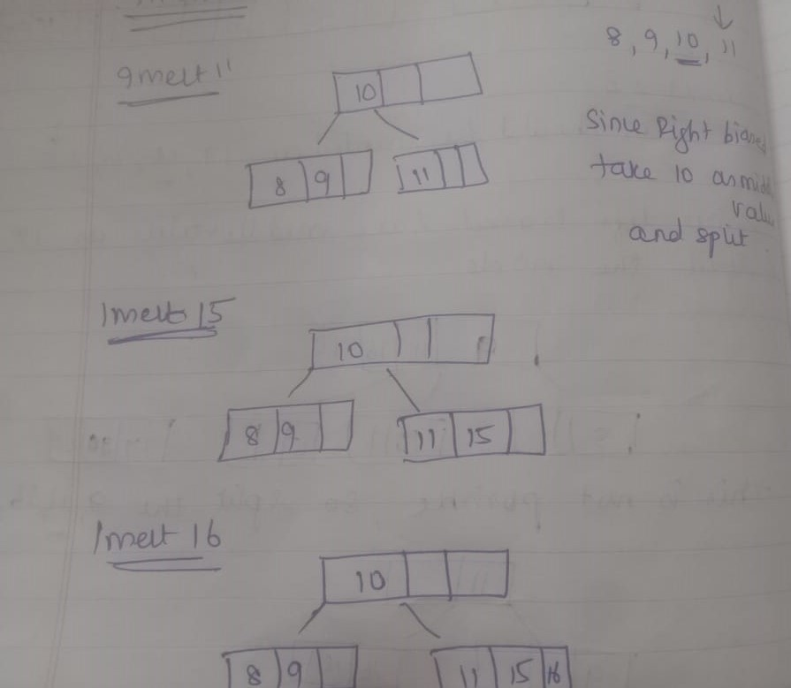
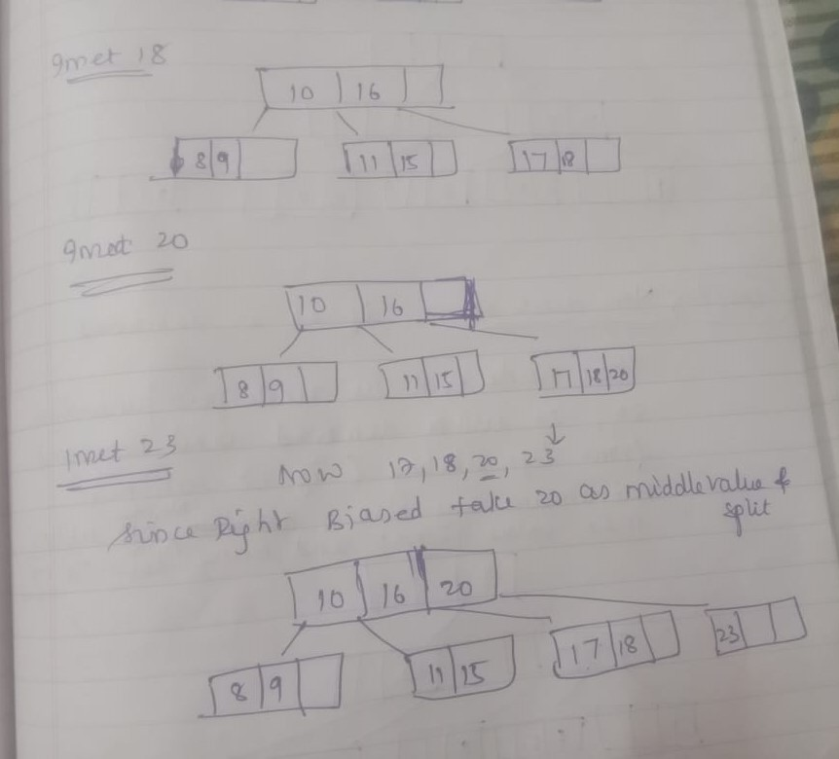
Assume order is 4 ---------------8,9,10,11,15,16,17,18,20,23
(Note: Right biased)

Slide 19
Deletion:
If the target key is in the leaf node
Target is in the leaf node, more than min keys.
  Deleting this will not violate the property of B Tree
Target is in leaf node, it has min key nodes
  Deleting this will violate the property of B Tree
  Target node can borrow key from immediate left node, or immediate right node (sibling)
  The sibling will say yes if it has more than minimum number of keys
  The key will be borrowed from the parent node, the max value will be transferred to a parent, the max value of the parent node will be transferred to the target node, and remove the target value
Target is in the leaf node, but no siblings have more than min number of keys
  Search for key
  Merge with siblings and the minimum of parent nodes
  Total keys will be now more than min
  The target key will be replaced with the minimum of a parent node
.

Slide 20
Deletion:
If the target key is in an internal node
Either choose, in- order predecessor or in-order successor
In case the of in-order predecessor, the maximum key from its left subtree will be selected
In case of in-order successor, the minimum key from its right subtree will be selected
If the target key's in-order predecessor has more than the min keys, only then it can replace the target key with the max of the in-order predecessor
If the target key's in-order predecessor does not have more than min keys, look for in-order successor's minimum key.
If the target key's in-order predecessor and successor both have less than min keys, then merge the predecessor and successor.

Slide 21
Deletion:
If the target key is in a root node
Replace with the maximum element of the in-order predecessor subtree
If, after deletion, the target has less than min keys, then the target node will borrow max value from its sibling via sibling's parent.
The max value of the parent will be taken by a target, but with the nodes of the max value of the sibling.

Slide 22
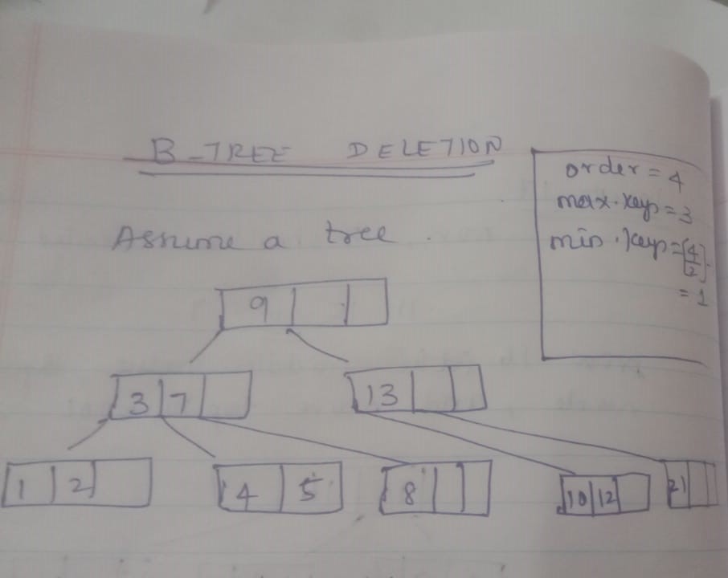
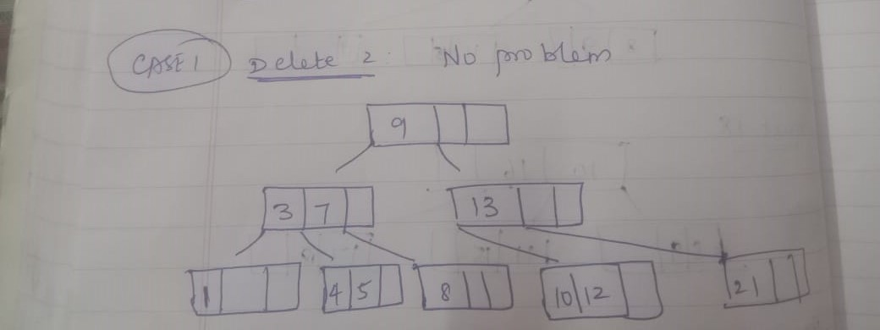
EXAMPLE ----delete 2,21,10,3,4

Slide 23
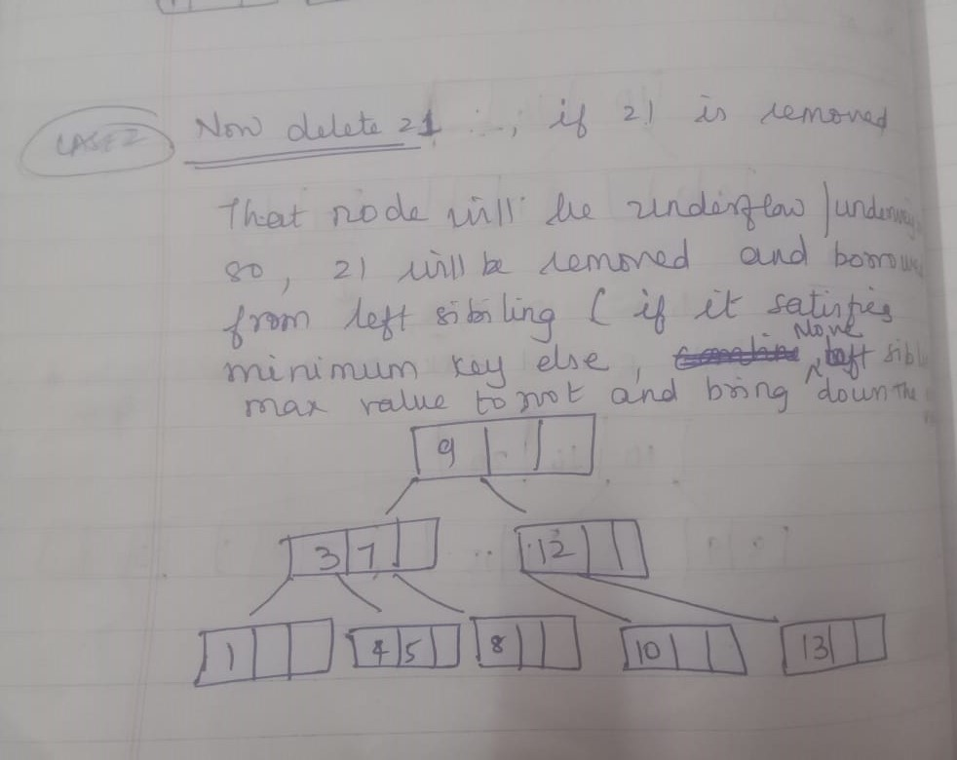
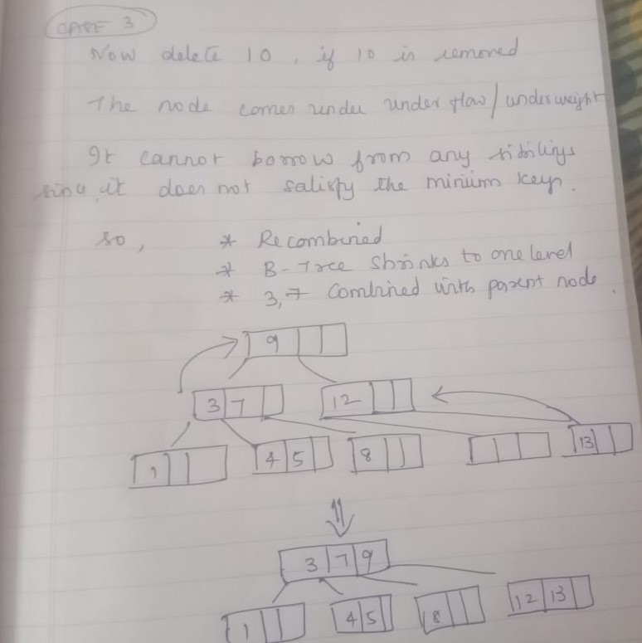
EXAMPLE ----delete 2,21,10,3,4

Slide 24
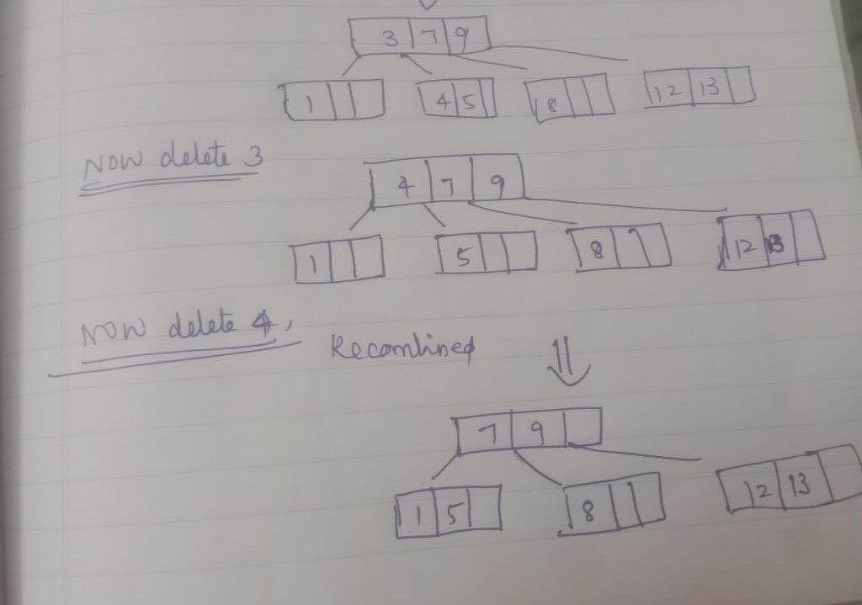
EXAMPLE ----delete 2,21,10,3,4

Slide 25
NEXT CLASS ………….B+ Tree

