Slide 1
Chapter 2
Database System Concepts and Architecture

Slide 2
Data Models
Data Model: A set of concepts to describe the structure of a database, and certain constraints that the database should obey.
Data Model Operations: Operations for specifying database retrievals and updates by referring to the concepts of the data model. Operations on the data model may include basic operations and user-defined operations.

Slide 3
Categories of data models
Conceptual (high-level, semantic) data models: Provide concepts that are close to the way many users perceive data. (Also called entity-based or object-based data models.)
Physical (low-level, internal) data models: Provide concepts that describe details of how data is stored in the computer.
Implementation (representational) data models: Provide concepts that fall between the above two, balancing user views with some computer storage details.

Slide 4
The Entity Relationship Model
The ER model is the most commonly used conceptual model
In this model, the real world consists of a collection of basic objects called entities and the relationships among these objects
An entity is an object that is distinguishable from other objects by a specific set of attributes
An entity set is the set of all entities of the same type
A relationship is an association among entities
The set of all relationships of the same type is a relationship set
One nice thing about this model is that you can represent the logical structure of a DB graphically, using an ER diagram.

Slide 5
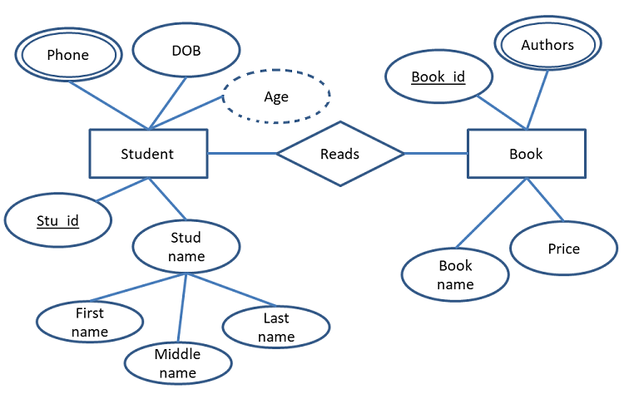
Example ER Diagram

Slide 6
The Object Oriented Model
The OO model is a representational data model that is still at a fairly high level
It’s similar to the ER model in that it’s based on a collection of objects, but the objects are designed differently
The real world consists of a collection of objects called objects, which store both data values and code for operating on these values
The values themselves may be objects, and so we can get nesting of objects
We can also have two or more objects containing all the same values that are nevertheless distinct. Physical address identifiers are used to distinguish them. In the ER model, entities must be distinguished by some unique value.

Slide 7
More Representational Models
Most representational models are record-based. In a record-based model, data is structured in fixed-format records.
Each record has a fixed number of fields, and each field usually has a fixed length.
Two older record-based models, the network model and hierarchical model, are no longer used to build new systems.
They use pointers, or hard-coded links, to connect the records of a DB.
The representational model supported by Oracle is the relational model.
In the relational model, you view data as being arranged in tables, with rows and columns. Each column has a unique name. Each row is a record.

Slide 8
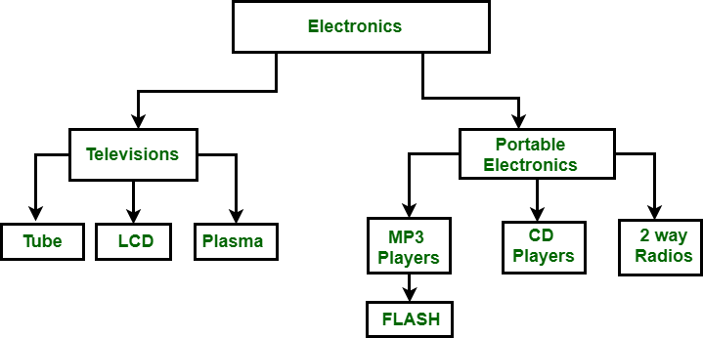
Hierarchical Data Model
Hierarchical data model is the oldest type of the data model.
It was developed by IBM in 1968.
It organizes data in the tree-like structure.

Slide 9
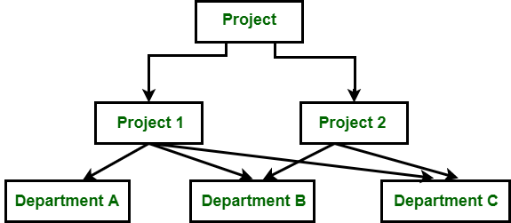
Network Data Model:
To organize data it uses directed graphs instead of the tree-structure.
In this child can have more than one parent.

Slide 10
Hierarchical Data Model | Network Data Model | Relational Data Model
In this model, to store data hierarchy method is used. It is the oldest method and not in use today. | It organizes records to one another through links or pointers. | It organizes records in the form of table and relationship between tables are set using common fields.
To organize records, it uses tree structure. | It organizes records in the form of directed graphs. | It organizes records in the form of tables.
It implements 1:1 and 1:n relations. | In addition to 1:1 and 1:n it also implements many to many relationships. | In addition to 1:1 and 1:n it also implements many to many relationships.
Pointers are used to establish relationships among records physically. | A linked list is used to establish a relationship among records physically. | The logical representation is used with rows and columns to depict relationship among records.
Insertion anomaly exits in this model i.e. child node cannot be inserted without the parent node. | There is no insertion anomaly. | There is no insertion anomaly.
Update leads to inconsistency problems because of the existence of multiple instances of a child record. | No such problem as only one instance of records exist. | Updating a record is easy and simple with the process of normalization, the redundant data gets removed.

Slide 11
Hierarchical Data Model | Network Data Model | Relational Data Model
This model lacks data independence. | There is partial data independence in this model. | This model provides data independence.
No such facility for querying database is supported. | No such facility for querying database is supported. | SQL-based declarative querying is supported.
It is less flexible. | It is flexible as compared to the hierarchical model. | It is flexible as compared to the hierarchical model.

Slide 12
Definitions
Database Schema: The description of a database. Includes descriptions of the database structure and the constraints that should hold on the database.
Schema Diagram: A diagrammatic display of (some aspects of) a database schema.
Schema Construct: A component of the schema or an object within the schema, e.g., STUDENT, COURSE.
Database Instance: The actual data stored in a database at a particular moment in time. Also called database state (or occurrence).

Slide 13
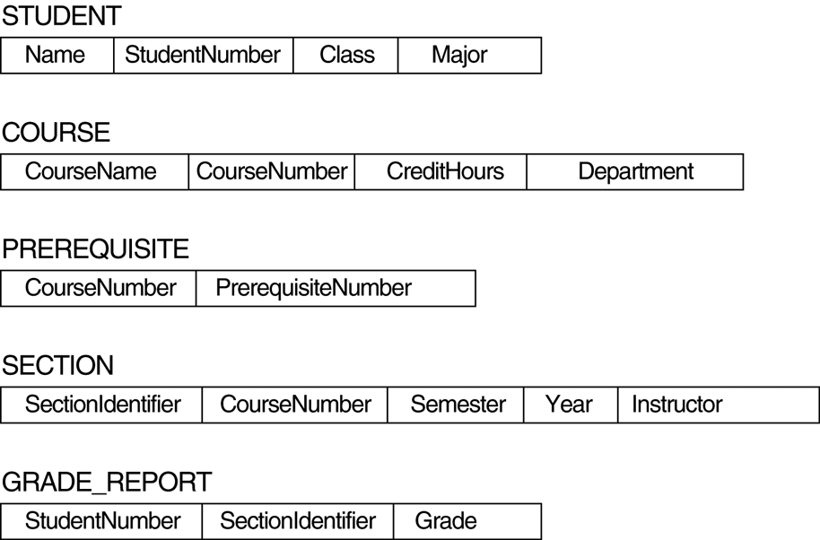
FIGURE 2.1 Schema diagram for the database in Figure 1.2.

Slide 14
Database Schema Vs. Database State
Database State: Refers to the content of a database at a moment in time.
Initial Database State: Refers to the database when it is loaded
Valid State: A state that satisfies the structure and constraints of the database.
Distinction
The database schema changes very infrequently. The database state changes every time the database is updated.
Schema is also called intension, whereas state is called extension.

Slide 15
Three-Schema Architecture
Proposed to support DBMS characteristics of:
Program-data independence.
Support of multiple views of the data.

Slide 16
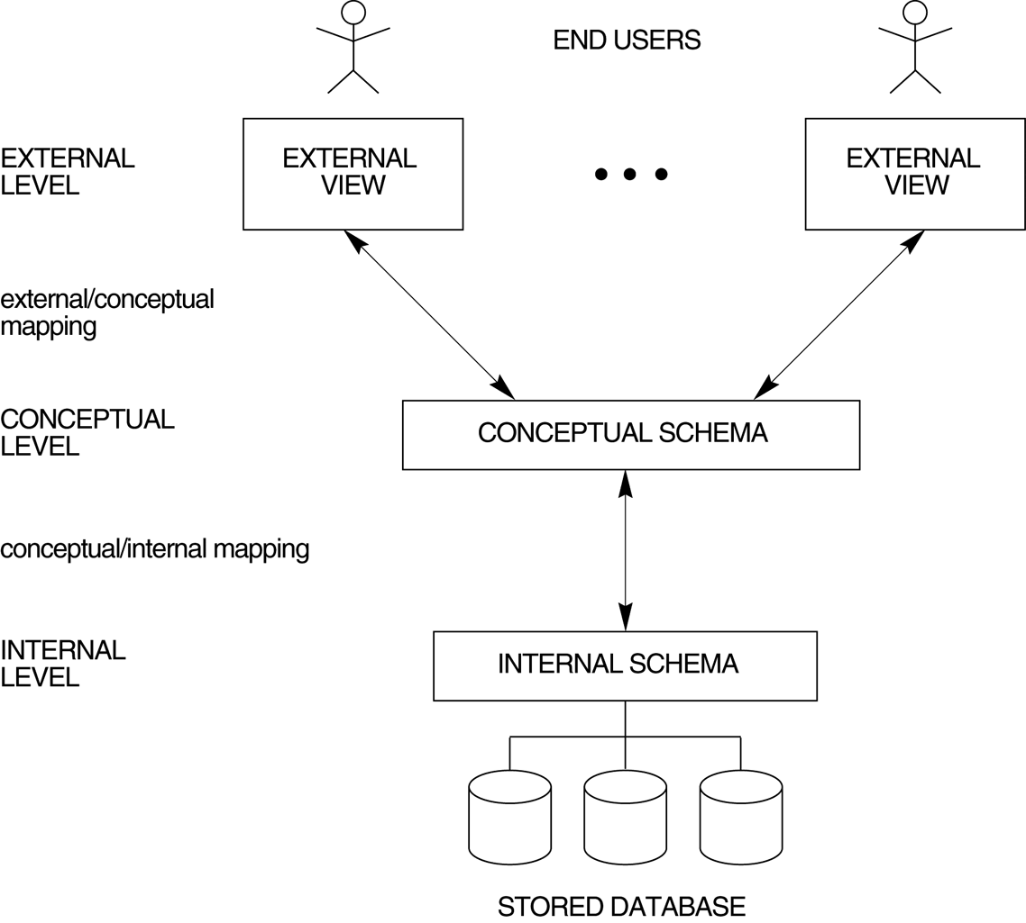
FIGURE 2.2 The three-schema architecture.

Slide 17
Three-Schema Architecture
Defines DBMS schemas at three levels:
Internal schema at the internal level to describe physical storage structures and access paths. Typically uses a physical data model.
Conceptual schema at the conceptual level to describe the structure and constraints for the whole database for a community of users. Uses a conceptual or an implementation data model.
External schemas at the external level to describe the various user views. Usually uses the same data model as the conceptual level.

Slide 18
Three-Schema Architecture
Mappings among schema levels are needed to transform requests and data.
Programs refer to an external schema, and are mapped by the DBMS to the internal schema for execution.

Slide 19
Data Independence
Logical Data Independence: The capacity to change the conceptual schema without having to change the external schemas and their application programs.
Physical Data Independence: The capacity to change the internal schema without having to change the conceptual schema.

Slide 20
Data Independence
When a schema at a lower level is changed, only the mappings between this schema and higher-level schemas need to be changed in a DBMS that fully supports data independence.

Slide 21
Centralized and Client-Server Architectures
Centralized DBMS: combines everything into single system including- DBMS software, hardware, application programs and user interface processing software.

Slide 22
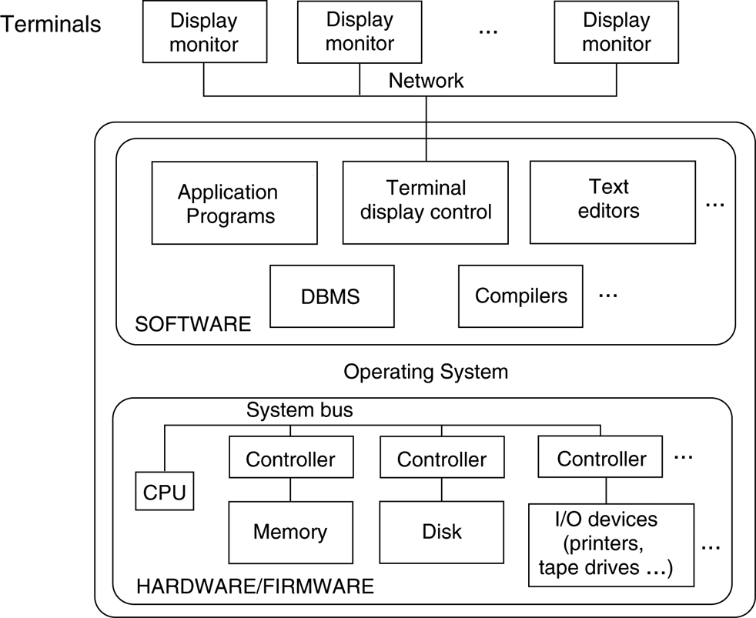
FIGURE 2.4 A physical centralized architecture.

Slide 23
Specialized Servers with Specialized functions:
File Servers
Printer Servers
Web Servers
E-mail Servers

Slide 24
Clients:
Provide appropriate interfaces and a client-version of the system to access and utilize the server resources.
Clients maybe diskless machines or PCs or Workstations with disks with only the client software installed.
Connected to the servers via some form of network. (LAN: local area network, wireless network, etc.)

Slide 25
Two Tier Client-Server Architecture
User Interface Programs and Application Programs run on the client side
Interface called ODBC (Open Database Connectivity ) provides an Application program interface (API) allow client side programs to call the DBMS. Most DBMS vendors provide ODBC drivers.

Slide 26
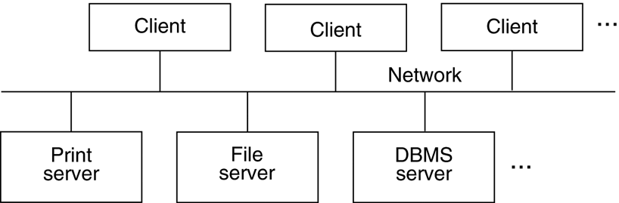
FIGURE 2.5 Logical two-tier client/server architecture.

Slide 27
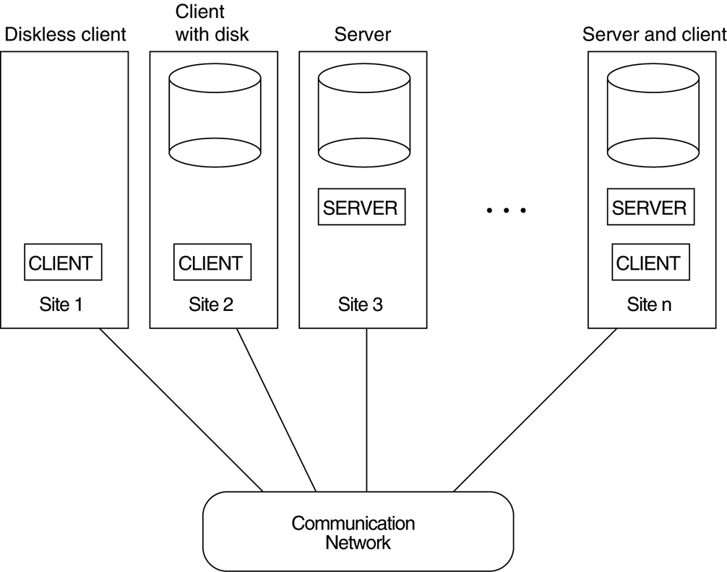
FIGURE 2.6 Physical two-tier client-server architecture.

Slide 28
Three Tier Client-Server Architecture
Common for Web applications
Intermediate Layer called Application Server or Web Server:
stores the web connectivity software and the rules and business logic (constraints) part of the application used to access the right amount of data from the database server
acts like a conduit for sending partially processed data between the database server and the client.
Additional Features- Security:
encrypt the data at the server before transmission
decrypt data at the client

Slide 29
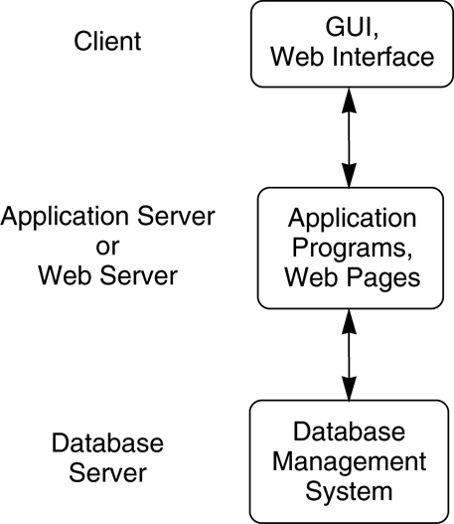
FIGURE 2.7 Logical three-tier client/server architecture.

