Slide 1
Relational Database Design by ER- and EER-to-Relational Mapping

Slide 2
Chapter Outline
ER-to-Relational Mapping Algorithm
Step 1: Mapping of Regular Entity Types
Step 2: Mapping of Weak Entity Types
Step 3: Mapping of Binary 1:1 Relation Types
Step 4: Mapping of Binary 1:N Relationship Types.
Step 5: Mapping of Binary M:N Relationship Types.
Step 6: Mapping of Multivalued attributes.
Step 7: Mapping of N-ary Relationship Types.
Mapping EER Model Constructs to Relations
Step 8: Options for Mapping Specialization or Generalization.
Step 9: Mapping of Union Types (Categories).

Slide 3
ER-to-Relational Mapping Algorithm
Step 1: Mapping of Regular Entity Types.
For each regular (strong) entity type E in the ER schema,
create a relation R that includes all the simple attributes of E.
Choose one of the key attributes of E as the primary key for R.
If the chosen key of E is composite, the set of simple attributes that form it will together form the primary key of R.
Example:
We create the relations EMPLOYEE, DEPARTMENT, and PROJECT in the relational schema corresponding to the regular entities in the ER diagram.
SSN, DNUMBER, and PNUMBER are the primary keys for the relations EMPLOYEE, DEPARTMENT, and PROJECT as shown.

Slide 4
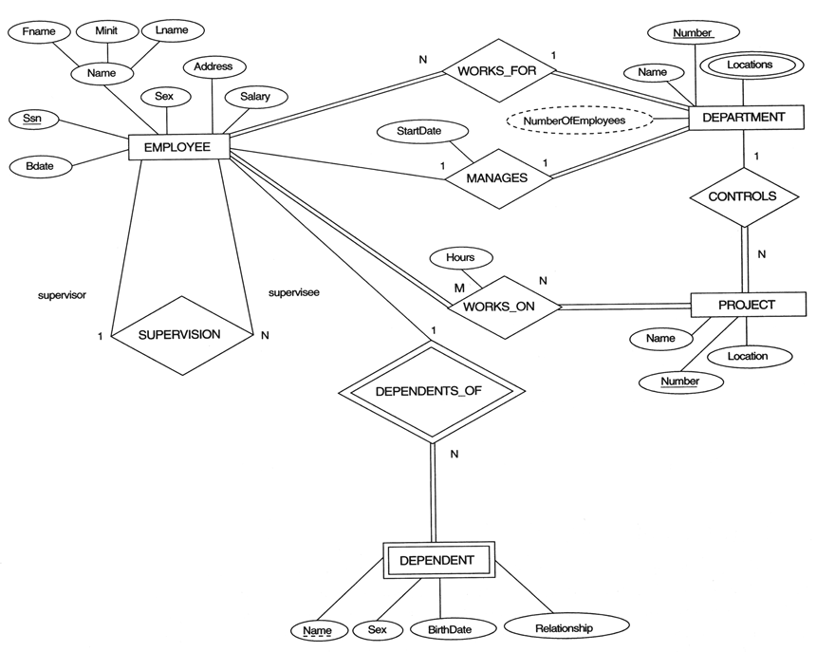

Slide 5
ER-to-Relational Mapping Algorithm (cont)
Step 2: Mapping of Weak Entity Types
For each weak entity type W in the ER schema with owner entity type E,
create a relation R and include all attributes of W as attributes of R.
Include as foreign key attributes of R the primary key attribute(s) of the relation(s) that correspond to the owner entity type(s).
The primary key of R is the combination of the primary key(s) of the owner(s) and the partial key of the weak entity type W, if any.
Example:
Create the relation DEPENDENT in this step to correspond to the weak entity type DEPENDENT.
Include the primary key SSN of the EMPLOYEE relation as a foreign key attribute of DEPENDENT (renamed to ESSN).
The primary key of the DEPENDENT relation is the combination {ESSN, DEPENDENT_NAME} because DEPENDENT_NAME is the partial key of DEPENDENT.

Slide 6
ER-to-Relational Mapping Algorithm (cont)
Step 3: Mapping of Binary 1:1 Relation Types
For each binary 1:1 relationship type R in the ER schema,
Identify the relations S and T that correspond to the entity types participating in R.
There are three possible approaches:
(1) Foreign Key approach:
Choose the relations with total participation in R – say S-- and include T’s primary key in S.
Example: 1:1 relation MANAGES is mapped by choosing the participating entity type DEPARTMENT to serve in the role of S, because its participation in the MANAGES relationship type is total.
(2) Merged relation option:
An alternate mapping of a 1:1 relationship type is possible by merging the two entity types and the relationship into a single relation. This may be appropriate when both participations are total.
(3) Cross-reference or relationship relation option:
The third alternative is to set up a third relation W(T.primarykey, S.primaryKey) for the purpose of cross-referencing the primary keys of the two relations S and T representing the entity types.

Slide 7
ER-to-Relational Mapping Algorithm (cont)
Step 4: Mapping of Binary 1:N Relationship Types.
For each regular binary 1:N relationship type R,
Identify the relation S that represent the participating entity type at the N-side of the relationship type.
Include as foreign key in S the primary key of the relation T that represents the other entity type participating in R.
Include any simple attributes of the 1:N relation type as attributes of S.
Example:
For WORKS_FOR we include the primary key NUMBER of the DEPARTMENT relation as foreign key in the EMPLOYEE relation and call it DNO.
For CONTROLS we include the primary key NUMBER of the DEPARTMENT relation as foreign key in the PROJECT relation and call it DNUM.
For SUPERVISION we include the primary key SSN of the EMPLOYEE relation as foreign key in the EMPLOYEE relation and call it SUPERSSSN.

Slide 9
ER-to-Relational Mapping Algorithm (cont)
Step 5: Mapping of Binary M:N Relationship Types.
For each regular binary M:N relationship type R,
create a new relation S to represent R.
Include as foreign key attributes in S the primary keys of the relations that represent the participating entity types; their combination will form the primary key of S.
Also include any simple attributes of the M:N relationship type as attributes of S
Example:
The M:N relationship type WORKS_ON from the ER diagram is mapped
By creating a relation WORKS_ON in the relational database schema.
The primary keys of the PROJECT and EMPLOYEE relations are included as foreign keys in WORKS_ON and renamed PNO and ESSN, respectively.
Attribute HOURS in WORKS_ON represents the HOURS attribute of the relation type.
The primary key of the WORKS_ON relation is the combination of the foreign key attributes {ESSN, PNO}.

Slide 10
ER-to-Relational Mapping Algorithm (cont)
Step 6: Mapping of Multivalued attributes.
For each multivalued attribute A,
create a new relation R.
This relation R will include an attribute corresponding to A, plus the primary key attribute K-as a foreign key in R-of the relation that represents the entity type that has A as an attribute.
The primary key of R is the combination of A and K. If the multivalued attribute is composite, we include its simple components.
Example:
The relation DEPT_LOCATIONS is created.
The attribute DLOCATION represents the multivalued attribute LOCATIONS of DEPARTMENT, while DNUMBER-as foreign key-represents the primary key of the DEPARTMENT relation.
The primary key of R is the combination of {DNUMBER, DLOCATION}.

Slide 11
ER-to-Relational Mapping Algorithm (contd.)
Step 7: Mapping of N-ary Relationship Types.
For each n-ary relationship type R, where n>2,
create a new relationship S to represent R.
Include as foreign key attributes in S the primary keys of the relations that represent the participating entity types.
Also include any simple attributes of the n-ary relationship type as attributes of S.
Example:
The relationship type SUPPLY in the ER on the next slide.
This can be mapped to the relation SUPPLY shown in the relational schema, whose primary key is the combination of the three foreign keys {SNAME, PARTNUM, JOBNAME}

Slide 12
N-ary example
sname
quantity
JobName
supply
supplier
job
PartNum
part

Slide 13
Solution to n-ary example
Tables that already exist:
Supplier (sname, …)
Job (jname, …)
Part (partNum, …)
Add new Table:
Supply (sname, jname, partNum, quantity, …)
sname is FK -> Supplier (sname)
jname is FK -> Job (jname)
partNum is FK -> Part (partNum)

Slide 15
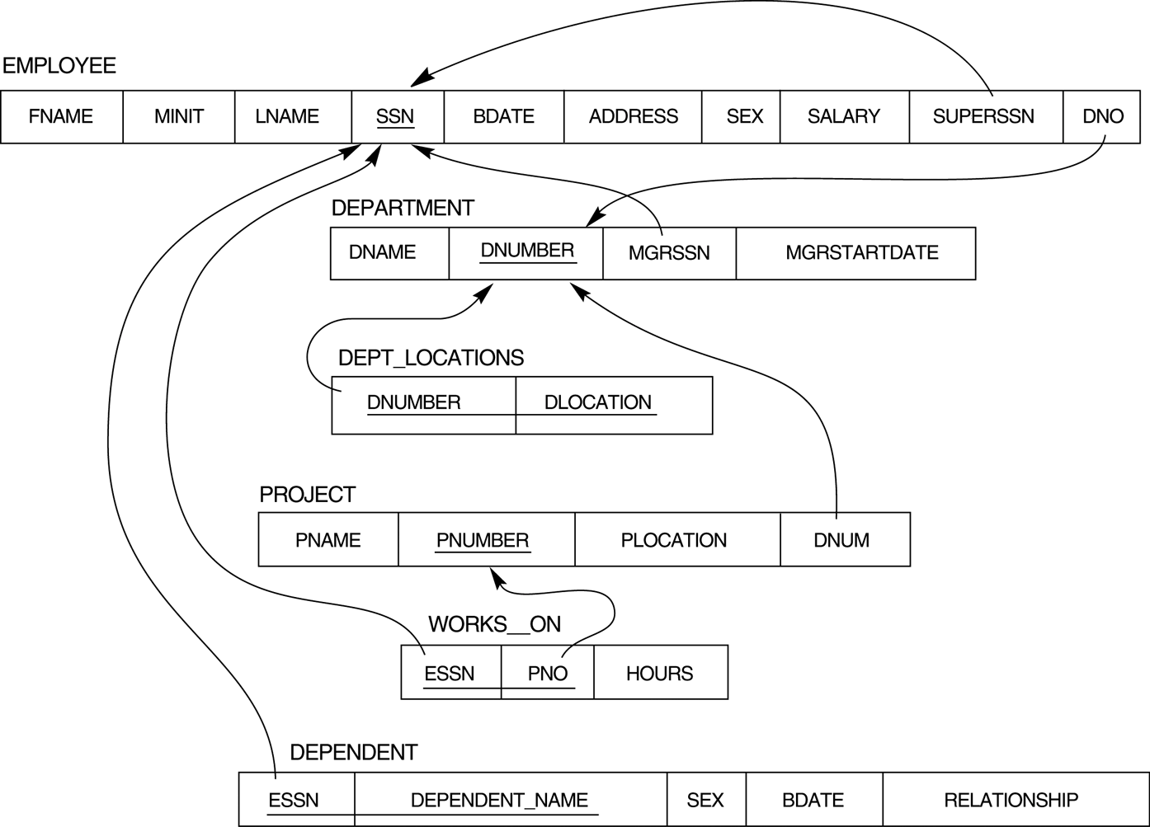
FIGURE 7.2 Result of mapping the COMPANY ER schema into a relational schema.

Slide 16
Summary of Mapping constructs and constraints
Table 7.1 Correspondence between ER and Relational Models
ER Model Relational Model
Entity type “Entity” relation
1:1 or 1:N relationship type Foreign key (or “relationship” relation)
M:N relationship type “Relationship” relation and two foreign keys
n-ary relationship type “Relationship” relation and n foreign keys
Simple attribute Attribute
Composite attribute Set of simple component attributes
Multivalued attribute Relation and foreign key
Value set Domain
Key attribute Primary (or secondary) key

Slide 17
Mapping EER Model Constructs to Relations
Step8: Options for Mapping Specialization or Generalization.
Convert each specialization with m subclasses {S1, S2,….,Sm} and generalized superclass C, where the attributes of C are {k,a1,…an} and k is the (primary) key, into relational schemas using one of the four following options:
Option 8A: Multiple relations-Superclass and subclasses
Option 8B: Multiple relations-Subclass relations only
Option 8C: Single relation with one type attribute
Option 8D: Single relation with multiple type attributes

Slide 18
Mapping EER Model Constructs to Relations
Option 8A: Multiple relations-Superclass and subclasses
Create a relation L for C as L{k,a1,…an}, and PK(L) = k.
Create a relation Li for each subclass Si, 1 < i < m, Li{k, s_{i1},…,s_{iik}}, where s_{i1},…,s_{iik} are the local attributes of Si, and PK(Li)=k.
This option works for any specialization (total or partial, disjoint or over-lapping).

Slide 19
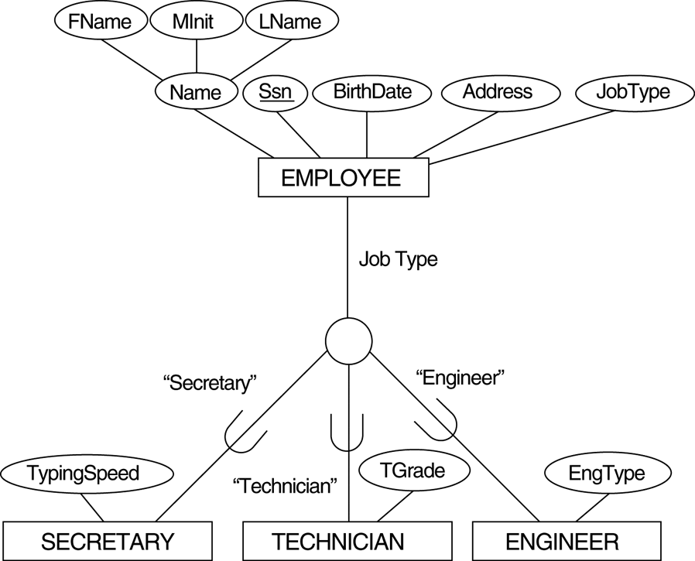
EER diagram notation for an attribute-defined specialization on JobType.

Slide 20
EER diagram notation for an attribute-defined specialization on JobType.

Slide 21
Mapping EER Model Constructs to Relations
Option 8B: Multiple relations-Subclass relations only
Create a relation Li for each subclass Si, 1 < i < m, with the attributes Attr(Li) = {attributes of Si} U {k,a1…,an} and PK(Li) = k.
This option only works for a specialization whose subclasses are total.

Slide 22
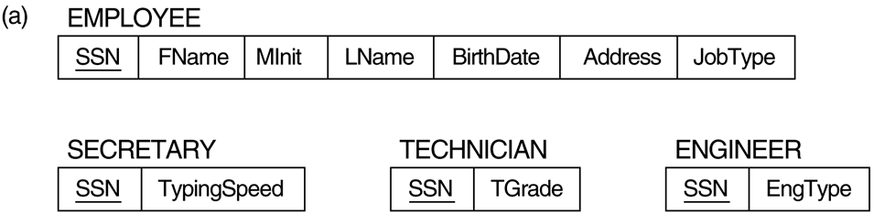
(a) Mapping the EER schema using option 8A.

Slide 23
(b) Mapping the EER schema using option 8B.
SECRETARY
TECHNICIAN
ENGINEER

Slide 24
Mapping EER Model Constructs to Relations (cont)
Option 8C: Single relation with one type attribute.
Create a single relation L with attributes Attrs(L) = {k,a₁,…a_{n}} U {attributes of S₁} U…U {attributes of S_{m}} U {t} and PK(L) = k.
The attribute t is called a type (or discriminating) attribute that indicates the subclass to which each tuple belongs
Option 8D: Single relation with multiple type attributes.
Create a single relation schema L with attributes Attrs(L) = {k,a₁,…a_{n}} U {attributes of S₁} U…U {attributes of S_{m}} U {t₁, t₂,…,t_{m}} and PK(L) = k.
Each t_{i}, 1 < I < m, is a Boolean type attribute indicating whether a tuple belongs to the subclass S_{i}.

Slide 25
EER diagram notation for an attribute-defined specialization on JobType.

Slide 26
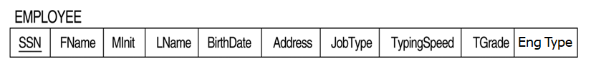
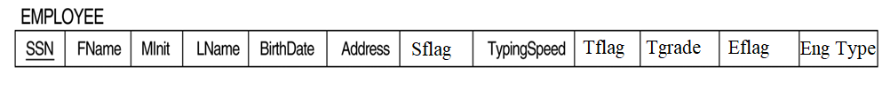
(c) Mapping the EER schema using option 8C.
(d) Mapping the EER schema using option 8d.

Slide 27
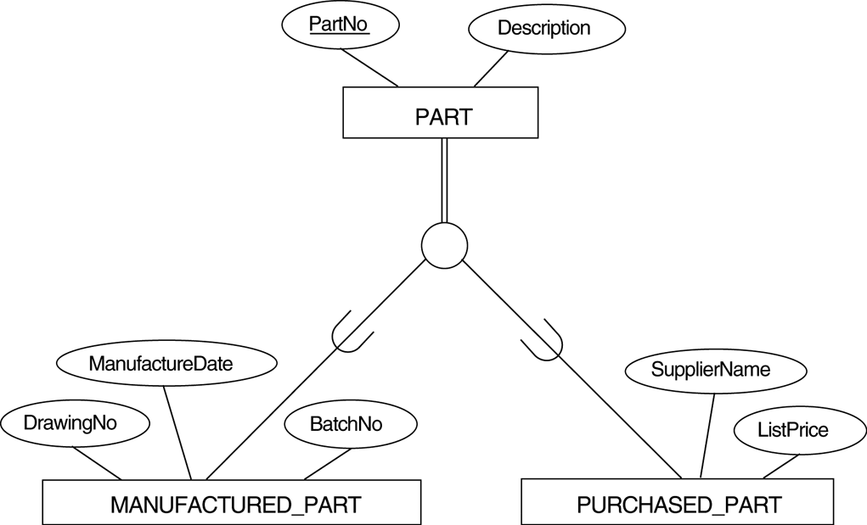
EER diagram notation for an overlapping (nondisjoint) specialization.

Slide 28
(d) Mapping using option 8D with Boolean type fields Mflag
and Pflag.

Slide 29
Mapping EER Model Constructs to Relations (cont)
Mapping of Shared Subclasses (Multiple Inheritance)
A shared subclass, such as STUDENT_ASSISTANT, is a subclass of several classes, indicating multiple inheritance.
These classes must all have the same key attribute.
We can apply any of the options discussed in Step 8 to a shared subclass, subject to the restriction discussed in Step 8 of the mapping algorithm.
In the example, both 8C and 8D are used for the shared class STUDENT_ASSISTANT.

Slide 30
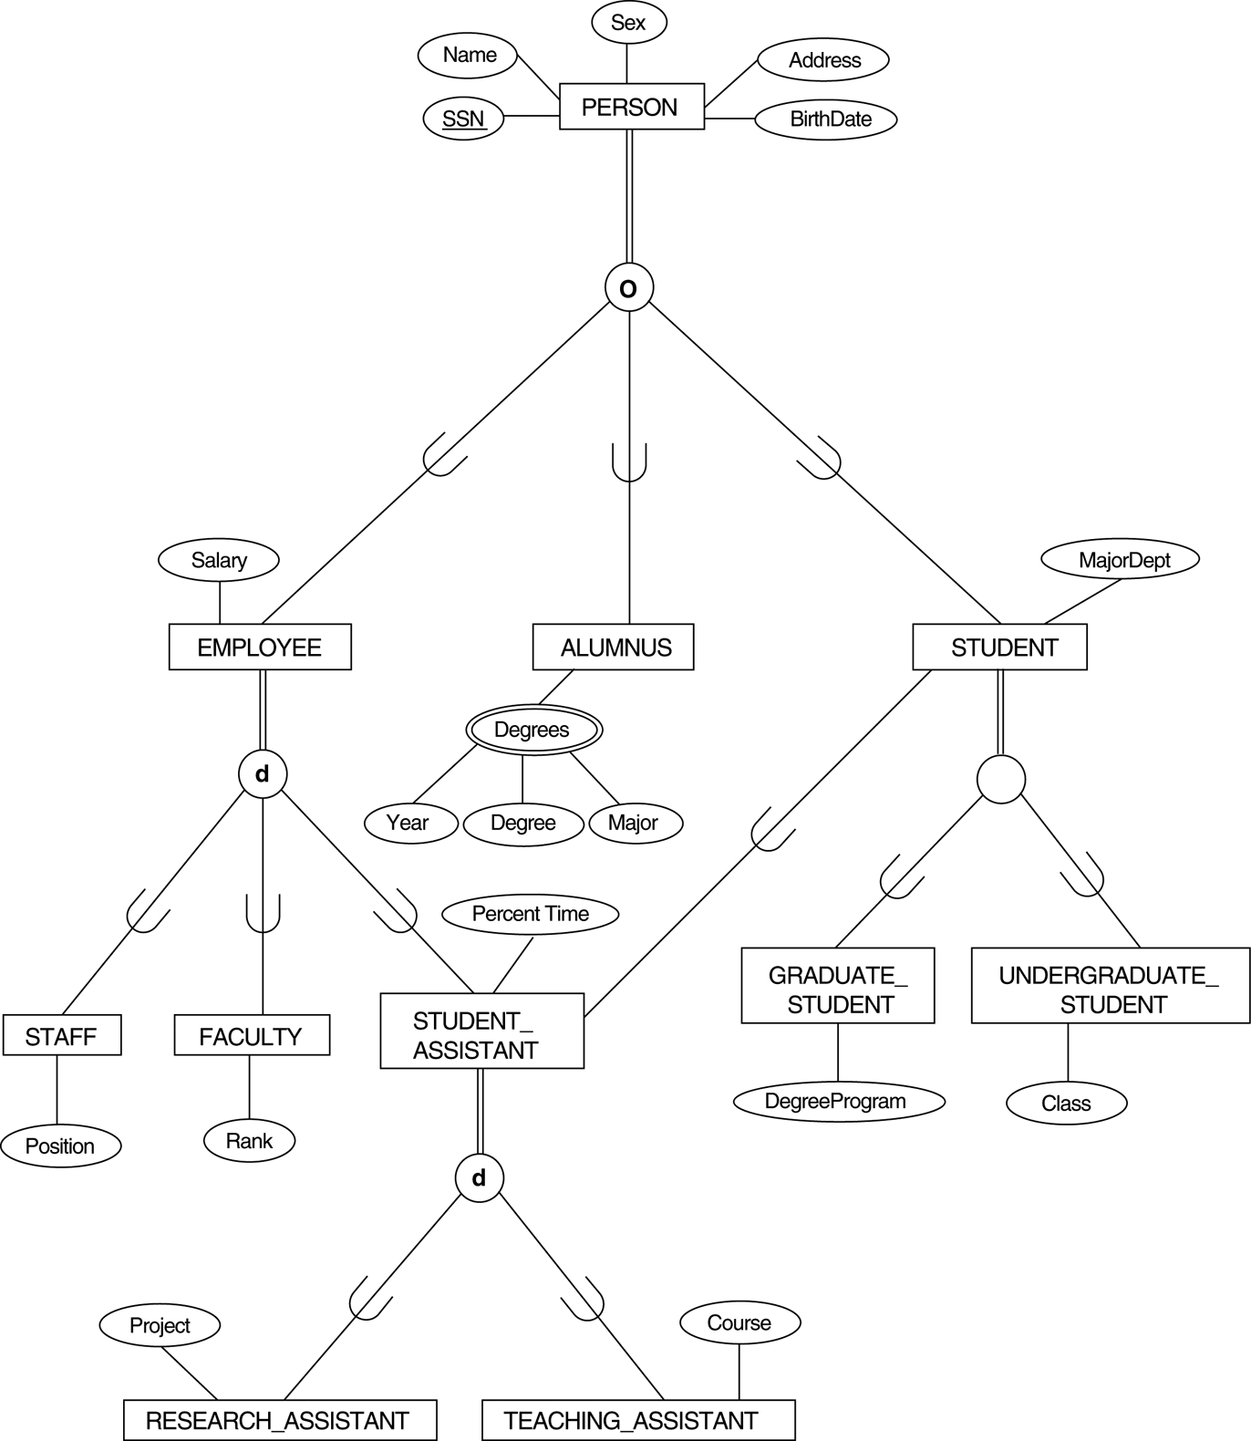
A specialization lattice with multiple inheritance for a UNIVERSITY database.

Slide 31
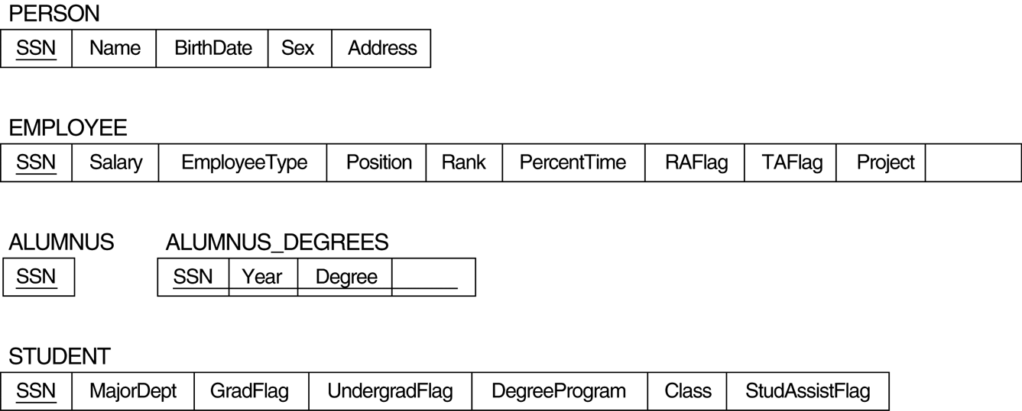
Mapping the EER specialization lattice using multiple options.
Course
Major

Slide 32
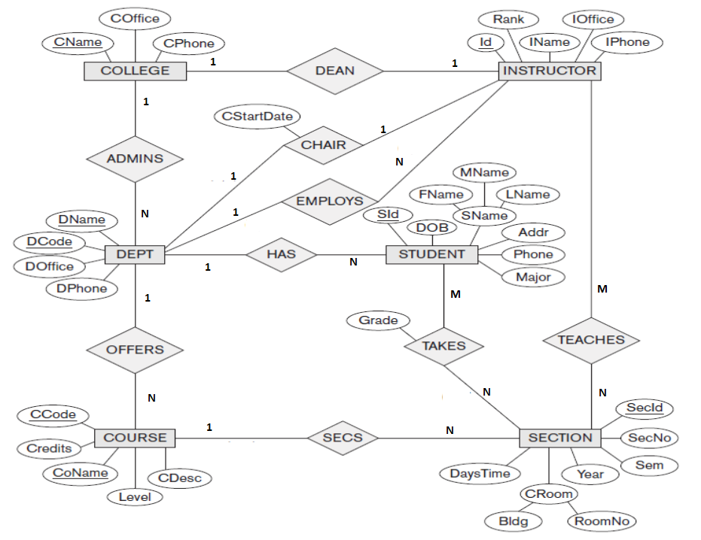

Slide 33
