Slide 1
CSE2004 – Database Management Systems
Module 2 DataModeling
Dr. V Vani
VIT Chennai,SCOPE

Slide 2
Overview
Entity Relationship Model
Types of Attributes
Relationship
Structural Constraints
Relational Model
Relational model Constraints
Mapping ER model to a relational schema
Integrity constraints

Slide 3
Data Model
A diagram that displays a set of tables and the relationships between them.

Slide 4
The Importance of Data Model
Blue print: official documentation
Eg. Blue print of house
Identify what data is important
Identify what data should be maintained

Slide 5
ER Schema
ER Model is a semantic data model which makes it easier for a user to come up with a good initial description of the data in an enterprise.
ER Model is a high-level conceptual data model.
ER model is a design or blueprint of a database.
ER diagram shows the complete logical structure of a database.

Slide 6
ER Schema
Description of a database is called the database schema.
Pictorial representation of schema is called a schema diagram.
This model is frequently used for the conceptual design of database applications.
Diagrammatic notation associated with the ER model, known as ER diagrams.

Slide 7
ER Schema
Notation for ER diagrams and common pitfalls that occur in schema design.
Choosing the names for database schema is based on entity types and relationship types.
ER diagram has three main components
1. Entity
2. Attribute
3. Relationship

Slide 8
ERD (Entity Relationship Diagram)
The major activity of this phase is identifying entities, attributes, and their relationships to construct model using the Entity Relationship Diagram.
Entity → table
Attribute → column
Relationship → line

Slide 9
Entity
Entity:
"...anything (people, places, objects, events, etc.) about which we store information (e.g. supplier, machine tool, employee, utility pole, airline seat, etc.).”
Tangible: customer, product
Intangible: order, accounting receivable

Slide 10
Entity Instance
Entity instance: a single occurrence of an entity.
6 instances
Entity: student
Student ID | Last Name | First Name
2144 | Arnold | Betty
3122 | Taylor | John
3843 | Simmons | Lisa
9844 | Macy | Bill
2837 | Leath | Heather
2293 | Wrench | Tim
instance

Slide 11
Attributes
Attribute:
Attributes are data objects that either identify or describe entities (property of an entity).
Eg. Student Id, First name, Last name

Slide 12
Relationships
Relationship:
Relationships are associations between entities.
Typically, a relationship is indicated by a verb connecting two or more entities.
Employees are assigned to projects
Relationships should be classified in terms of cardinality.
One-to-one, one-to-many, many-to-one, many-to-many

Slide 13
Relationships
WORKS_FOR (between EMPLOYEE, DEPARTMENT)
MANAGES (also between EMPLOYEE, DEPARTMENT)
CONTROLS (between DEPARTMENT, PROJECT)
WORKS_ON (between EMPLOYEE, PROJECT)
SUPERVISION (between EMPLOYEE (as subordinate), EMPLOYEE (as supervisor))
DEPENDENTS_OF (between EMPLOYEE, DEPENDENT)

Slide 14
Cardinality
Cardinality:
The cardinality is the number of occurrences in one entity which are associated to the number of occurrences in another.
There are three basic cardinalities (degrees of relationship).
one-to-one (1:1), one-to-many (1:M), and many-to-many (M:N)

Slide 15
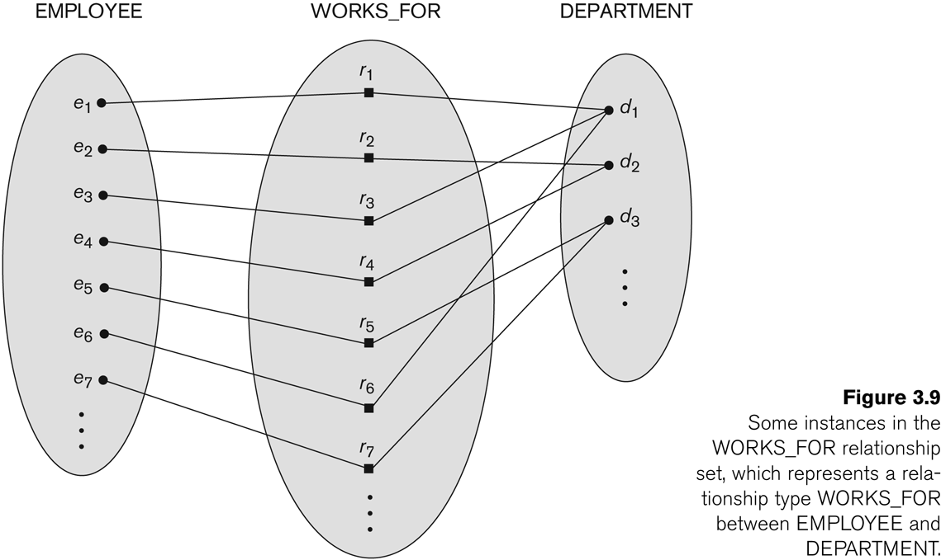
Many-to-one (N:1) Relationship

Slide 16
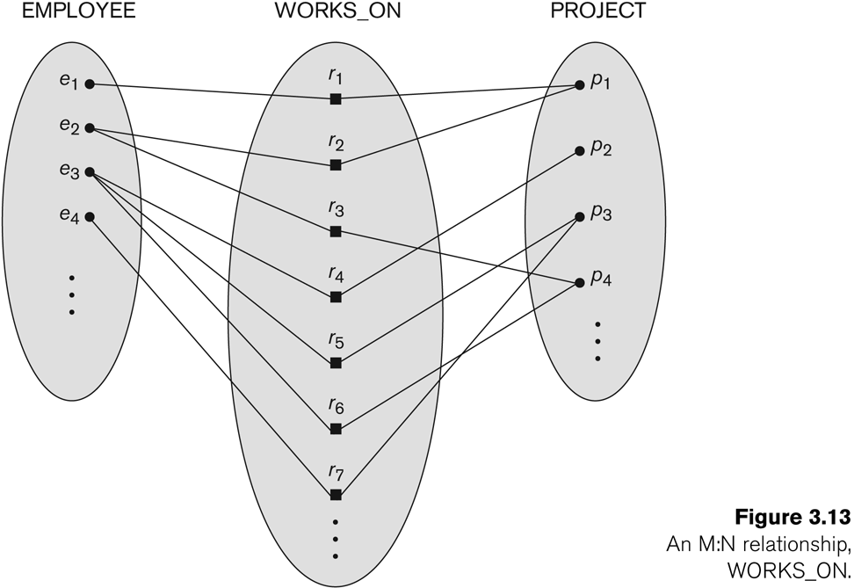
Many-to-Many (M:N) Relationship

Slide 17
Identifier
“attributes that uniquely identify entity instances”
Becomes a PK(primary key) in RDS
Composite identifiers are identifiers that consist of two or more attributes
Identifiers are represented by underlying the name of the attribute(s)
Employee (Employee_ID), student (Student_ID)

Slide 18
Classes of attributes
Simple attribute
Composite attribute
Derived attributes
Single-valued attribute
Multi-valued attribute
Notes:
5

Slide 19
Simple/Composite attribute
A simple attribute cannot be subdivided.
Examples: Age, Gender, and Marital status
A composite attribute can be further subdivided to yield additional attributes.
Examples:
ADDRESS --→ Street, City, State, Zip
PHONE NUMBER --→ Area code, Exchange number
Notes:
22

Slide 20
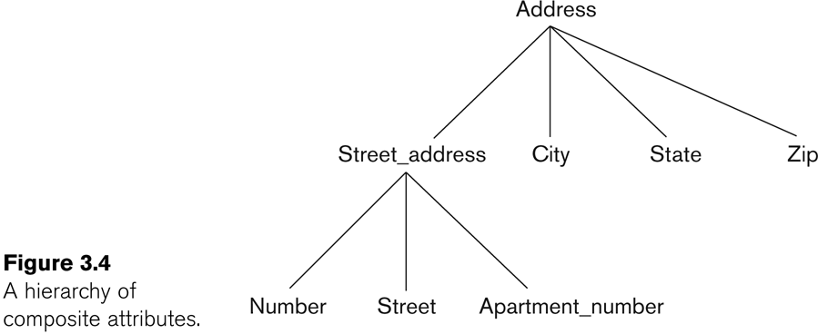
Composite attribute
Notes:
22

Slide 21
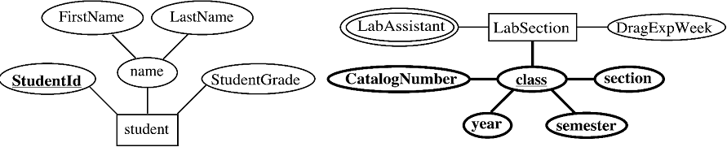
Notes:
22

Slide 22
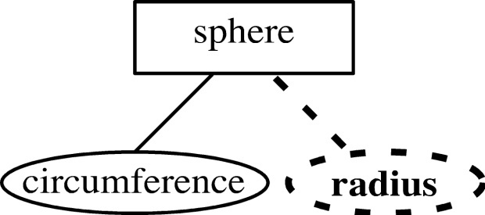
Derived attribute
is not physically stored within the database
instead, it is derived by using an algorithm.
Example 1: Late Charge of 2%
MS Access: InvoiceAmt * 0.02
Example 2: AGE can be derived from the date of birth and the current date.
MS Access: int(Date() – Emp_Dob)/365)
Notes:
22

Slide 23
Single-valued attribute
can have only a single (atomic) value.
Examples:
A person can have only one social security number.
A manufactured part can have only one serial number.
A single-valued attribute is not necessarily a simple attribute.
Part No: CA-08-02-189935
Location: CA, Factory#:08, shift#: 02, part#: 189935
Notes:
23

Slide 24

Multi-valued attributes
An attribute can have many values.
Examples:
A person may have several college degrees.
A household may have several phones with different numbers
A car color
Notes:
23

Slide 25
Notes:
22

Slide 26
Example - “Movie Database”
Entity:
Movie Star
Attributes:
SS#: “123-45-6789” (single-valued)
Cell Phone: “(661)123-4567, (661)234-5678” (multi-valued)
Name: “Harrison Ford” (composite)
Address: “123 Main Str., LA, CA” (composite)
Gender: “Female” (simple)
Age: 24 (derived)

Slide 27
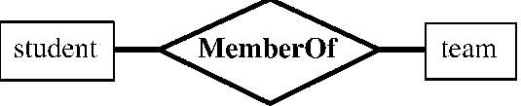

Slide 28
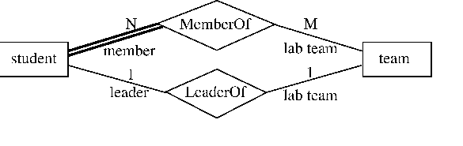
Participation 2 types: a. Total b. Partial

Slide 29
Keys
Key is an attribute or collection of attributes that uniquely identifies an entity among entity set.
Super Key
Candidate Key
Primary Key

Slide 30
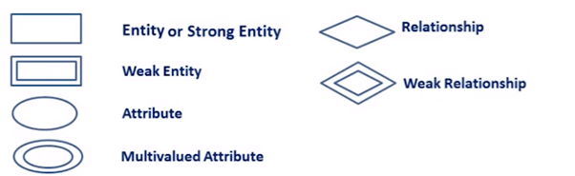
Symbols used in ERD
Rectangles: This Entity Relationship Diagram symbol represents entity types.
Ellipses : Symbol represent attributes.
Diamonds: This symbol represents relationship types.
Lines: It links attributes to entity types and entity types with other relationship types
Primary key: attributes are underlined.
Double Ellipses: Represent multi-valued attributes
Source:https://www.guru99.com/er-diagram-tutorial-dbms.html

Slide 31
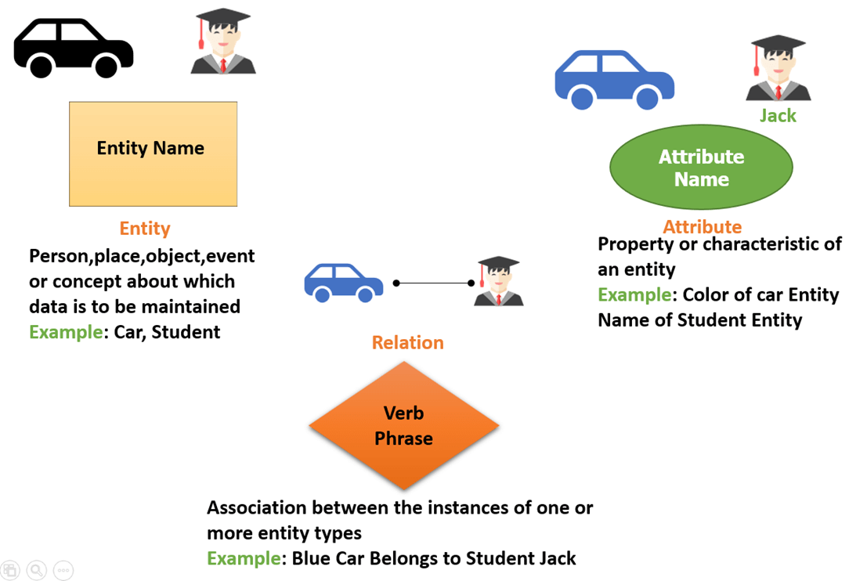
Source:https://www.guru99.com/er-diagram-tutorial-dbms.html

Slide 32
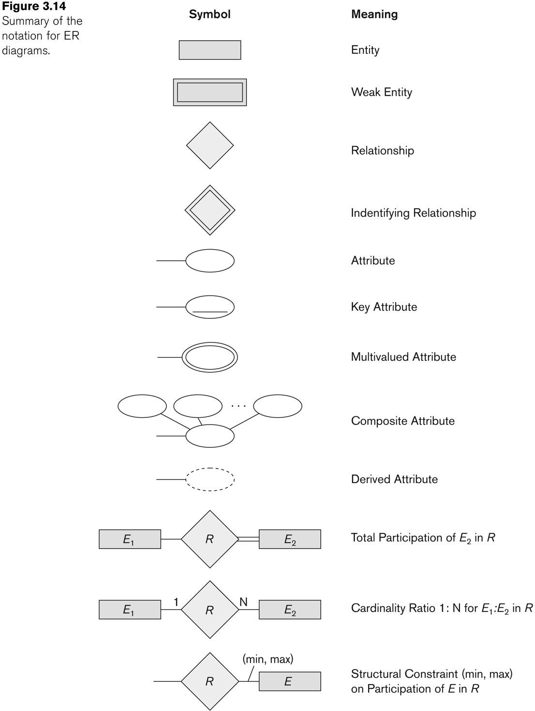
Source:Elmasri Navathae book@2007

Slide 33
Entities, Attributes, Relation & Keys
EID
Name
Posting
Employee
Employees Entity Set

Slide 34
Entities, Attributes, Relation & Keys
DID
Name
HOD
Department
Department Entity Set

Slide 35
Entities, Attributes, Relation & Keys
EID
Name
Posting
DID
Name
HOD
Works-In
Employee
Department
Works-ln Relationship Set

Slide 36
Entities, Attributes, Relation & Keys
In terms of DBMS, an entity is a table or attribute of a table, a relationship is relation among tables and their attributes.
In Database systems, the term "Table" highlights the Entity.
In Database systems, the term "Field" highlights the Attributes.

Slide 37
Entity Types
Types of Entities in ER Model
Strong entity
These shapes are independent from other entities
Weak entity
Weak entities depend on some other entity type
Associative entity
Associative entities relate the instances of several entity types

Slide 38
Strong Entity Set | Weak Entity Set
Strong entity set always has a primary key. | It does not have enough attributes to build a primary key.
It is represented by a rectangle symbol. | It is represented by a double rectangle symbol.
It contains a Primary key represented by the underline symbol. | It contains a Partial Key which is represented by a dashed underline symbol.
The member of a strong entity set is called as dominant entity set. | The member of a weak entity set called as a subordinate entity set.
Primary Key is one of its attributes which helps to identify its member. | In a weak entity set, it is a combination of primary key and partial key of the strong entity set.
In the ER diagram the relationship between two strong entity set shown by using a diamond symbol. | The relationship between one strong and a weak entity set shown by using the double diamond symbol.
The connecting line of the strong entity set with the relationship is single. | The line connecting the weak entity set for identifying relationship is double.
Source:https://www.guru99.com/er-diagram-tutorial-dbms.html

Slide 39
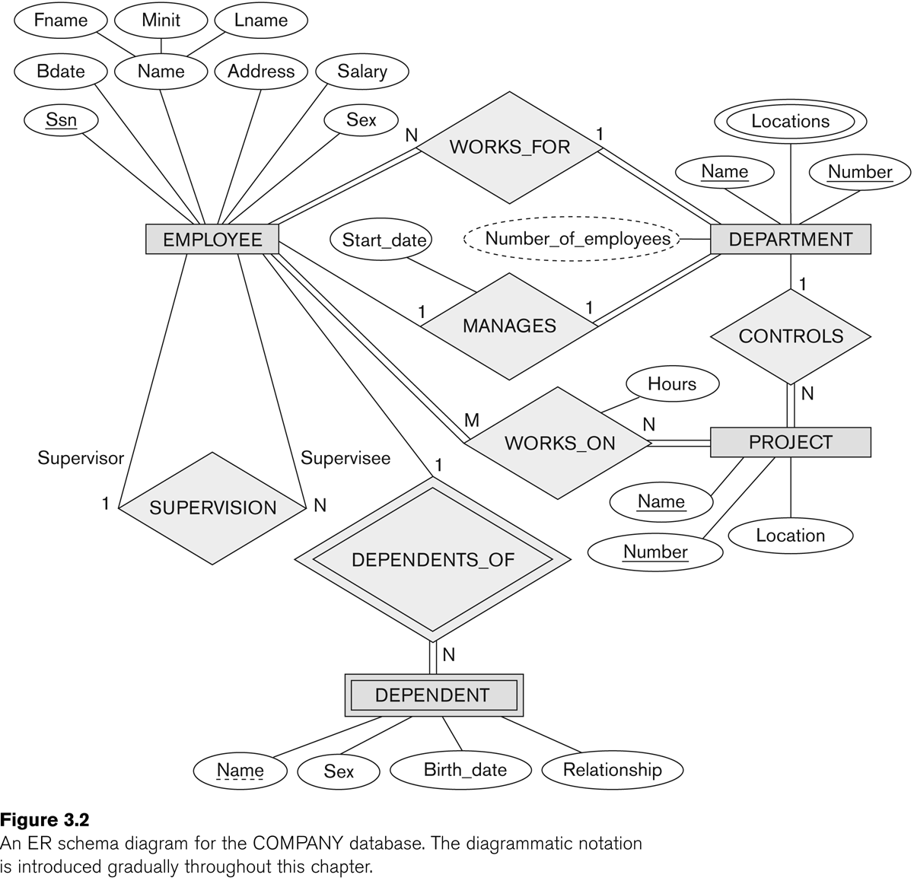
Source:ElmasriNavathae book@2007

Slide 40
Source:ElmasriNavathae book@2007

Slide 41
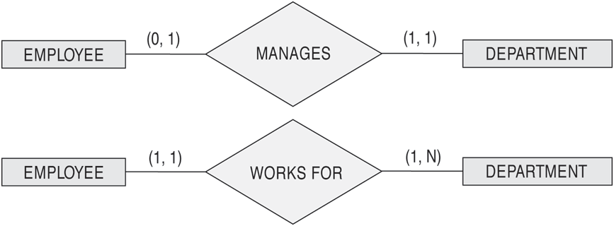
The (min, max) notation for relationship constraints
Read the min,max numbers next to the entity type and looking away from the entity type
Source:ElmasriNavathae book@2007

Slide 42
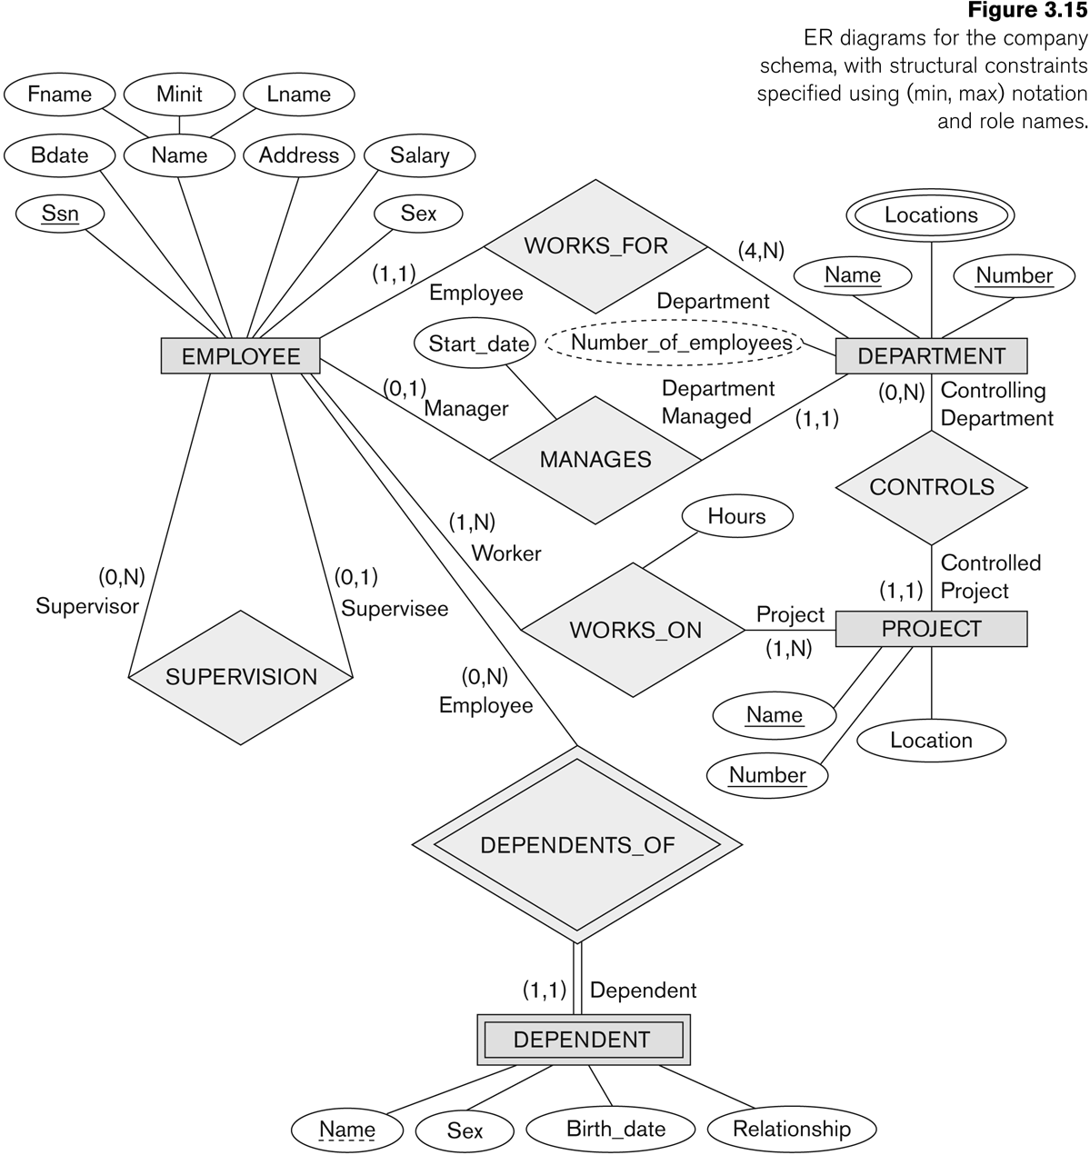
COMPANY ER Schema Diagram using (min, max) notation
Source:ElmasriNavathae book@2007

Slide 43
Keys
Key is an attribute or collection of attributes that uniquely identifies an entity among entity set.
For example, the roll_number of a student makes him/her identifiable among students.
Super Key − A set of attributes (one or more) that collectively identifies an entity in an entity set.
Candidate Key − A minimal super key is called a candidate key. An entity set may have more than one candidate key.
Primary Key − A primary key is one of the candidate keys chosen by the database designer to uniquely identify the entity set.

Slide 44
ER Model to Relational Schema

Slide 45
ER Model

Slide 46
Steps for converting ER Model to Relational Schema or Tables
Step1: Convert all strong entity sets into relations
Step2: Mapping weak Entity types
Step3: Mapping 1:1 Relationships types
Step4: Mapping 1:N Relationships types
Step5: Mapping M:N Relationships types
Step6: Mapping multi valued attributes

Slide 47
Step1:Convert all strong entity sets into relations
Covert all strong entities into separate tables or relations
Exclude multivalued attributes

Slide 48
Step2: Mapping weak entity types
Create separate relation and include all simple attributes
Exclude multi valued attributes.
Add Primary Key of the owner entity set into weak entity set

Slide 49
Step3: Mapping 1:1 Relationships types
Identify the entity sets with total participation (say entity S)
Add Primary key of R entity into S entity as Foreign key

Slide 50
Step4: Mapping 1:N Relationships types
Identify the entity sets with total participation (say entity S)
Add Primary Key of R entity in S entity as Foreign Key

Slide 51
Step5: Mapping M:N Relationships types
Create a separate relation containing Primary Key of both entity between which we have M:N relationship.
Also consider the descriptive attributes if it has.

Slide 52
Step6: Mapping Multi valued Attributes
Create a separate relation for each and every multi valued attributes.
That relation or table will be having key attribute from entity set which it as attached.

Slide 53
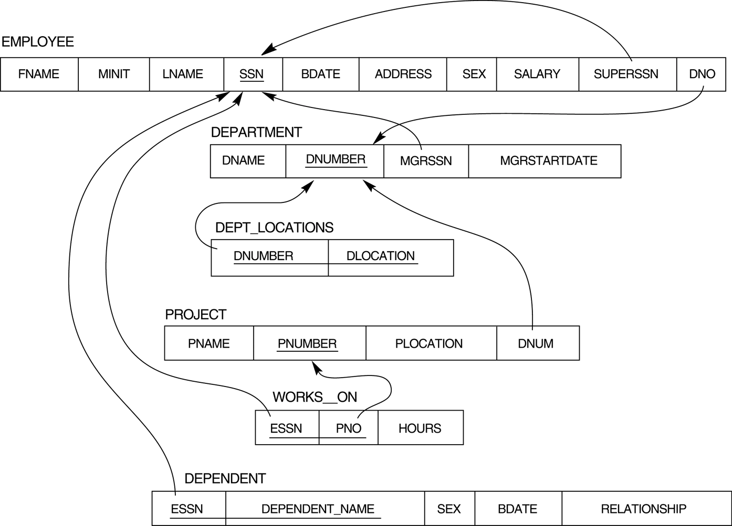
Relational Schema (for Company ER model)

Slide 54


