Slide 1
Chapter 3
Relational Model and E-R Modeling

Slide 2
Chapter Outline
Overview of Database Design Process
Example Database Application (COMPANY)
ER Model Concepts
Entities and Attributes
Entity Types, Value Sets, and Key Attributes
Relationships and Relationship Types
Weak Entity Types
Roles and Attributes in Relationship Types
ER Diagrams - Notation
ER Diagram for COMPANY Schema

Slide 3
Overview of Database Design Process
Two main activities:
Database design
Applications design
Focus in this chapter on database design
To design the conceptual schema for a database application
Applications design focuses on the programs and interfaces that access the database
Generally considered part of software engineering

Slide 4
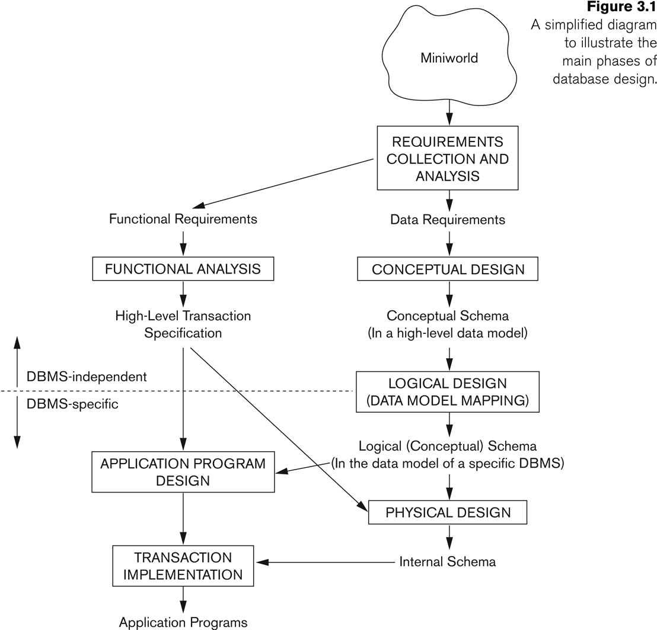
Overview of Database Design Process

Slide 5
Requirements collection and analysis.
Data requirements
The database designers interview prospective database users to understand and document their data requirements.
The result of this step is a concisely written set of users’ requirements.
These requirements should be specified in as detailed and complete a form as possible.
Functional requirements
These consist of the user defined operations (or transactions) that will be applied to the database, including both retrievals and updates.
Data flow diagrams, sequence diagrams, scenarios, and other techniques are used to specify functional requirements.

Slide 6
conceptual design
Create a conceptual schema for the database, using a high-level conceptual data model.
A concise description of the data requirements of the users
Includes detailed descriptions of the entity types, relationships, and constraints;
These are expressed using the concepts provided by the high-level data model.
These concepts do not include implementation details,
They are usually easier to understand and can be used to communicate with nontechnical users.
The high-level conceptual schema can also be used as a reference to ensure that all users’ data requirements are met and that the requirements do not conflict.
Enables database designers to concentrate on specifying the properties of the data, without being concerned with storage and implementation details.
The basic data model operations can be used to specify the high-level user queries and operations identified during functional analysis.

Slide 7
logical design
The conceptual schema is transformed from the high-level data model into the implementation data model.
This step is called data model mapping
Its result is a database schema in the implementation data model of the DBMS.
Data model mapping is often automated or semiautomated within the database design tools.

Slide 8
physical design
The internal storage structures, file organizations, indexes, access paths, and physical design parameters for the database files are specified.
Application programs are designed and implemented as database transactions corresponding to the high-level transaction specifications.

Slide 9
Example COMPANY Database
We need to create a database schema design based on the following (simplified) requirements of the COMPANY Database:
The company is organized into DEPARTMENTs. Each department has a name, number and an employee who manages the department. We keep track of the start date of the department manager. A department may have several locations.
Each department controls a number of PROJECTs. Each project has a unique name, unique number and is located at a single location.

Slide 10
Example COMPANY Database (Contd.)
We store each EMPLOYEE’s social security number, address, salary, Gender, and birthdate.
Each employee works for one department but may work on several projects.
We keep track of the number of hours per week that an employee currently works on each project.
We also keep track of the direct supervisor of each employee.
Each employee may have a number of DEPENDENTs.
For each dependent, we keep track of their name, Gender, birthdate, and relationship to the employee.

Slide 11
ER Model Concepts
Entities and Attributes
Entities are specific objects or things in the mini-world that are represented in the database.
For example the EMPLOYEE John Smith, the Research DEPARTMENT, the ProductX PROJECT
Attributes are properties used to describe an entity.
For example an EMPLOYEE entity may have the attributes Name, SSN, Address, Gender, BirthDate
A specific entity will have a value for each of its attributes.
For example a specific employee entity may have Name='John Smith', SSN='123456789', Address ='731, Fondren, Houston, TX’, Gender='M', BirthDate='09-JAN-55‘
Each attribute has a value set (or data type) associated with it – e.g. integer, string, subrange, enumerated type, …

Slide 12
Types of Attributes (1)
Simple
Each entity has a single atomic value for the attribute. For example, SSN or gender.
Composite - composed of several components.
Address(Apt#, House#, Street, City, State, ZipCode, Country)
Name(FirstName, MiddleName, LastName).
Composition may form a hierarchy where some components are themselves composite.
Single or Multi-valued
Single value for a particular entity
An entity may have multiple values for that attribute. For example, Color of a CAR or PreviousDegrees of a STUDENT.
Denoted as {Color} or {PreviousDegrees}.
Stored or Derived
Two (or more) attribute values are related.
Age and Birth_date

Slide 13
Types of Attributes (cont’d)
Simple
Professor
Start Date
First
Composite
Professor
Name
Last

Slide 14
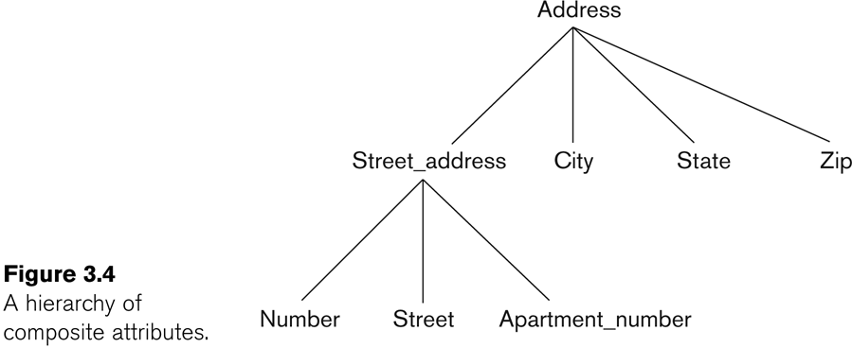
Example of a composite attribute

Slide 15
Composite Attribute as UDT
CREATE TYPE AddressType AS OBJECT (
street VARCHAR2(15),
city VARCHAR2(15),
state CHAR(2),
zip VARCHAR2(5));
CREATE TABLE Person (
id NUMBER,
first_name VARCHAR2(10),
last_name VARCHAR2(10),
dob DATE,
phone VARCHAR2(12),
address AddressType );

Slide 16
Types of Attributes (cont’d)
Single
Professor
Employee ID#
Multi-Valued
Professor
Email

Slide 17
Types of Attributes (2)
In general, composite and multi-valued attributes may be nested arbitrarily to any number of levels, although this is rare.
For example, PreviousDegrees of a STUDENT is a composite multi-valued attribute denoted by {PreviousDegrees (College, Year, Degree, Field)}
Multiple PreviousDegrees values can exist
Each has four subcomponent attributes:
College, Year, Degree, Field

Slide 18
Types of Attributes (cont’d)
Multi-Valued
College
Year
Professor
PreviousDegrees
Degree
Field

Slide 19
Types of Attributes (cont’d)
Stored
Professor
Start Date
Derived
Professor
Years Teaching

Slide 20
Entity Types and Key Attributes (1)
Entities with the same basic attributes are grouped or typed into an entity type.
For example, the entity type EMPLOYEE and PROJECT.
An attribute of an entity type for which each entity must have a unique value is called a key attribute of the entity type.
For example, SSN of EMPLOYEE.

Slide 21
Entity Types and Key Attributes (2)
A key attribute may be composite.
VehicleTagNumber is a key of the CAR entity type with components (Number, State).
An entity type may have more than one key.
The CAR entity type may have two keys:
VehicleIdentificationNumber (popularly called VIN)
VehicleTagNumber (Number, State), license plate number.
Each key is underlined

Slide 22
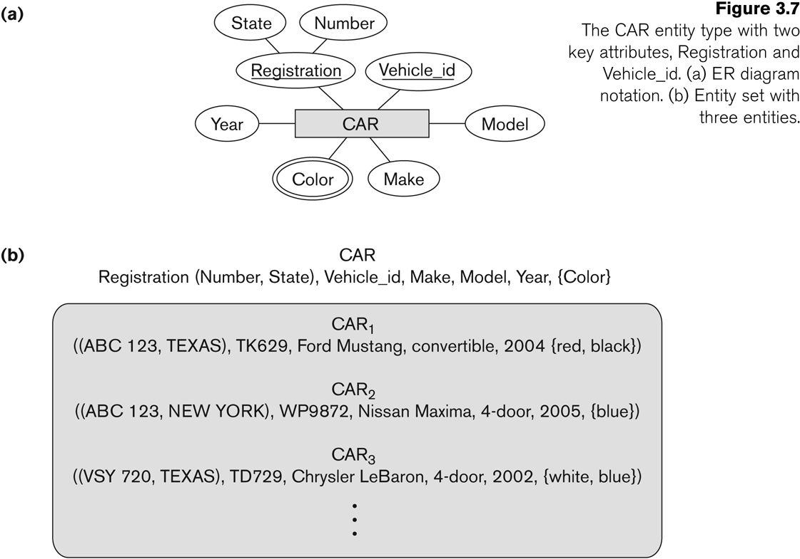
Displaying an Entity type
In ER diagrams, an entity type is displayed in a rectangular box
Attributes are displayed in ovals
Each attribute is connected to its entity type
Components of a composite attribute are connected to the oval representing the composite attribute
Each key attribute is underlined
Multivalued attributes displayed in double ovals

Slide 23
Entity Type CAR with two keys and a corresponding Entity Set

Slide 24
Entity Set
Each entity type will have a collection of entities stored in the database
Called the entity set
Previous slide shows three CAR entity instances in the entity set for CAR
Same name (CAR) used to refer to both the entity type and the entity set
Entity set is the current state of the entities of that type that are stored in the database

Slide 25
Initial Design of Entity Types for the COMPANY Database Schema
Based on the requirements, we can identify four initial entity types in the COMPANY database:
DEPARTMENT
PROJECT
EMPLOYEE
DEPENDENT
Their initial design is shown on the following slide
The initial attributes shown are derived from the requirements description

Slide 26
Initial Design of Entity Types: EMPLOYEE, DEPARTMENT, PROJECT, DEPENDENT

Slide 27
Refining the initial design by introducing relationships
The initial design is typically not complete
Some aspects in the requirements will be represented as relationships
ER model has three main concepts:
Entities (and their entity types and entity sets)
Attributes (simple, composite, multivalued)
Relationships (and their relationship types and relationship sets)

Slide 28
Relationships and Relationship Types (1)
A relationship relates two or more distinct entities with a specific meaning.
For example, EMPLOYEE John Smith works on the ProductX PROJECT, or EMPLOYEE Franklin Wong manages the Research DEPARTMENT.
Relationships of the same type are grouped or typed into a relationship type.
For example, the WORKS_ON relationship type in which EMPLOYEEs and PROJECTs participate, or the MANAGES relationship type in which EMPLOYEEs and DEPARTMENTs participate.
The degree of a relationship type is the number of participating entity types.
Both MANAGES and WORKS_ON are binary relationships.

Slide 29
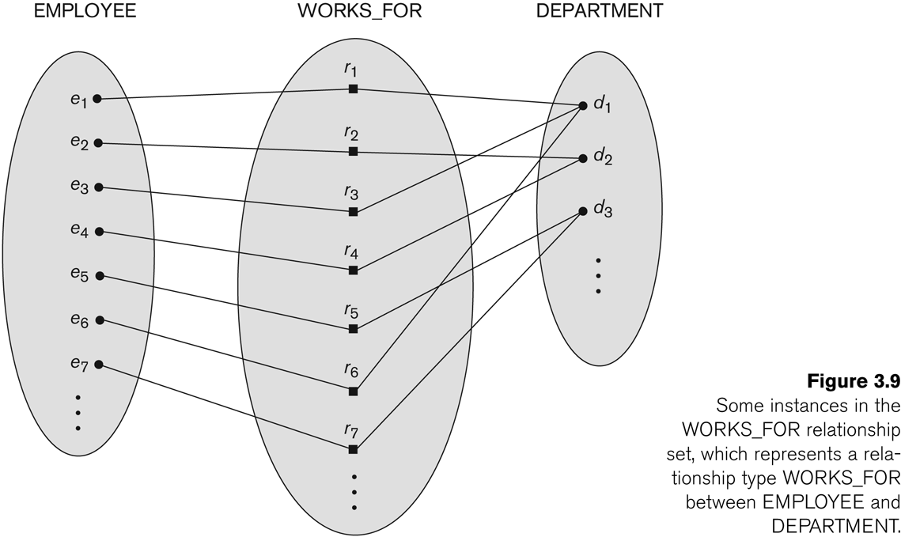
Relationship instances of the WORKS_FOR N:1 relationship between EMPLOYEE and DEPARTMENT

Slide 30
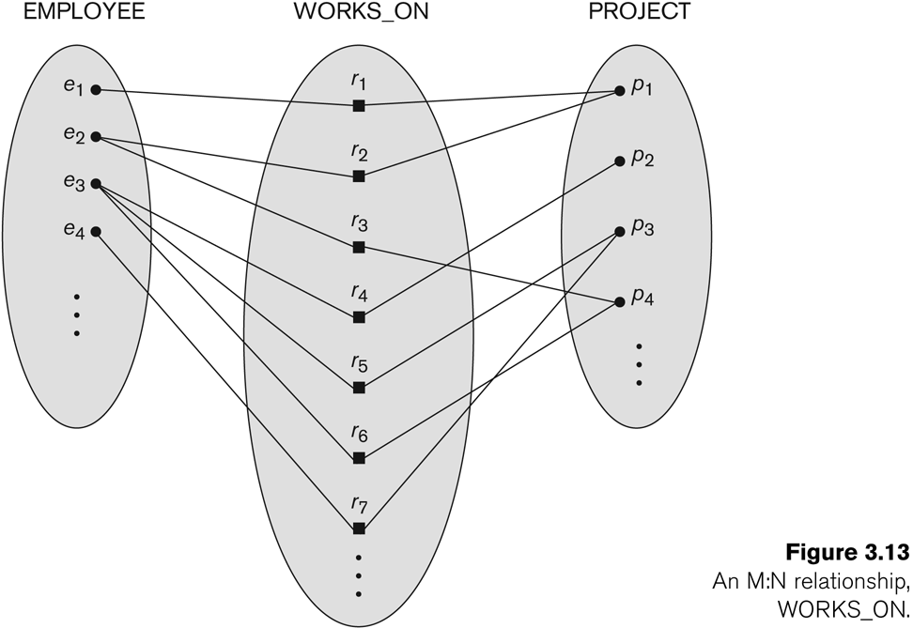
Relationship instances of the M:N WORKS_ON relationship between EMPLOYEE and PROJECT

Slide 31
Relationship type vs. relationship set (1)
Relationship Type:
Is the schema description of a relationship
Identifies the relationship name and the participating entity types
Also identifies certain relationship constraints
Relationship Set:
The current set of relationship instances represented in the database
The current state of a relationship type

Slide 32
Relationship type vs. relationship set (2)
Each instance in the set relates individual participating entities – one from each participating entity type
In ER diagrams, we represent the relationship type as follows:
Diamond-shaped box is used to display a relationship type
Connected to the participating entity types via straight lines

Slide 33
Refining the COMPANY database schema by introducing relationships
By examining the requirements, six relationship types are identified
All are binary relationships( degree 2)
Listed below with their participating entity types:
WORKS_FOR (between EMPLOYEE, DEPARTMENT)
MANAGES (also between EMPLOYEE, DEPARTMENT)
CONTROLS (between DEPARTMENT, PROJECT)
WORKS_ON (between EMPLOYEE, PROJECT)
SUPERVISION (between EMPLOYEE (as subordinate), EMPLOYEE (as supervisor))
DEPENDENTS_OF (between EMPLOYEE, DEPENDENT)

Slide 34
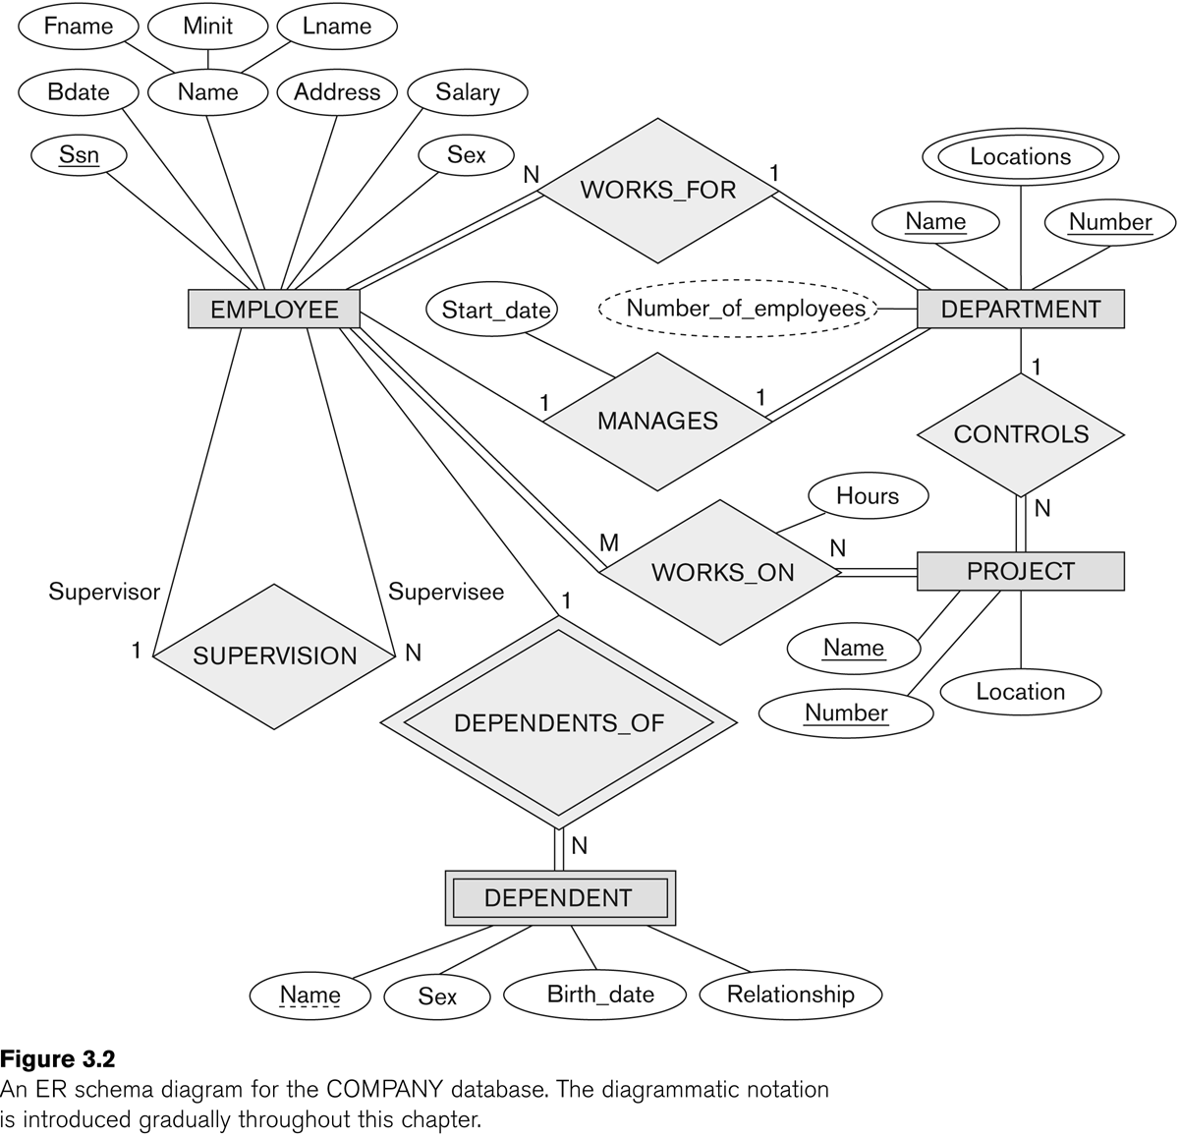
ER DIAGRAM – Relationship Types are: WORKS_FOR, MANAGES, WORKS_ON, CONTROLS, SUPERVISION, DEPENDENTS_OF

Slide 35
Discussion on Relationship Types
In the refined design, some attributes from the initial entity types are refined into relationships:
Manager of DEPARTMENT -> MANAGES
Works_on of EMPLOYEE -> WORKS_ON
Department of EMPLOYEE -> WORKS_FOR
etc
In general, more than one relationship type can exist between the same participating entity types
MANAGES and WORKS_FOR are distinct relationship types between EMPLOYEE and DEPARTMENT
Different meanings and different relationship instances.

Slide 36
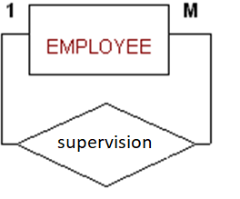
Recursive Relationship Type
An relationship type whose with the same participating entity type in distinct roles
Example: the SUPERVISION relationship
EMPLOYEE participates twice in two distinct roles:
supervisor (or boss) role
supervisee (or subordinate) role
Each relationship instance relates two distinct EMPLOYEE entities:
One employee in supervisor role
One employee in supervisee role

Slide 37
Displaying a recursive relationship
In a recursive relationship type.
Both participations are same entity type in different roles.
For example, SUPERVISION relationships between EMPLOYEE (in role of supervisor or boss) and (another) EMPLOYEE (in role of subordinate or worker).
In following figure, first role participation labeled with 1 and second role participation labeled with 2.
In ER diagram, need to display role names to distinguish participations.

Slide 38
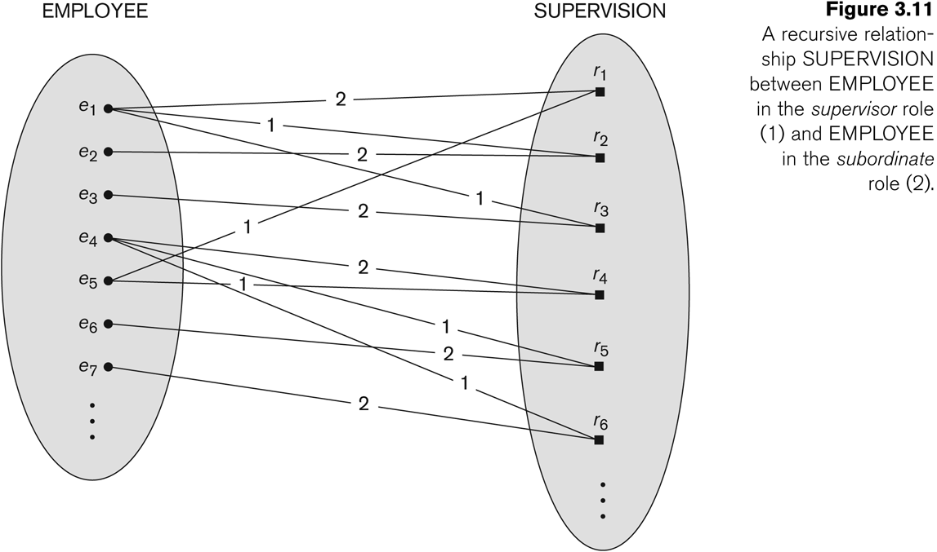
A Recursive Relationship Supervision`

Slide 39
Recursive Relationship Type is: SUPERVISION (participation role names are shown)

Slide 40
Weak Entity Types
An entity that does not have a key attribute
A weak entity must participate in an identifying relationship type with an owner or identifying entity type
Entities are identified by the combination of:
A partial key of the weak entity type
The particular entity they are related to in the identifying entity type
Example:
A DEPENDENT entity is identified by the dependent’s first name, and the specific EMPLOYEE with whom the dependent is related
Name of DEPENDENT is the partial key
DEPENDENT is a weak entity type
EMPLOYEE is its identifying entity type via the identifying relationship type DEPENDENT_OF

Slide 42
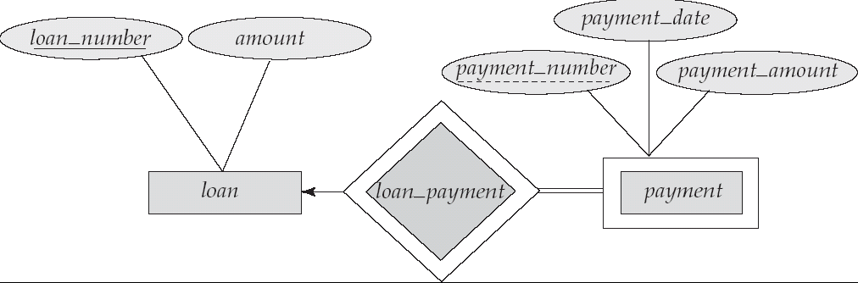
Weak Entity Types Example
We depict a weak entity set by double rectangles.
We underline the discriminator of a weak entity set with a dashed line.
payment_number – discriminator of the payment entity set
Primary key for payment – (loan_number, payment_number)

Slide 43
Constraints on Relationships
Structural Constraints on Relationship Types
Cardinality Ratio (specifies maximum participation)
One-to-one (1:1)
One-to-many (1:N)
Many-to-one (N:1)
Many-to-many (M:N)
participation constraint
Total
Partial

Slide 44
A 1:1 relationship, MANAGES.

Slide 45
Many-to-one (N:1) Relationship WORKS_FOR

Slide 46
Many-to-many (M:N) Relationship WORKS_ON

Slide 47
Participation Constraints and Existence Dependencies
Specifies whether the existence of an entity depends on its being related to another entity via the relationship type.
This constraint specifies the minimum number of relationship instances that each entity can participate in and Sometimes called the minimum cardinality constraint.
There are two types of participation constraints
Total
If a company policy states that every employee must work for a department, then an employee entity can exist only if it participates in at least one WORKS_FOR relationship instance.
Thus, the participation of EMPLOYEE in WORKS_FOR is called total participation.
Every entity in the total set of employee entities must be related to a department entity via WORKS_FOR.
Total participation is also called existence dependency.
Partial
we do not expect every employee to manage a department.
so the participation of EMPLOYEE in the MANAGES relationship type is partial,
some or part of the set of employee entities are related to some department entity via MANAGES, but not necessarily all.

Slide 48
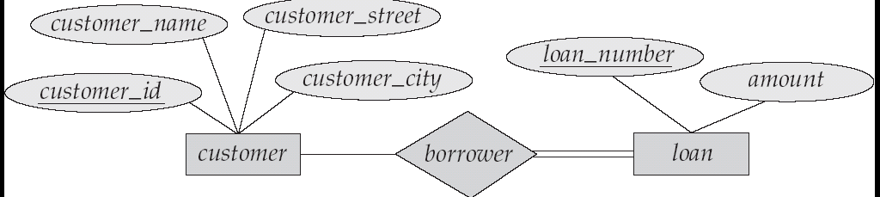
Participation of an Entity Set in a Relationship Set
Total participation (indicated by double line): every entity in the entity set participates in at least one relationship in the relationship set
E.g. participation of loan in borrower is total
Every loan must have a customer associated to it via borrower
Partial participation: some entities may not participate in any relationship in the relationship set
Example: participation of customer in borrower is partial

Slide 49
Attributes of Relationship types
A relationship type can have attributes:
For example, HoursPerWeek of WORKS_ON
Its value for each relationship instance describes the number of hours per week that an EMPLOYEE works on a PROJECT.
A value of HoursPerWeek depends on a particular (employee, project) combination
Most relationship attributes are used with M:N relationships
In 1:N relationships, they can be transferred to the entity type on the N-side of the relationship

Slide 50
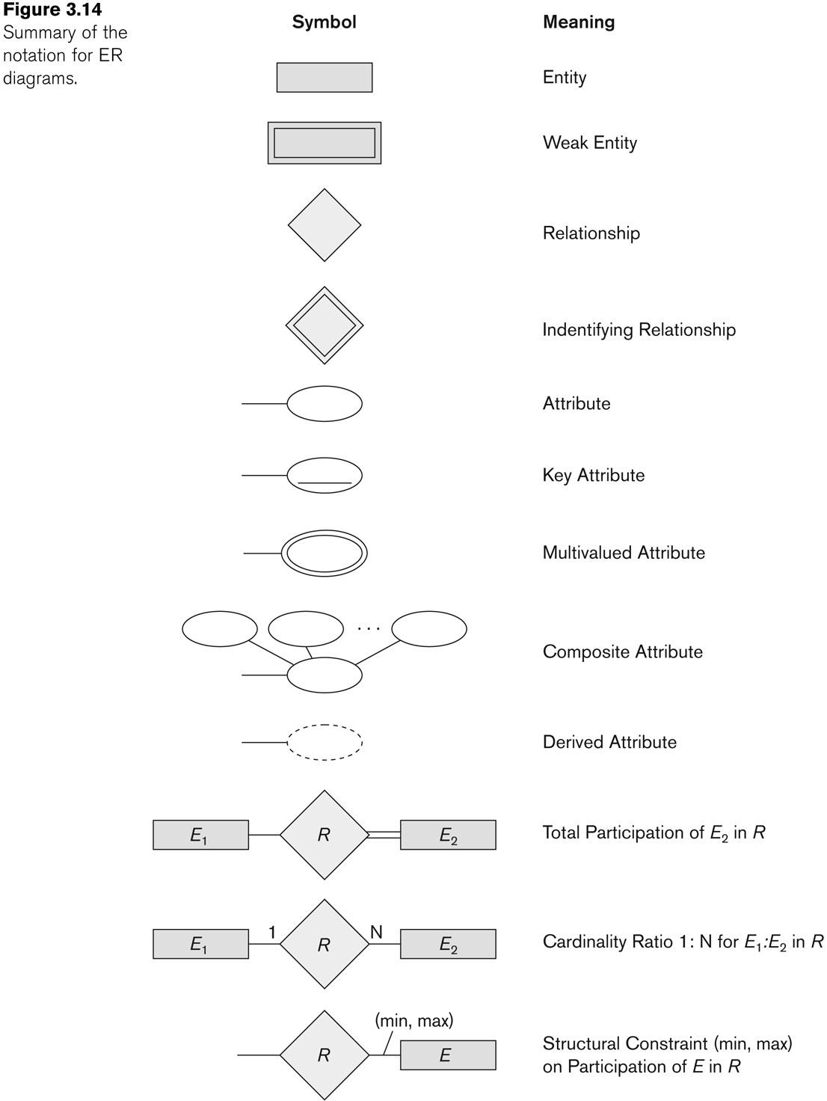
Summary of notation for ER diagrams

Slide 51
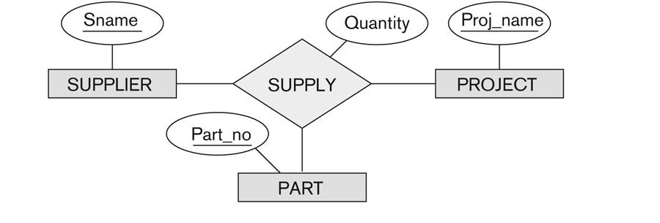
Relationships of Higher Degree
Relationship types of degree 2 are called binary
Relationship types of degree 3 are called ternary and of degree n are called n-ary
In general, an n-ary relationship is not equivalent to n binary relationships
Constraints are harder to specify for higher-degree relationships (n > 2) than for binary relationships

Slide 52
UNIVERSITY EXAMPLE
A UNIVERSITY database needed to keep track of student enrolments in classes
The university is organized into colleges (COLLEGE), and each college has a unique name (CName), a main office (COffice) and phone (CPhone), and a particular faculty member who is dean of the college. Each college administers a number of academic departments (DEPT). Each department has a unique name (DName), a unique code number (DCode), a main office (DOffice) and phone (DPhone), and a particular faculty member who chairs the department. We keep track of the start date (CStartDate) when that faculty member began chairing the department.
A department offers a number of courses (COURSE), each of which has a unique course name (CoName), a unique code number (CCode), a course level,a course credit hours (Credits), and a course description (CDesc). The database also keeps track of instructors (INSTRUCTOR); and each instructor has a unique identifier (Id), name (IName), office (IOffice), phone (IPhone), and rank (Rank); in addition, each instructor works for one primary academic department.
The database will keep student data (STUDENT) and stores each student’s name, student id (Sid, unique for every student), address (Addr), phone (Phone), major code (Major), and date of birth (DoB). A student is assigned to one primary academic department. It is required to keep track of the student’s grades in each section the student has completed.
Courses are offered as sections (SECTION). Each section is related to a single course and a single instructor and has a unique section identifier (SecId). A section also has a section number (SecNo: this is coded as 1, 2, 3, . . . for multiple sections offered during the same semester/year), semester (Sem), year (Year), classroom (CRoom: this is coded as a combination of building code (Bldg) and room number (RoomNo) within the building), and days/times. The SecId is unique for all sections, not just the sections for a particular semester. The database keeps track of the students in each section, and the grade is recorded when available. A section must have at least five students.

