Slide 1
CSE2004
Database Management System
Normalization

Slide 2
Normalization
It is a process for assigning attributes to entities.
It reduces data redundancies and helps eliminate the data anomalies.
Anomalies are problems that can occur in poorly planned, un-normalised databases where all the data is stored in one table

Slide 3
Why Normalization?
Sample Database Table
R
E
D
U
N
D
A
N
C
I
E
S
Row 1 |  |  | X
Row 2 |  |  | X
Row 3 |  |  | X
Row 4 |  |  | X
Row 5 |  |  | X

Slide 4
Redundancies lead to
Increases the size of Database
Insertion Problem
Deletion Problem
Updation Problem

Slide 5
Example (Students Table)
Registration Number | Name of the Student | School | Name of the Faculty | Contact Number
1 | AAAAA | SCOPE | Dr. ZZZZZ | 12345678910
2 | BBBBB | SCOPE | Dr. ZZZZZ | 12345678910
3 | CCCCC | SCOPE | Dr. ZZZZZ | 12345678910
4 | DDDDD | SCOPE | Dr. ZZZZZ | 12345678910
5 | EEEEE | SCOPE | Dr. ZZZZZ | 12345678910

Slide 6
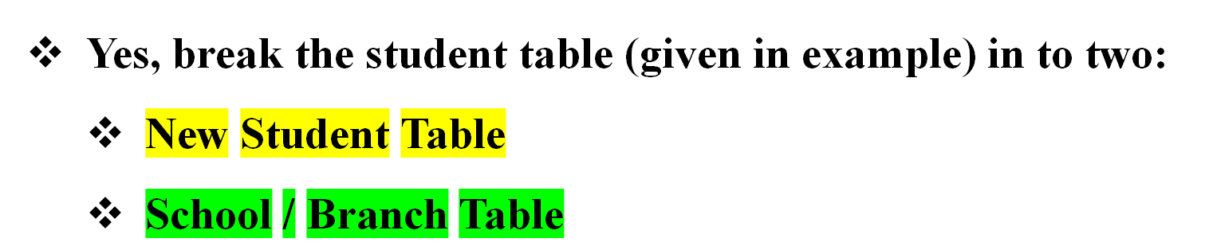
Normalization will solve?

Slide 7


Normalization will solve?
Registration Number | Name of the Student | School
1 | AAAAA | SCOPE
2 | BBBBB | SCOPE
3 | CCCCC | SCOPE
4 | DDDDD | SCOPE
5 | EEEEE | SCOPE
School | Name of the Faculty | Contact Number
SCOPE | Dr. ZZZZZ | 12345678910
It is not about eliminating redundancy
It is all about minimizing data redundancy

Slide 8
Normalization
Follows Divide and Rule
Logical, Independent but related data

Slide 9
Normalization Stages
Normalization works through a series of stages called “NORMAL FORMS”
  First Normal Form (1NF)
  Second Normal Form (2NF)
  Third Normal Form (3NF)
  Boyce-Codd Normal Form

Slide 10
First Normal Form
First Stage of Normalization Process
It gives us with a Scalable Table Design which can be extended (Easily)
If the table is not even in First Normal Form, it is considered as “POOR DATABASE DESIGN”

Slide 11
First Normal Form (Rule 1)
Each Column should contain atomic values
Entries like X, Y and W, Z will be treated as violation
Column 1 | Column 2 | Column 3
A | X, Y
B | W, X
C | Y
D | Z

Slide 12
First Normal Form (Rule 2)
A column should contain values that are of same type
Do not inter-mix different types of values in any column
D-O-B | NAME | Column 3
01-04-2021 | X
14-04-2021 | Y
07-03-2020 | Z
A | 01-01-2019

Slide 13
First Normal Form (Rule 3)
Each column should have unique name
Same names may lead to confusion
D-O-B | NAME | NAME
01-04-2021 | X | P
14-04-2021 | Y | Q
07-03-2020 | Z | R
09-09-2017 | A | S

Slide 14
First Normal Form (Rule 4)
Order in which the data stored is does not matter
SQL Query will help us to fetch the data
REG. NO | NAME | NAME
4 | X | P
1 | Y | Q
3 | Z | R
2 | A | S

Slide 15
Example (1 NF)
Student Table
Registration Number | Name of the Student | Name of the Subject
1 | AAAAA | DBMS, OS
2 | BBBBB | JAVA
3 | CCCCC | C, DBMS
4 | DDDDD | C++

Slide 16
Example (1 NF) – To ensure atomicity
Student Table
Registration Number | Name of the Student | Name of the Subject
1 | AAAAA | DBMS
1 | AAAAA | OS
2 | BBBBB | JAVA
3 | CCCCC | C
3 | CCCCC | DBMS
4 | DDDDD | C++

Slide 17
Second Normal Form (2NF)
It should be in the First Normal Form
It should not have Partial-Dependencies

Slide 18
Second Normal Form (2NF)
Partial-Dependency Example
It should be in the First Normal Form
It should not have Partial-Dependencies
  Know about Dependency (Primary Key)

Slide 19

Second Normal Form (2NF)
Dependency for understanding
Dependency Example (Students Table)
Student_ID | Student Name | Registration Number | School | Address
1 | AAAAA | 20BAI | SCOPE | Chennai
2 | AAAAA | 20BCE | SCOPE | Mumbai
3 | BBBBB | 20CPS | SCOPE | Kolkata
4 | CCCCC | 20BCE | SCOPE | Andhra

Slide 20
Second Normal Form (2NF)
Partial Dependency
If two columns act as primary key
Student Table
Subject Table (Subject ID, Name)
Score Table

Slide 21
Second Normal Form (2NF)
Partial Dependency
Score Table
Score_ID | Student_ID | Subject_ID | Marks | Faculty
1 | 1 | 1 | 99 | Dr. XXXX
2 | 1 | 2 | 97 | Dr. YYYY
3 | 2 | 1 | 100 | Dr. XXXX
4 | 2 | 2 | 96 | Dr. YYYY
5 | 2 | 4 | 84 | Dr. ZZZZ

Slide 22

Second Normal Form (2NF)
Partial Dependency
Score Table
Score_ID | Student_ID | Subject_ID | Marks | Faculty
1 | 1 | 1 | 99 | Dr. XXXX
2 | 1 | 2 | 97 | Dr. YYYY
3 | 2 | 1 | 100 | Dr. XXXX
4 | 2 | 2 | 96 | Dr. YYYY
5 | 2 | 4 | 84 | Dr. ZZZZ

Slide 23
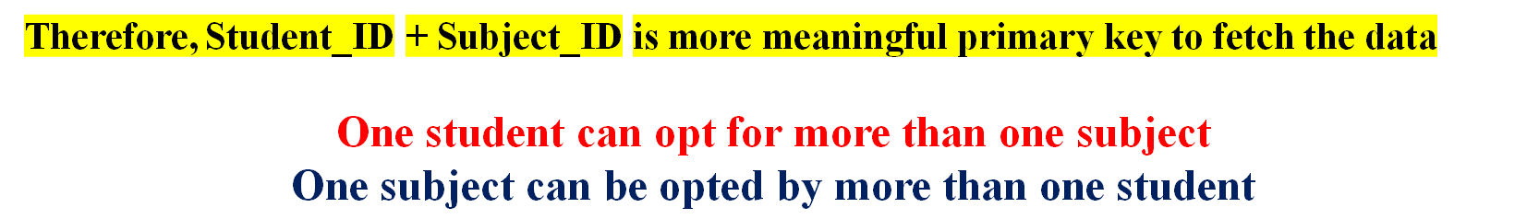
Second Normal Form (2NF)
Partial Dependency
Score Table
Score_ID | Student_ID | Subject_ID | Marks | Faculty
1 | 1 | 1 | 99 | Dr. XXXX
2 | 1 | 2 | 97 | Dr. YYYY
3 | 2 | 1 | 100 | Dr. XXXX
4 | 2 | 2 | 96 | Dr. YYYY
5 | 2 | 4 | 84 | Dr. ZZZZ

Slide 24

Second Normal Form (2NF)
Partial Dependency
Score Table
Score_ID | Student_ID | Subject_ID | Marks | Faculty
1 | 1 | 1 | 99 | Dr. XXXX
2 | 1 | 2 | 97 | Dr. YYYY
3 | 2 | 1 | 100 | Dr. XXXX
4 | 2 | 2 | 96 | Dr. YYYY
5 | 2 | 4 | 84 | Dr. ZZZZ

Slide 25
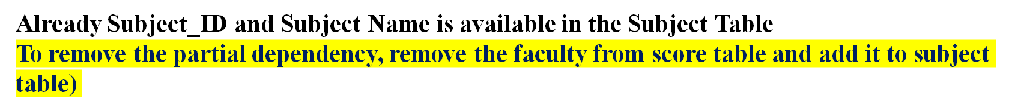
Second Normal Form (2NF)
Partial Dependency
Removing Partial Dependency (Faculty)
Subject_ID | Subject Name | Faculty
1 | Python | Dr. XXXX
2 | C | Dr. YYYY
3 | C++ | Dr. AAAA
4 | Java | Dr. ZZZZ

Slide 26
Third Normal Form (3NF)
Table must be in 2NF
It should not have Transitive Dependency
Three Tables were created in 2NF
Students Table
Score Table
Subject Table / Faculty Table

Slide 27
Third Normal Form (3NF)
Transitive Dependency not allowed
Table must be in 2NF
It should not have Transitive Dependency
Score Table
Score_ID | Student_ID | Subject_ID | Marks | Faculty
1 | 1 | 1 | 99 | Dr. XXXX
2 | 1 | 2 | 97 | Dr. YYYY
3 | 2 | 1 | 100 | Dr. XXXX
4 | 2 | 2 | 96 | Dr. YYYY
5 | 2 | 4 | 84 | Dr. ZZZZ

Slide 28
Third Normal Form (3NF)
Transitive Dependency not allowed
Once, Exam name is added, then total marks will have some differences based on theory and lab
So, total marks may change
Therefore, total marks is dependent on exam name

Slide 29
Third Normal Form (3NF)
Transitive Dependency not allowed
Now, the score table looks like
Score_ID | Student_ID | Subject_ID | Marks | Exam Name | Total Marks
1 | 1 | 1 | 99
2 | 1 | 2 | 97
3 | 2 | 1 | 100
4 | 2 | 2 | 96
5 | 2 | 4 | 84

Slide 30
Third Normal Form (3NF)
Transitive Dependency is Removed
Fourth Table is created
Exam Table
Exam Name | Total Marks

Slide 31
BCNF (Boyce-Codd)
Table must be in 3NF
Check Prime Attribute and Non-prime Attribute
A non prime attribute should not derive prime attribute

Slide 32
BCNF (Boyce-Codd)
Enrollment
Student_ID | Subject | Faculty
101 | Java | Dr. XXXXX
101 | C++ | Dr. BBBBB
102 | Java | Dr. CCCCC
103 | C | Dr. DDDDD
104 | Java | Dr. CCCCC
Satisfies 1 NF (Atomic, Unique Column names)
Satisfies 2 NF (No Partial Dependencies)
Satisfied 3 NF (No Transitive Dependencies)

Slide 33
BCNF (Boyce-Codd)
Enrollment
Student_ID | Subject | Faculty
101 | Java | Dr. XXXXX
101 | C++ | Dr. BBBBB
102 | Java | Dr. CCCCC
103 | C | Dr. DDDDD
104 | Java | Dr. CCCCC
The problem is
StudentID, Subject (prime, because of candidate key) fetches professor (Acceptable)
Professor (non prime / or not a primary key) fetching subject and student (not acceptable)

Slide 34
BCNF (Boyce-Codd)
Solution
Create two tables
Student Table
2. Faculty Table
Student ID | Faculty ID
Faculty ID | Name | Subject

Slide 35
https://www.youtube.com/watch?v=aAx_JoEDXQA&list=PLLGlmW7jT-nTr1ory9o2MgsOmmx2w8FB3&index=4

