Slide 1
Module 1 Fundamentals concepts and Architecture
Dr. S. RENUKA DEVI
Associate Profesor
SCOPE
VIT Chennai Campus

Slide 2
What is a Database?
Organized collection of related data
A repository or container for a collection of data files
Database can be of any size and complexity
Generated and maintained manually or may be computerized
Stored on disk and accessible by concurrent users

Slide 3
Operations performed on Database
Adding and removing existing files
Insert, delete, update and retrieve information from existing files

Slide 4
What is DBMS?
Collection of programs that allow users to create and maintain a database
Software package designed to store and manage database
General purpose software system that facilitates the process of defining, constructing, manipulating and sharing database among various users and applications
Other functions include protection and maintenance

Slide 5
Database System
Database and DBMS software together form a Database systems
Purpose of DB systems (Disadvantages of FPS)
Data redundancy and inconsistency
Difficulty in accessing data
Data isolation
Integrity problems
Atomicity problems
Concurrent access anomalies
Security problems – access policies

Slide 6
Components of Database Systems
Data
Hardware
Software
Users

Slide 7
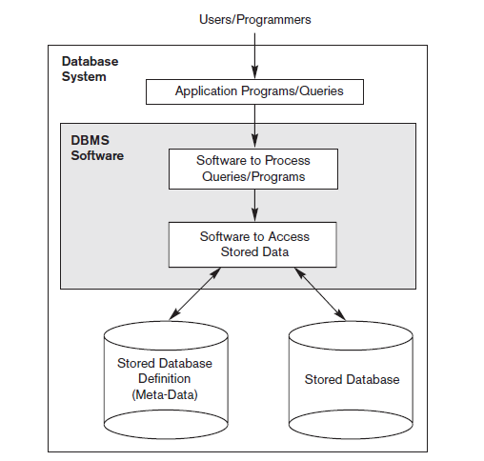
Simplified Database System Environment

Slide 8
Database System Applications
Banking and Finance
Universities
Airlines
Telecommunications
Enterprise Information and so on….

Slide 9
Characteristics of Database Approach
Self-describing nature of a database system
Insulation between programs and data, and data abstraction
Support of multiple views of the data
Sharing of data and multiuser transaction processing

Slide 10
Actors
Database Administrator
DB designers
End users
Casual end user
Naïve or parametric end user
Sophisticated end user
Standalone user
System Analysts and application programmers

Slide 11
Workers behind the scene
Those who work to maintain the database system environment
DBMS system designers and implementers
Tool developers
Operators and maintenance personnel (System Admin)

Slide 12
Advantages of using DBMS approach
Controlling redundancy
Restricting unauthorised access
Providing persistent storage for program objects
Providing storage structures and search techniques for efficient query processing
Providing backup
Providing multiple user interface
Representing complex relationships among data
Enforcing integrity constraints

Slide 13
Data models
One fundamental characteristic of the database approach - data abstraction.
Data abstraction refers to the suppression of details of data organization and storage, and the highlighting of the essential features
To achieve this abstraction, data models are used
A data model—a collection of concepts that can be used to describe the structure of a database
The structure of a database means the data types, relationships, and constraints that apply to the data

Slide 14
Categories of Data Models
High-level or conceptual data models
provide concepts that are close to the way many users perceive data
e.g.,Entity-Relationship model
Low-level or physical data models
provide concepts that describe the details of how data is stored on the computer storage media
meant for computer specialists, not for end users
Representational (or implementation) data models
hide many details of data storage on disk
e.g., Relational model
Sometimes called record-based data models

Slide 15
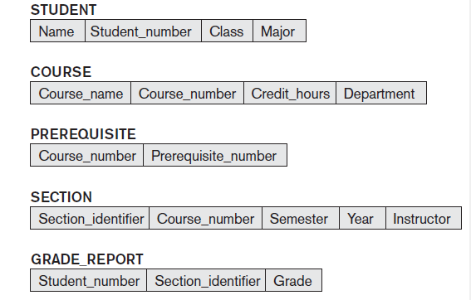
Schema
Database schema - description of a database
specified during database design and is not expected to change frequently

Slide 16
Instances and Database State
The data in the database at a particular moment in time is called a database state or snapshot
It is also called the current set of occurrences or instances in the database
Schema is sometimes called the intension
Database state is called an extension of the schema

Slide 17
Three Schema Architecture
Goal - to separate the user applications from the physical database
schemas can be defined at the following three levels:
Internal level – has an internal schema
describes the physical storage structure of the database.
Uses a physical data model
describes the complete details of data storage and access paths for the database

Slide 18
Three Schema Architecture
Conceptual level – has a conceptual schema
describes the structure of the whole database for a community of users
hides the details of physical storage structures and concentrates on describing entities, data types, relationships, user operations, and constraints.
Uses a representational data model
External or view level - includes a number of external schemas or user views
describes the part of the database that a particular user group is interested in and hides the rest of the database from that user group.
Uses a representational data model

Slide 19
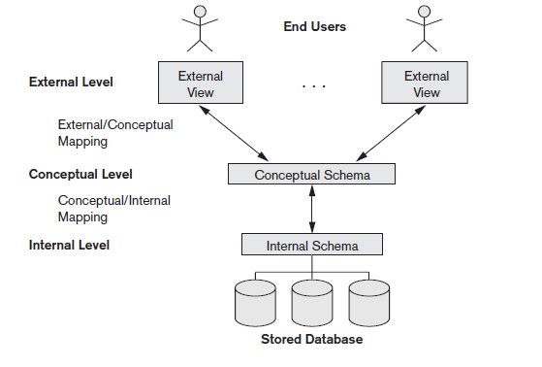
Three Schema Architecture

Slide 20
Data Independence
defined as the capacity to change the schema at one level of a database system without having to change the schema at the next higher level
Two types of data independence
Logical data independence - capacity to change the conceptual schema without having to change external schemas or application programs
Physical data independence - capacity to change the internal schema without having to change the conceptual schema.

Slide 21
Database Languages
Data definition language (DDL) - used by the DBA and by database designers to define schemas
DDL compiler - processes DDL statements and stores the schema description in the DBMS catalog
Data manipulation language (DML)– used for retrieval, insertion, deletion, and modification of the data
Procedural DMLs require a user to specify what data are needed and how to get those data.
Declarative DMLs (also referred to as nonprocedural DMLs) require a user to specify what data are needed without specifying how to get those data

Slide 22
Database Languages
Data Control Language (DCL) - used for granting and revoking user access on a database
Grant: To grant access to user
Revoke: To revoke access from user
Transaction Control Language (TCL)– The changes in the database that we made using DML commands are either performed or rollbacked using TCL
Commit - used to save the transaction on the database
Rollback - used to restore the database to original since the last Commit

Slide 23
DBMS Interfaces
Menu-Based Interfaces for Web Clients or Browsing
Forms-Based Interfaces
Graphical User Interfaces
Natural Language Interfaces
Speech Input and Output
Interfaces for Parametric Users
Interfaces for the DBA

Slide 24
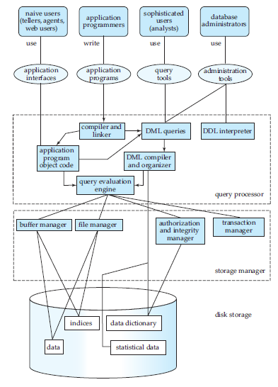
DBMS Component Modules

Slide 25
DBMS Component Modules
The functional components of a database system can be broadly divided into
storage manager component
query processor component
Storage Manager
provides the interface between the low-level data stored in the database and the application programs/queries submitted to the system
translates the various DML statements into low-level file-system commands
responsible for storing, retrieving, and updating data in the database

Slide 26
DBMS Component Modules (contd..)
The storage manager components include:
Authorization and integrity manager
tests for integrity constraints and checks user’s access rights on data
Transaction manager
ensures the consistency of database despite system failures
ensures that the concurrent transaction executions proceed without conflicts
File manager
manages the allocation of storage space and the data structures used to represent information stored on disk.
Buffer manager
fetching data from disk storage into main memory, and deciding what data to cache in main memory
The storage manager implements several data structures as part of the physical system implementation: Data files, Data dictionary, Indices

Slide 27
DBMS Component Modules (contd..)
The query processor components include:
DDL interpreter
interprets DDL statements and records the definitions in the data dictionary
DML compiler
translates DML statements in a query language into evaluation plan consisting of low-level instructions that the query evaluation engine understands
also performs query optimization; that is, it picks the lowest cost evaluation plan from among the alternatives
Query evaluation engine
executes low-level instructions generated by the DML compiler

Slide 28
Database Architecture
The architecture of a database system is greatly influenced by the underlying computer system on which the database system runs.
Database systems can be centralized, or distributed
Centralized, or client-server - server machine executes work on behalf of multiple client machines.
Distributed databases span multiple geographically separated machines.

Slide 29
Centralized and Client/Server Architectures for DBMSs
The client/server architecture was developed to deal with computing environments in which a large number of PCs, workstations, file servers, printers, data base servers, Web servers, e-mail servers, and other software and equipment are connected via a network.
The idea is to define specialized servers with specific functionalities
A client is typically a user machine that provides user interface capabilities and local processing. When it requires access to additional functionality— it connects to a server that provides the needed functionality.
A server is a system containing both hardware and software that can provide services to the client machines, such as file access, printing, archiving, or database access.

Slide 30
Centralized and Client/Server Architectures for DBMSs
Two main types of basic DBMS architectures were created on this underlying client/server framework:
two-tier
three-tier

Slide 31
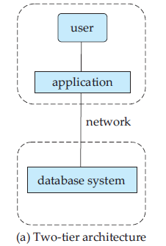
Two-tier Architecture
Application resides at the client machine and it invokes database system functionality at the server machine through query language statements.
API standards like ODBC and JDBC are used for client – server interaction

Slide 32
Three-tier Architecture
Client machine acts as a front end and does not contain any direct database calls
Instead, the client end communicates with an application server, usually through a forms interface
The application server in turn communicates with a database system to access data
The business logic of the application, which says what actions to carry out under what conditions, is embedded in the application server instead of being distributed across multiple clients
Three-tier applications are more appropriate for large applications, and for applications that run on the World Wide Web

Slide 33
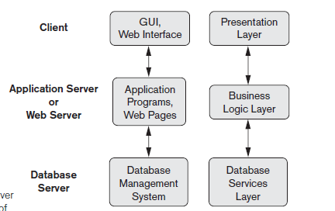
Three-tier Architecture

Slide 34
Classification of DBMS
Classification based on data model
Relational
Hierarchical
Network
Object oriented
XML
Classification based on the number of users
Single user
Multiuser
Classification based on database distribution
Centralized database system
Distributed database system
Homogeneous
Heterogeneous

Slide 35
References
Fundamentals of Database Systems by Ramez Elmasri and Shamkant B.Navathe Pearson Education,2013
Database System Concepts by Abraham Silberschatz, Henry F.Korth and S.Sudarshan, Tata Mc Graw Hill, 2011

