Slide 1
Introduction to Database

Slide 2
Course Outcomes
On completion of this course, student should be able to:
1. Comprehend the role of database management system in an organization and design the structure and operation of the relational data model.
2. Develop a database project depending on the business requirements, considering various design issues.
3. List the concepts of indexing and accessing methods.
4. Explain the concept of a database transaction processing and comprehend the concept of database facilities including concurrency control, backup and recovery.
5. Review the fundamental view on unstructured data and describe other emerging database technologies

Slide 3
Syllabus
Module:1
Database Systems Concepts and Architecture
Need for database systems – Characteristics of Database Approach – Advantages of using DBMS approach - Actors on the Database Management Scene: Database Administrator - Classification of database management systems - Data Models - Schemas and Instances - Three-Schema Architecture - The Database System Environment - Centralized and Client/Server Architectures for DBMSs – Overall Architecture of Database Management Systems

Slide 4
Module:2 Relational Model and E-R Modeling
Relational Model: Candidate Keys, Primary Keys, Foreign Keys - Integrity Constraints - Handling of Nulls - Entity Relationship Model: Types of Attributes, Relationships, Structural Constraints, Relational model Constraints – Mapping ER model to a relational schema – Extended ER Model - Generalization – Specialization – Aggregations

Slide 5
Module:3 Relational Database Design
Database Design – Schema Refinement - Guidelines for Relational Schema - Functional dependencies - Axioms on Functional Dependencies- Normalization: First, Second and Third Normal Forms - Boyce Codd Normal Form, Multi-valued dependency and Fourth Normal form - Join dependency and Fifth Normal form

Slide 6
Module:4 Physical Database Design and Query Processing
File Organization - Indexing: Single level indexing, multi-level indexing, dynamic multilevel Indexing - B+ Tree Indexing – Hashing Techniques: Static and Dynamic Hashing – Relational Algebra - Translating SQL Queries into Relational Algebra - Query Processing – Query Optimization: Algebraic Query Optimization, Heuristic query optimization Rules, Join Query Optimization using Indexing and Hashing - Tuple Relational Calculus.

Slide 7
Module:5 Transaction Processing and Recovery
Introduction to Transaction Processing – Transaction concepts: ACID Properties of Transactions, Transaction States - Serial and Serializable Schedules - Schedules based on recoverability – Schedules based on Serializability - Conflict Serializabilty - Recovery Concepts: Log Based Recovery Protocols, Recovery based on deferred update, Recovery techniques based on immediate update – Shadow Paging Algorithm

Slide 8
Module:6 Concurrency Control In Transaction Processing
Concurrent Transactions – Lost Update Problem - Concurrency Control Techniques: Time Stamp Based Protocols, Thomas Write Rule, Lock Based Protocols, Lock Compatibility Matrix, - Two-Phase Locking Protocol - Lock Conversions - Graph Based Protocols for Concurrency Control - Tree Protocol for Concurrency Control – Deadlocks Based on Locks in Transactions – Deadlock Handling Techniques – Transaction Deadlock Detection Techniques – Transaction Deadlock Prevention Techniques – Multi-Granularity Locking for avoiding Transaction Deadlocks

Slide 9
Module:7 NOSQL Database Management
Introduction, Need of NoSQL, CAP Theorem, different NoSQL data bases: Key-value data stores, Columnar families, Document databases, Graph databases

Slide 10
Module:8
Contemporary Issues

Slide 11
Books
R. Elmasri & S. B. Navathe, Fundamentals of Database Systems, Addison Wesley, 7th Edition, 2016
A. Silberschatz, H. F. Korth & S. Sudarshan, Database System Concepts, McGraw Hill, 7th Edition 2019
Raghu Ramakrishnan, Database Management Systems, Mcgraw-Hill, 4th Edition, 2018
C.J.Date, A.Kannan, S.Swamynathan,” An Introduction to Database Systems”, Pearson, Eighth Edition, 2006
Gerardus Blokdyk, NoSQL Databases A Complete Guide, 5STARCooks, 2021

Slide 12
Introduction to Database
Topics to be covered
Overview of File Systems
Purpose of Database System
View of Data, Database Characteristics
Users of Database System
Advantages of DBMS Approach
Schemas and Instances
Three Schema Architecture
Data Independence
The Database System Environment.

Slide 13
Database Applications Examples
Enterprise Information
Sales: customers, products, purchases
Accounting: payments, receipts, assets
Human Resources: Information about employees, salaries, payroll taxes.
Manufacturing: management of production, inventory, orders, supply chain.
Banking and finance
customer information, accounts, loans, and banking transactions.
Credit card transactions
Finance: sales and purchases of financial instruments (e.g., stocks and bonds; storing real-time market data
Universities: registration, grades
Notes:
13

Slide 14
Database Applications Examples (Cont.)
Airlines: reservations, schedules
Telecommunication: records of calls, texts, and data usage, generating monthly bills, maintaining balances on prepaid calling cards
Web-based services
Online retailers: order tracking, customized recommendations
Online advertisements
Document databases
Navigation systems: For maintaining the locations of varies places of interest along with the exact routes of roads, train systems, buses, etc.
Notes:
14

Slide 15
Overview of File Processing System
In a typical file processing system, each department has its own set of applications and its own files, designed specifically for those applications.
The department itself ,working with the data processing staff, set policies or standards for the format and maintenance of its files.
Computer readable data in file system are kept in files stored on magnetic tape or disk.
Example : lets us take an example of college where student record for examination is stored in one file, admission records on other file and library record is stored in different file that creates many duplicate values like roll Number, Name and Father Name that creates data redundancy.

Slide 16
Overview of File Processing System
It stores data of an organization in group of files.
Files carrying data are independent on each other.
COBOL, C, C++ programming languages were used to design the files.
Each file contains data for some specific area or department like library, student fees, and student examinations.
It is less flexible and has many limitations.
It is very difficult to maintain file processing system.
Any change in one file affects all the files that creates burden on the programmer.
File in Traditional File Processing Systems are called flat files.

Slide 17
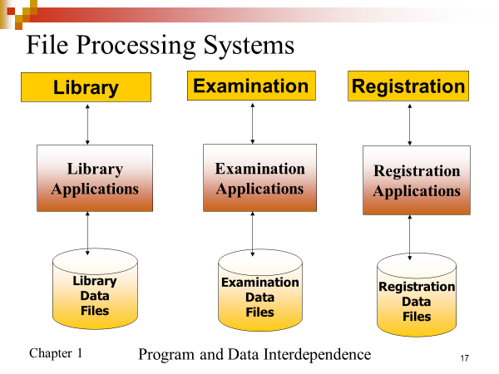
File Processing Systems

Slide 18
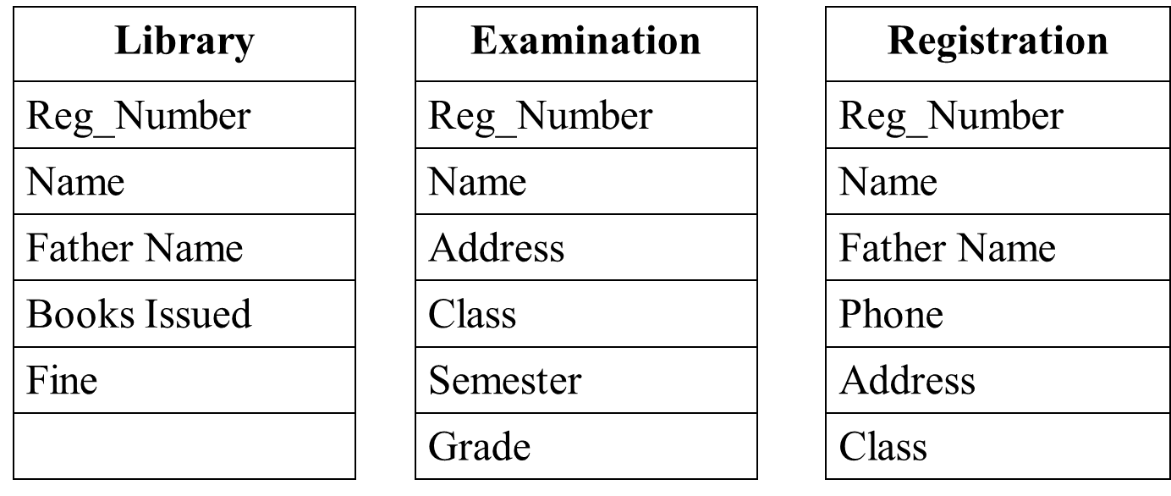
File Processing Systems

Slide 19
Database Systems
DBMS contains information about a particular enterprise
Collection of interrelated data
Set of programs to access the data
An environment that is both convenient and efficient to use
Database systems are used to manage collections of data that are:
Highly valuable
Relatively large
Accessed by multiple users and applications, often at the same time.
A modern database system is a complex software system whose task is to manage a large, complex collection of data.
Databases touch all aspects of our lives
Notes:
19

Slide 20
Introduction to Database
Topics to be covered
Overview of File Systems
Purpose of Database System
View of Data, Database Characteristics
Users of Database System
Advantages of DBMS Approach
Schemas and Instances
Three Schema Architecture
Data Independence
The Database System Environment.

Slide 21
Purpose of Database System
In the early days, database applications were built on top of file systems
Drawbacks of using file systems to store data:
Data redundancy and inconsistency
Multiple file formats, duplication of information in different files
Difficulty in accessing data
Need to write a new program to carry out each new task
Data isolation— multiple files and formats
Integrity problems
Integrity constraints (e.g. account balance > 0) become part of program code
Hard to add new constraints or change existing ones

Slide 22
Purpose of Database Systems (Cont.)
Drawbacks of using file systems (cont.)
Atomicity of updates
Failures may leave database in an inconsistent state with partial updates carried out
E.g. transfer of funds from one account to another should either complete or not happen at all
Concurrent access by multiple users
Concurrent accessed needed for performance
Uncontrolled concurrent accesses can lead to inconsistencies
E.g. two people reading a balance and updating it at the same time
Security problems
Database systems offer solutions to all the above problems

Slide 23
University Database Example
Application program examples
Add new students, instructors, and courses
Register students for courses, and generate class rosters
Assign grades to students, compute grade point averages (GPA) and generate transcripts
In the early days, database applications were built directly on top of file systems
Notes:
23

Slide 24
Basic Definitions
Database: A collection of related data.
Data: Known facts that can be recorded and have an implicit meaning.
Mini-world: Some part of the real world about which data is stored in a database. For example, student grades and transcripts at a university.
Database Management System (DBMS): A software package/ system to facilitate the creation and maintenance of a computerized database.
Database System: The DBMS software together with the data itself. Sometimes, the applications are also included.

Slide 25
Typical DBMS Functionality
Define a particular database in terms of its data types, structures, and constraints
Construct or load the initial database contents on a secondary storage medium
Manipulating the database:
Retrieval: Querying, generating reports
Modification: Insertions, deletions and updates to its content
Accessing the database through Web applications
Processing and Sharing by a set of concurrent users and application programs – yet, keeping all data valid and consistent

Slide 26
Typical DBMS Functionality
Other features:
Protection or Security measures to prevent unauthorized access
Maintaining the database and associated programs over the lifetime of the database application

Slide 27
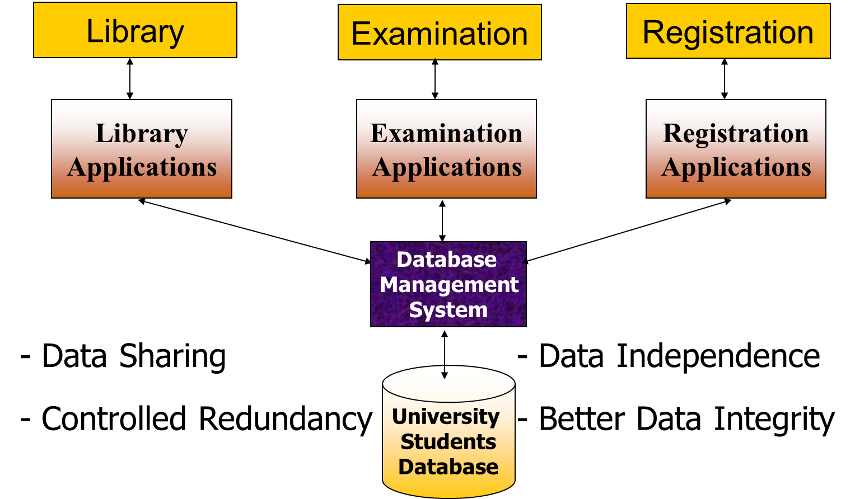
Database Approach

Slide 28

Example of a simple database

Slide 29
Main Characteristics of the Database Approach
Self-describing nature of a database system:
A DBMS catalog stores the description of the database. The description is called meta-data.
This allows the DBMS software to work with different databases.
Insulation between programs and data:
Called program-data independence.
Allows changing data storage structures and operations without having to change the DBMS access programs.

Slide 30
Main Characteristics of the Database Approach
Data Abstraction:
A data model is used to hide storage details and present the users with a conceptual view of the database.
Support of multiple views of the data:
Each user may see a different view of the database, which describes only the data of interest to that user.

Slide 31
Main Characteristics of the Database Approach
Sharing of data and multiuser transaction processing
Allowing a set of concurrent users to retrieve and to update the database.
Concurrency control within the DBMS guarantees that each transaction is correctly executed or completely aborted.
Recovery subsystem ensures each completed transaction has its effect permanently recorded in the database. Similarly, each failed transaction is rolled back

Slide 32
Introduction to Database
Topics to be covered
Overview of File Systems
Purpose of Database System
View of Data, Database Characteristics
Users of Database System
Advantages of DBMS Approach
Schemas and Instances
Three Schema Architecture
Data Independence
The Database System Environment.

Slide 33
Database Users
Users may be divided into two types.
Actors on the Scene
Actually use and control the content
Workers Behind the Scene
Enable the database to be developed and the DBMS software to be designed and implemented

Slide 34
Database Users
Actors on the scene
Database administrators:
Responsible for authorizing access to the database, for coordinating and monitoring its use, acquiring software, and hardware resources, controlling its use and monitoring efficiency of operations.
Database Designers:
Responsible to define the content, the structure, the constraints, and functions or transactions against the database. They must communicate with the end-users and understand their needs.
End-users:
They use the data for queries, reports and some of them actually update the database content.

Slide 35
Categories of End-users
Casual
Access database occasionally when needed
Naïve or Parametric
They make up a large section of the end-user population.
They use previously well-defined functions in the form of “canned transactions” against the database.
Examples are bank-tellers or reservation clerks who do this activity for an entire shift of operations.

Slide 36
Categories of End-users
Sophisticated
These include business analysts, scientists, engineers, others thoroughly familiar with the system capabilities.
Many use tools in the form of software packages that work closely with the stored database.
Stand-alone
Mostly maintain personal databases using ready-to-use packaged applications.
An example is a tax program user that creates his or her own internal database.

Slide 37
Introduction to Database
Concepts:
Overview of File Systems
Purpose of Database System
View of Data, Database Characteristics
Users of Database System
Advantages of DBMS Approach
Schemas and Instances
Three Schema Architecture
Data Independence
The Database System Environment.

Slide 38
Advantages of Using the Database Approach
Controlling redundancy in data storage and in development and maintenance efforts.
Sharing of data among multiple users.
Restricting unauthorized access to data.
Providing persistent storage for program Objects.
In Object-oriented DBMSs

Slide 39
Advantages of using the Database Approach
Providing Storage Structures (e.g. indexes) for efficient Query Processing
Providing backup and recovery services.
Providing multiple interfaces to different classes of users.
Representing complex relationships among data.
Enforcing integrity constraints on the database.
Permitting actions using active rules
triggers, stored procedures

Slide 40
Introduction to Database
Topics to be covered
Overview of File Systems
Purpose of Database System
View of Data, Database Characteristics
Users of Database System
Advantages of DBMS Approach
Schemas and Instances
Three Schema Architecture
Data Independence
The Database System Environment.

Slide 41
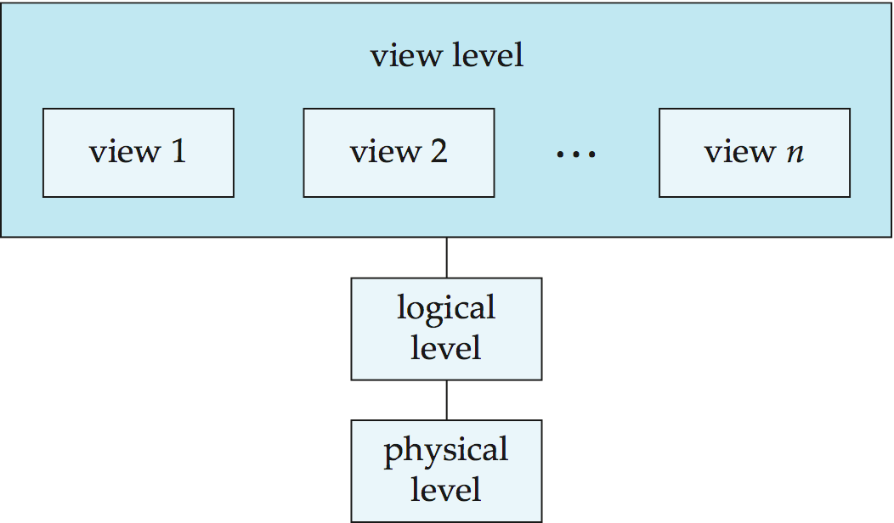
View of Data

Slide 42
Levels of Abstraction
Physical level: describes how a record (e.g., customer) is stored.
Logical level: describes data stored in database, and the relationships among the data.
type instructor = record
ID : string; name : string; dept_name : string; salary : integer;
end;
View level: application programs hide details of data types. Views can also hide information (such as an employee’s salary) for security purposes.
Notes:
42

Slide 43
Database Schema Architecture
external schema: use of data
conceptual schema:meaning of data
internal schema: storage of data
external schema: use of data
conceptual schema:meaning of data
internal schema: storage of data
ASSIGNMENT(ENO,PNO,ENAME,PNAME)
Users
External
Schema
External
view
External
view
External
view
Conceptual
Schema
EMP(ENO: string, ENAME: string, TITLE: string)
PROJ(PNO: string, PNAME: string, BUDGET: integer)
WORKS(ENO: string, PNO: string, RESP: string,
DUR: integer)
Conceptual
view
Internal
Schema
Internal
view
Store all the relations as unsorted files.
Build indexes on EMP(ENO), PROJ(PNO) and
WORKS(ENO,PNO).
DBMS

Slide 44
Simplified database system environment

Slide 45
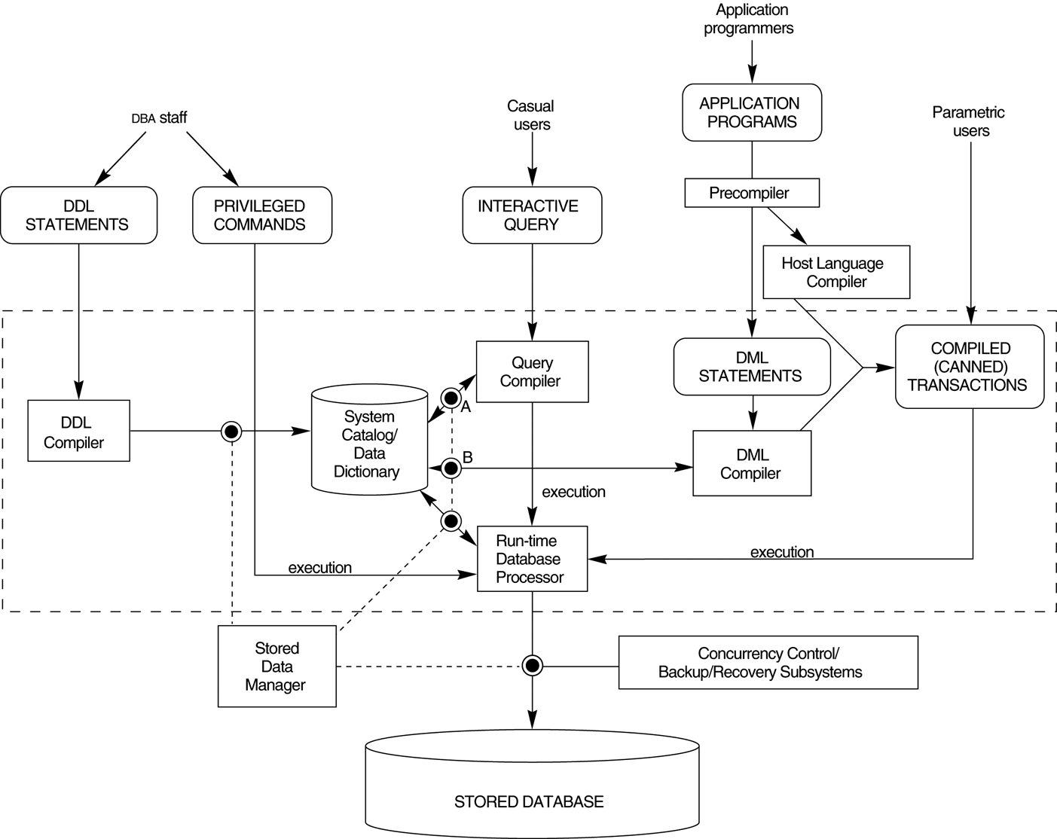
Component modules of a DBMS and their interactions.

Slide 46
The Database System Environment.
The database and the DBMS catalog are usually stored on disk.
Access to the disk is controlled primarily by the operating system (OS), which schedules disk input/output.
stored data manager
Controls access to DBMS information that is stored on disk, whether it is part of the database or the catalog.
The dotted lines and circles marked A, B, C, D, and E illustrate accesses that are under his control.
May use basic OS services for carrying out lowlevel data transfer between the disk and computer main storage
but it controls other aspects of data transfer, such as handling buffers in main memory.

Slide 47
The Database System Environment.
DDL compiler
processes schema definitions, specified in the DDL, and stores descriptions of the schemas (meta-data) in the DBMS catalog.
The catalog includes information such as
The names and sizes of files
Names and data types of data items
Storage details of each file
Mapping information among schemas, and constraints
Other types of information that are needed by the DBMS modules.

Slide 48
The Database System Environment.
Runtime database processor
Handles database accesses at runtime.
It receives retrieval or update operations and carries them out on the database.
Access to disk goes through the stored data manager, and the buffer manager keeps track of the database pages in memory.
The query compiler
handles high-level queries that are entered interactively.
It parses, analyzes, and compiles or interprets a query by creating database access code, and then generates calls to the runtime processor for executing the code.

Slide 49
The Database System Environment.
Precompiler
Extracts DML commands from an application program written in a host programming language.
These commands are sent to the DML compiler for compilation into object code for database access.
The rest of the program is sent to the host language compiler.
The object codes for the DML commands and the rest of the program are linked, forming a canned transaction whose executable code includes calls to the runtime database processor.

Slide 50
Data Models
Data Model:
A set of concepts to describe the structure of a database, the operations for manipulating these structures, and certain constraints that the database should obey.
Data Model Structure and Constraints:
Constructs are used to define the database structure
Constructs typically include elements (and their data types) as well as groups of elements (e.g. entity, record, table), and relationships among such groups
Constraints specify some restrictions on valid data; these constraints must be enforced at all times

Slide 51
Data Models (continued)
Data Model Operations:
These operations are used for specifying database retrievals and updates by referring to the constructs of the data model.
Operations on the data model may include basic model operations (e.g. generic insert, delete, update) and user-defined operations (e.g. compute_student_gpa, update_inventory)

Slide 52
Categories of Data Models
Conceptual (high-level, semantic) data models:
Provide concepts that are close to the way many users perceive data.
Also called entity-based or object-based data models.
Physical (low-level, internal) data models:
Provide concepts that describe details of how data is stored in the computer.
These are usually specified in an ad-hoc manner through DBMS design and administration manuals
Implementation (representational) data models:
Provide concepts that fall between the above two, used by many commercial DBMS implementations
e.g. relational data models used in many commercial systems.

Slide 53
Schemas versus Instances
Database Schema:
The description of a database.
Includes descriptions of the database structure, data types, and the constraints on the database.
Schema Diagram:
An illustrative display of (most aspects of) a database schema.
Schema Construct:
A component of the schema or an object within the schema, e.g., STUDENT, COURSE.

Slide 54
Schemas versus Instances
Database State:
The actual data stored in a database at a particular moment in time. This includes the collection of all the data in the database.
Also called database instance (or occurrence or snapshot).
The term instance is also applied to individual database components, e.g. record instance, table instance, entity instance

Slide 55
Database Schema vs. Database State
Database State:
Refers to the content of a database at a moment in time.
Initial Database State:
Refers to the database state when it is initially loaded into the system.
Valid State:
A state that satisfies the structure and constraints of the database.

Slide 56
Database Schema vs. Database State (continued)
Distinction
The database schema changes very infrequently.
The database state changes every time the database is updated.
Schema is also called intension.
State is also called extension.

Slide 57
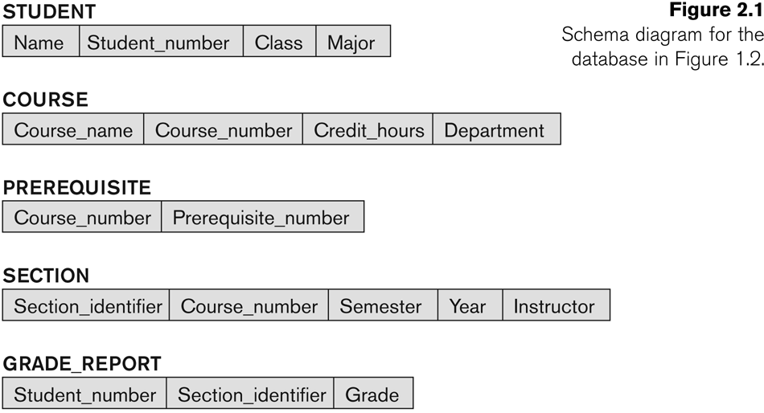
Example of a Database Schema

Slide 58

Example of a database state

Slide 59
Introduction to Database
Topics to be covered
Overview of File Systems
Purpose of Database System
View of Data, Database Characteristics
Users of Database System
Advantages of DBMS Approach
Schemas and Instances
Three Schema Architecture
Data Independence
The Database System Environment.

Slide 60
Three-Schema Architecture
Proposed to support DBMS characteristics of:
Program-data independence.
Support of multiple views of the data.

Slide 61
Three-Schema Architecture
Defines DBMS schemas at three levels:
Internal schema at the internal level to describe physical storage structures and access paths (e.g indexes).
Typically uses a physical data model.
Conceptual schema at the conceptual level to describe the structure and constraints for the whole database for a community of users.
Uses a conceptual or an implementation data model.
External schemas at the external level to describe the various user views.
Usually uses the same data model as the conceptual schema.

Slide 62
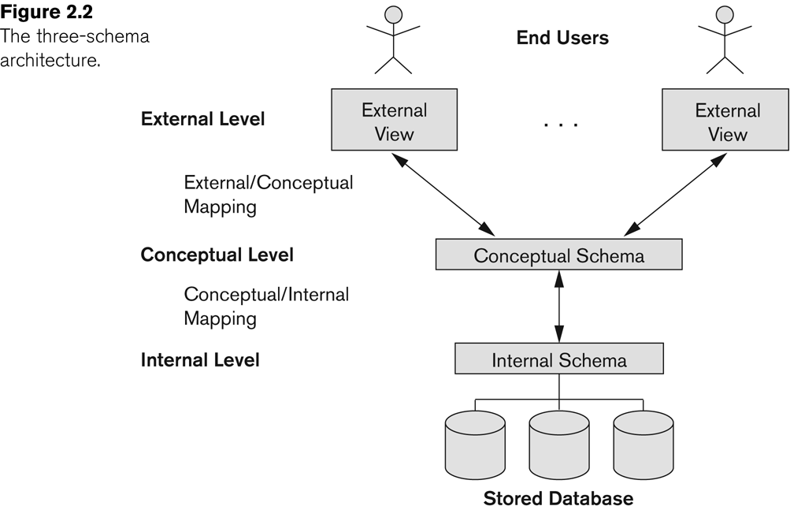
The three-schema architecture

Slide 63
Three-Schema Architecture
Mappings among schema levels are needed to transform requests and data.
Programs refer to an external schema, and are mapped by the DBMS to the internal schema for execution.
Data extracted from the internal DBMS level is reformatted to match the user’s external view (e.g. formatting the results of an SQL query for display in a Web page)

Slide 64
Introduction to Database
Topics to be covered
Overview of File Systems
Purpose of Database System
View of Data, Database Characteristics
Users of Database System
Advantages of DBMS Approach
Schemas and Instances
Three Schema Architecture
Data Independence
The Database System Environment.

Slide 65
Data Independence
Logical Data Independence:
The capacity to change the conceptual schema without having to change the external schemas and their associated application programs.
Physical Data Independence:
The capacity to change the internal schema without having to change the conceptual schema.
For example, the internal schema may be changed when certain file structures are reorganized or new indexes are created to improve database performance

Slide 66
Data Independence (continued)
When a schema at a lower level is changed, only the mappings between this schema and higher-level schemas need to be changed in a DBMS that fully supports data independence.
The higher-level schemas themselves are unchanged.
Hence, the application programs need not be changed since they refer to the external schemas.

