Slide 1
CSE2005 – Database Management Systems
Module 1: Fundamental Concepts & Architecture

Slide 2
Module 1
Module:1 | Fundamental Concepts and Architecture:
Introduction to database system, Characteristics of the Database Approach, Actors on the Scene, Workers behind the Scene, Advantages of Using the DBMS Approach, Data Models, Schemas, and Instances, Three-Schema Architecture and Data Independence, Database Languages and Interfaces, The Database System Environment, Classification of Database Management Systems

Slide 3
Book(s)
Text Book:
  Fundamentals of Database Systems by Ramez Elmasri and Shamkant B.Navathe Pearson Education,2013.
Reference Books:
  Database Management Systems by Raghu Rama Krishnan, Tata Mcgraw Hill, 2010.
  Database System Concepts by Abraham Silberschatz, Henry F.Korth and S.Sudarshan, Tata Mc Graw Hill, 2011
  Database System Design and Implementation by Rob Cornell,cennage learning, 2011

Slide 4
Acknowledgement
Profound thanks to the authors of the book: Fundamentals of Database Systems by Ramez Elmasri and Shamkant B.Navathe Pearson Education,2013. as the content of the book were helpful in preparing this presentation.

Slide 5

Basic Definitions
Database
Data
Mini-world
Database management System (DBMS)
Database System
Image Source: https://www.theteflcentre.com/news/skills-reading-6-tasks-for-reading-activities-matching-words-to-definitions

Slide 6
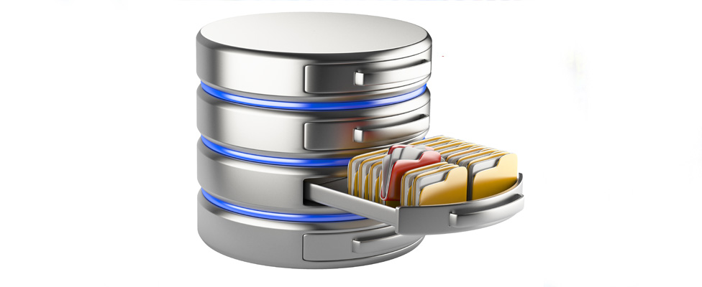
Basic Definitions
Database
A collection of related data.
Image Source: https://tdwi.org/articles/2019/03/11/dtw-all-five-database-requirements-for-digital-transformation.aspx

Slide 7

Basic Definitions
Data
Known facts that can be recorded and have an implicit meaning.
Image Source: https://analyticsindiamag.com/10-best-data-cleaning-tools-get-data/

Slide 8

Basic Definitions
Mini-World
Some part of the real world about which data is stored in a database. For example, student grades and transcripts at a university.
Image Source: https://store.steampowered.com/app/814480/Mini_World_Block_Art/

Slide 9
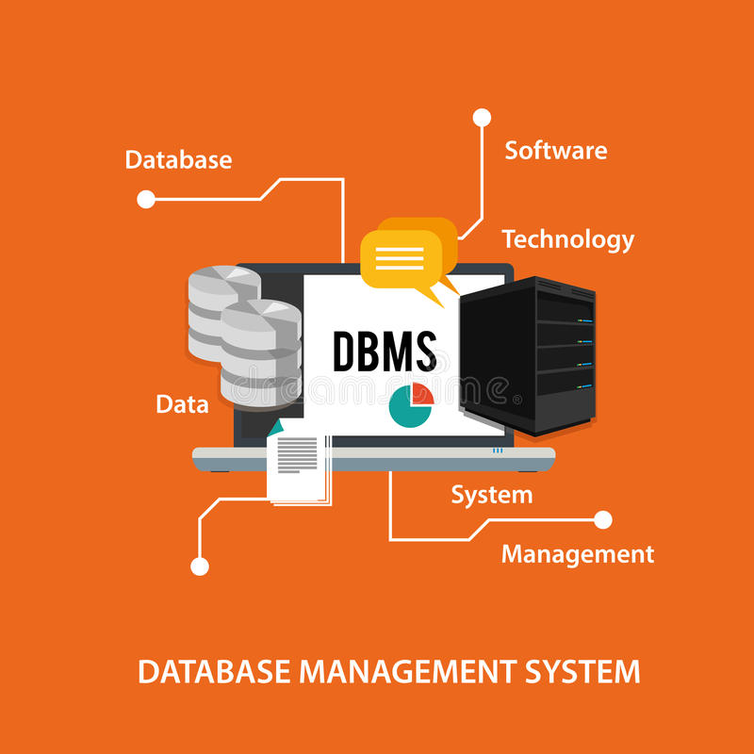
Basic Definitions
Database Management System
A software package/ system to facilitate the creation and maintenance of a computerized database.
Image Source: https://www.webinhindi.com/2019/04/what-is-dbms-in-hindi.html

Slide 10
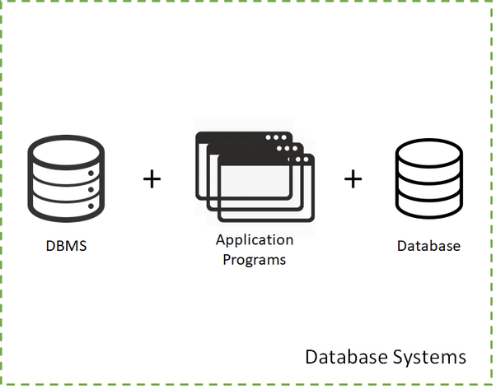
Basic Definitions
Database System
The DBMS software together with the data itself. Sometimes, the applications are also included.
Image Source: https://www.quora.com/What-is-database-system

Slide 11
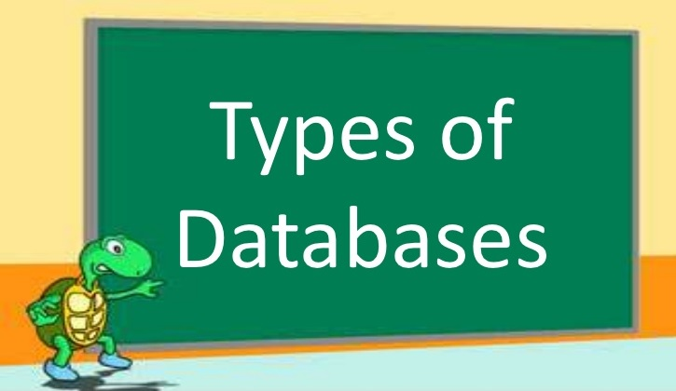
Types of Databases and Database Applications
Image Source: https://www.slideshare.net/PAQUIAAIZEL/types-of-databases

Slide 12
Types of Databases and Database Applications
Traditional Applications:
  Numeric and Textual Databases
More Recent Applications:
  Multimedia Databases
  Geographic Information Systems (GIS)
  Data Warehouses
  Real-time and Active Databases
  Many other applications

Slide 13
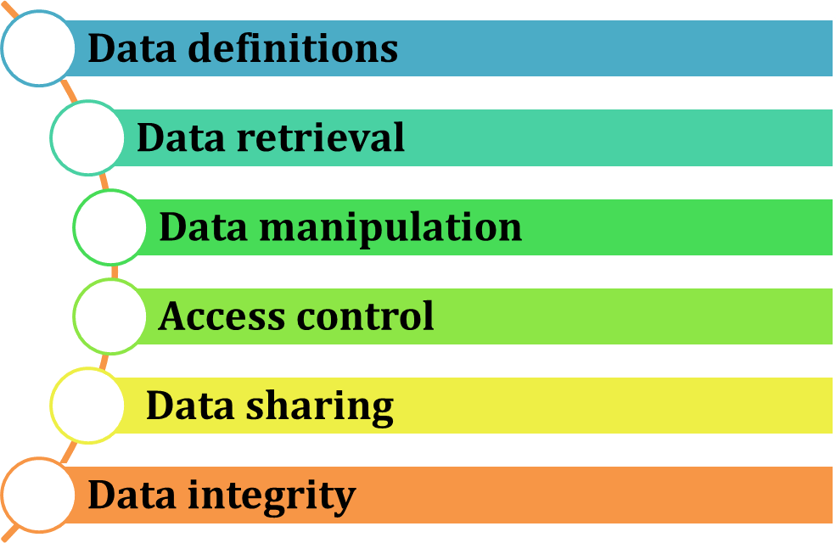
Typical Database Functionalities

Slide 14
Example of a Database
Mini-world for the example:
  Part of a UNIVERSITY environment.
Some mini-world entities:
  STUDENTs
  COURSEs
  SECTIONs (of COURSEs)
  (academic) DEPARTMENTs
  INSTRUCTORs

Slide 15
Example of a Database
Some mini-world relationships:
  SECTIONs are of specific COURSEs
  STUDENTs take SECTIONs
  COURSEs have prerequisite COURSEs
  INSTRUCTORs teach SECTIONs
  COURSEs are offered by DEPARTMENTs
  STUDENTs major in DEPARTMENTs

Slide 16
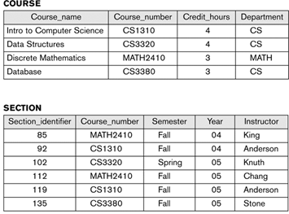
Example of a Database
Image Source: Ramez Elmasri and Shamkant B. Navathe

Slide 17
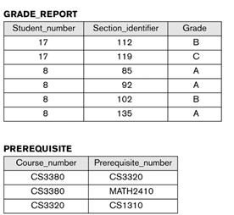
Example of a Database
Image Source: Ramez Elmasri and Shamkant B. Navathe

Slide 18

Characteristics of Database Approach
Self-describing nature of a database system:
  A DBMS catalog stores the description of a particular database (e.g. data structures, types, and constraints)
  The description is called meta-data.
  This allows the DBMS software to work with different database applications.
Image Source: https://www.quora.com/How-should-I-write-my-self-description-in-SSB-interviews

Slide 19

Characteristics of Database Approach
Insulation between programs and data:
  Called program-data independence.
  Allows changing data structures and storage organization without having to change the DBMS access programs.
Image Source: https://www.indiamart.com/proddetail/insulation-tape-19584466491.html

Slide 20

Characteristics of Database Approach
Data Abstraction:
  A data model is used to hide storage details and present the users with a conceptual view of the database.
  Programs refer to the data model constructs rather than data storage details.
Image Source: https://www.hitechnectar.com/blogs/data-abstraction-level/

Slide 21
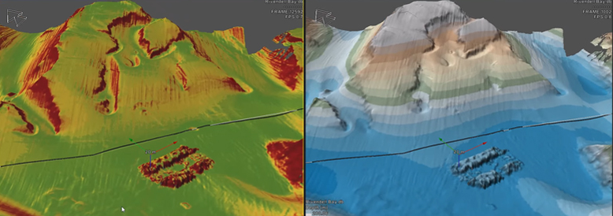
Characteristics of Database Approach
Support of multiple views of the data:
  Each user may see a different view of the database, which describes only the data of interest to that user.

Slide 22
Characteristics of Database Approach
Sharing of data and multi-user transaction processing:
  Allowing a set of concurrent users to retrieve from and to update the database.
  Concurrency control within the DBMS guarantees that each transaction is correctly executed or aborted
  Recovery subsystem ensures each completed transaction has its effect permanently recorded in the database
  OLTP (Online Transaction Processing) is a major part of database applications. This allows hundreds of concurrent transactions to execute per second.

Slide 23

Database Users
Users may be divided into
  Those who actually use and control the database content, and those who design, develop and maintain database applications (called “Actors on the Scene”)
  Those who design and develop the DBMS software and related tools, and the computer systems operators (called “Workers Behind the Scene”).
Image Source: https://www.iconfinder.com/icons/85409/users_icon

Slide 24

Actors on the Scene
  Database administrators:
    Responsible for authorizing access to the database, for coordinating and monitoring its use, acquiring software and hardware resources, controlling its use and monitoring efficiency of operations.
Image Source: https://www.dataversity.net/so-you-want-to-be-a-database-administrator/

Slide 25
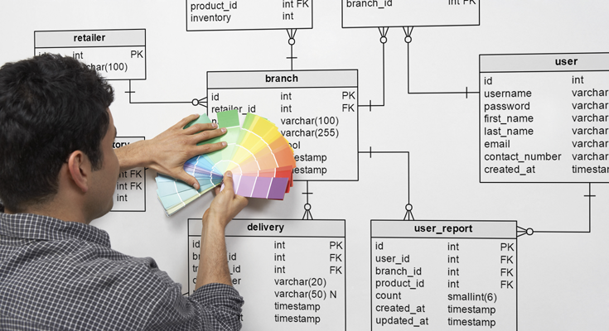
Actors on the Scene
  Database Designers:
    Responsible to define the content, the structure, the constraints, and functions or transactions against the database. They must communicate with the end-users and understand their needs.
Image Source: https://www.cybertec-postgresql.com/en/services/postgresql-design/postgresql-database-modeling/

Slide 26

Actors on the Scene
  End-users: They use the data for queries, reports and some of them update the database content. End-users can be categorized into:
    Casual: access database occasionally when needed
    Naive or Parametric: they make up a large section of the end-user population.
      Examples are bank-tellers or reservation clerks who do this activity for an entire shift of operations.
Image Source: http://dinesql.blogspot.com/2015/10/types-of-database-end-users.html

Slide 27

Actors on the Scene
    Sophisticated:
      These include business analysts, scientists, engineers, others thoroughly familiar with the system capabilities.
      Many use tools in the form of software packages that work closely with the stored database.
Image Source: https://knowyourmeme.com/photos/1698903-computer-reaction-faces

Slide 28
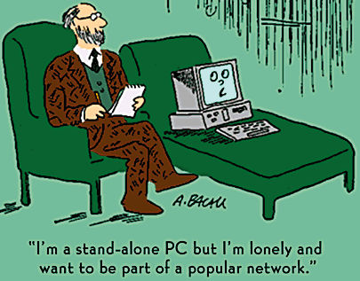
Actors on the Scene
    Stand-alone:
      Mostly maintain personal databases using ready-to-use packaged applications.
      An example is a tax program user that creates its own internal database.
      Another example is a user that maintains an address book.
Image Source: https://www.yourdictionary.com/stand-alone-pc

Slide 29

Workers behind the Scene
    DBMS System Designers and Implementers
      Design and implement DBMS modules and interfaces as a software package.
    Tool Developers
      They design and implement tools which include software packages that facilitate database modelling and design, database system design and improved performance.
Image Source: https://www.yourdictionary.com/stand-alone-pc

Slide 30
Workers behind the Scene
  Operators and Maintenance Personnel
    Responsible for actual running and maintenance of the hardware and software environment for the database system.
Image Source: https://www.yourdictionary.com/stand-alone-pc

Slide 31
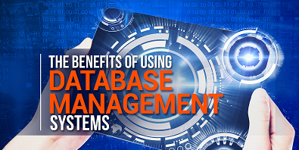
Advantages of Database Approach
Controlling redundancy in data storage and in development and maintenance efforts.
  Sharing of data among multiple users.
Restricting unauthorized access to data.
Providing persistent storage for program Objects
Image Source: https://www.ringlead.com/blog/the-benefits-of-using-database-management-systems

Slide 32
Advantages of Database Approach
Providing Storage Structures (e.g. indexes) for efficient Query Processing.
Providing backup and recovery services.
Providing multiple interfaces to different classes of users.
Representing complex relationships among data.
Image Source: https://www.ringlead.com/blog/the-benefits-of-using-database-management-systems

Slide 33
Advantages of Database Approach
Enforcing integrity constraints on the database.
Drawing inferences and actions from the stored data using deductive and active rules.
Potential for enforcing standards.
Reduced application development time.
Image Source: https://www.ringlead.com/blog/the-benefits-of-using-database-management-systems

Slide 34
Advantages of Database Approach
Flexibility to change data structures.
Availability of current information.
Economies of scale:
  Wasteful overlap of resources and personnel can be avoided by consolidating data and applications across departments
Image Source: https://www.ringlead.com/blog/the-benefits-of-using-database-management-systems

Slide 35
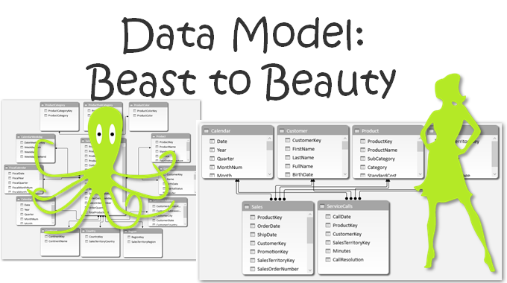
Data Models
Data Model:
  A set of concepts to describe the structure of a database, the operations for manipulating these structures, and certain constraints that the database should obey.
Image Source: https://powerpivotpro.com/2016/02/data-modeling-power-pivot-power-bi/

Slide 36
Data Model Structure and Constraints
  Constructs are used to define the database structure
  Constructs typically include elements (and their data types) as well as groups of elements (e.g. entity, record, table), and relationships among such groups
  Constraints specify some restrictions on valid data; these constraints must be enforced at all times

Slide 37
Data Model Operations
  These operations are used for specifying database retrievals and updates by referring to the constructs of the data model.
  Operations on the data model may include basic model operations (e.g. generic insert, delete, update) and user-defined operations (e.g. compute_student_gpa, update_inventory).

Slide 38
Data Model - Categories
Conceptual (high-level, semantic) data models:
  Provide concepts that are close to the way many users perceive data.
    (Also called entity-based or object-based data models.)
Physical (low-level, internal) data models:
  Provide concepts that describe details of how data is stored in the computer.
Implementation (representational) data models:
  Provide concepts that fall between the above two, used by many commercial DBMS implementations.

Slide 39
Schema vs Instances
Database Schema:
  The description of a database.
  Includes descriptions of the database structure, data types, and the constraints on the database.
Schema Diagram:
  An illustrative display of (most aspects of) a database schema.
Schema Construct:
  A component of the schema or an object within the schema, e.g., STUDENT, COURSE.

Slide 40
Schema vs Instances
Database State:
  The actual data stored in a database at a particular moment in time. This includes the collection of all the data in the database.
  Also called database instance (or occurrence or snapshot).
    The term instance is also applied to individual database components, e.g. record instance, table instance, entity instance.

Slide 41
Database Schema vs State
Database State:
  Refers to the content of a database at a moment in time.
Initial Database State:
  Refers to the database state when it is initially loaded into the system.
Valid State:
  A state that satisfies the structure and constraints of the database.

Slide 42
Database Schema vs State
Distinction
  The database schema changes very infrequently.
  The database state changes every time the database is updated.
Schema is also called intension.
State is also called extension.

Slide 43
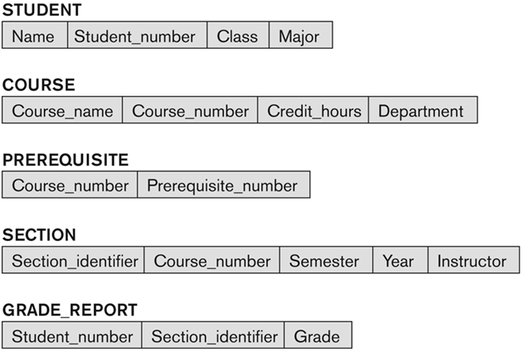
Database Schema - Example
Image Source: Ramez Elmasri and Shamkant B. Navathe

Slide 44
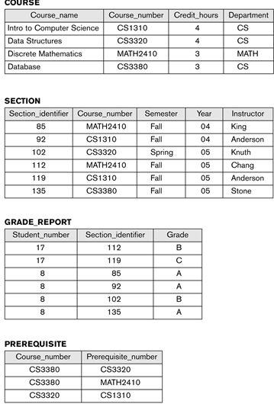
Database State - Example
Image Source: Ramez Elmasri and Shamkant B. Navathe

Slide 45
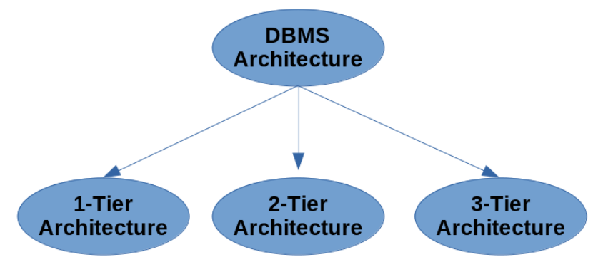
DBMS Architecture
DBMS design depends upon its architecture.
Client/server architecture is used to deal with a large number of PCs, web servers, database servers and other components that are connected with networks.
Client/server architecture consists of many PCs and a workstation which are connected via the network.

Slide 46

1- Tier Architecture
In this architecture, the database is directly accessed by the user.
Any changes will be performed over the database itself.
Used for development of the local application, where programmers can directly communicate with the database for the quick response.
Image Source: guru99.com

Slide 47
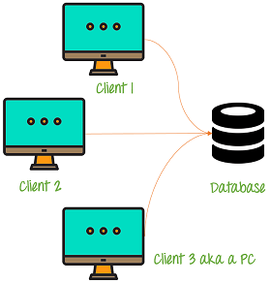
2 - Tier Architecture
It is basic client-server. But Applications on the client end can directly communicate with the database at the server side.
For this interaction, API’s like: ODBC, JDBC are used. The user interfaces and application programs are run on the client-side.
The server side is responsible to provide the functionalities like: query processing and transaction management.
To communicate with the DBMS, client-side application establishes a connection with the server side.
Image Source: guru99.com

Slide 48
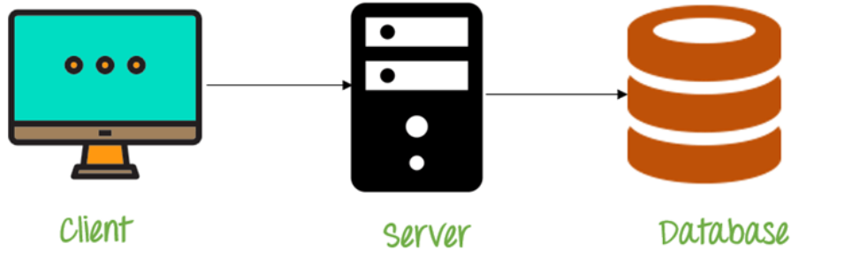
3 - Tier Architecture
The 3-Tier architecture contains another layer between the client and server.
In this architecture, client can’t directly communicate with the server.
The application on the client-end interacts with an application server which further communicates with the database system.
End user has no idea about the existence of the database beyond the application server and the database also has no idea about any other user beyond the application.
The 3-Tier architecture is used in case of large web application.
Image Source: guru99.com

Slide 49
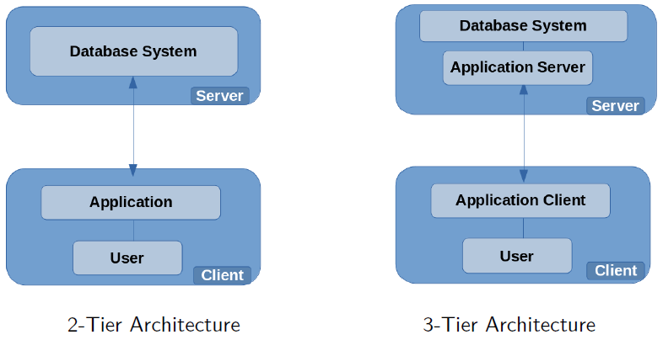
Comparing 2 - Tier & 3 - Tier Architecture

Slide 50
Three Schema Architecture
It is also called ANSI/SPARC architecture or 3-level architecture.
It is used to describe the structure of a specific database system.
It is also used to separate the user applications and physical database.
It contains 3-levels. It breaks the database down into three different
categories.
  Internal Level: Actual PHYSICAL storage structure and access paths.
  Conceptual or Logical Level: Structure and constraints for the entire database
  External or View level: Describes various user views

Slide 51
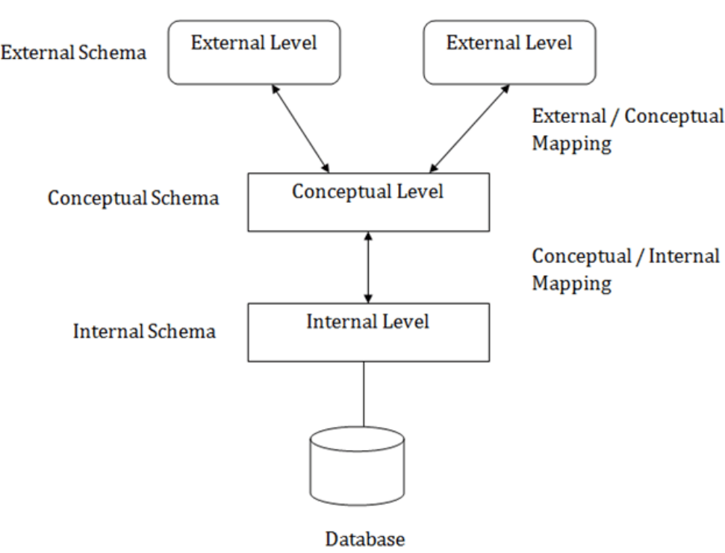
Three Schema Architecture

Slide 52
Three Schema Architecture – Internal Schema
Internal level/Schema : It defines the physical storage structure of the database. It is a very low-level representation of the entire database.
It contains multiple occurrences of multiple types of internal records. In the ANSI term, it is also called "stored record".
Facts about Internal schema:
The internal schema is the lowest level of data abstraction.
It helps you to keep information about the actual representation of the entire database. It is similar to the actual storage of the data on the disk in theform of records
The internal view tells us what data is stored in the database and how its stored.
It never deals with the physical devices. Instead, internal schema views a physical device as a collection of physical pages.

Slide 53
Three Schema Architecture – Conceptual Schema
Conceptual Schema/Level :
It describes the Database structure of the whole database for the community of users.
It hides information about the physical storage structures and focuses on describing data types, entities, relationships, etc.
This logical level comes between the user level and physical storage view.
However, there is only single conceptual view of a single database.
Facts about Conceptual schema:
Defines all database entities, their attributes, and their relationships.
Security and integrity information.
In the conceptual level, the data available to a user must be contained in or derivable from the physical level.

Slide 54
Three Schema Architecture – External Schema
External Schema/Level :
It describes the part of the database which specific user is interested in & hides the unrelated details of the database from the user.
There may be "n" number of external views for each database.
Each external view is defined using an external schema, which consists of definitions of various types of external record of that specific view.
An external view is just the content of the database as it is seen by some specific particular user.
For example, a user from the sales department will see only sales related data.

Slide 55
Objectives of Three Schema Architecture
An external level is only related to the data which is viewed by specific end users.
This level includes some external schemas.
External schema level is nearest to the user.
The external schema describes the segment of the database which is needed for a certain user group and hides the remaining details from the database from the specific user group.

Slide 56
Objectives of Three Schema Architecture
An external level is only related to the data which is viewed by specific end users.
This level includes some external schemas.
External schema level is nearest to the user.
The external schema describes the segment of the database which is needed for a certain user group and hides the remaining details from the database from the specific user group.

Slide 57
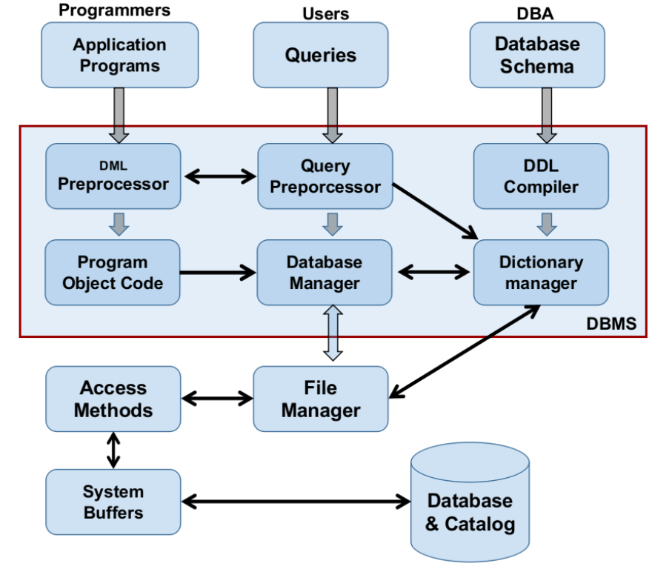
DBMS Components

Slide 58
DBMS Components
DML : DML processor must interact with the query processor to generate the appropriate code
DDL interacts with Data Dictionary/ System Catalog
System Catalog : It is a collection of tables and views that contain important information about a database. It is available for each database. It defines the structure of the database.
For example, the DDL (data dictionary language) for all tables in the database is stored in the system catalog.
Query processor : It transforms user queries into a series of low level instructions. It is used to interpret the online user’s query and convert it into an efficient series of operations in a form capable of being sent to the run time data manager for execution.

Slide 59
DBMS Components
It uses the data dictionary to find the structure of the relevant portion of the database and uses this information in modifying the query and preparing and optimal plan to access the database.
Data Dictionary : It contains all the information about the database. As the name suggests, it is the dictionary of all the data items. It contains description of all the tables, view, materialized views, constraints, indexes, triggers etc.

Slide 60
DBMS – Data Models
Data Models define how the logical structure of a database is modeled.
They are fundamental entities to introduce abstraction in a DBMS.
They define how data is connected to each other and how they are processed and stored inside the system.
The very first data model could be flat data-models, where all the data used are to be kept in the same plane.
Earlier data models were not so scientific, hence they were prone to introduce lots of duplication and update anomalies.

Slide 61
Data Models - Categories
Conceptual (high-level, semantic) data models: Provide concepts that are close to the way many users perceive data. (Also called entity-based or object-based data models.)
Physical (low-level, internal) data models: Provide concepts that describe details of how data is stored in the computer.
Implementation (representational) data models: Provide concepts that fall between the above two, balancing user views with some computer storage details.

Slide 62
Data Independence
Data Independence is defined as a property of DBMS that helps the user to change the Database schema at one level of a database system without requiring to change the schema at the next higher level.
Data independence helps the user to keep data separated from all programs that make use of it.
Types of Data Independence
  Physical Data Independence
  Logical Data Independence

Slide 63
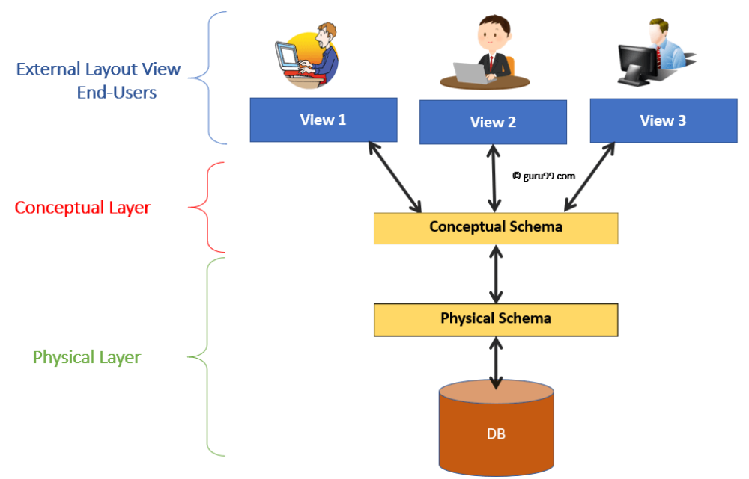
Levels of Database

Slide 64
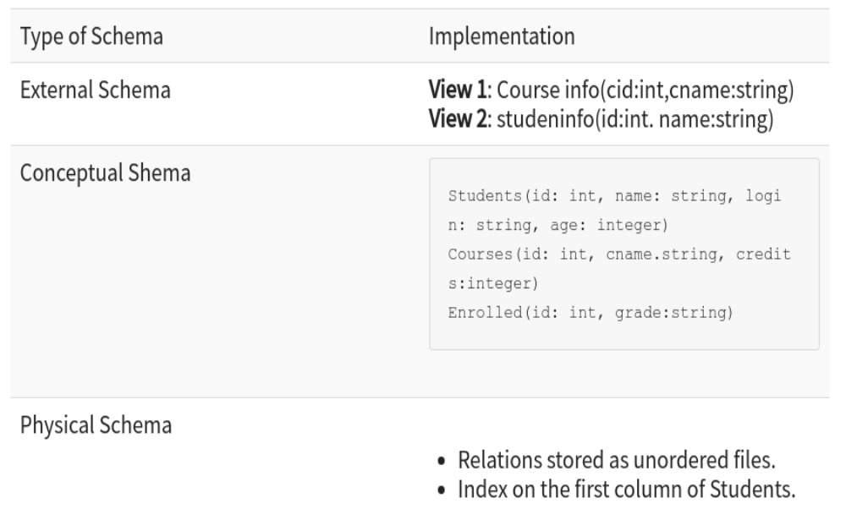
Levels of Database

Slide 65
Physical Data Independence
Physical Data Independence : Change internal schema without having to change conceptual schema. i.e can easily change the physical storage structures or devices with an effect on the conceptual schema.
It helps user to separate conceptual levels from the Internal/Physical levels.
It allows user to provide a logical description of the database without the need to specify physical structures.
It is achieved by the presence of the internal level of the database and then the transformation from the conceptual level of the database to the internal level.

Slide 66
Benefits of Physical Data Independence
Due to Physical independence, any of the below changes will not affect the conceptual layer:
Using a new storage device like Hard Drive or Magnetic Tapes
Modifying the file organization technique in the Database
Switching to different data structures.
Changing the access method. Modifying indexes.
Changes to compression techniques or hashing algorithms.
Change of Location of Database from say C drive to D Drive

Slide 67
Logical Data Independence
Logical Data Independence is the ability to change the conceptual
scheme without changing :
  External views
  External API or programs
Any change made will be absorbed by the mapping between external and conceptual levels.
When compared to Physical Data independence, it is challenging to achieve logical data independence.
Due to Logical independence, any of the below change will not affect the external layer.
  Add/Modify/Delete a new attribute, entity or relationship is possible without a rewrite of existing application programs.
  Merging two records into one.
  Breaking an existing record into two or more records.

Slide 68
Benefits of Logical Data Independence
Helps user to improve the quality of the data.
Database system maintenance becomes affordable.
Enforcement of standards and improvement in database security.
User does not need to alter data structure in application programs.
Permits developer to focus on the general structure of the Database rather than worrying about the internal implementation.
It allows user to improve state which is undamaged or undivided.
Database incongruity is vastly reduced.
Easily make modifications in the physical level is needed to improve the performance of the system.

Slide 69
Benefits of Logical Data Independence
Helps user to improve the quality of the data.
Database system maintenance becomes affordable.
Enforcement of standards and improvement in database security.
User does not need to alter data structure in application programs.
Permits developer to focus on the general structure of the Database rather than worrying about the internal implementation.
It allows user to improve state which is undamaged or undivided.
Database incongruity is vastly reduced.
Easily make modifications in the physical level is needed to improve the performance of the system.

Slide 70
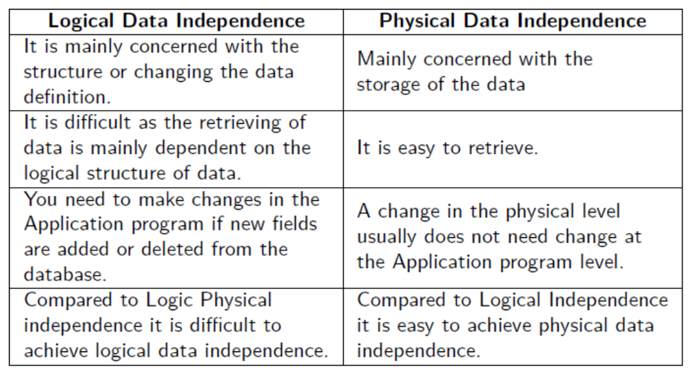
Physical vs. Logical Data Independence

Slide 71
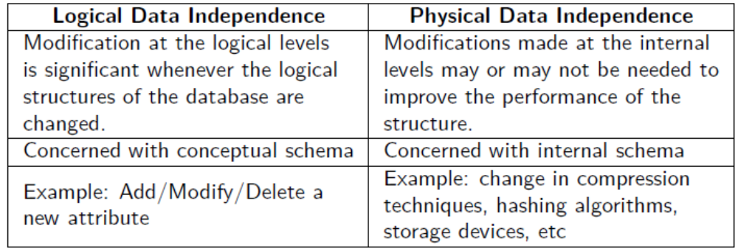
Physical vs. Logical Data Independence

Slide 72
DBMS Languages
Data Definition Language (DDL) allows the DBA or user to describe and name entities, attributes, and relationships required for the application plus any associated integrity and security constraints.
Data Manipulation Language (DML) provides basic data manipulation operations on data held in the database.
Data Control Language (DCL) defines activities that are not in the categories of those for the DDL and DML, such as granting privileges to users, and defining when proposed changes to a databases should be irrevocably made.
Low Level or Procedural DML: allow user to tell system exactly how to manipulate data (e.g., Network and hierarchical DMLs).
High Level or Non-procedural DML(declarative language): allow user to state what data is needed rather than how it is to be retrieved (e.g., SQL, QBE).

Slide 73
History of Data Models
Relational Model: proposed in 1970 by E.F. Codd (IBM), first commercial system in 1981-82. Now in several commercial products (DB2, ORACLE, SQL Server, SYBASE, INFORMIX).
Network Model: the first one to be implemented by Honeywell in 1964-65 (IDS System). Adopted heavily due to the support by CODASYL (CODASYL - DBTG report of 1971). Later implemented in a large variety of systems - IDMS (Cullinet - now CA), DMS 1100 (Unisys), IMAGE (H.P.), VAX -DBMS (Digital Equipment Corp.).
Hierarchical Data Model: implemented in a joint effort by IBM and North American Rockwell around 1965. Resulted in the IMS family of systems. The most popular model. Other system based on this model: System 2k (SAS inc.)

Slide 74
History of Data Models
Object-oriented Data Model(s):
  Several models have been proposed for implementing in a database system. One set comprises models of persistent O-O Programming Languages such as C++ (e.g., in OBJECTSTORE or VERSANT), and Smalltalk (e.g., in GEMSTONE).
  Additionally, systems like O 2, ORION (at MCC - then ITASCA), IRIS (at H.P.- used in Open OODB).
Object-Relational Models:
  Most Recent Trend. Started with Informix Universal Server. Exemplified in the latest versions of Oracle-10i, DB2, and SQL Server etc. systems.

Slide 75
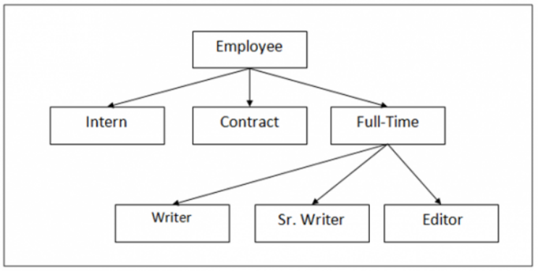
Hierarchical Data Model
In Hierarchical Model, a hierarchical relation is formed by collection of relations and forms a tree-like structure.
The relationship can be defined in the form of parent child type.
One of the first and most popular Hierarchical Model is Information Management System (IMS), developed by IBM.

Slide 76
Hierarchical Data Model - Merits and Demerits
Merits
  The design of the hierarchical model is simple.
  Provides Data Integrity since it is based on parent/ child relationship
  Data sharing is feasible since the data is stored in a single database.
  Even for large volumes of data, this model works perfectly.
De-Merits
  Implementation is complex.
  This model has to deal with anomalies like Insert, Update and Delete.
  Maintenance is difficult since changes done in the database may want you to do changes in the entire database structure.

Slide 77
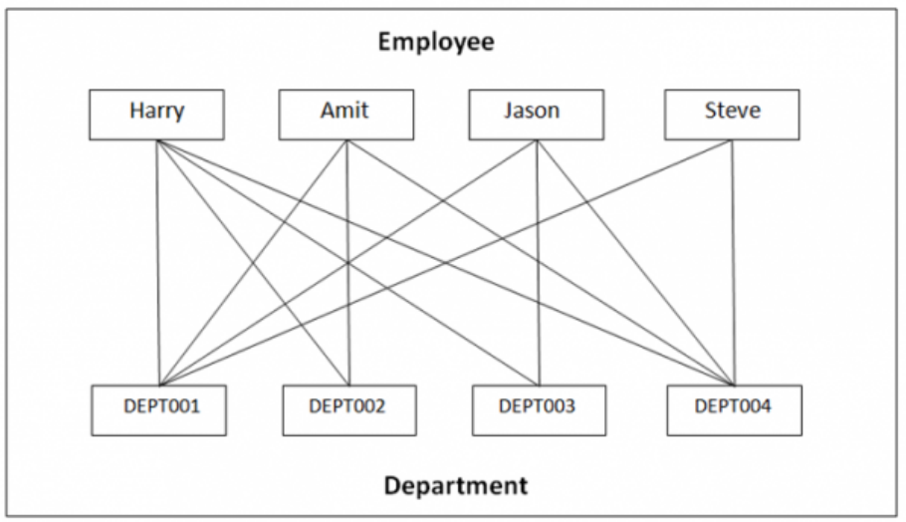
Network Data Model
The Hierarchical Model creates hierarchical tree with parent/ child relationship, whereas the Network Model has graph and links.
The relationship can be defined in the form of links and it handles many-to-many relations. This itself states that a record can have more than one parent.

Slide 78
Network Data Model - Merits and Demerits
Merits
  Easy to design the Network Model
  The model can handle one-one, one-to-many, many-to-many relationships.
  It isolates the program from other details.
  Based on standards and conventions.
De-Merits
  Pointers bring complexity since the records are based on pointers and graphs.
  Changes in the database isn’t easy that makes it hard to achieve structural independence.

Slide 79
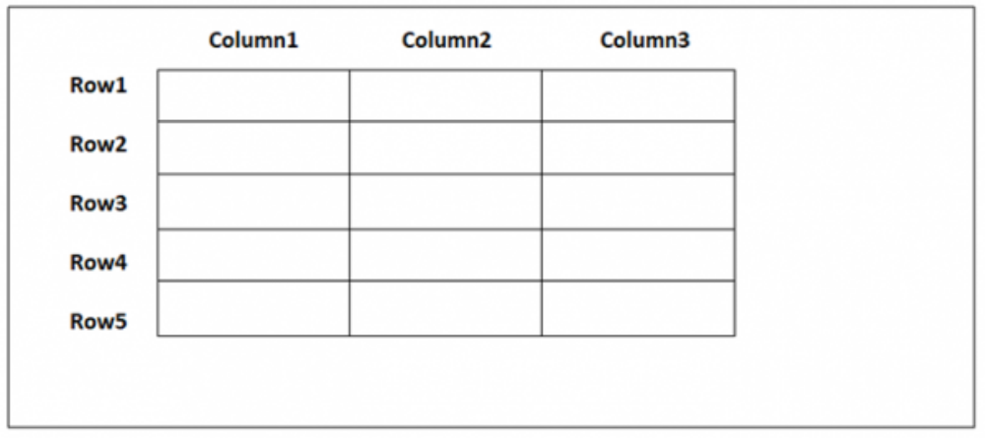
Relational Data Model
A Relational model groups data into one or more tables. These tables are related to each other using common records.
The data is represented in the form of rows and columns i.e. tables.

Slide 80
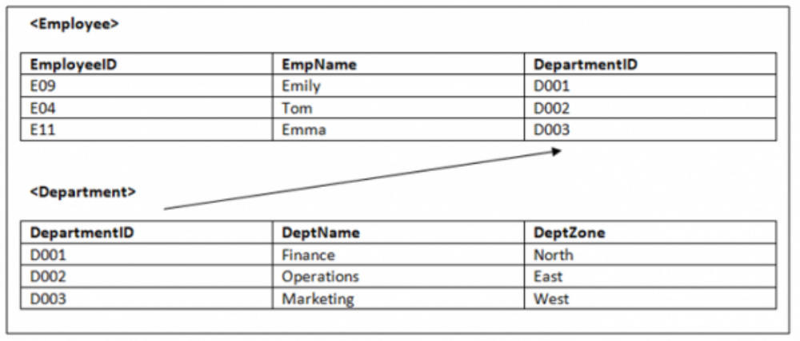
Relational Data Model
Example : Let us see an example of two relations <Employee> and <Department> linked to each other, with DepartmentID, which is Foreign Key of <Employee> table and Primary key of <Department> table.

Slide 81
Relational Data Model - Merits and Demerits
Merits
  It does not have any issues that we saw in the previous two models i.e. update, insert and delete anomalies have nothing to do in this model.
  Changes in the database do not require you to affect the complete database.
  Implementation of a Relational Model is easy.
  To maintain a Relational Model is not a tiresome task.
  De-Merits
  Database inefficiencies hide and arise when the model has large volumes of data.
  The overheads of using relational data model come with the cost of using powerful hardware and devices.

Slide 82
DBMS Interfaces
Stand-alone query language interfaces.
Programmer interfaces for embedding DML in programming languages:
  Pre-compiler Approach.
  Procedure (Subroutine) Call Approach.
User-friendly interfaces:
  Menu-based, popular for browsing on the web
  Forms-based, designed for users.
  Graphics-based (Point and Click, Drag and Drop etc.).
  Natural language: requests in written English.
  Combinations of the above.
Interfaces for the DBA:
  Creating accounts, granting authorizations.
  Setting system parameters.
  Changing schema’s or access path.

Slide 83
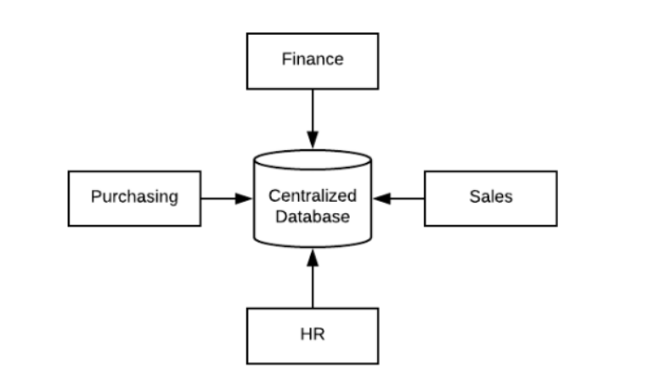
Centralized Database Management System
A centralized database is stored at a single location such as a mainframe computer.
It is maintained and modified from that location only and usually accessed using an internet connection such as a LAN or WAN.
The centralized database is used by organizations such as colleges, companies, banks etc.

Slide 84
Merits and De-merits of Centralized DBMS
Advantages :
The Data Integrity is maximized as the whole database is stored at a single physical location. It is easier to coordinate the data and it is as accurate and consistent as possible.
The Data Redundancy is minimal in the centralized database. All the data is stored together and not scattered across different locations. So, there is no redundant data available.
Since all the data is in one place, there can be stronger security measures around it. So, It is much more secure.
Data is easily portable because it is stored at the same place.
It is cheaper than other types of databases as it requires less power and maintenance.
All the information can be easily accessed from the same location and at the same time.

Slide 85
Merits and De-merits of Centralized DBMS
Disadvantages :
Since all the data is at one location, it takes more time to search and access it. If the network is slow, this process takes even more time.
There is a lot of data access traffic for the centralized database. This may create a bottleneck situation.
Since all the data is at the same location, if multiple users try to access it simultaneously it creates a problem. This may reduce the efficiency
of the system.
If there are no database recovery measures in place and a system failure occurs, then all the data in the database will be destroyed.

Slide 86
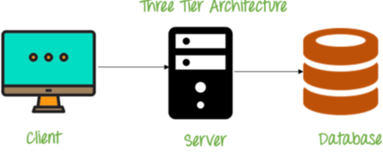
Client-Server Database Management System
A client does not share any of its resources, but requests a server’s content or service function.
Clients therefore initiate communication sessions with servers which await incoming requests.
Examples of computer applications that use the client–server model are Email, network printing, and the World Wide Web.
Image Source: guru99.com

Slide 87
Merits and De-merits of Client-Server DDBMS
Advantages :
Centralization – Access, Resources, and Data Security are controlled through server.
Scalability – Any element can be upgraded when needed.
Flexibiltiy – New Technology can be easily integrated into the system.
Interoperabilty – All components work together.

Slide 88
Merits and De-merits of Client-Server DDBMS
Disadvantages :
Dependability – When Servers goes down, operations will cease.
Lack of Mature Tools - To administrate.
Lack of Scalability – Network OS are not vary scalable.
Higher than anticipated Cost.
Network Congestion.

Slide 89


