Slide 1
MODULE 7
No SQL

Slide 2
NoSQL
NoSQL, which stands for “not only SQL,”
An approach to database design that provides flexible schemas for the storage and retrieval of data beyond the traditional table structures found in relational database.
"NoSQL" was only coined in the early 21st century, triggered by the needs of Web 2.0 companies.

Slide 3
NoSQL
Does not require a fixed schema, avoids joins, and is easy to scale.
Never follow the relational model it is either schema-free or has relaxed schemas
BASE stands for Basically Available, Soft state, Eventual consistency
The term "eventual consistency" means to have copies of data on multiple machines to get high availability and scalability
NOSQL offer limited query capabilities

Slide 4
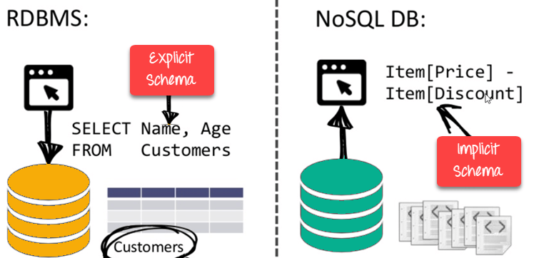
Features of No SQL
Non-relational
Schema Free
Distributed
  Multiple NoSQL databases can be executed in a distributed fashion

Slide 5
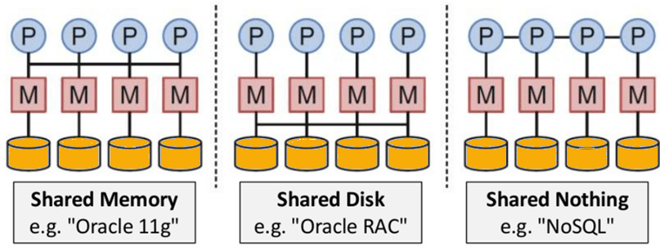
Features of No SQL
Non-relational
Schema Free
Distributed
  Multiple NoSQL databases can be executed in a distributed fashion
  Shared Nothing Architecture. This enables less coordination and higher distribution.

Slide 6
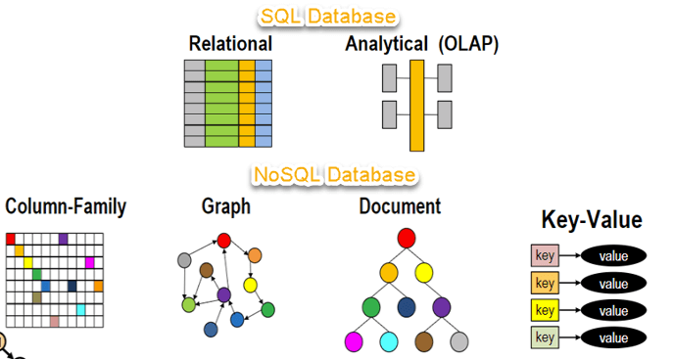

Slide 8
Comparison
SQL databases are relational
  No SQL are non-relational.
SQL databases use structured query language and have a predefined schema.
  No SQL databases have dynamic schemas for unstructured data.
SQL databases are table based
  No SQL databases are document, key-value, graph or wide-column stores.

Slide 9
Need of No SQL
NoSQL databases are often better suited to
  Storing
  modeling structured
  semi-structured
  unstructured data
  in one database

Slide 10
No SQL Database Examples
MongoDB, CouchDB, CouchBase, Cassandra, HBase, Redis, Riak, Neo4J are the popular
a. MongoDB, CouchDB, CouchBase , Amazon SimpleDB, Riak, Lotus Notes are document-oriented NoSQL databases
b. Neo4J, InfoGrid, Infinite Graph, OrientDB, FlockDB are graph databases.

Slide 11
Types
NoSQL Databases are mainly categorized into four types:
  Key-value pair
  Column-oriented
  Graph-based and Document-oriented
  Every category has its unique attributes and limitations.

Slide 12
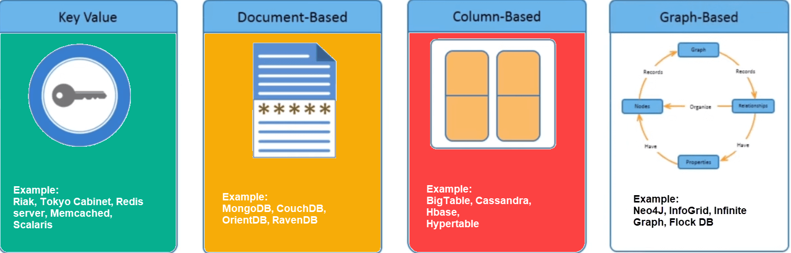
Types of No SQL Databases

Slide 13
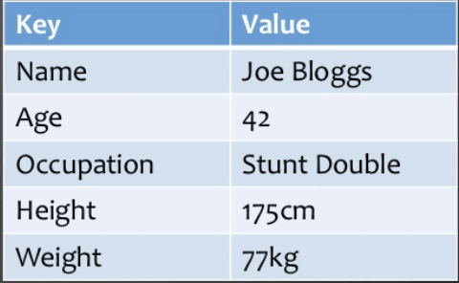
Key value pair based
Data is stored in key/value pairs. It is designed in such a way to handle lots of data and heavy load.
They work best for shopping cart contents.

Slide 14
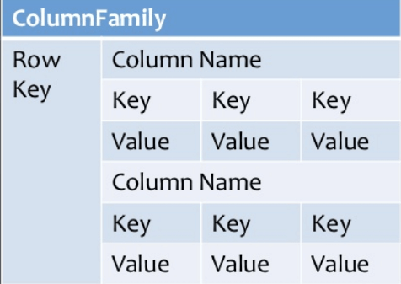
Column-oriented databases
Column-oriented databases work on columns and are based on BigTable paper by Google.
Every column is treated separately. Values of single column databases are stored contiguously.

Slide 15
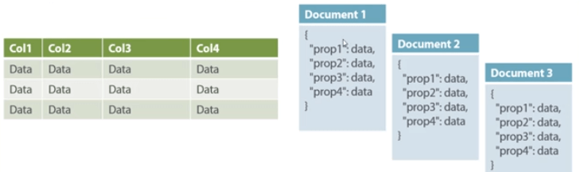
Document Based Database
Document-Oriented NoSQL DB stores and retrieves data as a key value pair but the value part is stored as a document.

Slide 16
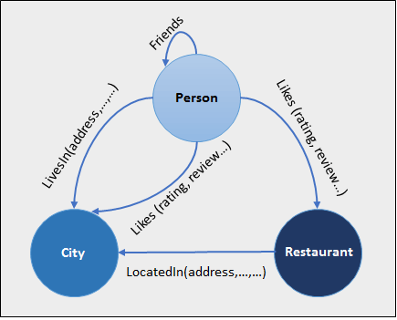
Graph type Database
A graph type database stores entities as well the relations amongst those entities.
The entity is stored as a node with the relationship as edges. An edge gives a relationship between nodes.
Every node and edge has a unique identifier.
Graph base database mostly used for social networks, logistics, spatial data.

Slide 17
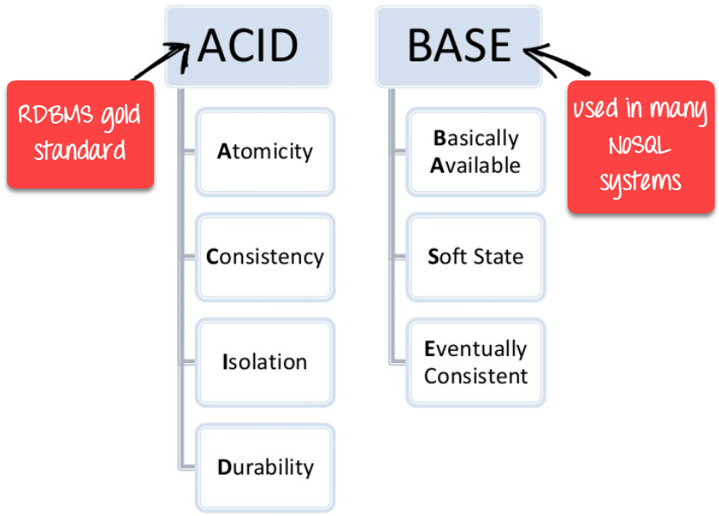

Slide 18
Advantages of NoSQL
Simple to implement than using RDBMS
It can serve as the primary data source for online applications.
Handles big data which manages data velocity, variety, volume, and complexity
Excels at distributed database
Easy Replication
Can handle structured, semi-structured, and unstructured data with equal effect

Slide 19
Disadvantages of NoSQL
No standardization rules
Doesn't work as well with relational data
It does not offer any traditional database capabilities, like consistency when multiple transactions are performed simultaneously.

Slide 20
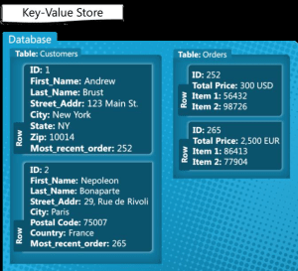
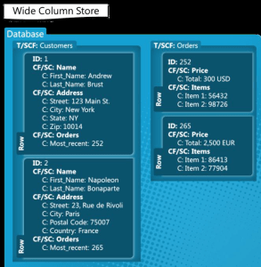
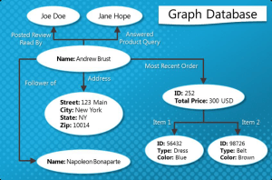
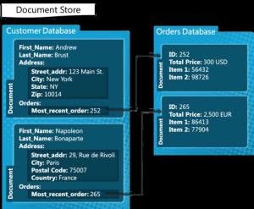

Slide 21
CAP Theorem
The CAP Theorem states that it is impossible for a distributed computer system to simultaneously provide all three of the following guarantees:
Consistency (all nodes see the same data at the same time)
Availability (a guarantee that every request receives a response about whether it succeeded or failed)
Partition tolerance (the system continues to operate despite arbitrary message loss or failure of part of the system)

Slide 22
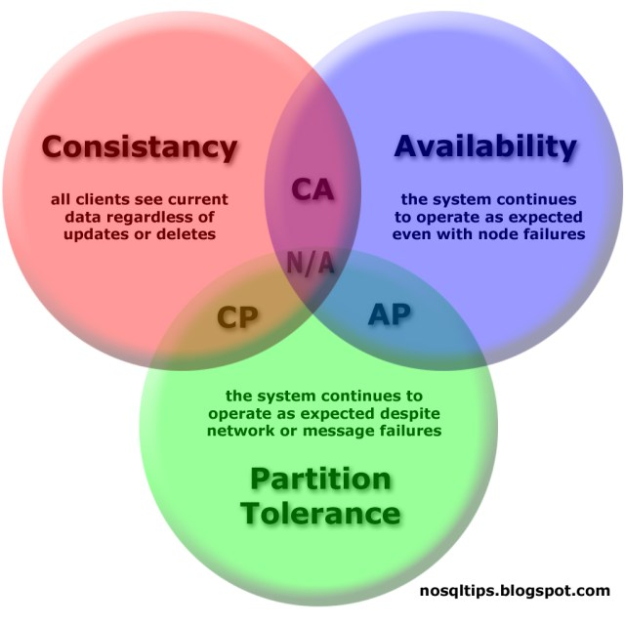

Slide 23
THANK YOU

