Slide 1
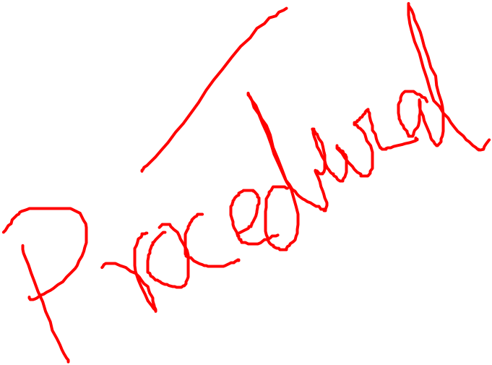
Introduction to PL/SQL

Slide 2
Introduction to PL/SQL
Procedural Language extension for SQL
Oracle Proprietary
3GL Capabilities
Integration of SQL
Portable within Oracle data bases
Callable from any client

Slide 3
Structure of PL/SQL
PL/SQL is Block Structured
A block is the basic unit from which all PL/SQL programs are built. A block can be named (functions and procedures) or anonymous
Sections of block
1- Header Section
2- Declaration Section
3- Executable Section
4- Exception Section

Slide 4
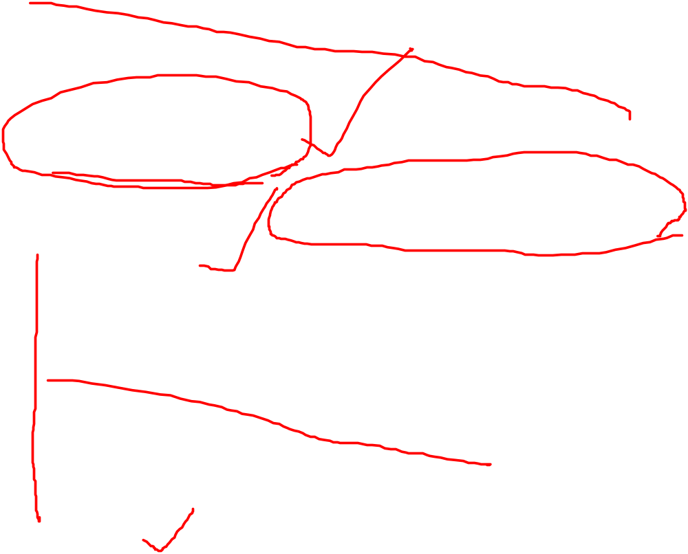
Structure of PL/SQL
HEADER
Type and Name of block
DECLARE
Variables; Constants; Cursors;
BEGIN
PL/SQL and SQL Statements
EXCEPTION
Exception handlers
END;

Slide 5
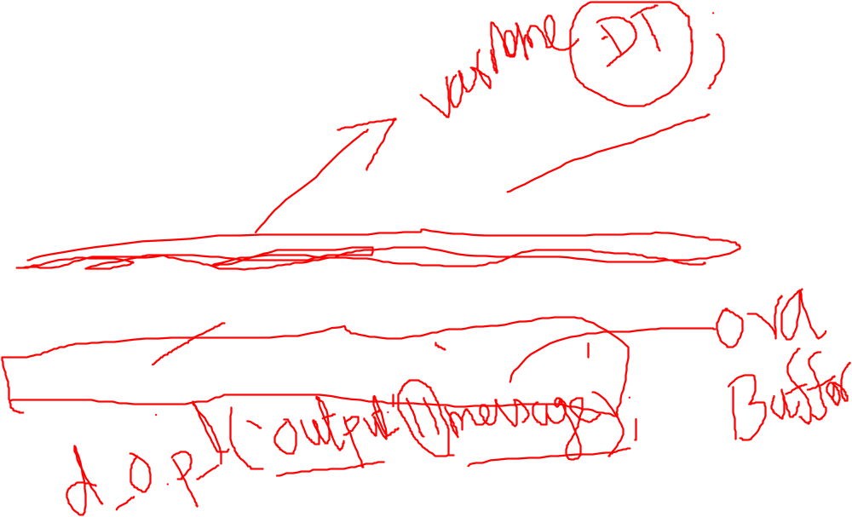
DECLARE
message varchar2(20):= 'Hello, World!';
BEGIN
dbms_output.put_line(message);
END;
/
Command lines
/*, */ | Multi-line comment delimiter (begin and end)
-- | Single-line comment indicator

Slide 6
Example 1
DECLARE
-- variable declaration
message varchar2(20):= 'Hello, World!';
BEGIN
/*
* PL/SQL executable statement(s)
*/
dbms_output.put_line(message);
END;
/

Slide 7
PL/SQL Program Units
A PL/SQL unit is any one of the following
  PL/SQL block
  Function
  Package
  Package body
  Procedure
  Trigger
  Type
  Type body
  cursor

Slide 8
DATA TYPES
CHAR ( max_length )
VARCHAR2 ( max_length )
NUMBER ( precision, scale )
BINARY_INTEGER – more efficient than number
RAW ( max_length )
DATE
BOOLEAN (true, false, null)
Also LONG, LONG RAW and LOB types but the capacity is usually less in PL/SQL than SQL

Slide 9
VARIABLE CONSTRAINTS
NOT NULL
▪ Can not be empty
CONSTANT
▪ Can not be changed

Slide 10
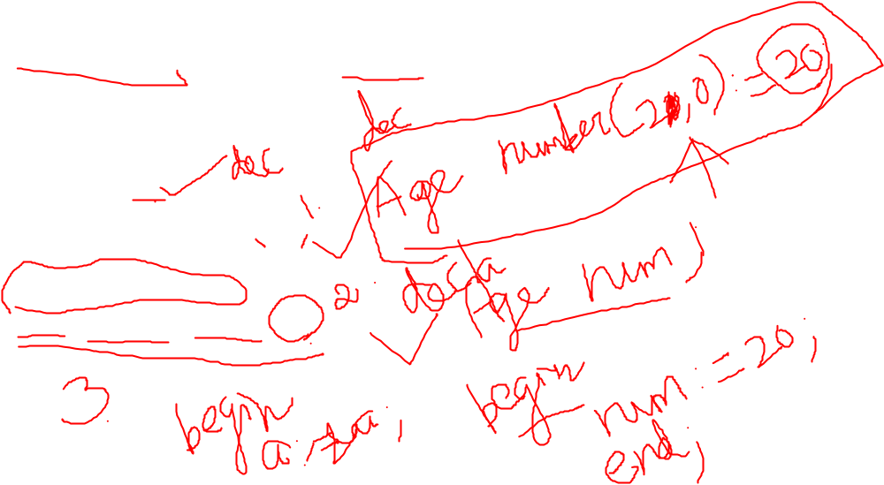
Variable Declaration in PL/SQL
The syntax for declaring a variable is −
variable_name [CONSTANT] datatype [NOT NULL] [:= | DEFAULT initial_value]
Eg:
Age number;
Last char ( 10 );
DVal Date := Sysdate;
SID number not null;
Adjust constant number := 1;

Slide 11
Structure of PL/SQL
DECLARE
a number;
text1 varchar2(20);
text2 varchar2(20) := “HI”;
BEGIN
---------- ---------- ----------
END;

Slide 12
EXAMPLE 2
DECLARE
a integer := 10;
b integer := 20;
c integer;
f real;
BEGIN
c := a + b;
dbms_output.put_line('Value of c: ' || c);
f := 70.0/3.0;
dbms_output.put_line('Value of f: ' || f);
END;
/

Slide 13
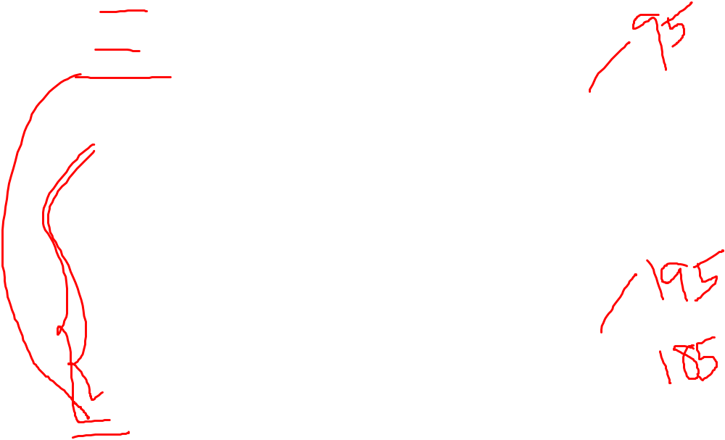
SCOPE OF VARIABLES
DECLARE
-- Global variables
num1 number := 95;
num2 number := 85;
BEGIN
dbms_output.put_line('Outer Variable num1: ' || num1);
dbms_output.put_line('Outer Variable num2: ' || num2);
DECLARE
-- Local variables
num1 number := 195;
num2 number := 185;
BEGIN
dbms_output.put_line('Inner Variable num1: ' || num1);
dbms_output.put_line('Inner Variable num2: ' || num2);
END;
END;
/

Slide 14
PL/SQL Control Structure
PL/SQL has a number of control structures which includes:
Conditional controls
Iterative or loop controls.
Exception or error controls
It is these controls, used singly or together, that allow the PL/SQL developer to direct the flow of execution through the program.

Slide 15


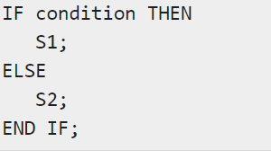
PL/SQL Control Structure
Conditional Controls
  IF....THEN....END IF;
  IF....THEN...ELSE....END IF;

Slide 16
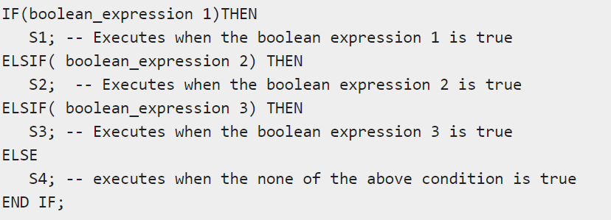
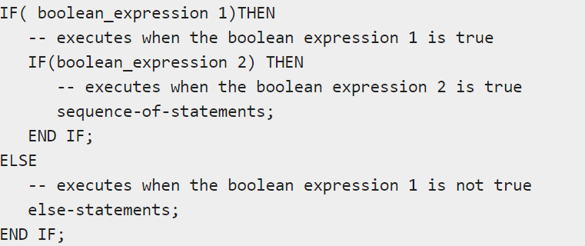
  IF....THEN...ELSIF....THEN....ELSE....END IF;
Nested IF

Slide 17
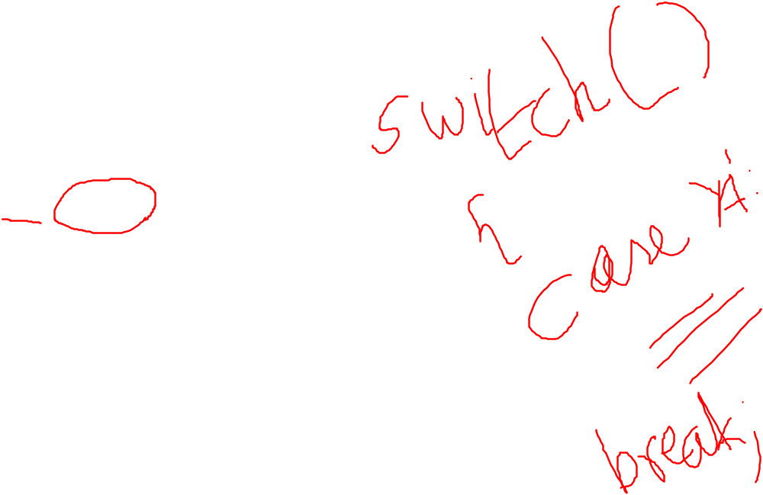
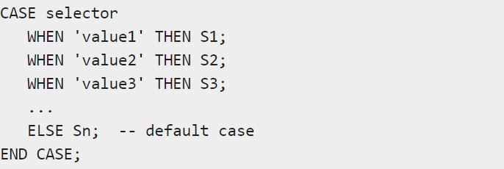
Switch case;

Slide 18
DECLARE
grade char(1) := 'A';
BEGIN
CASE grade
when 'A' then dbms_output.put_line('Excellent');
when 'B' then dbms_output.put_line('Very good');
when 'C' then dbms_output.put_line('Well done');
when 'D' then dbms_output.put_line('You passed');
when 'F' then dbms_output.put_line('Better try again');
else dbms_output.put_line('No such grade');
END CASE;
END;
/

Slide 19
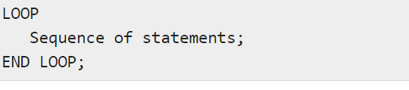
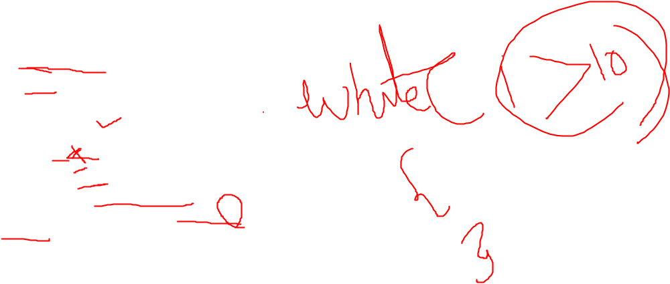
PL/SQL Control Structure
LOOP
...SQL Statements...
EXIT;
END LOOP;
Example:
DECLARE
x number := 10;
BEGIN
LOOP
dbms_output.put_line(x);
x := x + 10;
IF x > 50 THEN
exit;
END IF;
END LOOP;
-- after exit, control resumes here
dbms_output.put_line('After Exit x is: ' || x);
END;
/

Slide 20
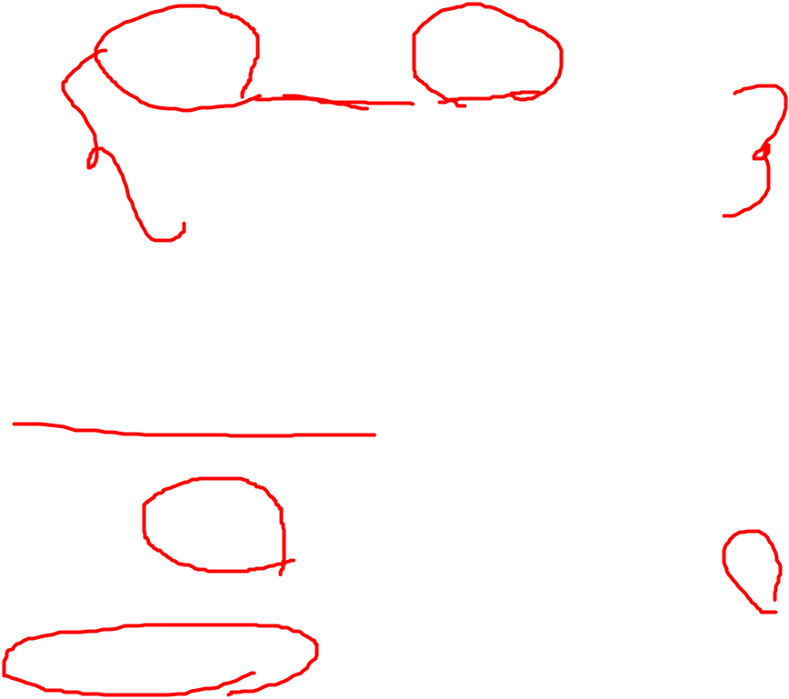
WHILE loops
    WHILE condition LOOP
    ...SQL Statements...
    END LOOP;
    Example:
DECLARE
a number(2) := 10;
BEGIN
WHILE a < 20 LOOP
dbms_output.put_line('value of a: ' || a);
a := a + 1;
END LOOP;
END;
/

Slide 21
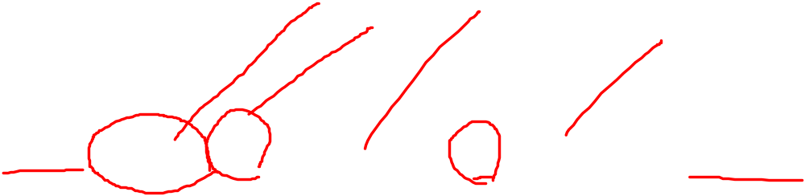
FOR loops
  FOR counter IN initial_value .. final_value LOOP
  sequence_of_statements;
  END LOOP;
  Example:
    DECLARE
    a number(2);
    BEGIN
    FOR a in 10 .. 20 LOOP
    dbms_output.put_line('value of a: ' || a);
    END LOOP;
    END;
    /

Slide 22

Reverse FOR LOOP Statement
DECLARE
a number(2) ;
BEGIN
FOR a IN REVERSE 10 .. 20 LOOP
dbms_output.put_line('value of a: ' || a);
END LOOP;
END;
/

Slide 23
To run a PL/SQL PROGRAM
Sql>set serveroutput on;
Sql>edit filename.sql;
Sql>@filename.sql;

