Slide 1
PL/SQL
Procedures and Functions

Slide 2
Introduction
A subprogram is a program unit/module that performs a particular task
A subprogram can be invoked by another subprogram or program which is called the calling program.
A subprogram can be created:
At schema level
Inside a package
Inside a PL/SQL block

Slide 3
Schema Level
A schema level subprogram is a standalone subprogram.
It is created with the CREATE PROCEDURE or CREATE FUNCTION statement.
It is stored in the database and can be deleted with the DROP PROCEDURE or DROP FUNCTION statement.

Slide 4
Package Level
A subprogram created inside a package is a packaged subprogram.
It is stored in the database and can be deleted only when the package is deleted with the DROP PACKAGE statement.

Slide 5
PL/SQL
PL/SQL subprograms are named PL/SQL blocks that can be invoked with a set of parameters. PL/SQL provides two kinds of subprograms:
Functions: these subprograms return a single value, mainly used to compute and return a value.
Procedures: these subprograms do not return a value directly, mainly used to perform an action.

Slide 6
Parts of a PL/SQL Subprogram
 | Three parts
1 | Declarative Part It is an optional part. However, the declarative part for a subprogram does not start with the DECLARE keyword. It contains declarations of types, cursors, constants, variables, exceptions, and nested subprograms. These items are local to the subprogram and cease to exist when the subprogram completes execution.
2 | Executable Part This is a mandatory part and contains statements that perform the designated action.
3 | Exception-handling This is again an optional part. It contains the code that handles run-time errors.

Slide 7
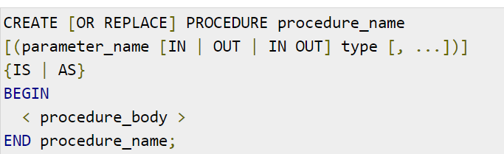
Creating a Procedure
A procedure is created with the CREATE OR REPLACE PROCEDURE statement.
The simplified syntax for the CREATE OR REPLACE PROCEDURE statement is as follows:

Slide 8
Creating a Procedure
Where,
procedure-name specifies the name of the procedure.
[OR REPLACE] option allows modifying an existing procedure.
The optional parameter list contains name, mode and types of the parameters.
IN represents that value will be passed from outside .
OUT represents that this parameter will be used to return a value outside of the procedure.
procedure-body contains the executable part.
The AS keyword is used instead of the IS keyword for creating a standalone procedure.

Slide 9
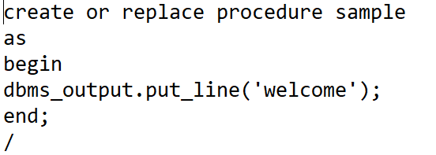
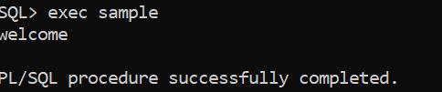
Executing a Standalone Procedure
A standalone procedure can be called in two ways:
Using the EXECUTE keyword
Calling the name of the procedure from a PL/SQL block
The procedure named ‘sample' can be called with the EXECUTE keyword as:
EXECUTE sample;
or
exec sample;

Slide 10
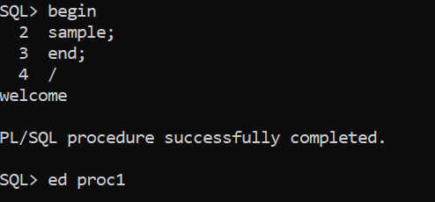
Executing a Standalone Procedure
The procedure can also be called from another PL/SQL block:

Slide 11

Deleting a Standalone Procedure
A standalone procedure is deleted with the DROP PROCEDURE statement. Syntax for deleting a procedure is:
DROP PROCEDURE procedure-name;

Slide 12
Parameter Modes in PL/SQL – Procedures represented as functions
1 | IN An IN parameter lets you pass a value to the subprogram. It is a read-only parameter. Inside the subprogram, an IN parameter acts like a constant. It cannot be assigned a value. You can pass a constant, literal, initialized variable, or expression as an IN parameter. You can also initialize it to a default value; however, in that case, it is omitted from the subprogram call. It is the default mode of parameter passing. Parameters are passed by reference.
2 | OUT An OUT parameter returns a value to the calling program. Inside the subprogram, an OUT parameter acts like a variable. You can change its value and reference the value after assigning it. The actual parameter must be variable and it is passed by value.
2 | IN OUT An IN OUT parameter passes an initial value to a subprogram and returns an updated value to the caller. It can be assigned a value and its value can be read. The actual parameter corresponding to an IN OUT formal parameter must be a variable, not a constant or an expression. Formal parameter must be assigned a value. Actual parameter is passed by value.

Slide 13
IN & OUT Mode Example 1
-This program finds the minimum of two values.
-program
declare
a number;
b number;
c number;
procedure findmin(x in number, y in number, z out number) is
begin
if x < y then
z:= x;
else
z:= y;
end if;
end;
begin
a:= 23;
b:= 45;
findmin(a, b, c);
dbms_output.put_line(' minimum of (23, 45) : ' || c);
end;
/

Slide 14
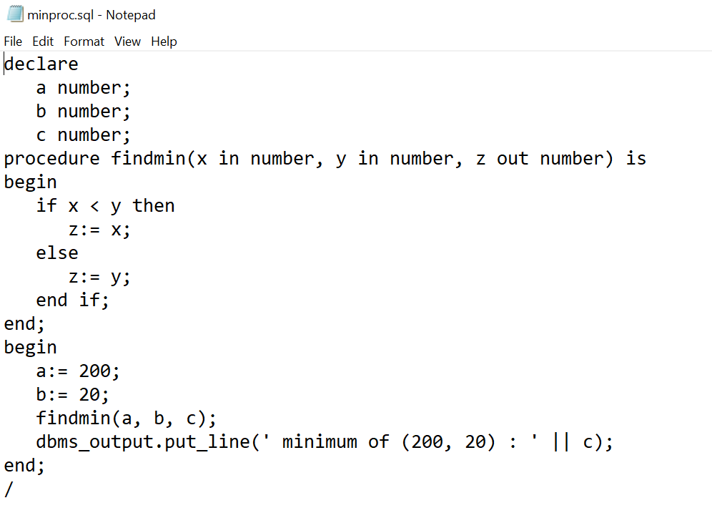
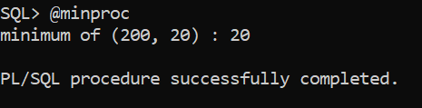
IN & OUT Mode Example 1

Slide 15
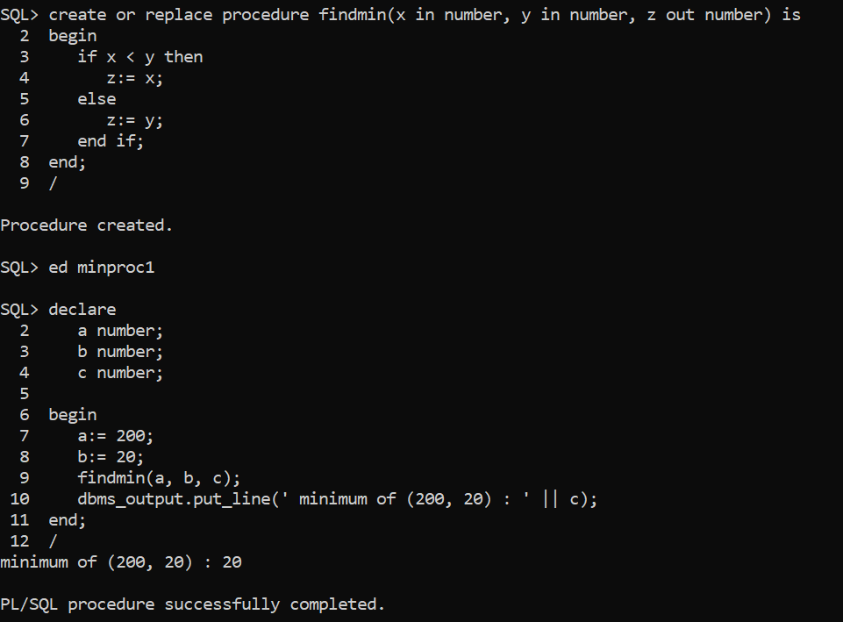

Slide 16
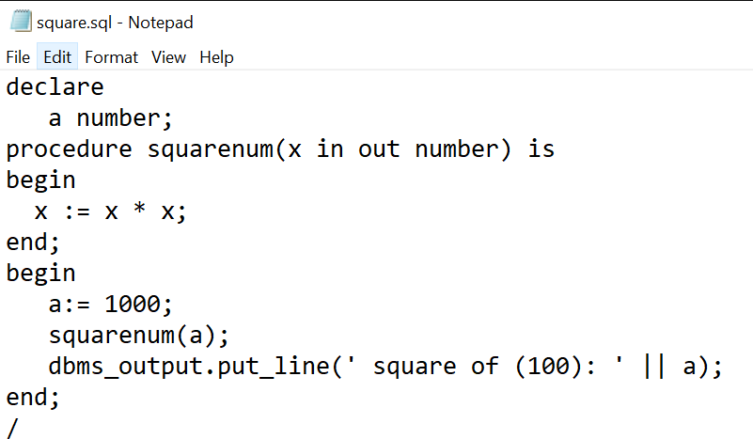
IN & OUT Mode Example 2
declare
a number;
procedure squarenum(x in out number) is
begin
x := x * x;
end;
begin
a:= 100;
squarenum(a);
dbms_output.put_line(' square of (100): ' || a);
end;
/

Slide 17
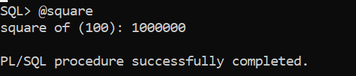

Slide 18
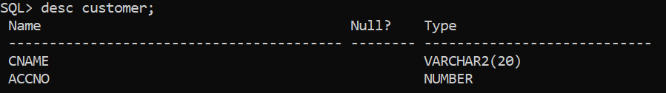
Procedure accessing Tables

Slide 19
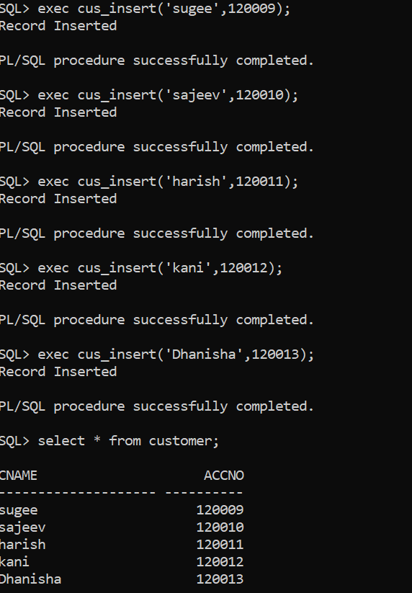

Slide 20
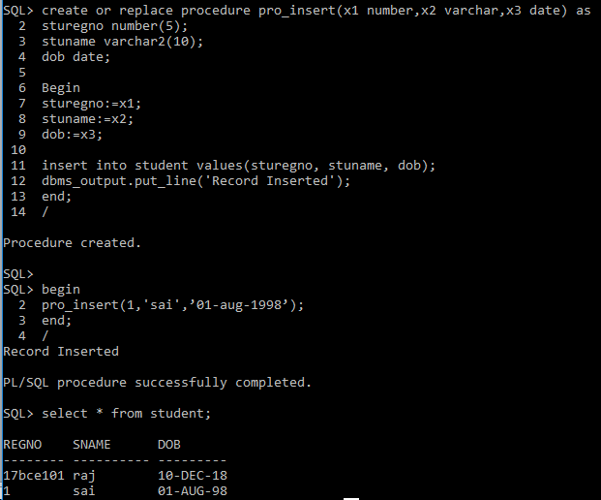

Slide 21
Inventory Table
procode
proname
pqty
pprice

Slide 22
Insert Procedure
SQL> ed ex1;
create or replace procedure pro_insert(x1 varchar,x2 varchar,x3 number,x4 number) as
procode varchar2(5);
proname varchar2(10);
pqty number(4);
pprice number(5);
Begin
procode:=x1;
proname:=x2;
pqty:=x3;
pprice:=x4;
insert into inventory values(procode,proname,pqty,pprice);
dbms_output.put_line('Record Inserted');
end;
/

Slide 23
Compiling and Executing
Execution
exec procedure-name

Slide 24
Executing Insert Procedure:
SQL> exec pro_insert('p1','book',50,10);
Record Inserted
PL/SQL procedure successfully completed.
SQL> exec pro_insert('p2','pen',60,20);
Record Inserted
PL/SQL procedure successfully completed.
SQL> exec pro_insert('p3','pencil',30,50);
Record Inserted
PL/SQL procedure successfully completed.

Slide 25
Executing Insert Procedure:
SQL> exec pro_insert('p4','ink',10,10);
Record Inserted
PL/SQL procedure successfully completed.
SQL> exec pro_insert('p5','scale',20,5);
Record Inserted
PL/SQL procedure successfully completed.

Slide 26
Executing Insert Procedure:
SQL> select * from inventory;
PCODE PNAME PQTY PPRICE
----- ---------- ---------- ----------
p1 book 50 10
p2 pen 60 20
p3 pencil 30 50
p4 ink 10 10
p5 scale 20 5

Slide 27
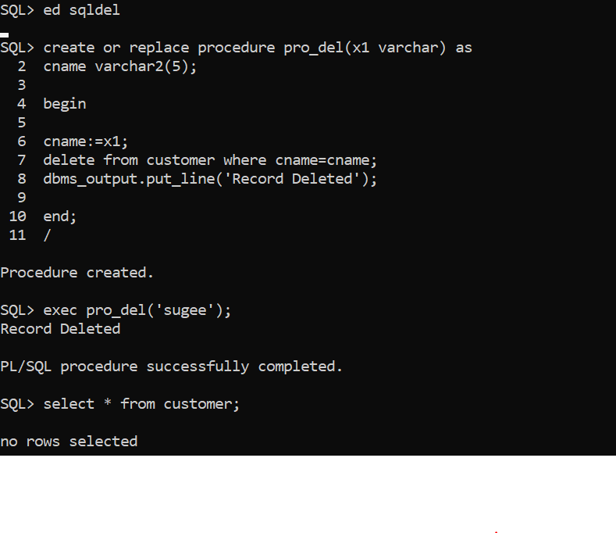
Delete Procedure:

Slide 28
Creating a Function
Where,
function-name specifies the name of the function.
[CREATE OR REPLACE] option allows modifying an existing function.
The optional parameter list contains name, mode and types of the parameters. IN represents that value will be passed from outside and OUT represents that this parameter will be used to return a value outside of the procedure.
The function must contain a return statement.
RETURN clause specifies that data type you are going to return from the function.
function-body contains the executable part.
The AS keyword is used instead of the IS keyword for creating a standalone function.

Slide 29
Basic function
Procedure
create or replace function call(x in number) return number is
begin
return x;
end;
/
declare
a number;
x number;
begin
x:=2;
a:=call(x);
dbms_output.put_line('value: '||a);
end;
/

Slide 30
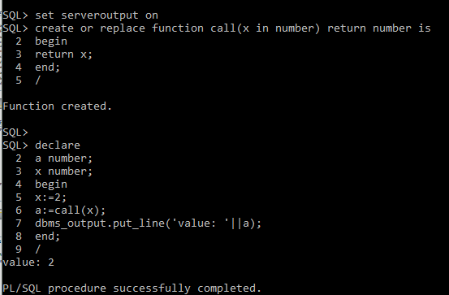
Output
value: 2
Statement processed.
0.01 seconds

Slide 31
DECLARE
a number;
b number;
c number;
function findmax(x in number, y in number)
return number
is
z number;
begin
if x > y then
z:= x;
else
z:= y;
end if;
return z;
end;
BEGIN
a:= 23;
b:= 45;
c := findMax(a, b);
dbms_output.put_line(' Maximum of (23,45): ' || c);
END;
/

Slide 32
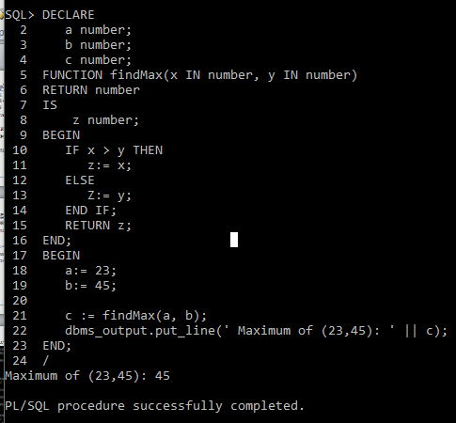
Output

Slide 33
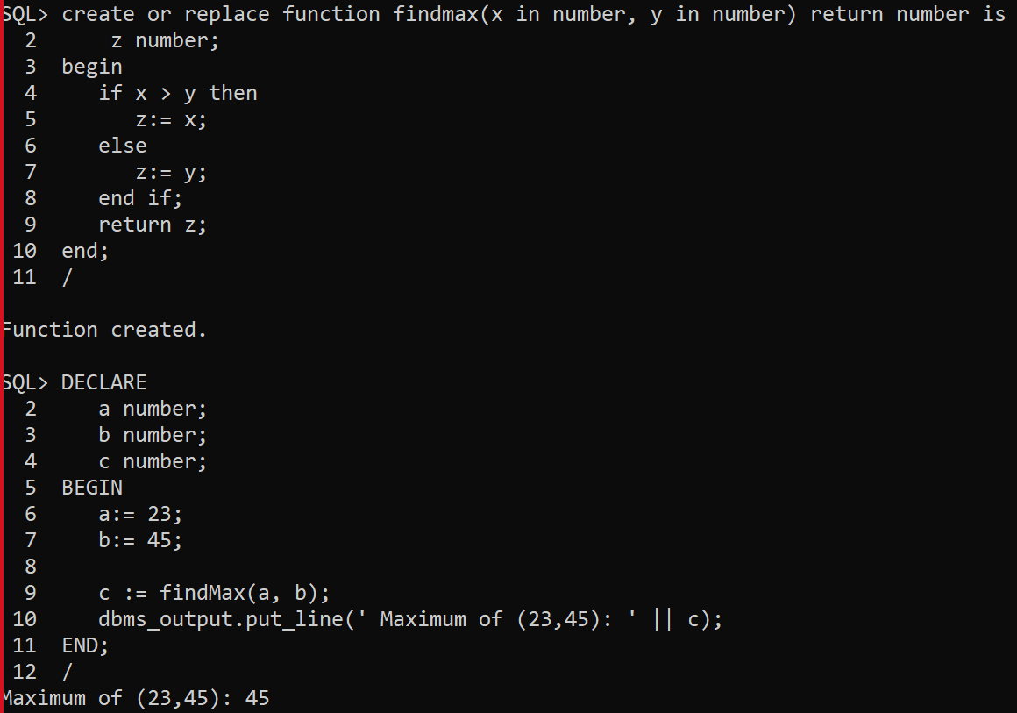

Slide 34
Example:
Select * from customer;
+----+----------+-----+-----------+----------+
| ID | NAME | AGE | ADDRESS | SALARY |
+----+----------+-----+-----------+----------+
| 1 | Ramesh | 32 | Ahmedabad | 2000.00 |
| 2 | Khilan | 25 | Delhi | 1500.00 |
| 3 | kaushik | 23 | Kota | 2000.00 |
| 4 | Chaitali | 25 | Mumbai | 6500.00 |
| 5 | Hardik | 27 | Bhopal | 8500.00 |
| 6 | Komal | 22 | MP | 4500.00 |
+----+----------+-----+-----------+----------+

Slide 35
Function accessing tables
create or replace function totalcustomers
return number is
total number(2) := 0;
begin
select count(*) into total
from customer;
return total;
end;
/

Slide 36
Calling a Function
declare
c number(2);
begin
c := totalcustomers();
dbms_output.put_line('total no. of customers: ' || c);
end;
/

Slide 37
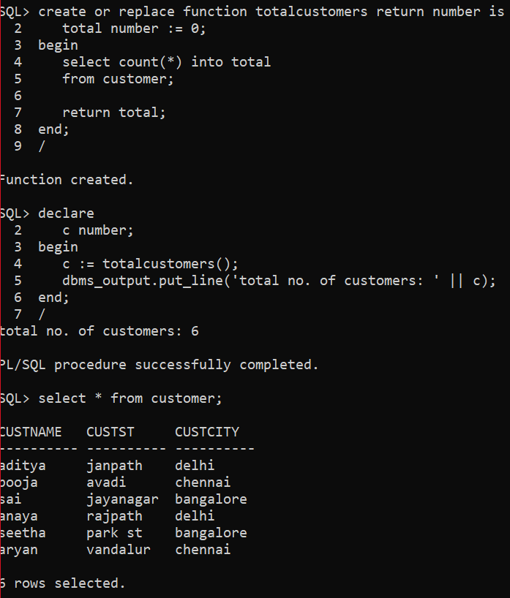
Output

Slide 38
Example 2
SQL> ed function1
SQL> create or replace function totemp return number is
2 total number(2) := 0;
3 begin
4 select count(*) into total from employee;
5 return total;
6 end;
7 /
Function created.
SQL> ed function1
SQL> declare
2 c number(2);
3 begin
4 c := totemp();
5 dbms_output.put_line('total no. of employees: ' || c);
6 end;
7 /
total no. of employees: 4
PL/SQL procedure successfully completed.
SQL> /

Slide 39
Procedure with Tables
SQL> create or replace procedure totalcity (total out number) is
2 begin
3 select count(distinct custcity) into total
4 from customer;
5 end;
6 /
Procedure created.
SQL> declare
2 c number;
3 begin
4 totalcity(c);
5 dbms_output.put_line('total no. of city: ' || c);
6 end;
7 /
total no. of city: 3
PL/SQL procedure successfully completed.

Slide 40
