Slide 1
SQL Operations From Set Theory
UNION (ᴜ)
INTERSECTION ( ∩),
DIFFERENCE (-)
CARTESIAN PRODUCT ( x )
Join (⋈)
Inner Join
Outer Join

Slide 2
Union operation (υ)
UNION is symbolized by ∪ symbol.
It includes all tuples that are in tables A or in B.
It also eliminates duplicate tuples.
set A UNION set B would be expressed as:
The result <- A ∪ B

Slide 3
Union operation (υ) contd.
For a union operation to be valid, the following conditions must hold -
R and S must be the same number of attributes.
Attribute domains need to be compatible.
Duplicate tuples should be automatically removed.

Slide 4
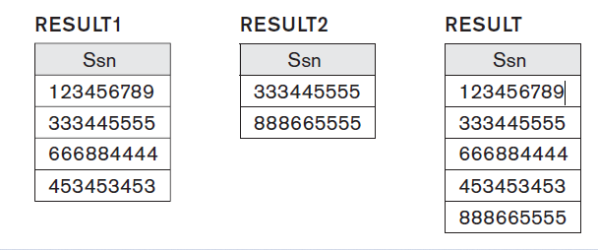
Example
To retrieve the social security numbers of all employees who work in department 5 (Result 1 below) or directly supervise an employee who works in department 5 (Result 2 below)

Slide 5
Set Difference (-)
- Symbol denotes it. The result of A - B, is a relation which includes all tuples that are in A but not in B.
The attribute name of A has to match with the attribute name in B.
The two-operand relations A and B should be either compatible or Union compatible.

Slide 6
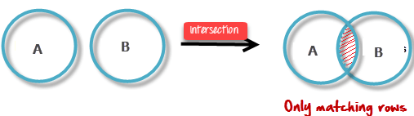
Intersection
An intersection is defined by the symbol ∩
A ∩ B
Defines a relation consisting of a set of all tuple that are in both A and B.
However, A and B must be union-compatible.

Slide 7
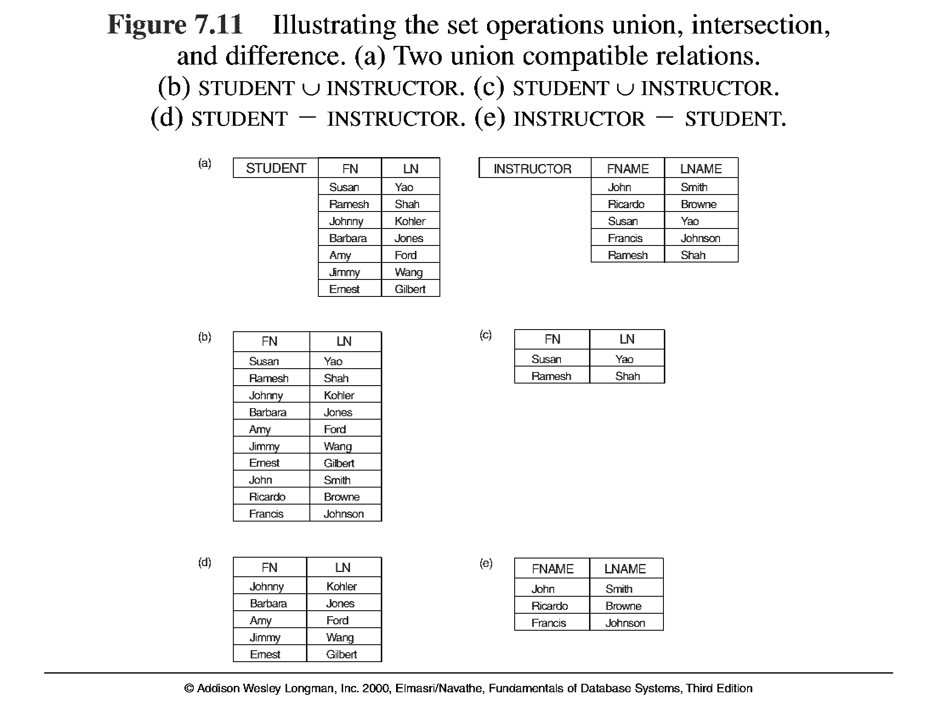

SQL Operations From Set Theory (cont.)

Slide 8
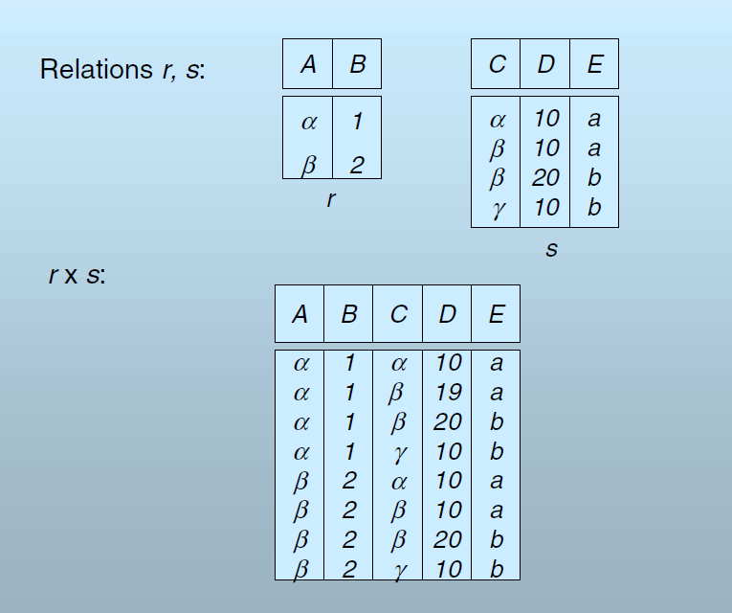
Cross product or cartesian product
This type of operation is helpful to merge columns from two relations.

Slide 9
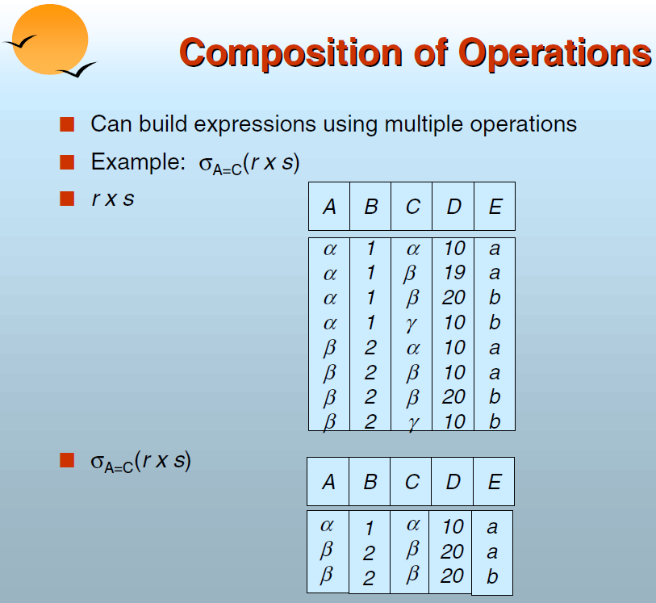

Slide 10
Join Operations
Join operation is essentially a Cartesian product followed by a selection criterion.
Join operation is denoted by ⋈.
JOIN operation also allows joining variously related tuples from different relations.

Slide 11
Cross product or cartesian product

Slide 12
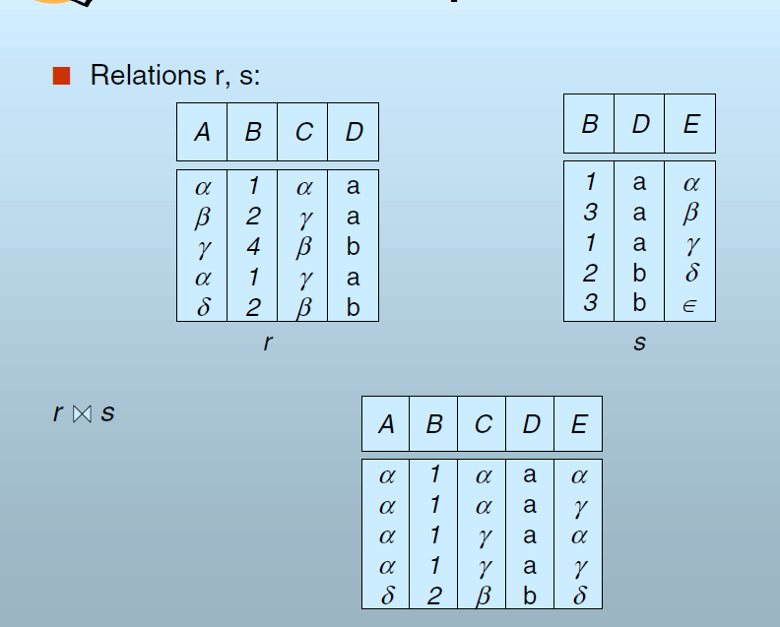
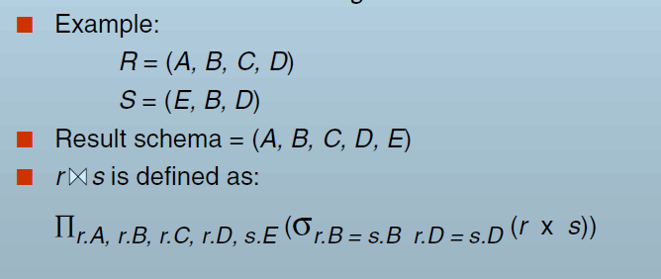
Natural Join
Join

Slide 13
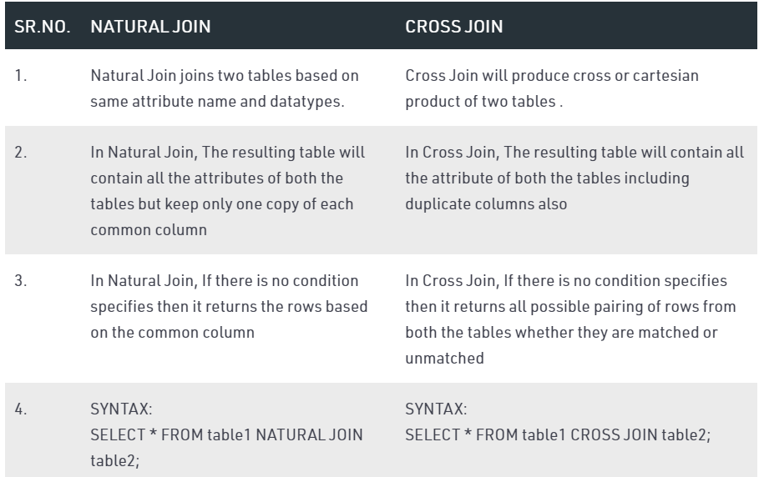

Slide 14
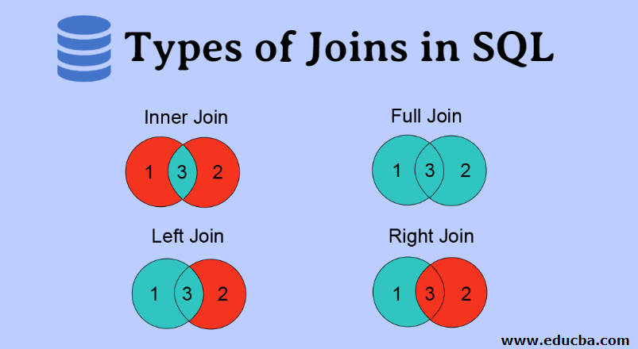
Types of joins
Various forms of join operation are:
Inner Joins:
Outer join:
Left Outer Join
Right Outer Join
Full Outer Join

Slide 15
Inner Join
In an inner join, only those tuples that satisfy the matching criteria are included, while the rest are excluded.

Slide 16
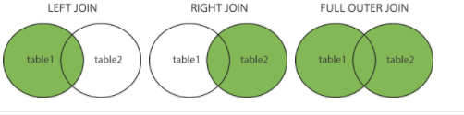
OUTER JOIN
In an outer join, along with tuples that satisfy the matching criteria, all tuples that do not match the criteria are also included.

Slide 17
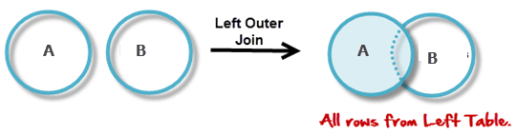
Left Outer Join
In the left outer join, operation allows keeping all tuple in the left relation.
If there is no matching tuple found in right relation, the attributes of right relation in the join result are filled with null values.

Slide 18
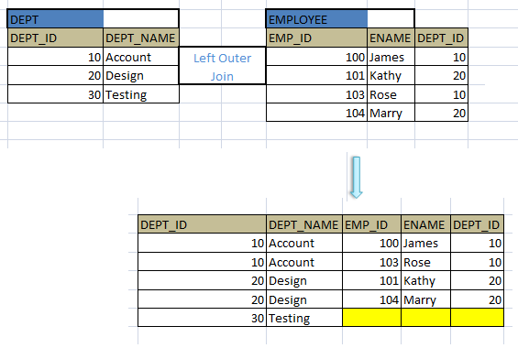
Left Outer Join- Example

Slide 19
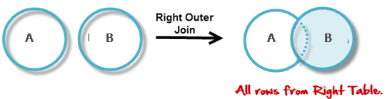
Right Outer Join
In the right outer join operation, all tuples in the right relation are retained.
If there is no matching tuple found in the left relation, then the attributes of the left relation in the join result are filled with null values.

Slide 20
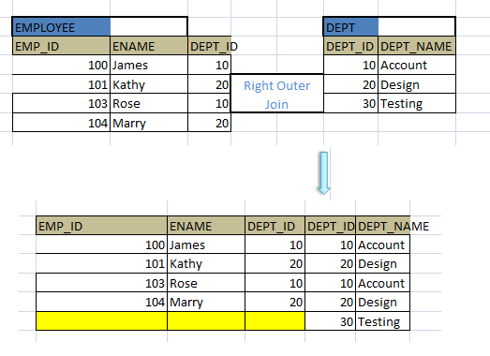
Right Outer Join - Example

Slide 21
Full Outer Join
In a full outer join, all tuples from both relations are included in the result, irrespective of the matching condition.

Slide 22
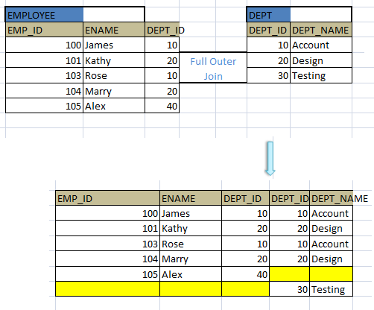
Full Outer Join - Example

