Slide 1
Design of a Lexical Analyzer (LEX)

Slide 2
Design of a Lexical Analyzer
LEX is a software tool that automatically construct a lexical analyzer from a program
The Lexical analyzer will be of the form
P1 {action 1}
P2 {action 2}
--
--
Each pattern pi is a regular expression and action i is a program fragment that is to be executed whenever a lexeme matched by pi is found in the input
If two or more patterns that match the longest lexeme, the first listed matching pattern is chosen

Slide 3
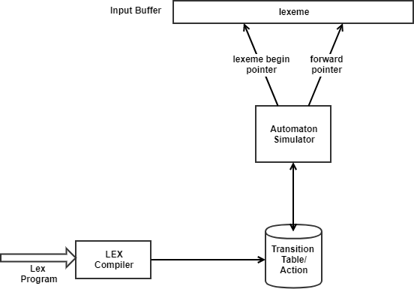
Design of a Lexical Analyzer
Here the Lex compiler constructs a transition table for a finite automaton from the regular expression pattern in the Lex specification
The lexical analyzer itself consists of a finite automaton simulator that uses this transition table to look for the regular expression patterns in the input buffer

Slide 4
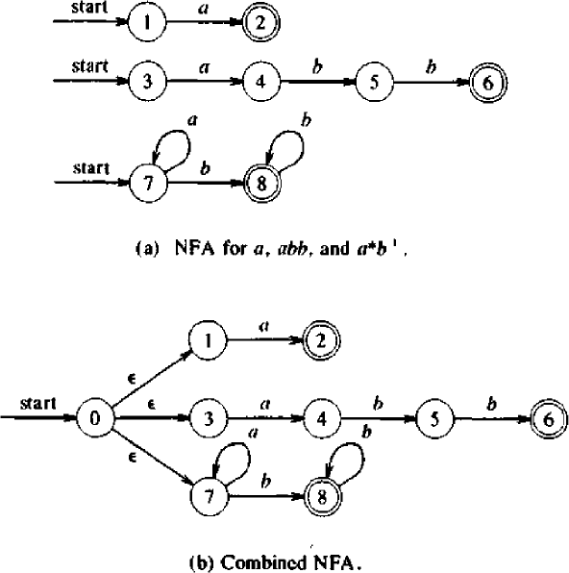
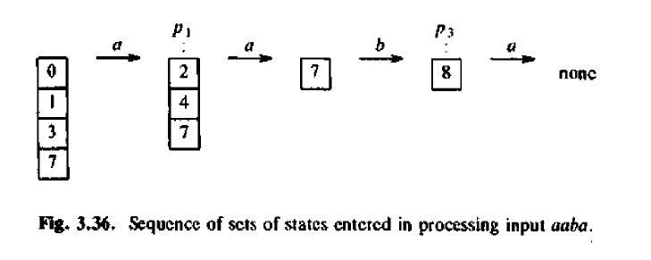
Example
Consider Lexeme
a {action A1 for pattern p1}
abb{action A2 for pattern p2}
a*b* {action A3 for pattern p3}

Slide 5
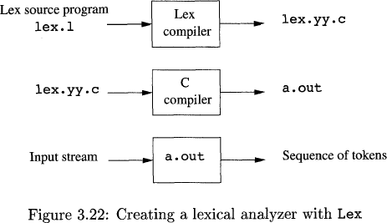
LEX in use
An input file, which we call lex.1, is
written in the Lex language and
describes the lexical analyzer to be generated.
The Lex compiler transforms lex. 1
to a C program, in a file that is always named lex. yy . c.
The latter file is compiled by the C compiler into a file called a. out.
The C-compiler output is a working
lexical analyzer that can take a
stream of input characters and produce a stream of tokens.

Slide 6
Structure of LEX Program
%{ Definition section %} %% Rules section %% User Subroutine section

Slide 7
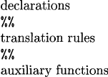
General format
The declarations section includes declarations of variables, manifest constants (identifiers declared to stand for a constant, e.g., the name of a token)
The translation rules each have the form
Pattern { Action )
Each pattern is a regular expression, which may use the regular definitions of the declaration section.
The actions are fragments of code, typically written in C, although many variants of Lex using other languages have been created.
The third section holds whatever additional functions are used in the actions.

Slide 8
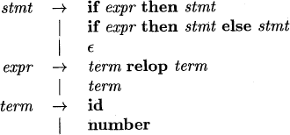
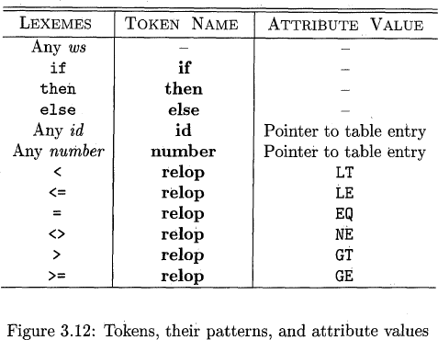
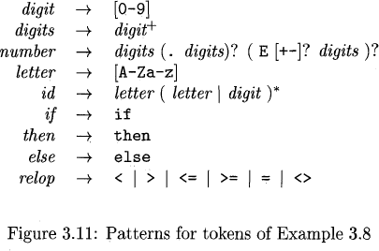
Consider the following statement

Slide 9
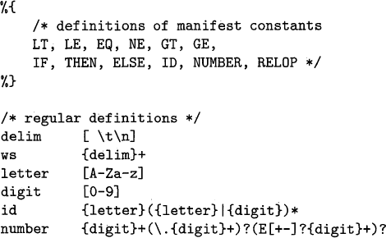
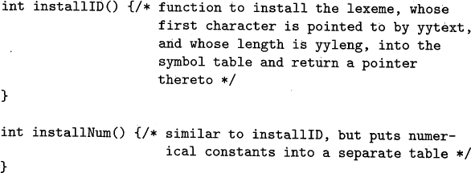
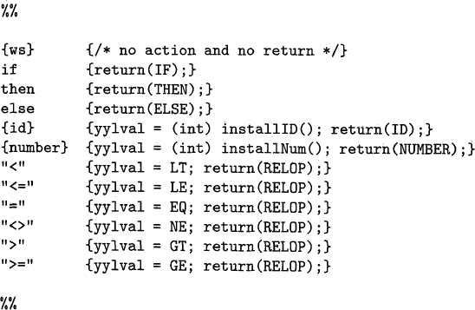

Slide 10
/*
Lex program to count the number of vowels & consonants from the given input string.*/
%{
#include<stdio.h> int vow=0, con=0;
%}
%%
[ \t\n]+ ;
[aeiouAEIOU]+ {vow++;}
[^aeiouAEIOU] {con++;}
%%
int main( )
{
printf("Enter some input string:\n");
yylex();
printf("Number of vowels=%d\n",vow);
printf("Number of consonants=%d\n",con);
}

